Slide 1



Concepts for Multitenancy

Slide 2
Multi-tenancy on SAP Cloud Plaform
With SAP Cloud Platform you can develop and run multi-tenant (tenant-aware) applications
Applications running on a shared compute unit that can be used by multiple consumers (tenants)
Each consumer accesses the application through a dedicated tenant-specific URL.

Slide 3
What is a Multi-Tenant application ?
Customer 1
Partner SAP Cloud Platform
Subscription 1
Extension Application
Customer 2
Subscription 2
Extension application resides on Partner account
Note: Extension application is not copied over to Customer account
Customer X
Subscription X

Slide 4
Some basic terminology
Customer = Consumer = Subscriber = Tenant = Entity paying for the subscription
Customer Account
Customer Account = SAP Cloud Platform account of the customer / consumer
Partner = Provider = Entity that created the Extension application
Partner Account
Partner Account = SAP Cloud Platform account of the partner / provider

Slide 5
Before we move on… What is a destination ?
Partner Account
Datasource 1
Extension Application
Destinations
dest 1
dest 2
dest 3
Datasource 2
dest 1
Datasource 3
Datasource 4
Destination = Secure connection string to a data source
Destination – Account Level (Visible for the whole account) Destination – Application Level (Visible for the application only)

Slide 6

Before we move on… What is a sub account ?
Partner Account
PROD Account
DEV Account
dest 1
dest 1

Slide 7




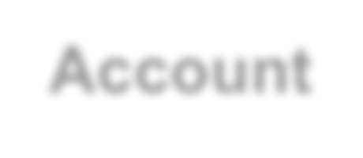




Understanding SAP Cloud Platform Accounts
Each account holds:
Resources that can be consumed by apps
Users allowed to work in the account
Apps deployed and running in the account
Data written by apps running in the account
Configuration for apps running in the account Each account is assigned to a datacenter. * Each account is fully isolated.
*) New datacenters in setup
Apps
Resources
Account
Data
Users
Configuration
Datacenter

Slide 8









Sub – Accounts Concept
Global Account
Sub-Accounts
Java
VMs
Java
VMs
Java
VMs
DEV
QA
…
PRD
HANA
HANA
HANA
IdP
IdP
IdP
Destination
Destination
Destination
Datacenter

Slide 9






Pairing of Accounts with Backend Systems
Java
VMs
Java
VMs
DEV
…
PRD
HANA
HANA
Destination
Destination
Cloud Connector
Cloud Connector
S/4HANA
…
S/4HANA
DEV
PROD

Slide 10
What is a Multi-Tenant application ?
Customer SAP Cloud Platform Account
Partner SAP Cloud Platform Account
Application
Subscription
Extension application resides on Partner account
Note: Extension application is not copied over to Customer account

Slide 11

Customer does not have an account…
Partner SAP Cloud Platform Account
Subscription
Application
Customer Sub Account
PROD Sub
Account

Slide 12
General Programming Guidelines for multitenant programming
Shared in-memory data such as Java static fields, caches, static tables will breach tenant isolation
Avoid any possibility that an application user can execute custom code in the application JVM, as this will certainly give them access to other tenants' data
Avoid any possibility that an application user can access a file system, as this will certainly give them access to other tenants' data.

Slide 13
Multitenant Core Services in HCP
Connectivity Service
Identity and Access Management Service
Persistency Service
Document Service
Keystore Service
Extensions service

Slide 14
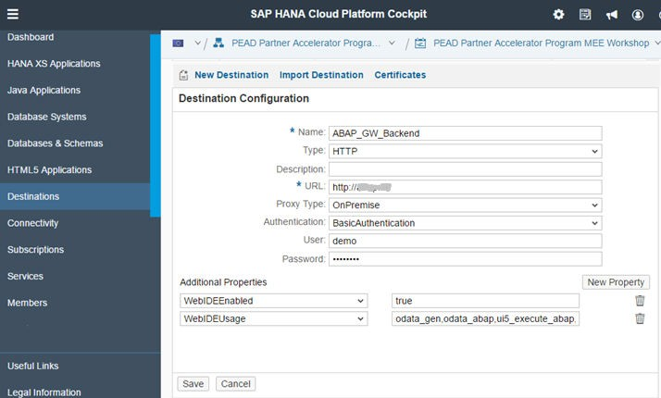
Destination
Destinations are used for the outbound communication of a cloud application to a remote system
Contain connection details for remote communication
Contain symbolic names
The connectivity service resolves the destination at runtime based on the symbolic name provided
The currently supported destination types are HTTP, Mail and RFC.

Slide 15
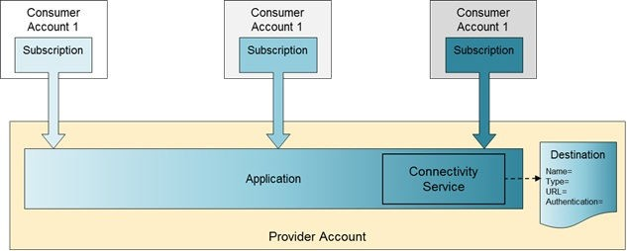
Provider Specific Destination
A common shared destination (DestinationProvider=Application)
The destination is always read from the provider account
For example, weather data

Slide 16
Destination visibility
Destinations visibility according to the level:
Account
Consumer account
1. Destination uploaded on account level - it is visible for the whole account
2. Destination uploaded on subscription level - it is only visible for the dedicated subscription
Subscription
overrides
may override
Provider account
3. Destination uploaded on application level - it is visible by all tenants and accounts, regardless their permission settings
Application

Slide 17
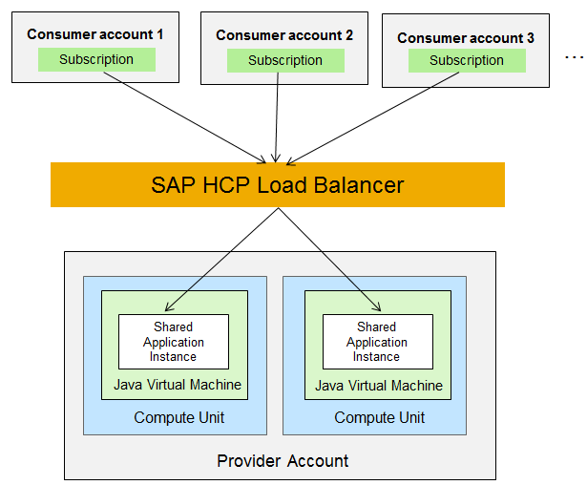
Scaling Applications
Java Applications developed can run on one or more processes (VMs)
Compute Unit quota for an account determines the number of processes that can be started
One or more JVMs can be shared between all consumers in case of Multi-tenant applications
Scaling down with soft shutdown on application processes
Advantages:
Savings in resource costs
Manage failover scenarios
Savings in operational costs
27

Slide 18



Data Level Isolation using the Persistency service
1. Sharing a single database schema between all application consumers
Discriminatory field in each table
Tenant ID can be used as a value in discriminatory field
Each SQL statement should use the Tenant ID
DB
Schema level isolation
A schema for each tenant bound to the application
The application uses JNDI to dynamically look up the data source
Multi-Data Container (MDC) isolation*
A DB container for each tenant bound to the application
The application uses JNDI to dynamically look up the data source
DB
* Planned on HCP

Slide 19
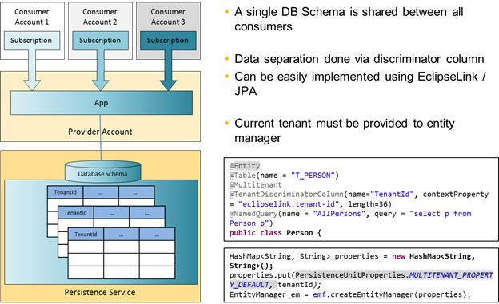
Sharing a single database schema between all application consumers

Slide 20

Thank you
© 2014 SAP SE or an SAP affiliate company. All rights reserved.

Slide 21
© 2014 SAP SE or an SAP affiliate company. All rights reserved.
No part of this publication may be reproduced or transmitted in any form or for any purpose without the express permission of SAP SE or an SAP affiliate company.
SAP and other SAP products and services mentioned herein as well as their respective logos are trademarks or registered trademarks of SAP SE
(or an SAP affiliate company) in Germany and other countries. Please see http://global12.sap.com/corporate-en/legal/copyright/index.epx for additional trademark information and notices.
Some software products marketed by SAP SE and its distributors contain proprietary software components of other software vendors. National product specifications may vary.
These materials are provided by SAP SE or an SAP affiliate company for informational purposes only, without representation or warranty of any kind, and SAP SE or its affiliated companies shall not be liable for errors or omissions with respect to the materials. The only warranties for SAP SE or
SAP affiliate company products and services are those that are set forth in the express warranty statements accompanying such products and services, if any. Nothing herein should be construed as constituting an additional warranty.
In particular, SAP SE or its affiliated companies have no obligation to pursue any course of business outlined in this document or any related presentation, or to develop or release any functionality mentioned therein. This document, or any related presentation, and SAP SE’s or its affiliated companies’ strategy and possible future developments, products, and/or platform directions and functionality are all subject to change and may be changed by SAP SE or its affiliated companies at any time for any reason without notice. The information in this document is not a commitment, promise, or legal obligation to deliver any material, code, or functionality. All forward- looking statements are subject to various risks and uncertainties that could cause actual results to differ materially from expectations. Readers are cautioned not to place undue reliance on these forward-looking statements, which speak only as of their dates, and they should not be relied upon in making purchasing decisions.
49

