Slide 1

FARMZONE

Slide 2
App Objective
Profile Farmers
Biodata, Farm Data, Family Data
Add Support
Type of support, Detail description, Support worth
Capture Activities
Activity name, date performed, Remarks
Add Yield
Crop Type, Number of bags, date harvested, Remarks

Slide 3
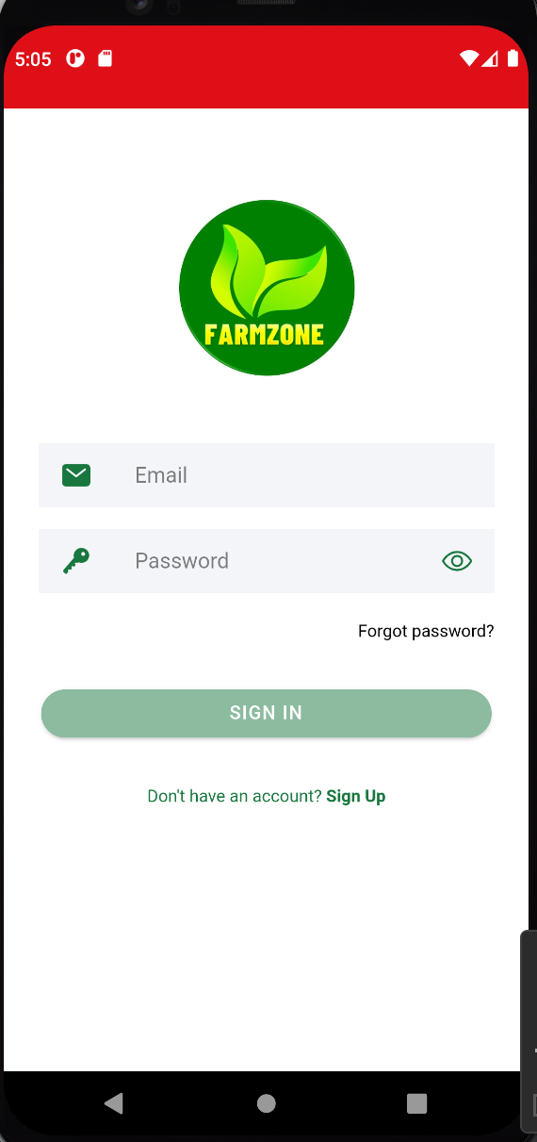
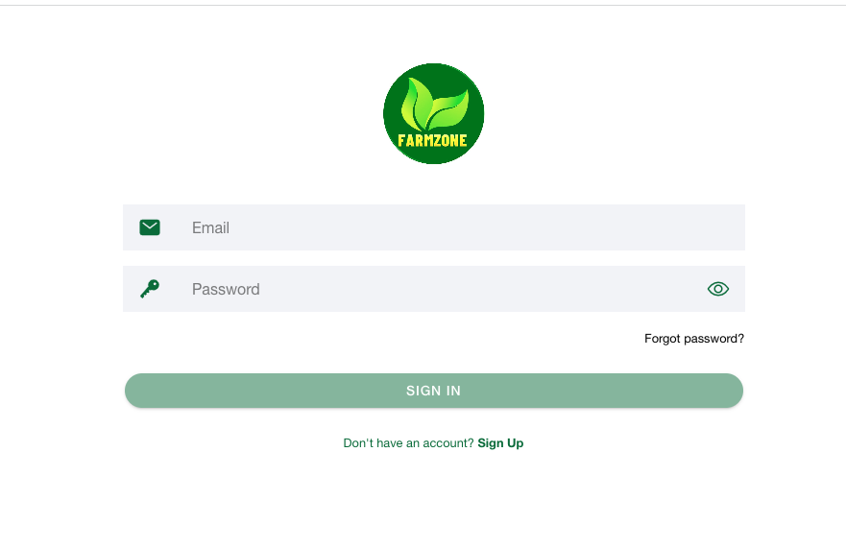
Login Interface
1. You first need to sign up for an

Slide 4
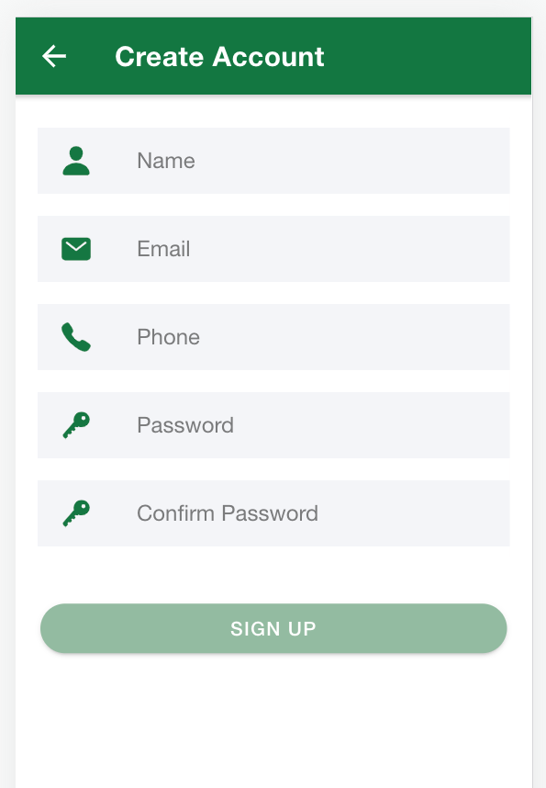
Create an account
NB: You only need internet connection for the account creation and login
Type your full name
Enter a valid email address
Enter Phone Number
Type your desired password
Confirm by typing the same password
Click Sign Up
You will be automatically logged in after sign up
NB: Log out and Login again before data entry

Slide 5
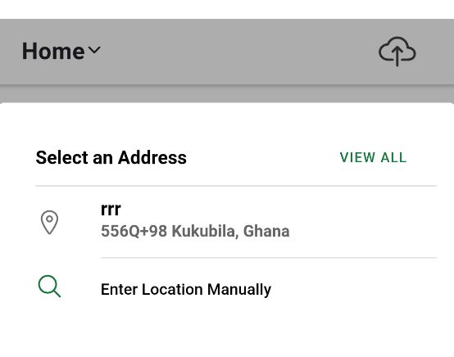
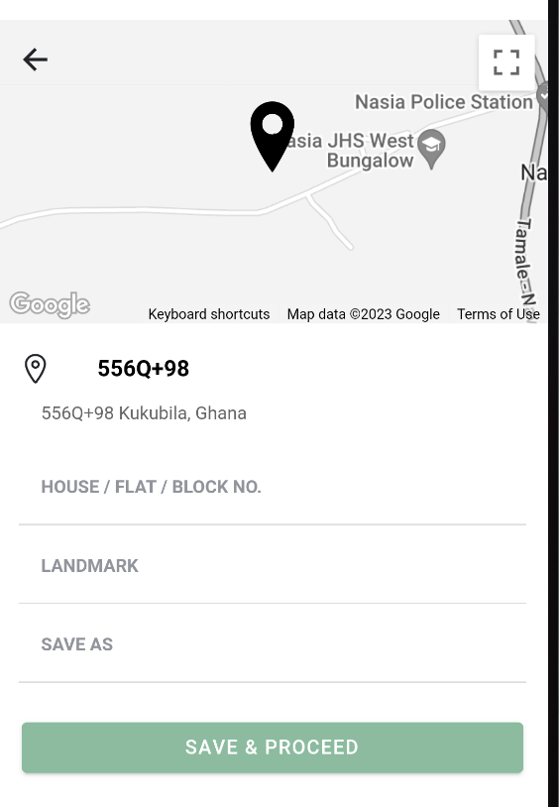
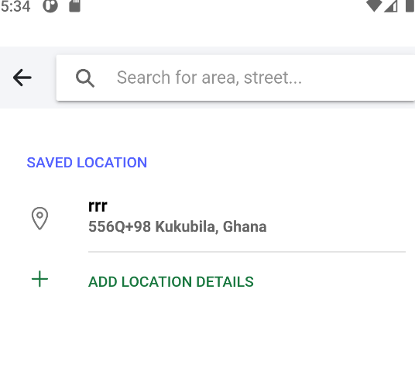
Landing Page
You are required to enter your location before using the app
1
2
3
Click ”Enter Location Manually”
Click ”Add Location Details”
Fill the description of the map shown and click “save and proceed”
NB: The location/address entered will be use for all activities
You may switch off your data at this point

Slide 6
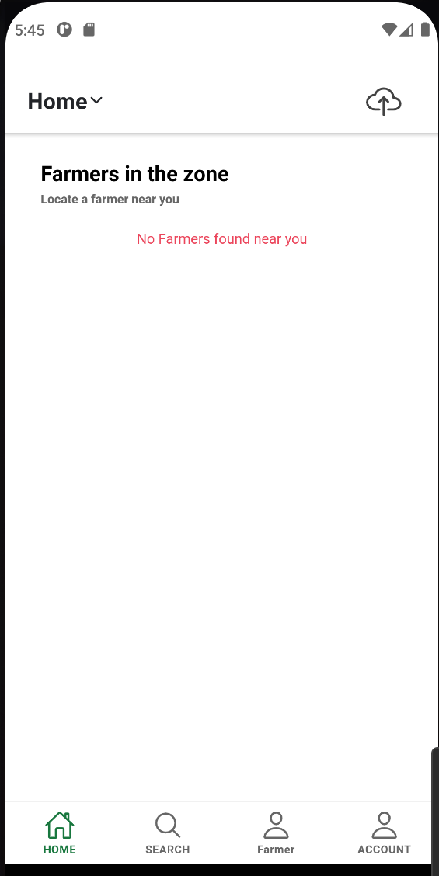
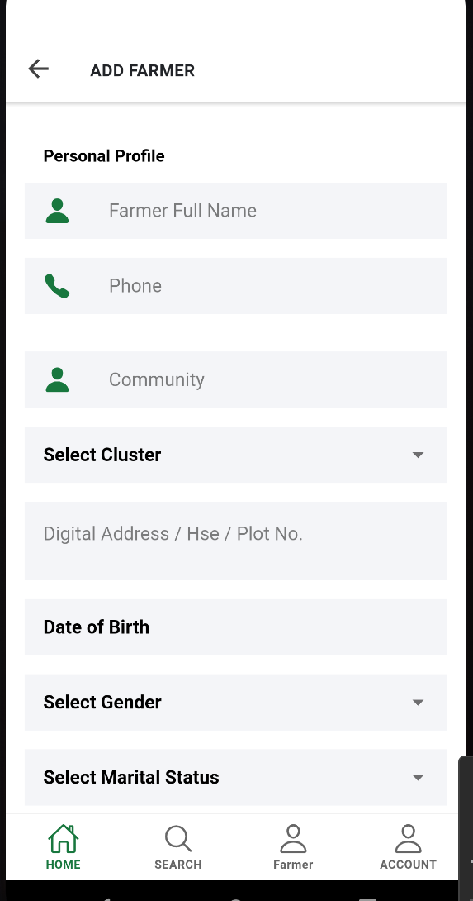
Home Page
Click on the arrow next to home page to select the address you entered previously
Fill all details
Select photo using the photo button
Click save to add farmer
Click Farmer to add Farmer

Slide 7
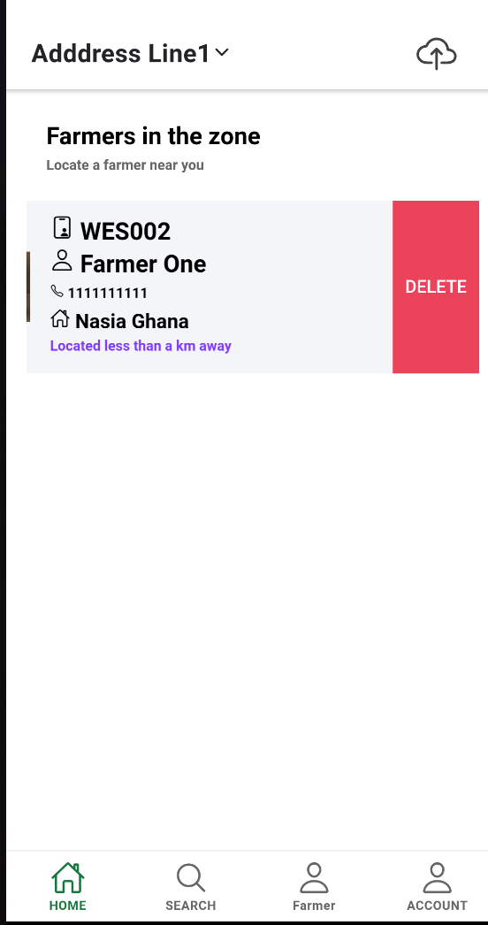
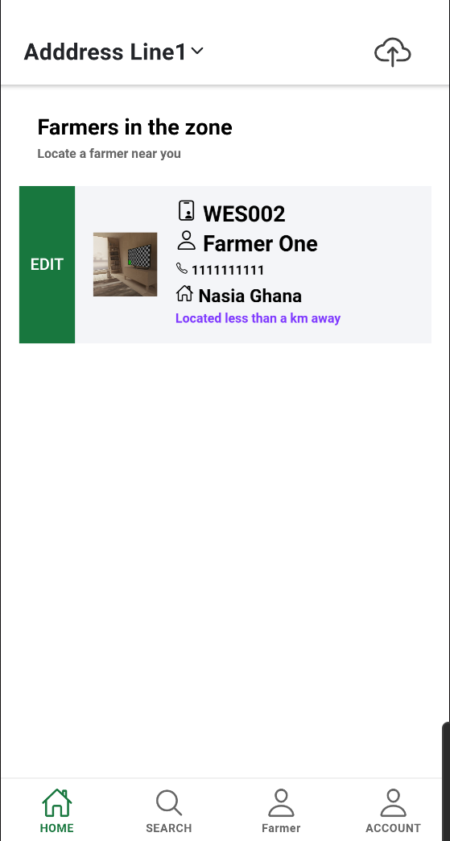
Deleting and Editing farmer Information
This cloud symbols indicatates availability of internet, a red exclamation indicates absence of connecctivity.
Whilst on the home page swiping left will reveal the delete button used to delete a farmer
Whilst swiping right reveals the edit button used to edit a farmer
Tapping or clicking will lead you to the Services and calendar page on the next slide

Slide 8
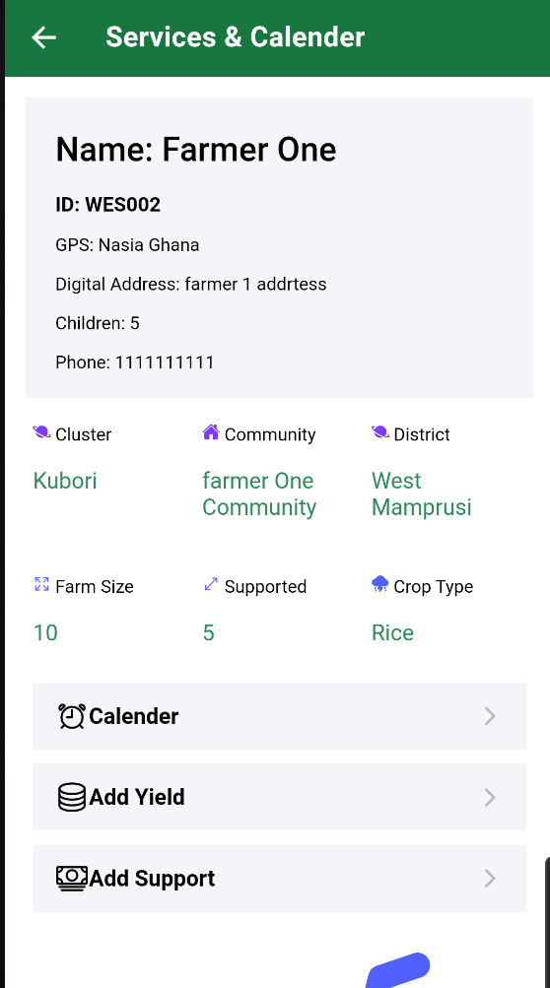
Services and Calendar page
This presents you with details of the farmer
Grants you access to enter support services offered to the farmer
Calendar of activities performed by the farmer
The farmer’s yield after harvest
As well as the opportunity to take back support services rendered to the farmer

Slide 9
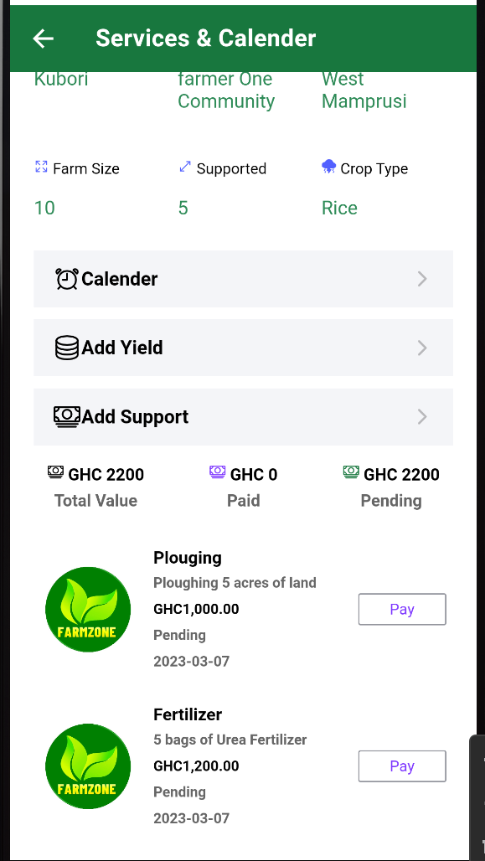
Services and Calendar page
Support page with some sample support items captured
During harvest or Pay back, you click on pay when collecting back supports rendered to the farmers
Status will change from ”pending” to “paid” for each item that is closed by clicking pay and following the procedure to collect money.
Pay will vanish from the page after the support item is closed by accepting payment.
NB: Data for support, calendar and yield can only be deleted whilst on the farm. The data cannot be modified after 24 hours

Slide 10
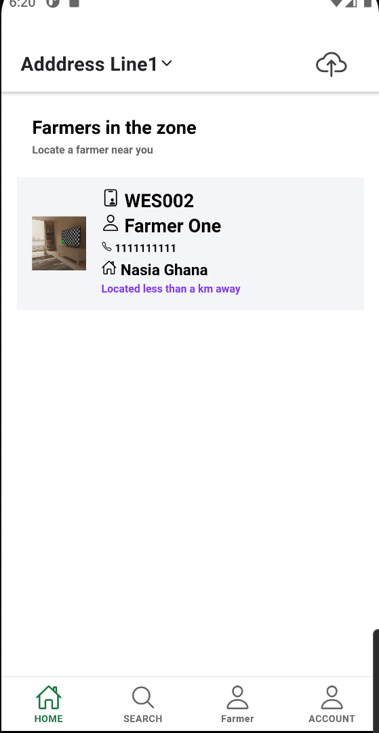
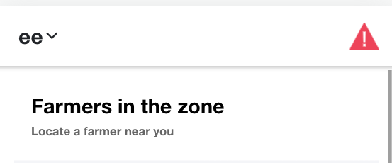
Final Part
Cloud icon
Excalamtion sign
The above processes are all done offline
When you get back to where there is good connectivity
Switch on your data
The exclamation sign will change to a cloud button
Click the cloud buttoin to upload all data and updates for managers to view.

Slide 11
THANK YOU

