Slide 1
Keeping Things Peachy When Shiny Gets Hairy
Marianna Foos | Associate Developer, Biogen
@mariannafoos
Notes:
- hello
- thank you

Slide 2
First things first
Never accept any Shiny requests
Notes:
- model in my role is requests

Slide 3
First things first
Never accept any Shiny requests
Spec with care
Scope
Transparency
Decisiveness
Notes:
People don’t appreciate under-the-hood work
People have a bad sense of what takes time
People don’t know what they want but you might
Statisticians – it’s hard to fix bad experimental design, it’s hard to fix bad app design

Slide 4
An expression should only do one thing
agedata <- reactive({
dat <- read.csv(”data.txt”)
dat[dat$age > input$threshold,]
})
output$plot <- renderPlot({
plot(agedata()[[“x”]], agedata()[[“y”]])
})
output$table <- renderDataTable({
agedata()
})
Notes:
- output-specific cleaning can go in chunktion, shared cleaning should go in reactive
- Calculate once, display many times

Slide 5
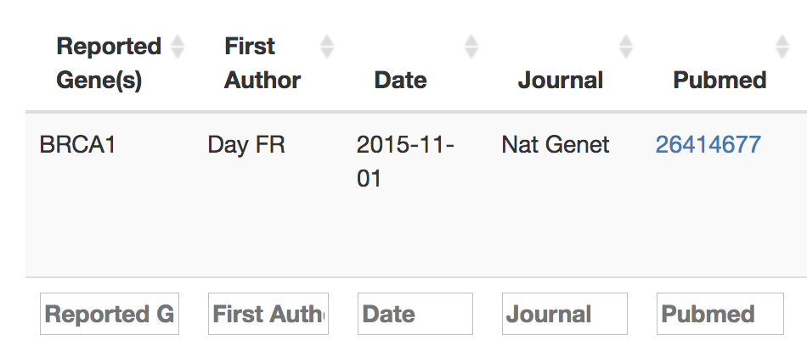
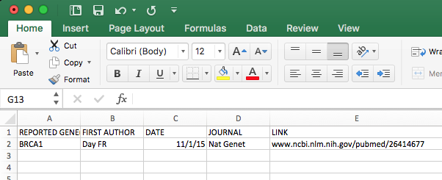
Use dplyr to reduce clutter
output$table <- renderDataTable({
agedata() %>%
mutate(PubMed = createLinkout(PubMed))
})

Slide 6
You don’t have to use Shiny where it’s not the best tool
Start
Integration
Output 2
Output 1
Annotation
Visualization
Output 3
Notes:
- Sequential operations
- “reactive context” limitations

Slide 7
You don’t have to use Shiny where it’s not the best tool
HMRobject <- reactive({
hmr <- runHMR(checkInputs())
saveRDS(hmr, rdsfilename())
enable("writepdfnow") # from shinyjs package
return(hmr)
})
Notes:
All calculations need to be done before any can be displayed no matter what (if you use sequential)
And treat your users to a spinner, I like shinycssloaders

Slide 8
Use modules (for jobs big and small)
plotExpr_UI <- function(id){
ns <- NS(id)
taglist(
selectizeInput(ns(“ingene”), choices = genelist),
plotOutput(ns(“geneplot”))
)
}
plotExpr <- function(input, output, session, dataset, …){
output$geneplot <- renderPlot({
ggplot(dataset %>% filter(x == input$ingene), aes(…)) + geom_boxplot()
})
}
Notes:
- Label implementation means functions don’t work for chunktions
- Can take many arguments for flexibility

Slide 9
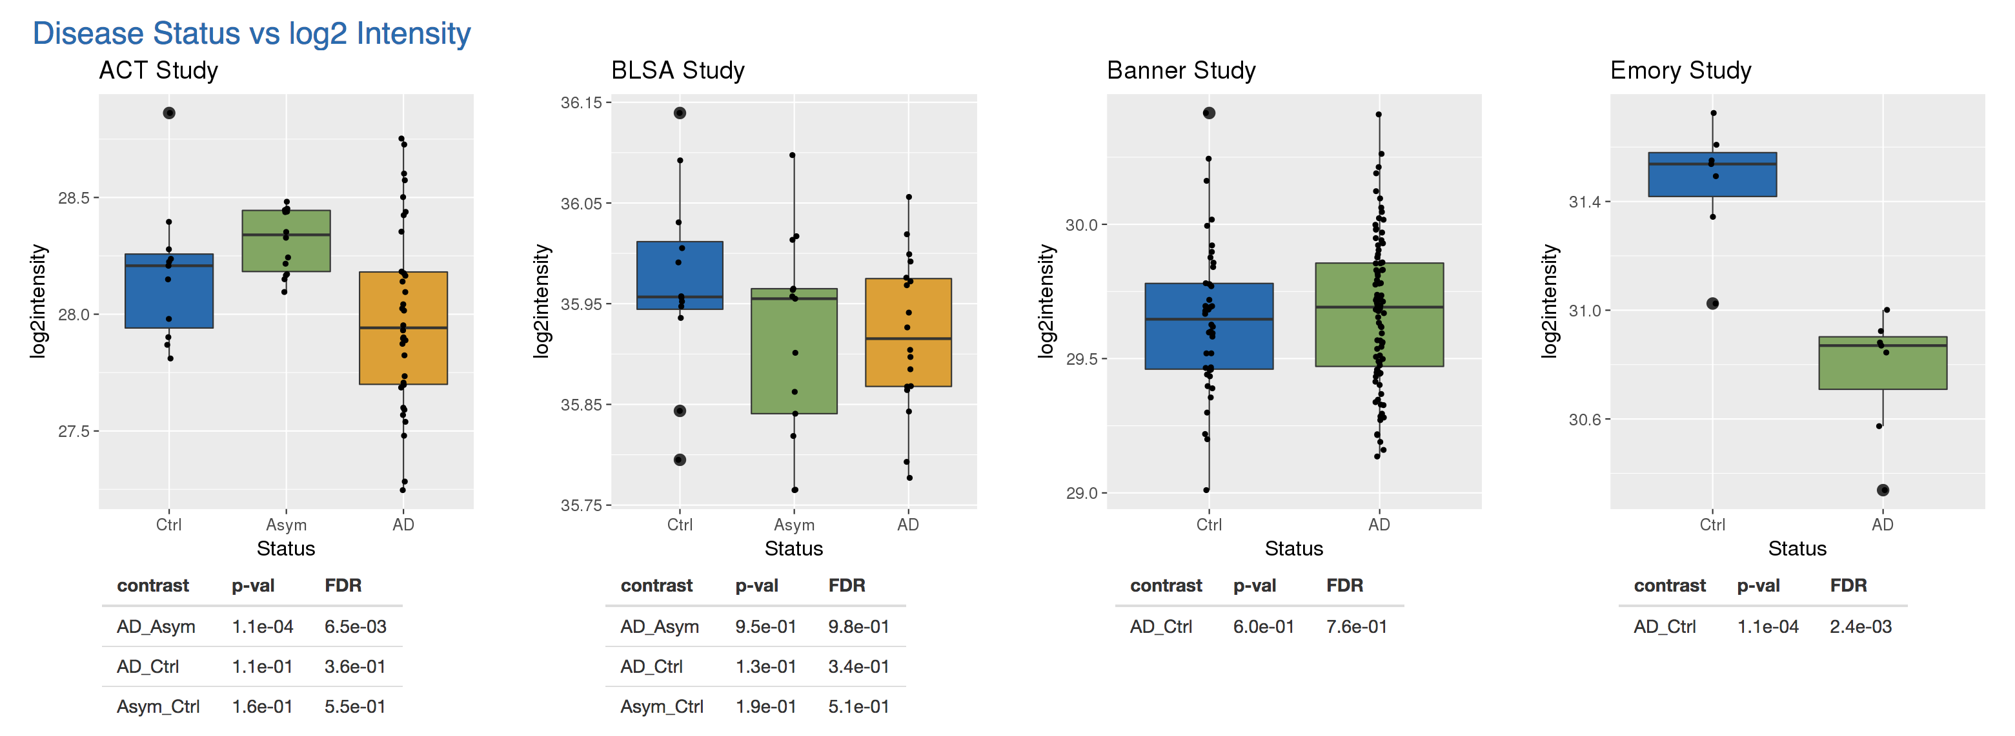
Use modules (for jobs big and small)
Notes:
- Worth it even for formatting

Slide 10

Last things last
Column names
Filtering
Formatting

Slide 11
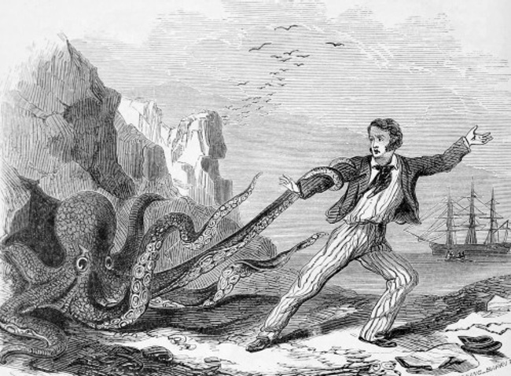
Good luck!

