Slide 1
Using R in a Regulatory Environment: some FDA perspectives
Paul Schuette
Scientiﬁc Computing Coordinator
Food and Drug Administration
Center for Drug Evaluation and Research
Oﬃce of Translational Sciences
Oﬃce of Biostatistics
Paul.Schuette@fda.hhs.gov

Slide 2
Disclaimer
This presentation reflects the views of the author and should not be construed to represent the FDA's views or policies.

Slide 3
Statistical Software Clarifying Statement
“FDA does not require use of any specific software for statistical analyses, and statistical software is not explicitly discussed in Title 21 of the Code of Federal Regulations [e.g., in 21CFR part 11]. However, the software package(s) used for statistical analyses should be fully documented in the submission, including version and build identification.
As noted in the FDA guidance, E9 Statistical Principles for Clinical Trials, ‘The computer software used for data management and statistical analysis should be reliable, and documentation of appropriate software testing procedures should be available.’ Sponsors are encouraged to consult with FDA review teams and especially with FDA statisticians regarding the choice and suitability of statistical software packages at an early stage in the product development process. ”
https://www.fda.gov/downloads/forindustry/datastandards/studydatastandards/ucm587506.pdf

Slide 4
R for Regulatory Review
How is R used for regulatory review work?
Reviewers may opt to perform their analyses using R rather than commercial packages.
R is used for graphics and data visualization.
Simulations in general.
Bayesian Methods
JAGS
Stan
Complex, innovative designs

Slide 5
Some R packages for Biostatistics
survival, Therneau
Hmisc, Harrell et al
DoseFinding, Bornkamp, Pinheiro, and Bretz
gsDesign, Anderson
Beanz, Wang et al
ORCI, Sun
IDE RStudio is used extensively at FDA.

Slide 6
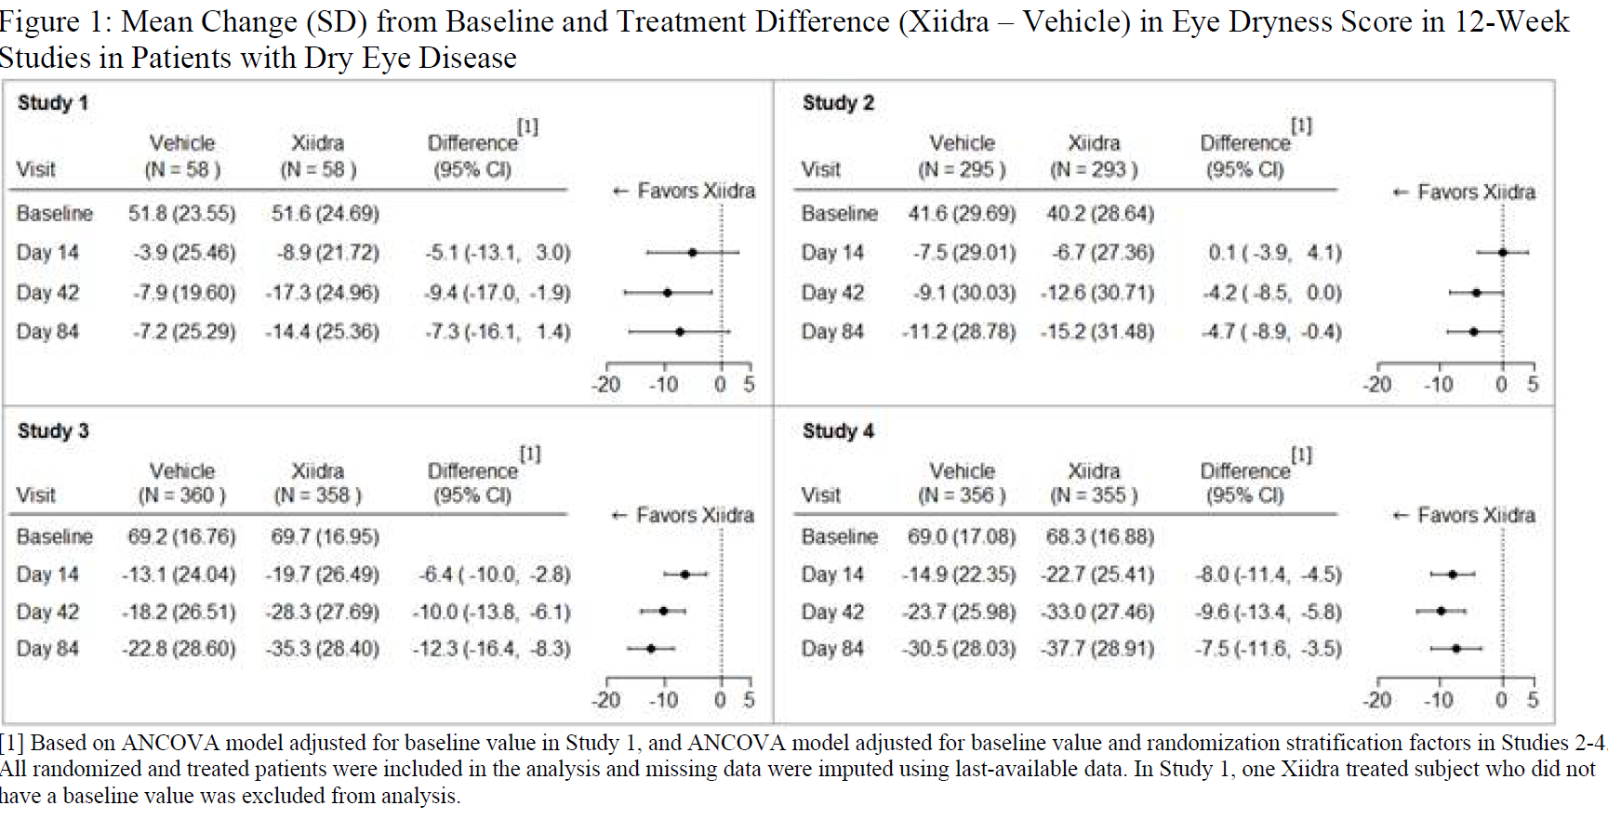
Product Label https://www.accessdata.fda.gov/drugsatfda_docs/label/2016/208073s000lbl.pdf

Slide 7
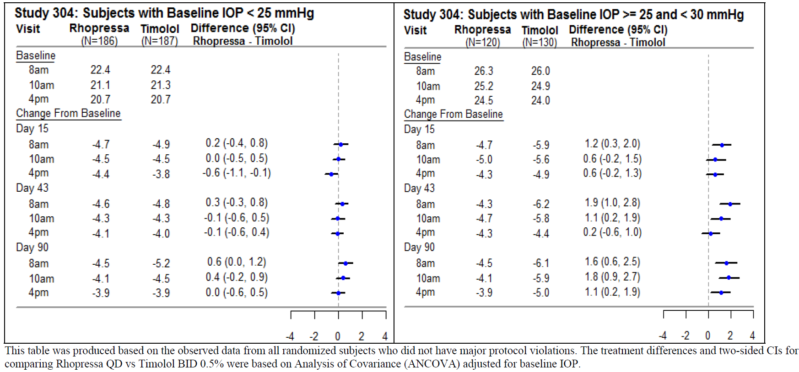
Another Product Label
R Graphic. Drug for the reduction of elevated intraocular pressure (IOP) in patients with open-angle glaucoma or ocular hypertension https://www.accessdata.fda.gov/drugsatfda_docs/label/2017/208254lbl.pdf

Slide 8
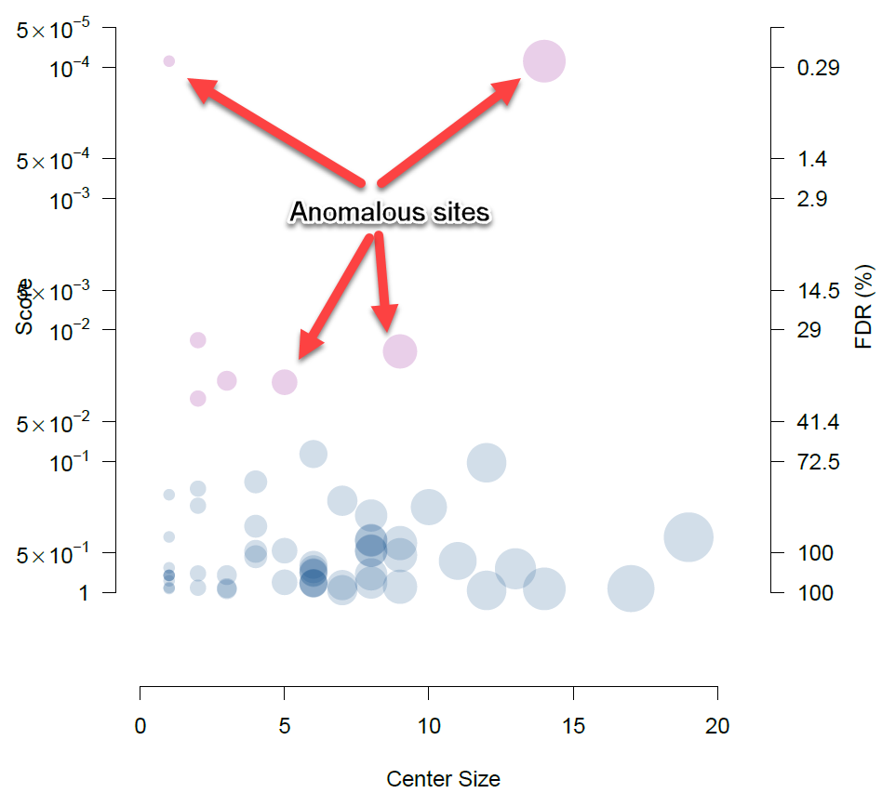
Data Anomaly Detection
Use open source software to detect potential data problems
Example of CRADA software output
DABERS: Data Anomalies in BioEquivalence R Shiny app. Used for PK/PD profiles.
Cooperative Research and Development Agreement (CRADA) with CluePoints for detecting anomalous clinical trial sites.

Slide 9
R Shiny Apps
Internal to FDA
Waterfall Plot
Hepatotoxicity
Demographics
PRO
DABERS
External to FDA (openFDA)
LRT app for Adverse Event analyses

Slide 10
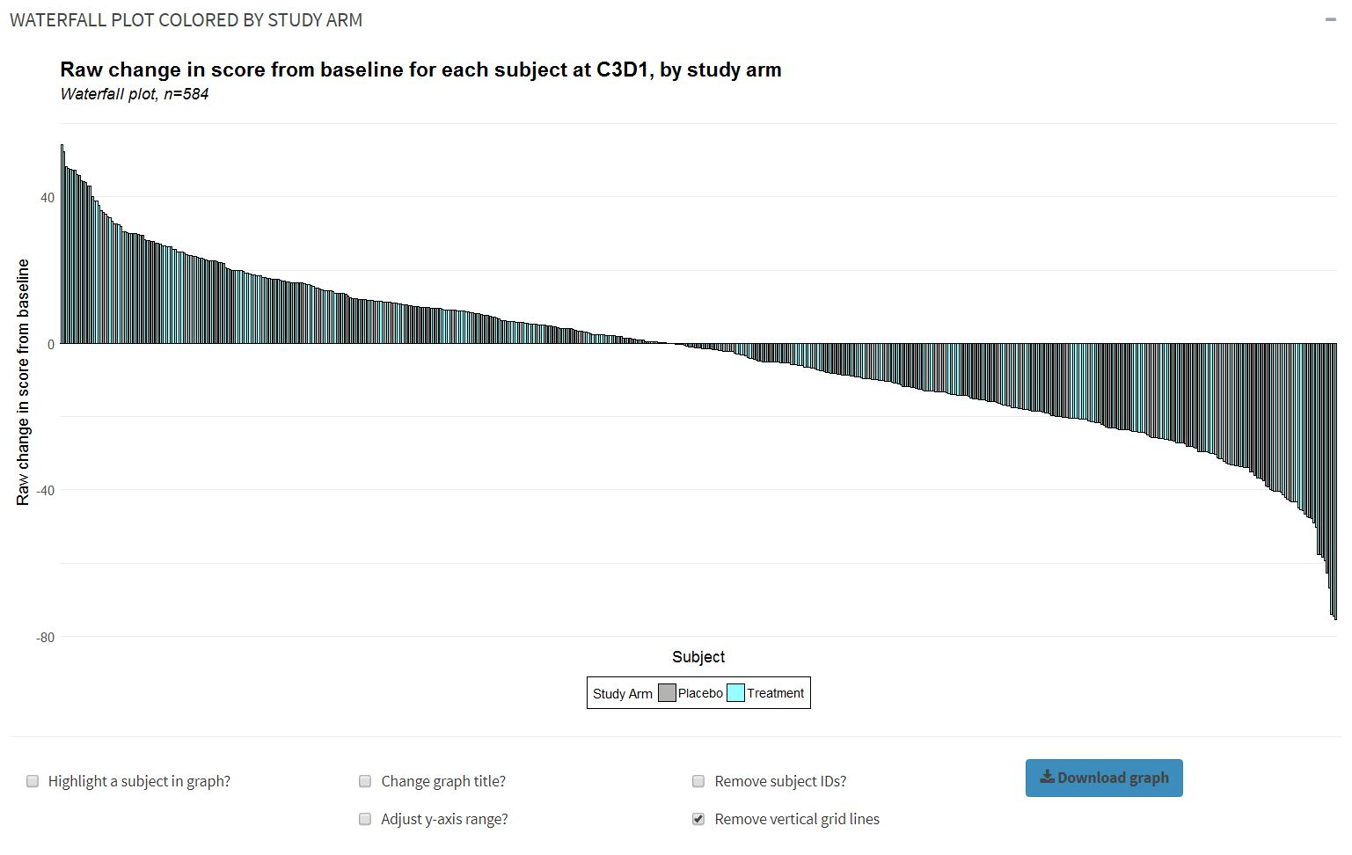
Waterfall Plot

Slide 11
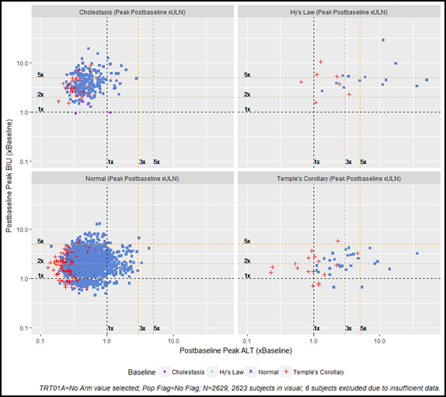
Hepatotoxicity
The Hepatotoxicity tool bolsters analysis of Drug Induced Liver Injury (DILI) through a composite visualization that includes both pre-treatment and on-treatment prevalence of ALT and BILI in terms of Hy’s Law candidate laboratory Upper Limit Normal (ULN) thresholds as well as the magnitude of these elevations normalized by respective baseline test results. This analysis is particularly useful for studies in which subjects have elevated liver enzyme test results at baseline (e.g., subjects with Chronic Hepatitis C).

Slide 12
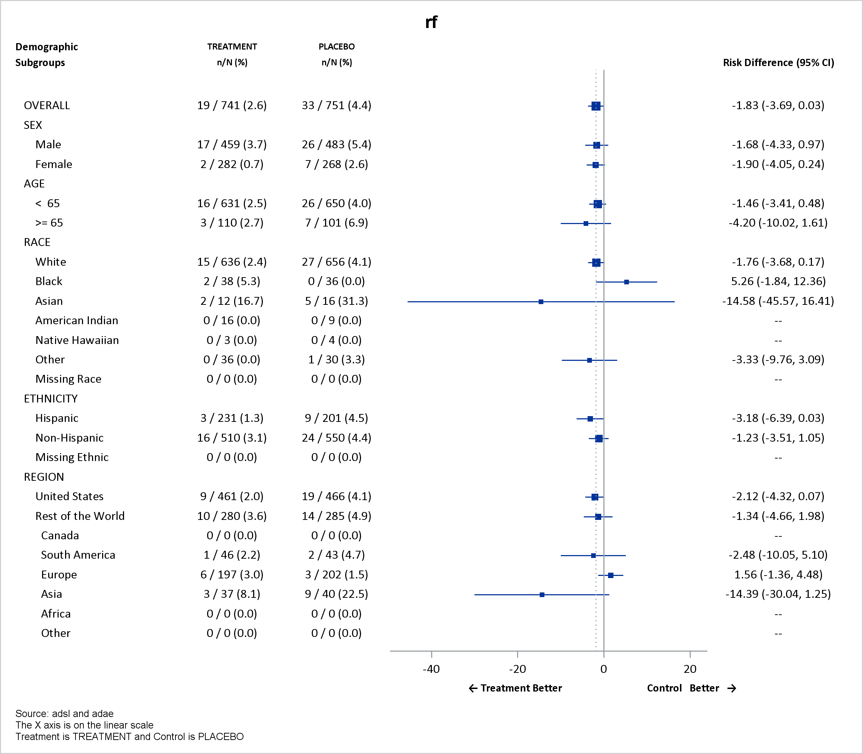
Demographic Tool
The Demographic Tool provides targeted descriptive statistics and safety endpoint analysis for demographic subgroups, including age, sex, race, and ethnicity. The tool has a simple user interface that dynamically walks end-users through the process of executing the analysis. The example deals with a safety endpoint analysis.

Slide 13
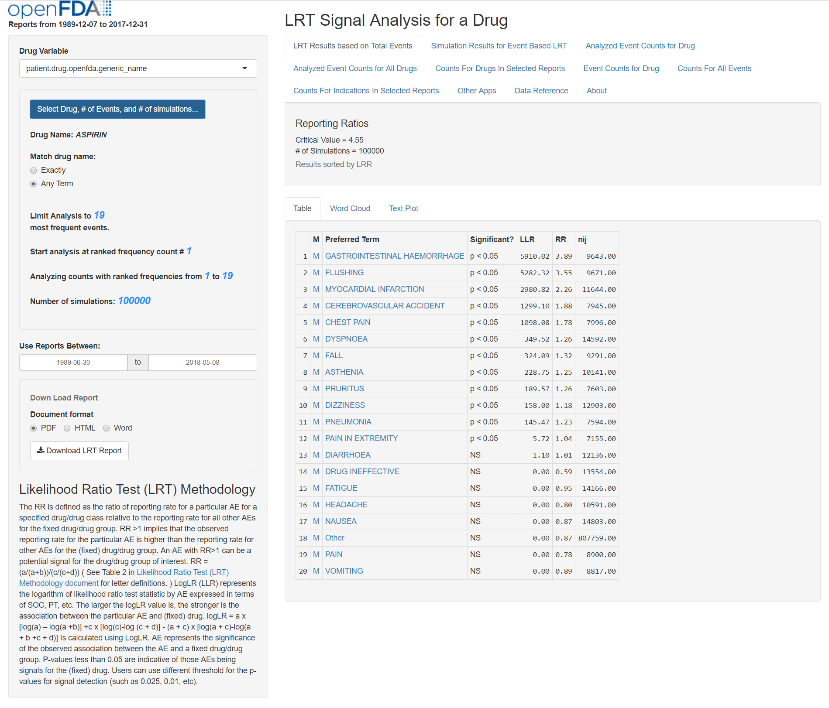
FAERS data, OpenFDA https://openfda.shinyapps.io/LRTest/

Slide 14
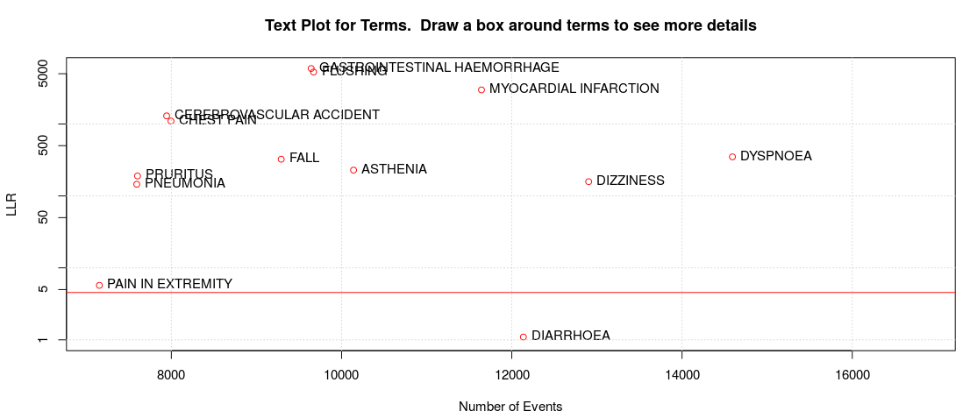
Text Plot from LRT app, Drug: aspirin
Notes:
Potential confounding by indication?

Slide 15
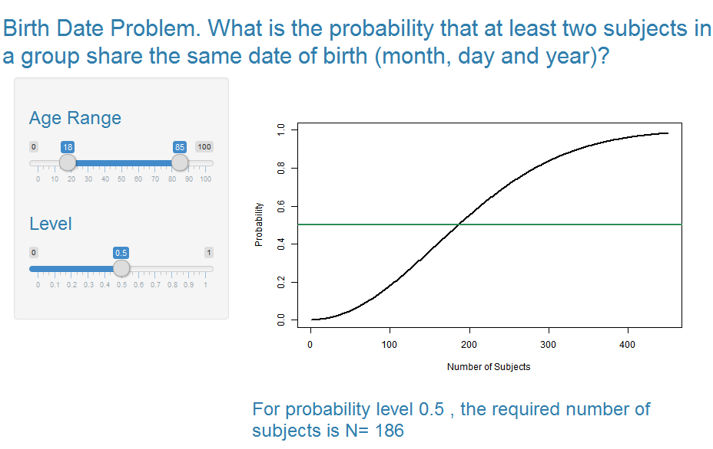
Birthdate Problem

Slide 16
R for Research
Data Mining and Machine Learning (also with Python)
Simulations
Evaluation of methodology
Oak Ridge Institute for Science and Education (ORISE) Internships
Broad Agency Agreements (BAA)
Cooperative Research and Development Agreements (CRADA)
PhUSE, DIA, and ASA working groups

Slide 17
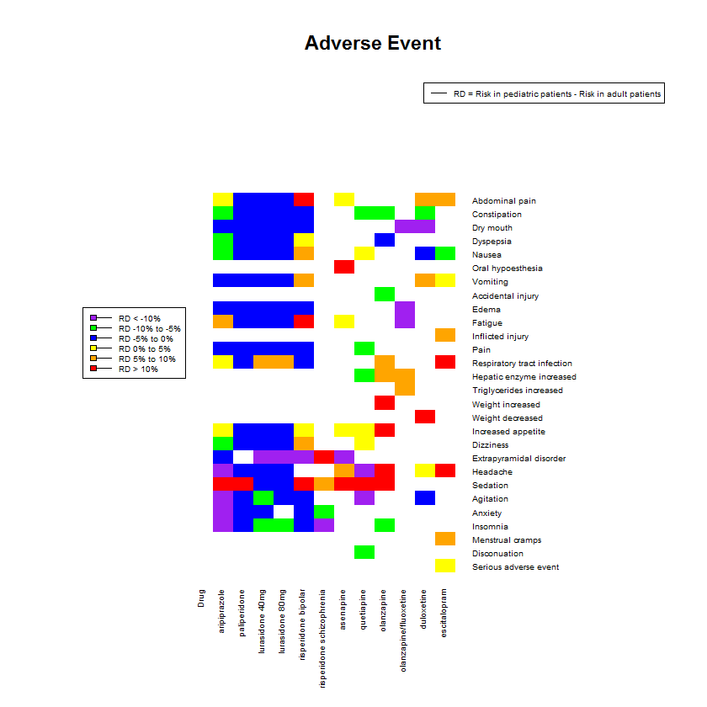
Research, Pediatric vs Adult ADRs

Slide 18
Concluding Observations
Open source tools such as R offer cost effective ways for FDA to carry out its public health mission, and to enhance communications with the public, health care providers and regulated industry.
R is widely used in academe, and is the first choice for many recent graduates.
Managing packages and dependencies can be challenging.
Interactive tools such as R Shiny can enhance users’ experience and understanding.
We still need subject matter experts to help frame questions and draw appropriate conclusions.

Slide 19
Acknowledgements
Yan Wang
Jimmy Wong
Daniel Choi
Austin Taylor
Xiaomei Liu

