Slide 1
Enhance R – Interactive recruitment modeling in r/shiny
Jay Timmerman Principal Data Scientist

Slide 2
What is Enhance R?

Slide 3

A Web-based Recruitment Forecasting Tool
Previously an ultra-sophisticated VBA application
R/Shiny package offered advantages over VBA application, including:
Centralized, permissioned access
Control over inputs
Robust version control
Integration with Sharepoint

Slide 4

Different Than Other Modeling Tools
It’s calculations occur in real time and include high levels of sophistication, including:
Probability of success
Country-level vacations
Permissioned access to certain model attributes
Model version control
Direct export to Sharepoint
Fancy graphics

Slide 5
What does it look like?

Slide 6

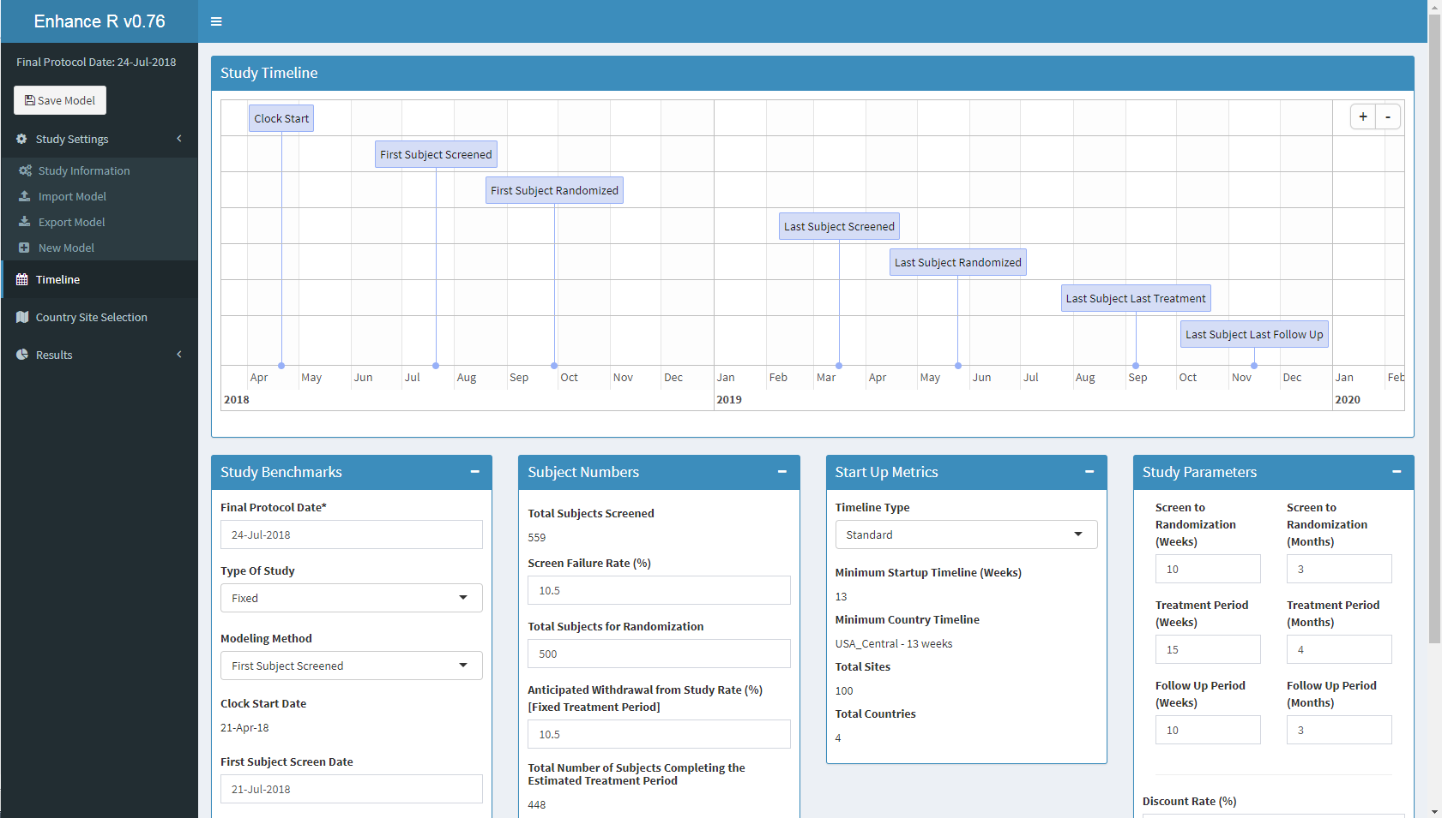

Slide 7
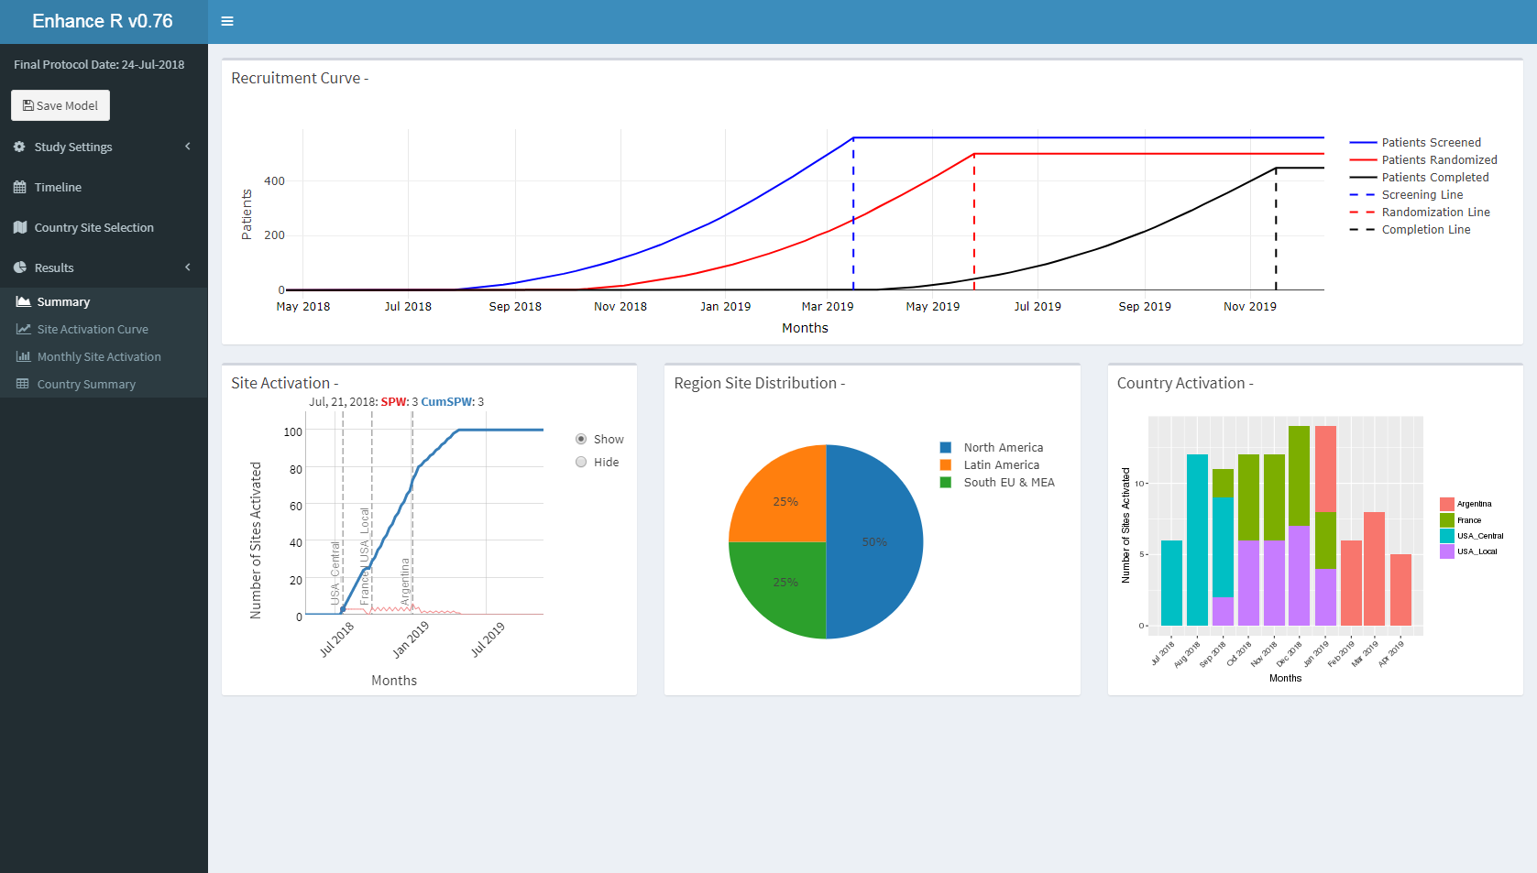

Slide 8
Making the Difference

Slide 9

Large Applications Require More Professional Development
Gitlab for collaboration, issue tracking and development progress
Documented UAT, QC and Test scripts
Batching feature requests in different releases

Slide 10

Required Significant Knowledge and Coordination with IT
SLA
Installation, configuration and hosting of RStudio Server/Connect environments
Coordinating with storage team to support mounted drives
Setting up SLA for unexpected downtime

