Slide 1
Pfizer Vaccine R&D’s Use of R in a GxP Environment
Boyd Gonnerman* – Senior Analyst, Data Science
Francesco DePierro – Director, Research Informatics
John Sims* – Associate Director, Data Science
Peter Giardina – Director, Clinical Testing and Business Operations
*RinPharma program committee
Notes:
My names’ boyd gonnerman.
Other. On program committee.
Work for Research informatics group at pfizer within VRD. More about vaccine Research in subsequent slides, but first lets discuss Vaccines...

Slide 2
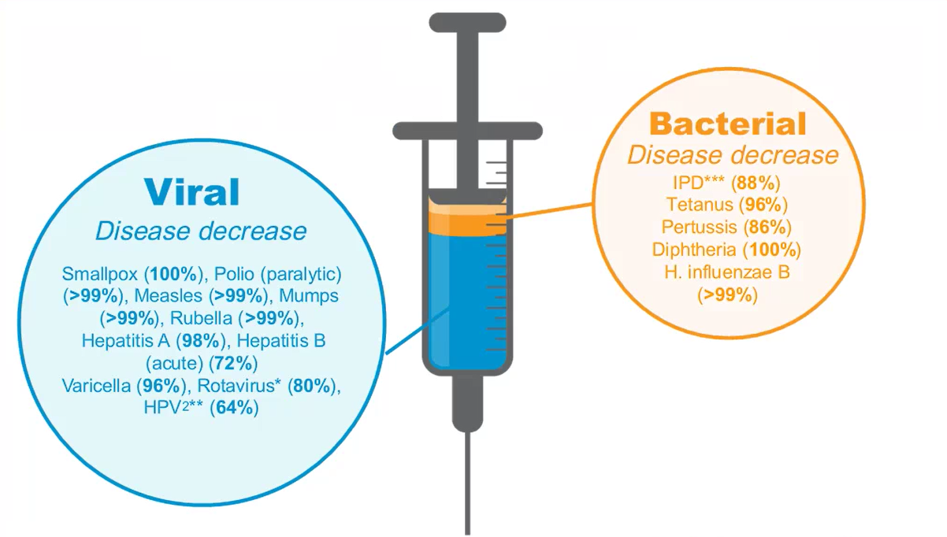
Positive Health Impact of Vaccines (US)1
1 CDC. Epidemiology and Prevention of Vaccine-Preventable Diseases. 2015
2 Markowitz et al. Pediatrics. Feb 2016, peds. 2015-1968; DOI: 10.1542/peds
* Hospitalizations < 3 years of age
** Among females aged 14 to 19 years receiving at least one dose; vaccine coverage ~57%
*** All invasive pneumococcus < 5 years of age
Notes:
Vaccines have been highly effective in decreasing disease incidence across the United States. our group has a long history in the vaccine space, most recently with vaccines that target bacterial Meningitis and Pneumococcal disease as well as viral pathogens and immuno-oncology.

Slide 3


Example Study Distribution
Assay 1
Clinical Site
CRO 1
Frozen Sera
Assay 10
Blood Sample
Blood Sample
Pfizer Receipt and Sample Receipt
CRO 3
CRO 2
Assay 2
Assay 3
Frozen Blood
Pfizer Site 1
Pfizer Site 2
Assay 4
Assay 5
Serum
Assay 6
Assay 7
Assay 8
Pfizer Site 1
Serum
Pfizer Site 2
Pfizer Site 2
Assay 11
Assay 12
Assay 9
Notes:
Pfizer Vaccine Research and Development develops and validates laboratory assays to support our vaccine programs from early development through late stage studies.
Speak to typical setup and use of CROs and that some assays require analytical processes in connection with lims.

Slide 4
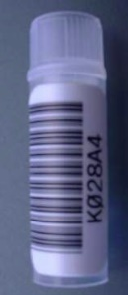
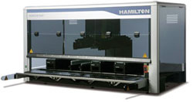
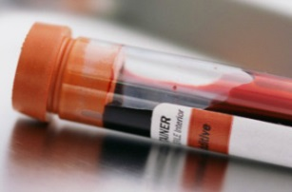

Typical Clinical Sample Workflow
A study plan is created and
configured.
Upfront work defines how samples
will be received for the study.
As sample boxes are opened, each sample is
scanned into system. A lookup is done by the
system to clinical to retrieve/download relevant
information about the barcode/sample.
Before the study begins, VR
sends barcoded tubes to the
clinical sites
Sample aliquoting according to
prescribed (as specified in the plan)
testing needs performed by robot.
As the study progresses,
subject samples are collected
into the pre-barcoded tubes
at clinical sites
Samples stored in freezers in
organized workbox units.
Collection information entered into clinical system (linking pre-labeled tube to a specific subject collection event) and samples shipped to our location.
Sample workboxes sent to
laboratories based on an
in-depth testing schedule.
As assays are performed,
data is uploaded for final
reporting.
VR Sample Management receives
sample shipment
Notes:
Speak to upfront clinical process, once study is defined, that gets samples to the lab to ground discussion.

Slide 5
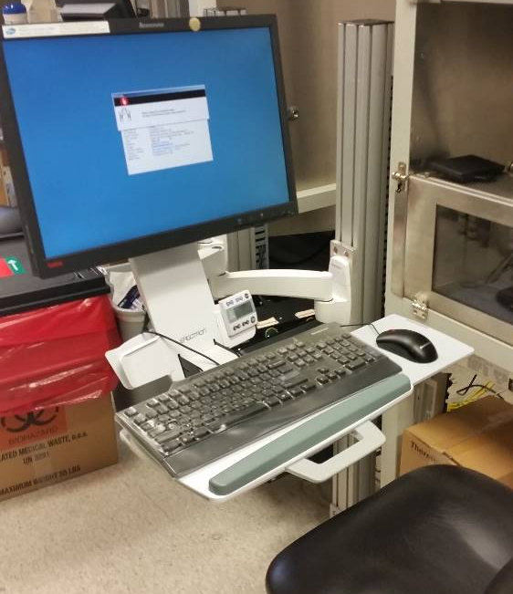
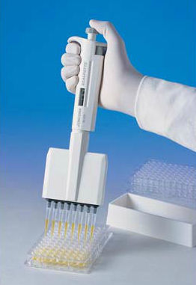
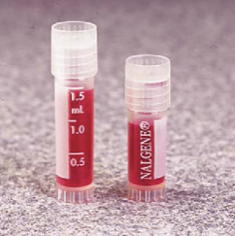
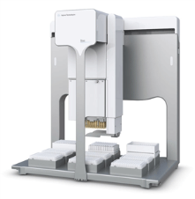
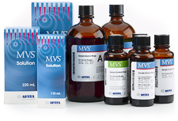
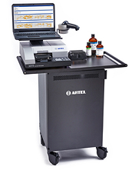
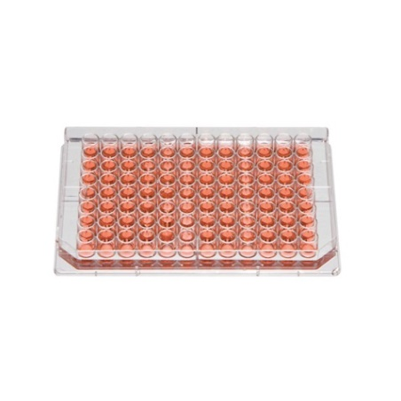
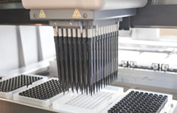
Background on Usage of Systems
Receipt and collection of thousands samples/month
Aliquoting, storage, or/and shipping of samples
Processing and calculation of 20,000 to 50,000 results/month
Pfizer’s information systems ensure high-quality data to support vaccine programs:
Consistent approach across all assay platforms
Clear and transparent analytical methodologies
Verifiable data throughout the assay process (traceable, repeatable)
Qualified and secure infrastructure for analysis and reporting
Strict compliance with various Gov. Agency regulations (validated)
Notes:
Very quick discussion on scale of work and high throughput nature, robotics, systems, etc.

Slide 6
What does the Research Informatics (RI) Team Do?
Development of information systems used to perform clinical assays, collect raw data, & perform statistical analysis
Day-to-day technical support for information systems (e.g. bug fixes, general data querying, data storage)
Regulatory processes around information system validation (e.g. data maintenance, data access, system requirements)
Secure data connections and transfers from external CROs
Maintenance/merging of exploratory research collaborative data
Computer hardware and software support for various instruments, robotics, and automation
Development of innovative solutions to replace manual processes
Notes:
Those systems we talked about on last slide…RI is involved and manages them plus more.

Slide 7

Let’s Go Deeper into Analytics…
Notes:
We’ve only scratched the surface of some of what the RI team does, let’s focus on Data Science and the analytical portions. Let’s especially get into SAS and R and what we do there…

Slide 8
Advantages / Challenges of using SAS to Process Assay Data
Advantages
SAS is generally accepted in Pharma Industry
Pfizer has many statisticians with SAS background
Comprehensive documentation around SAS procedures
Challenges
SAS is relatively Expensive
Batch-oriented job submission requires separate Java component (more moving parts)
Difficult to deploy with web-based applications
Programming: SAS has only one data structure
Outdated IDE in PC SAS
Notes:
Pfizer statisticians: Comfortable using SAS, legacy code
Expensive: particularly important when working with small labs
Batch-oriented submission products expensive
With One data structure: sometimes data wrangling isn’t as easy/intuitive. Lists in R, vectors, dataframes
Debugging macros

Slide 9











Background Architecture
Web Interface
Java enabled Application Server
Raw data collected using various instruments and robots
Mid-Tier application written using Java Servlet Spec
http connection (SSO Through Proxy)
Connection with HPC Grid established over secure shell. Batch SAS process started
Batch SAS Process reads raw data from LIMS/Oracle, reads parameter files, calculates and reports results
Secure Shell connection for batch SAS program submission
JDBC
Instrument Data:
C.T.L.
Bioplex
SpectraMax
Raw data
SAS/Access
LIMS
High Performance
Computing Grid

Slide 10

Scalability
Ease of Use
Ease of Administration
Hardware Reduction
Notes:
R may be an opportunity to bring about valuable change…

Slide 11

Change
Notes:
Change isn’t always welcomed though or easy… SAS is a behemoth in the industry.

Slide 12
Advantages of using Shiny Server and R to Process Assay Data
Advantages
Easy deployment for early-phase research
Flexible and responsive interface
Flexible and comprehensive suite of packages
Relative lower cost
Notes:
Over the last few years, VRD has been exploring the use of R for validated applications.

Slide 13



Pfizer VRD Architecture for Validated R Implementation
Mid-tier and application coexist
http connection
ROracle
R Source files owned by UNIX
service accounts
Instrument Data:
C.T.L.
Bioplex
SpectraMax
LIMS
Notes:
Similar layout- midtier layer and applications coexist.
Fewer moving pieces-
Equivalent results

Slide 14
Challenges of using Shiny Server and R to Process Assay Data
Challenges
Misconception that open source means uncontrolled for GxP activities
Requires governance to maintain robust qualified environment
Inconsistent documentation standards for R packages
Notes:
Governance: Similar challenge as other applications, but no precedent for maintaining qualified R environment at Pfizer. Build from scratch.
Inconsistent documentation: One advantage to SAS is consistently well-documented analytical methods.

Slide 15
Overcoming Challenges
Challenge: Requires governance to maintain robust qualified environment
Highly controlled:
Server environment
Secure, restricted access
Clearly-defined processes / SOPs for server maintenance (i.e. package installation, disaster recovery)
Application Change Management process
SDLC (extensive planning, testing)
Notes:
Similar to processes used for other applications, but somewhat built from scratch. Some pieces required extra effort on RI’s part.

Slide 16
Overcoming Challenges (cont’d)
Challenge: Requires governance to maintain robust qualified environment
Well-designed workflow can provide additional security without impacting efficiency
Version control
Code review / sharing
Application design
Setting up easy-to-use, cross-platform tools to manage security and log usage within applications
Standardization can reduce complexity

Slide 17
Overcoming Challenges
Challenge: Misconception that open source means uncontrolled for GxP activities
Our ability to provide a secure, stable environment through which deployed applications generate consistent results will be our strongest selling point
Challenge: Inconsistent documentation standards for R packages
Internal documentation / tests
Notes:
RinPharma / other conferences will help build trust as widespread adoption brings R to be fully mainstreamed

Slide 18
Continuing Challenges
Next Steps:
Validation documents / templates
Test scripts / validation protocol for commonly used packages
Identify stable package/releases
Unit tests
Collaborations between Pharma companies and Regulatory Agencies

Slide 19


Slide 20
Backup

Slide 21
High Level Process for Calculating Assay Results: General Information
Programs are accessed through a web interface.
Access to the system, the data and various functionality are controlled at the levels of Laboratory, User ID, Role and Assay Platform. Ease of deployment is key to success
Programs adhere to the following high level process
Compile input data
Assess the fitness / validity of the assay against prospective criteria
Calculate assay results where applicable
Identify failed tests where applicable
Create output
Programs are designed for hands-off processing (point & click)
Consistent from run to run and across all operators (repeatability).
Secure, compliant

Slide 22
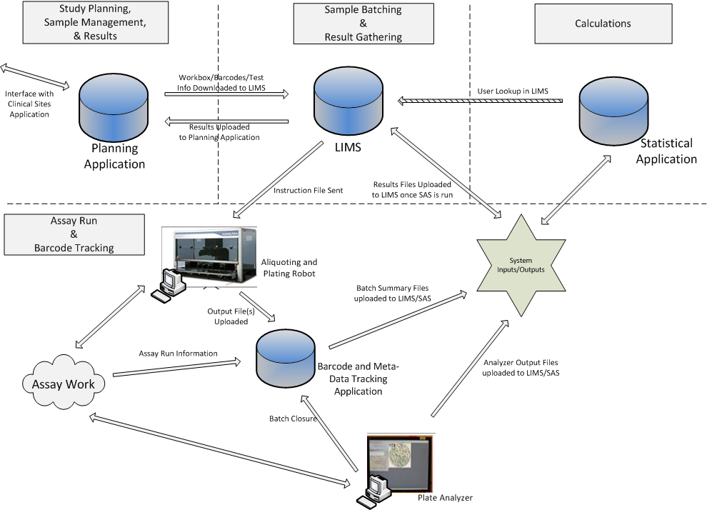
1. Consolidating Systems into a robust LIMS platform Legacy Model and System Architecture
Pfizer Confidential │ 22

Slide 23
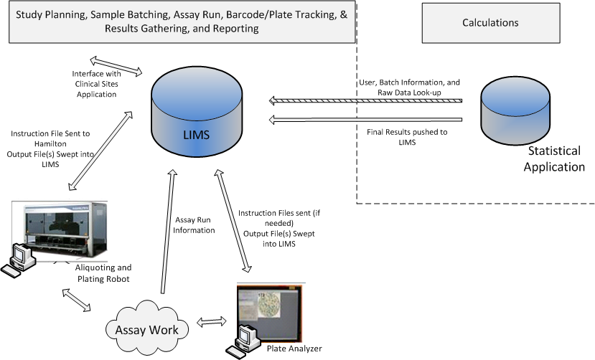
1. Consolidating Systems into a robust LIMS platform New Model and System Architecture

Slide 24
Wrapping up Suggestions and Points to Consider
Empower customers
Be as inclusive as possible
Find ways to have the customers drive harmonization and standardization
Make changes gradually or in distinct chunks
Avoid scope creep and table requests for future
Partner with QA as early as possible
Both to improve validation process and ensure testing goes smoothly
Ensure various team members are clear on roles and responsibilities

