Slide 1
Data-Driven Strategies for Synthetic Route Design and Operational Modeling within Pharmaceutical Development
R Pharma Conference
Aug 15th, 2018
Jun Li, Jacob Albrecht, Martin D. Eastgate
Bristol-Myers Squibb, Chemical and Synthetic Development

Slide 2
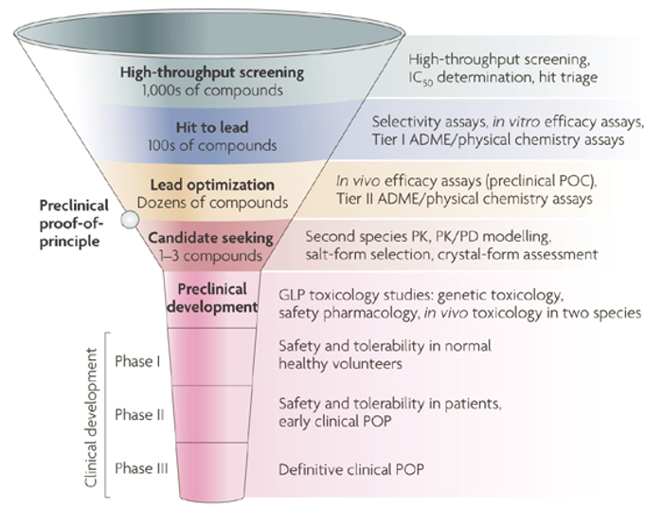
Where We Are in the Drug Development
CSD
Discovery
Drug Safety
Pharm R&D
Manufacturing
Regulatory
Clinical
Route Design
Safety, Economics, Legal, Environment, Control, Throughput
Reaction Science
High throughput experimentation
Process Optimization
Mechanism-based study
Statistical Design of Experiment
QbD
Lab-to-Plant Manufacturing excellence, robustness and risk assessment in a highly regulated environment.
Chemical Synthetic Development
Data Science
Speed to Patients
Ref: (1) Nature Reviews Drug Discovery 2007, 6, 636; (2) Drug Discovery Today, 2014, 19,859

Slide 3
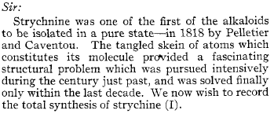
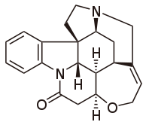
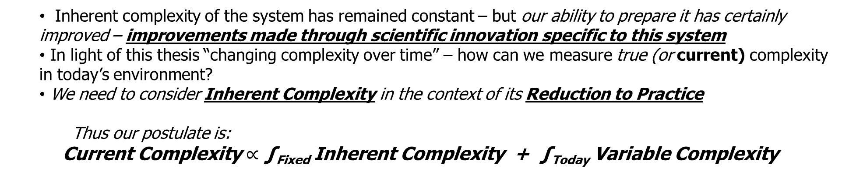
Current Complexity Postulate
Woodward; 1954
 | Woodward | Magnus | Overman | Rawal | Martin | Padwa | MacMillan | Vanderwal
Year | 1954 | 1992 | 1993 | 1994 | 2001 | 2007 | 2011 | 2011
Steps | 29 | 28 | 24 | 15 | 15 | 17 | 12 | 6
Inherent complexity of the system has remained constant – but our ability to prepare it has certainly improved – improvements made through scientific innovation specific to this system
In light of this thesis “changing complexity over time” – how can we measure true (or current) complexity in today’s environment?
We need to consider Inherent Complexity in the context of its Reduction to Practice
Thus our postulate is:
Current Complexity $∝$ ∫_{Fixed} Inherent Complexity + ∫_{Today} Variable Complexity

Slide 4
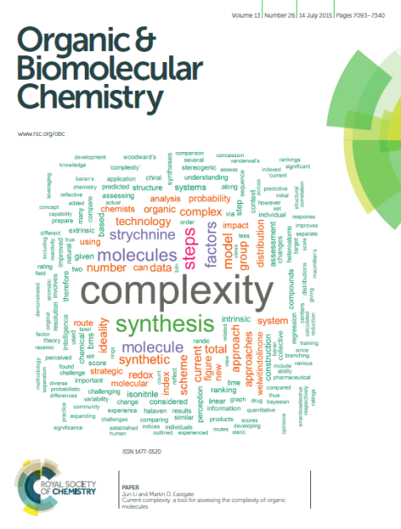
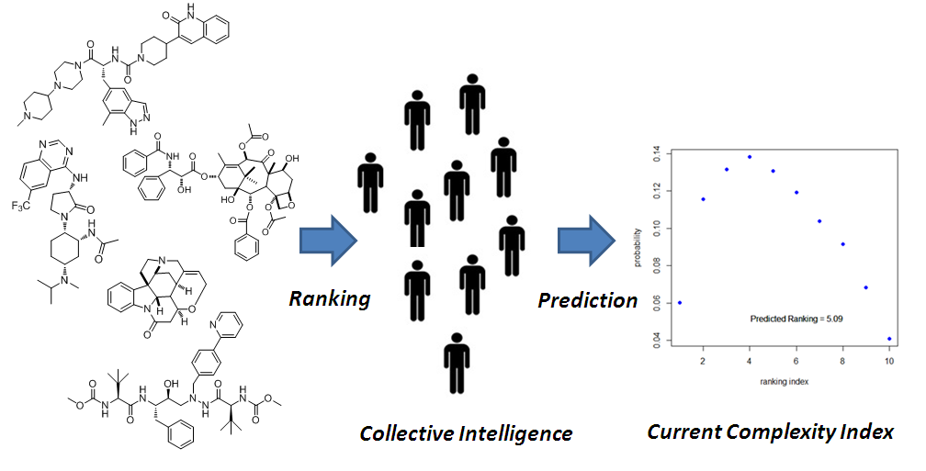
Current Complexity: R&D Innovation Tacking Index
Leverage Feature selection to establish Bayesian probabilistic model to predict complexity index
Experts with Diverse Backgrounds in Synthesis
Various Set of Molecules
Molecular structure
Lens
Variable Technology
I
Fixed Attributes
Context
Current Complexity Index (1-10 scale)
Ref: Li, J.; Eastgate, M. D., Org. Biomol. Chem., 2015, 13, 7164–7176.

Slide 5
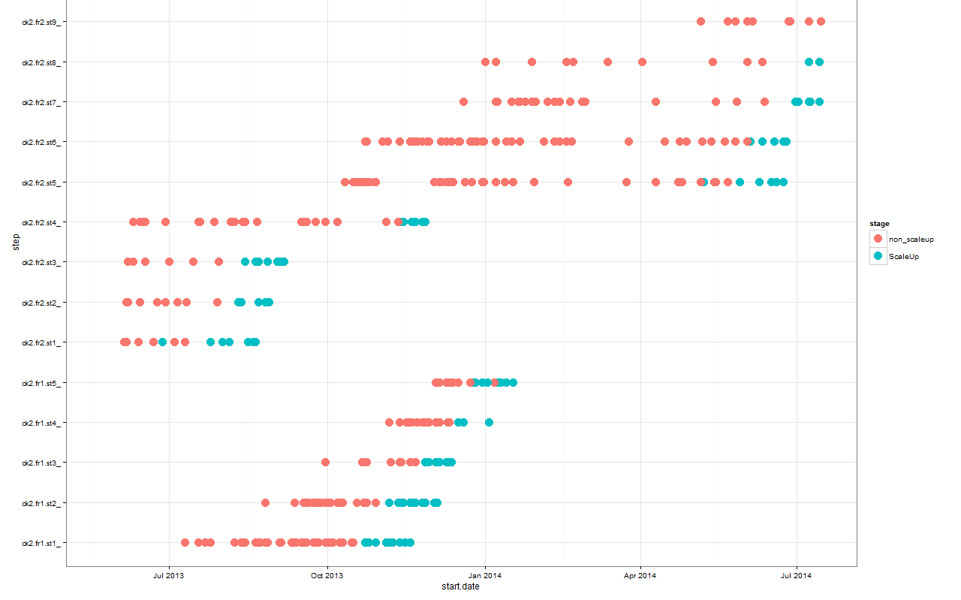
ECN Resource Model
Project Steps
Red dot: lab experiment
Blue dot: scaleup batch
Key Question: Can we build a quantitative risk model that enables staffing decisions that balance risk across the portfolio, provides an understanding of delivery timelines, risks and trade-offs made to support the dynamics of the early portfolio?

Slide 6
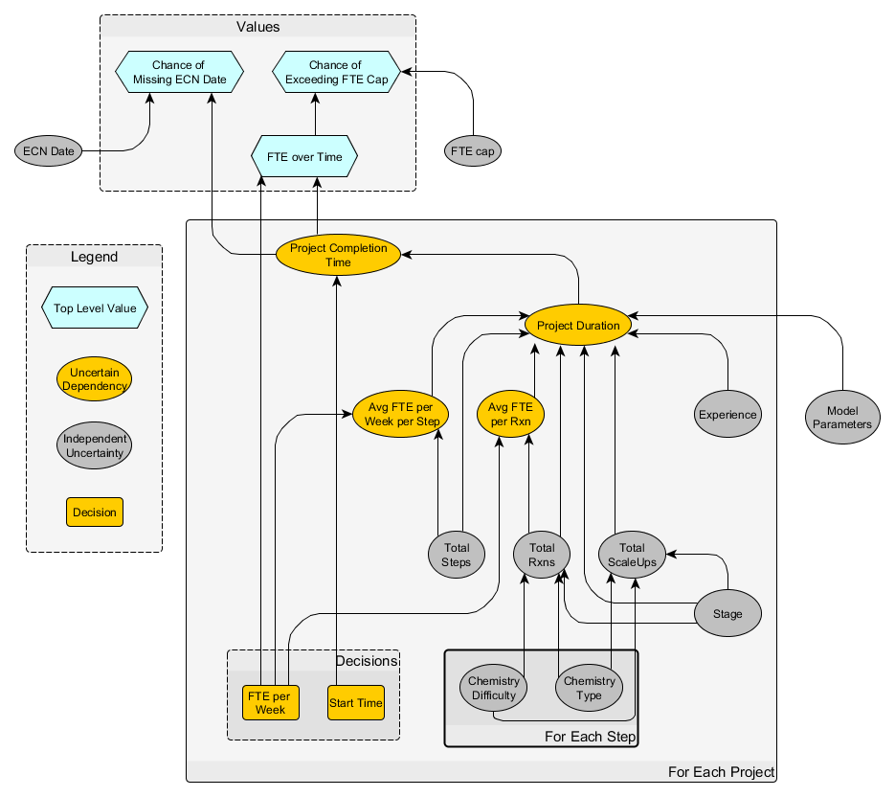
Decision Diagram and Model Feature Selection
Stakeholder
Values
Analyzing the R&D effort:
Lab/Scale-up
Chemistry types/difficulty
Campaign types
Prior campaign experiences
Productivity.
Using a genetic algorithm-based automated model search, key features were identified; LEAP subset selection was then used to find the best models.
K-fold cross validation was employed to predict error in the final selected model.
Using Bayesian framework to obtain the prediction incl credible intervals
Attributes
Options

Slide 7
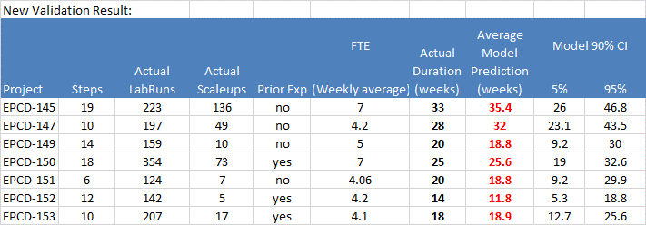
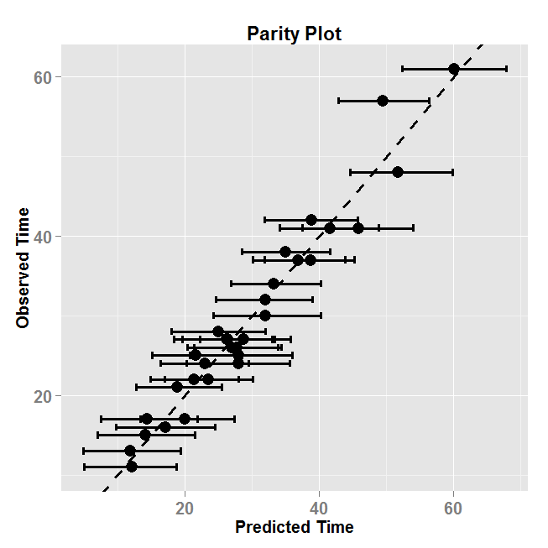
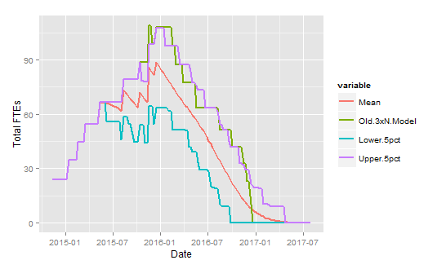
Model Validation
Predicted average duration matched with actual duration very well for new data
RMSE=2.56
“Gut feeling” case
Model implemented in WinBUGS
Old heuristic model matched the upper bound of the 90% CI very well, indicating this predictive model is accurate to capture the rule-of-thumb conservative estimate.

Slide 8
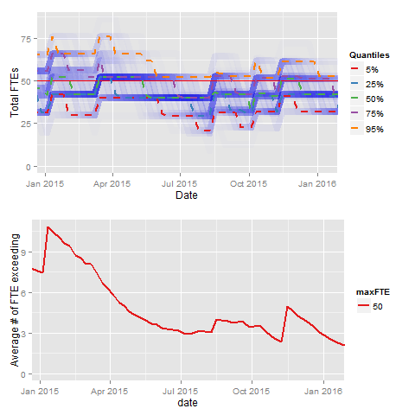
Chance of Exceeding Resource Limit: Total FTEs vs. Time
Total flow approximated by productivity: reactions/chemist/time
Capacity expressed in FTE number
Determines FTE needs over time using Monte Carlo
Provides potential for 12 months planning, plots distribution of FTE requirements over time
Calculates chance of exceeding a specified FTE limit
Determines the average FTE overage experienced within the group if the headcount limit is exceeded

Slide 9
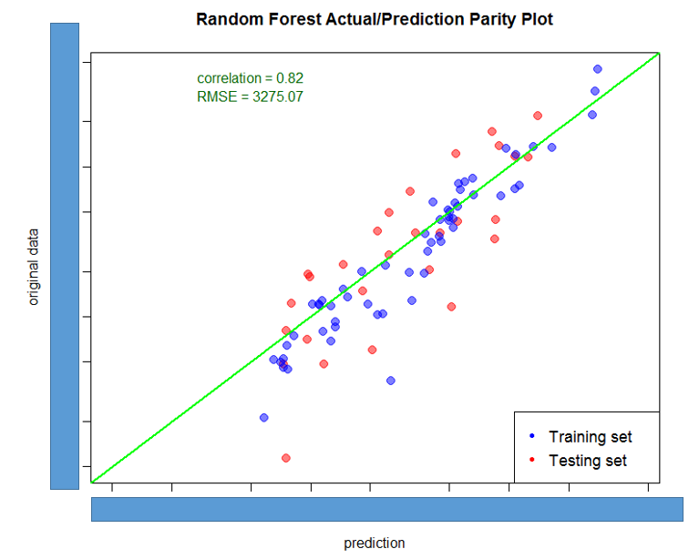
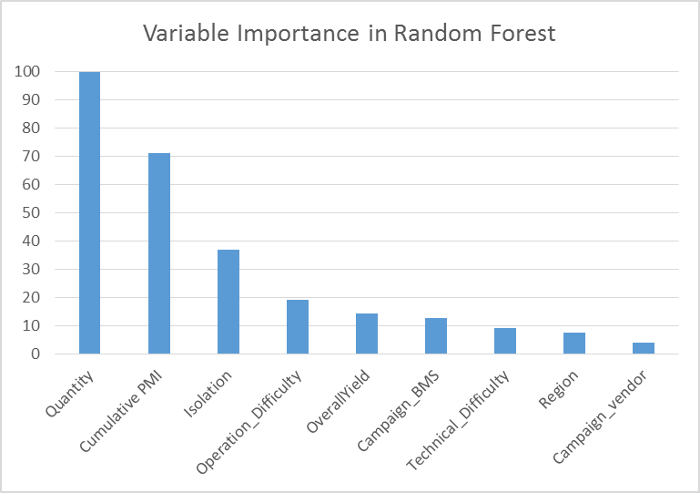
PMI & Machine Learning Production Cost Model
$$Process Mass Intensity \left(PMI\right)= \frac{quantity of raw materials input (kg)}{quantity of bulk API out (kg)}$$
Random forest model gave the best prediction in the vendor unit production cost model.
Variable importance plot confirmed that production/labor cost is mainly driven by scale and greenness metrics such as PMI.
Ref: 1) Kuhn, M.; Johnson, K. Applied Predictive Modeling, 2013, Springer. 2) Kelleher, J. D.; Namee, B. M.; D'Arcy, A. “Fundamentals of Machine Learning for Predictive Data Analytics: Algorithms, Worked Examples, and Case Studies” 2015, MIT Press

Slide 10
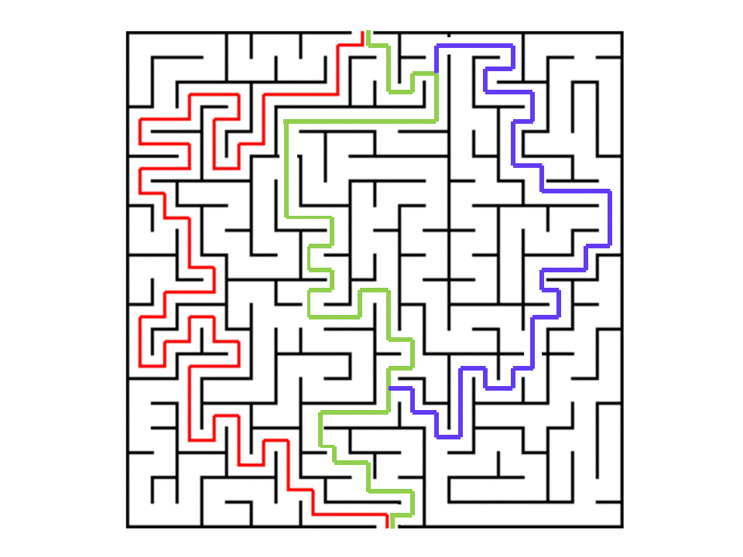
Can we influence synthetic design by PMI?
cPMI(A)
cPMI(B)
cPMI(C)
Reaction-level Knowledge
Step PMI
I) Can we find “centrality” in step PMI based on reaction? II) Can we establish a relationship between process cPMI and step PMI?
Cumulative PMI
Ref: 1) Li, J.; Simmons, E. M.; Eastgate, M. D. A data-driven strategy for predicting greenness scores, rationally comparing synthetic routes and benchmarking PMI outcomes for the synthesis of molecules in the pharmaceutical industry. Green Chem. 2017, 19, 127-139. 2) Li, J.; Albrecht, J.; Borovika, A.; Eastgate, M. D. Evolving green chemistry metrics into predictive tools for decision making and benchmarking analytics. ACS Sustainable Chem Eng, 2018, 6, 1121-1132

Slide 11
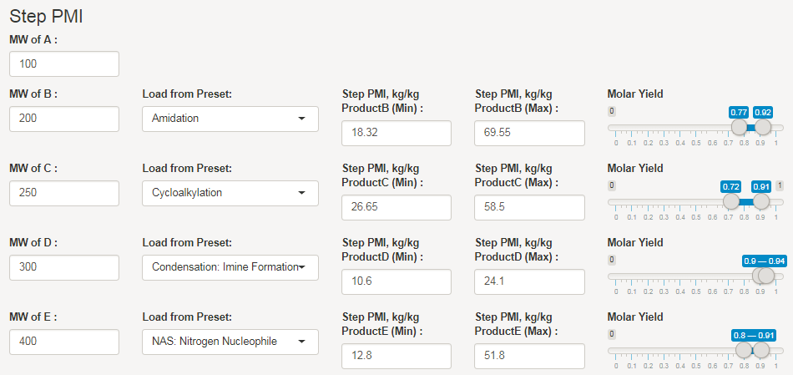
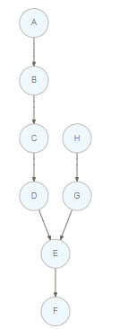
R Shiny Web App Demo Screenshots
This tool can allow user to easily select the synthetic route design with autofilled step PMI and step yield ranges based on reaction subtypes from ACS GCI collated scale-up dataset.
With known/anticipated step PMI/Yield process info, it can quickly generate expected value of cumulative PMI projection.
Simulated 10,000 samples from correlated step PMI and step yield distributions

Slide 12
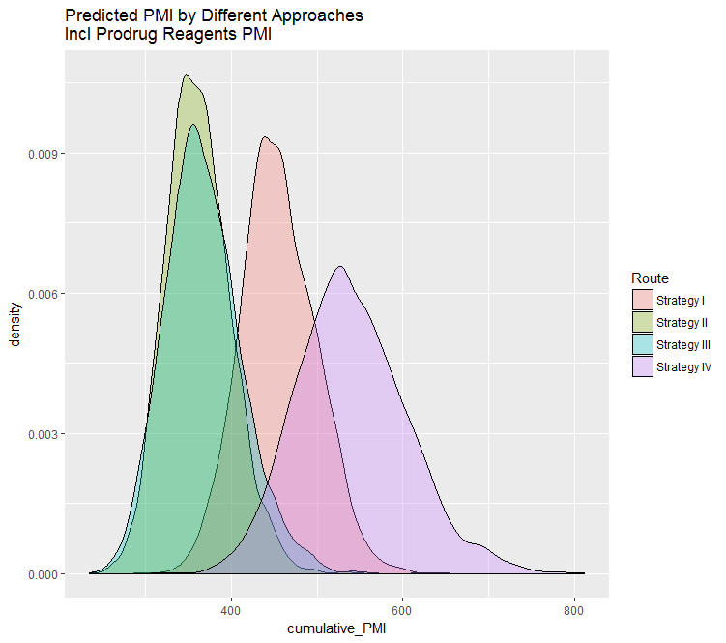
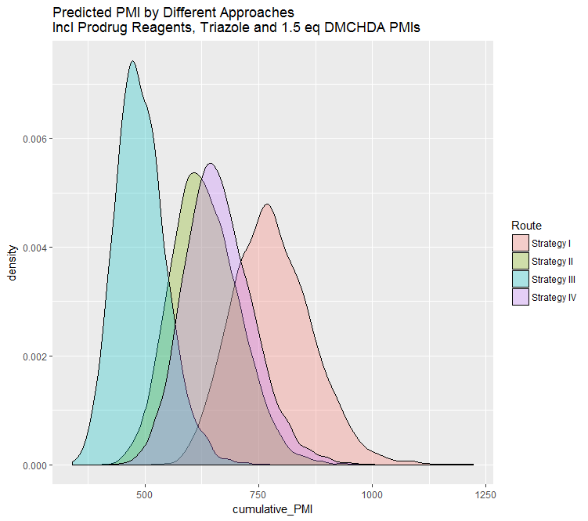
Option Analysis with Cumulative PMI in HIV Drug
Ref: Chen, K.; Risatti, C.; Simpson, J.; Soumeillant, M.; Soltani, M.; Bultman, M.; Zheng, B.; Mudryk, B.; Tripp, J. C.; La Cruz, T. E.; Hsiao, Y.; Conlon, D. A.; Eastgate, M. D. Org. Proc. Res. Dev. 2017, 21, 1110-1121

Slide 13
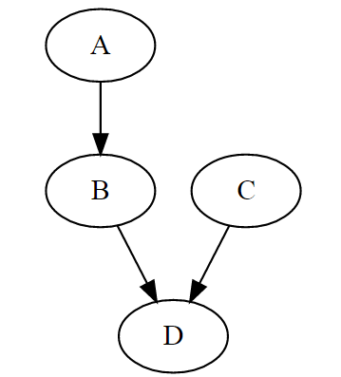
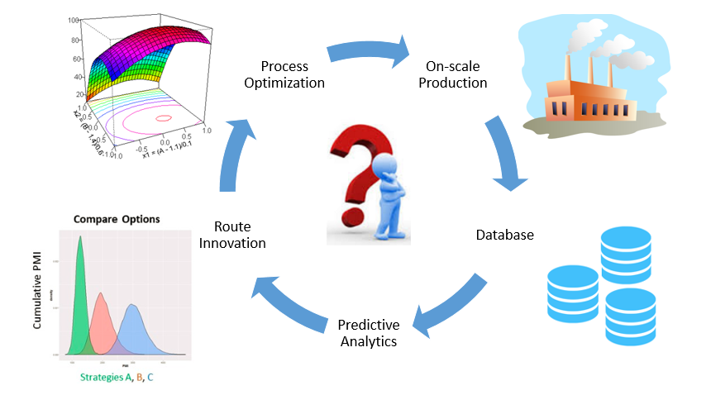
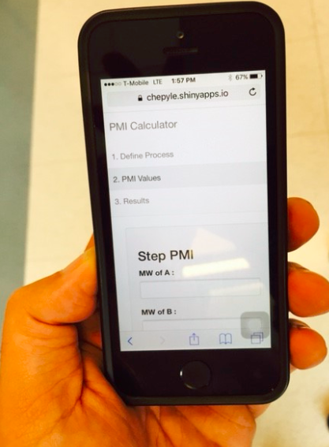
Data-driven Greenness Design to Decision-making
Web-based app, which calculates cumulative PMI for an arbitrary synthetic sequence
Improved decisions at the point of genesis of a synthesis
Ref: Version under development publicly available online: 1) https://acsgcipr-predictpmi.shinyapps.io/pmi_calculator/

Slide 14













Acknowledgement
BMS team:
Ron Behling
Alina Borovika
Victor Hung
Elias Mattas
Melanie Miller
Eric Simmons
Dan Treitler
Srinivas Tummala
ACS GCI Pharma roundtable team:
Barry Dillon
Jim Gage
Fabrice Gallou
Stefan Koenig
Mike Kopach
David Leahy
Isamir Martinez
Jared Piper
Frank Roschangar
Ed Sherer
Sankaran Vaidheeswaran
Consulting:
Andy Wells

