Slide 1


Common Cloud Operations in Microsoft Azure and AWS
Tim Warner

Slide 2
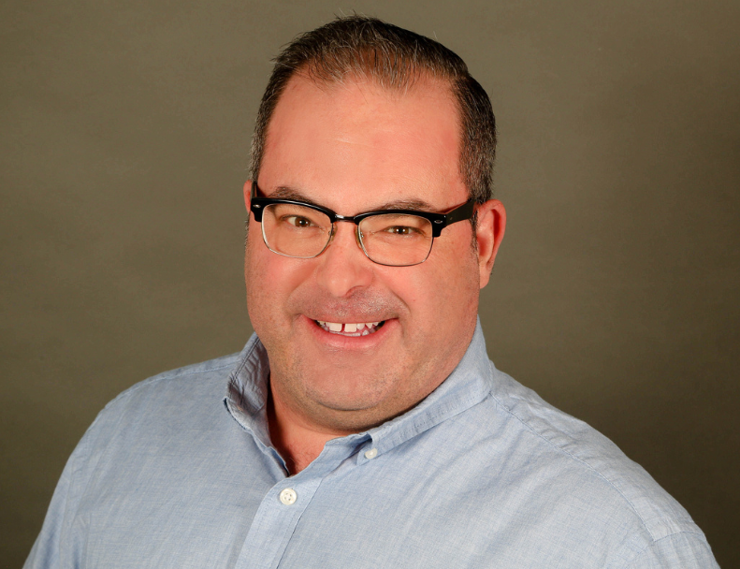


Tim Warner
Based in Nashville, TN, US
MCT, MVP
Twitter: @TechTrainerTim
Badge: TechTrainerTim.com

Slide 3
Session 1 of 2 Learning Goals
Introduction
General comparisons
Storage
Compute

Slide 4
Session 2 of 2 Learning Goals
Networking
Security
Monitoring
Pricing

Slide 5
Course Materials
timw.info/azureaws

Slide 6
Setting Expectations
10-minute break at midpoint
Please ask/answer questions and provide feedback in the Q/A panel, not the group chat
I'll post outstanding questions/answers to my Twitter feed: @TechTrainerTim

Slide 7
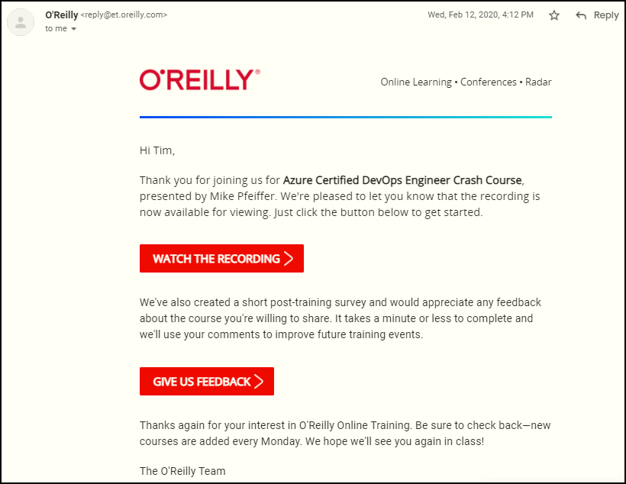
Session Recordings

Slide 8
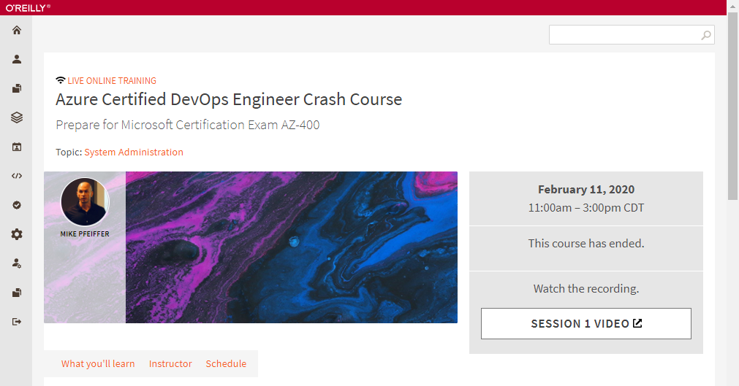
Session Recordings

Slide 9
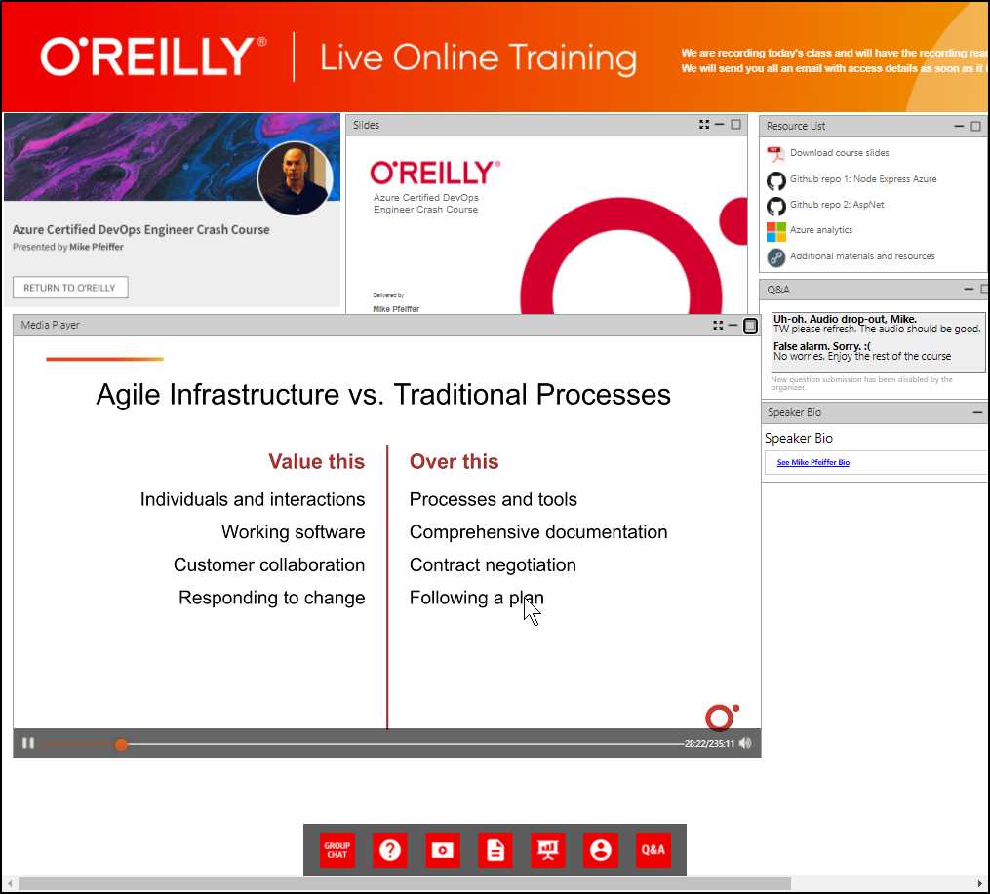
Session Recordings

Slide 10
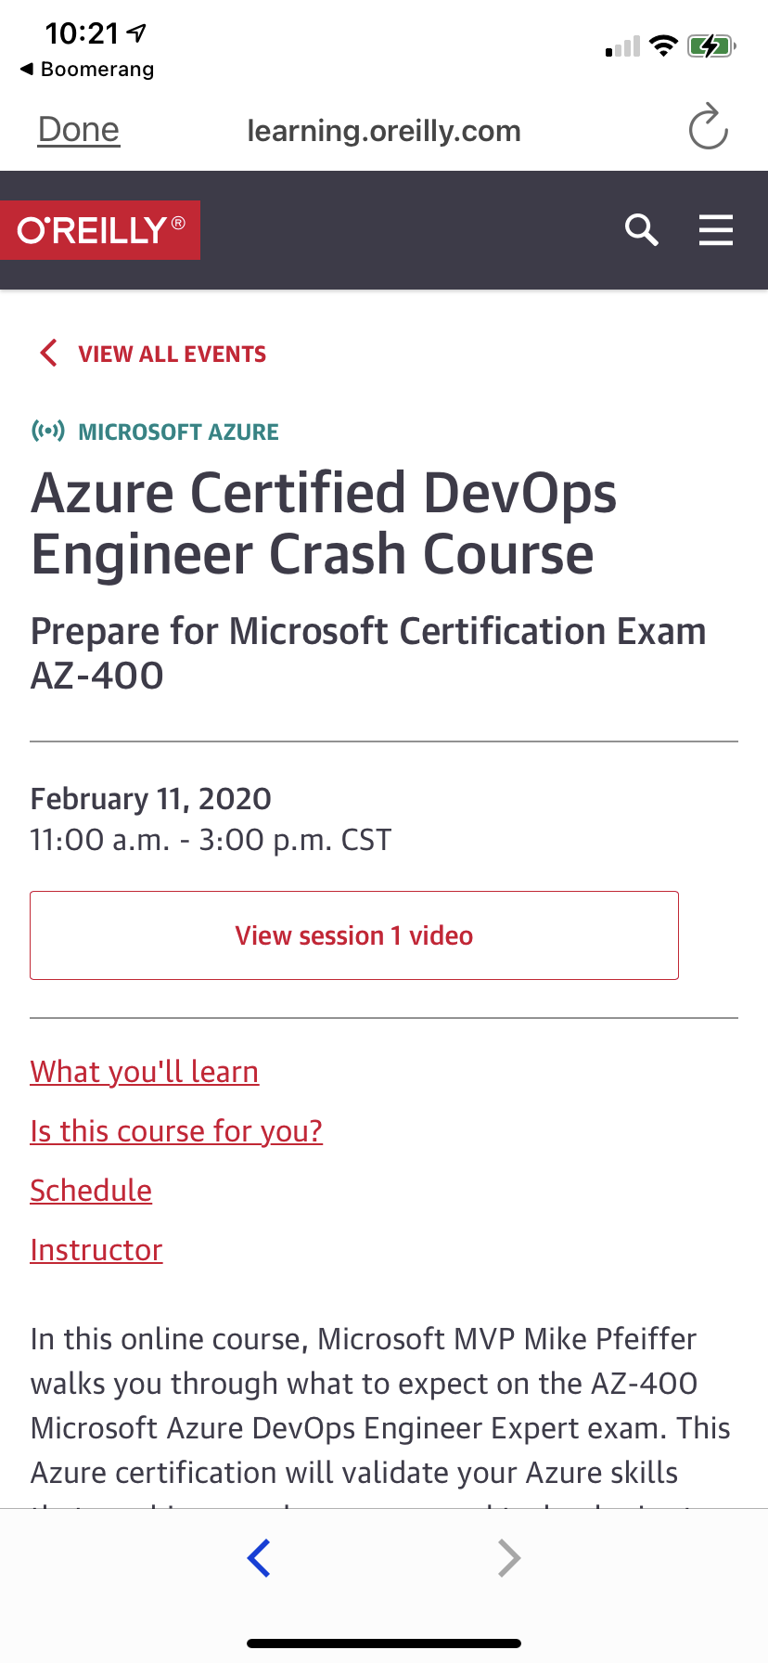
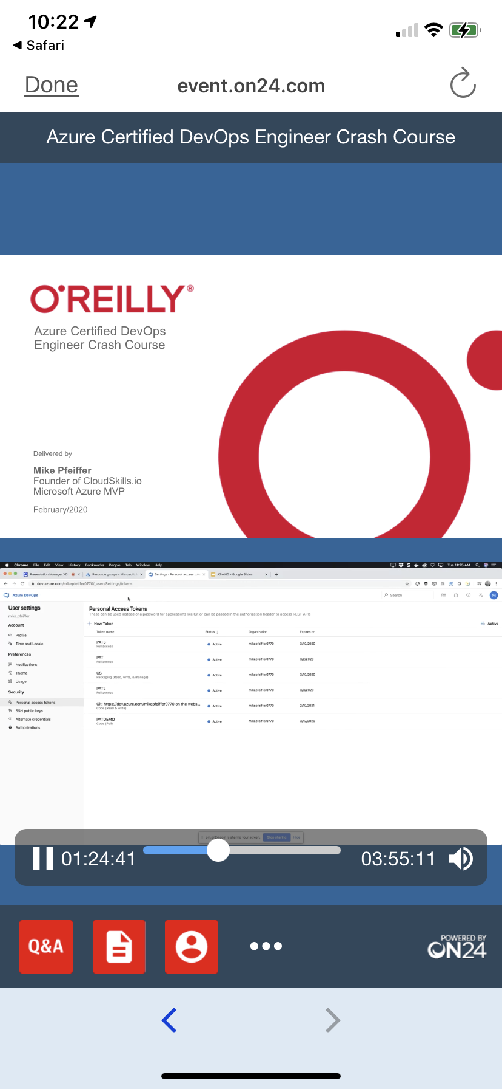
Session Recordings

Slide 11
Thank you!
Course materials: timw.info/az400
Twitter: @TechTrainerTim
Work: timw.info/ps
Web: TechTrainerTim.com

Slide 12
Title

Slide 13
Title

Slide 14
Title

Slide 15
Title

Slide 16
Title

Slide 17
Title

Slide 18
Title

Slide 19
Title

Slide 20
Title

Slide 21
Title

Slide 22
Title

Slide 23
Title

Slide 24
Title

Slide 25
Title

