Slide 1


Common Cloud Operations in Microsoft Azure and AWS
Tim Warner

Slide 2
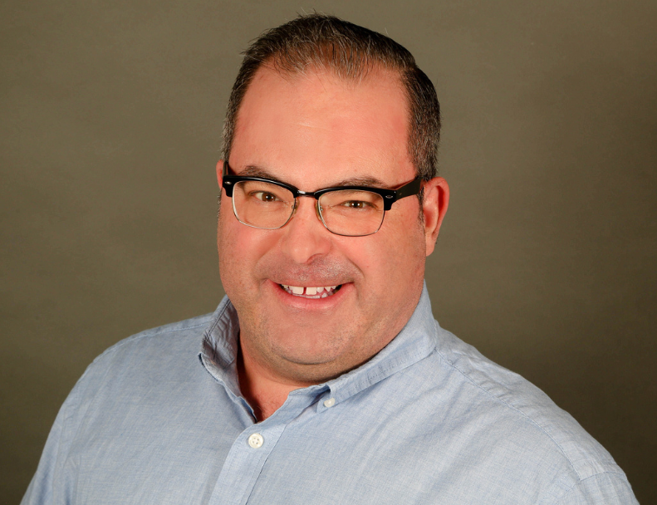


Tim Warner
Based in Nashville, TN, US
MCT, MVP
Twitter: @TechTrainerTim
Badge: TechTrainerTim.com

Slide 3
Session 1 of 2 Learning Goals
sadf

Slide 4
Session 2 of 2 Learning Goals
asdf

Slide 5
Course Materials
timw.info/azureaws

Slide 6
Setting Expectations
10-minute break at midpoint
Please ask/answer questions and provide feedback in the Q/A panel, not the group chat
I'll post outstanding questions/answers to my Twitter feed: @TechTrainerTim

Slide 7
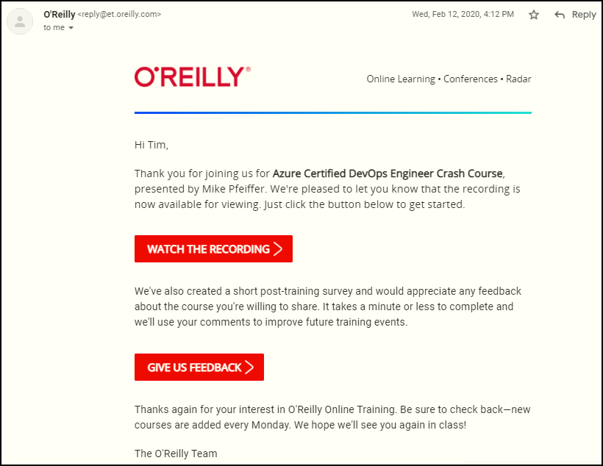
Session Recordings

Slide 8
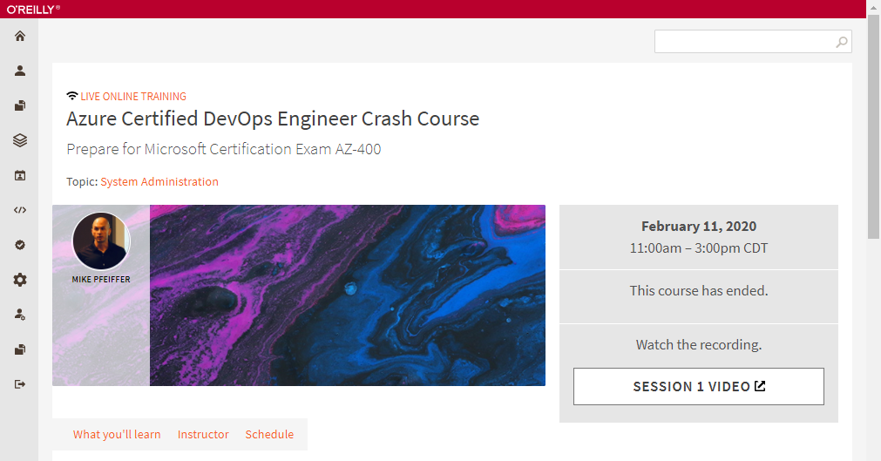
Session Recordings

Slide 9
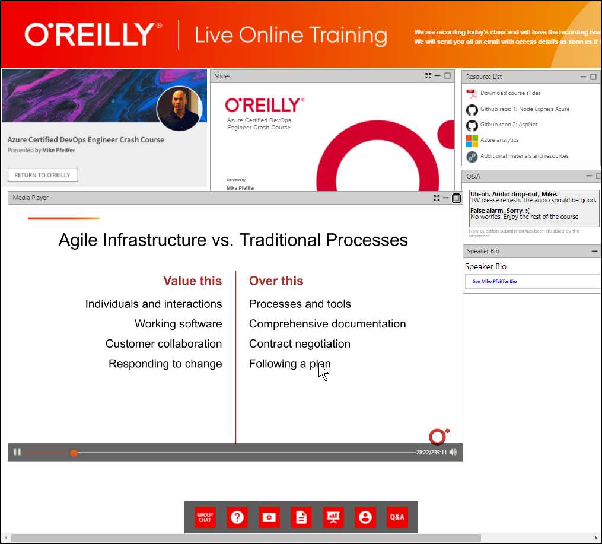
Session Recordings

Slide 10
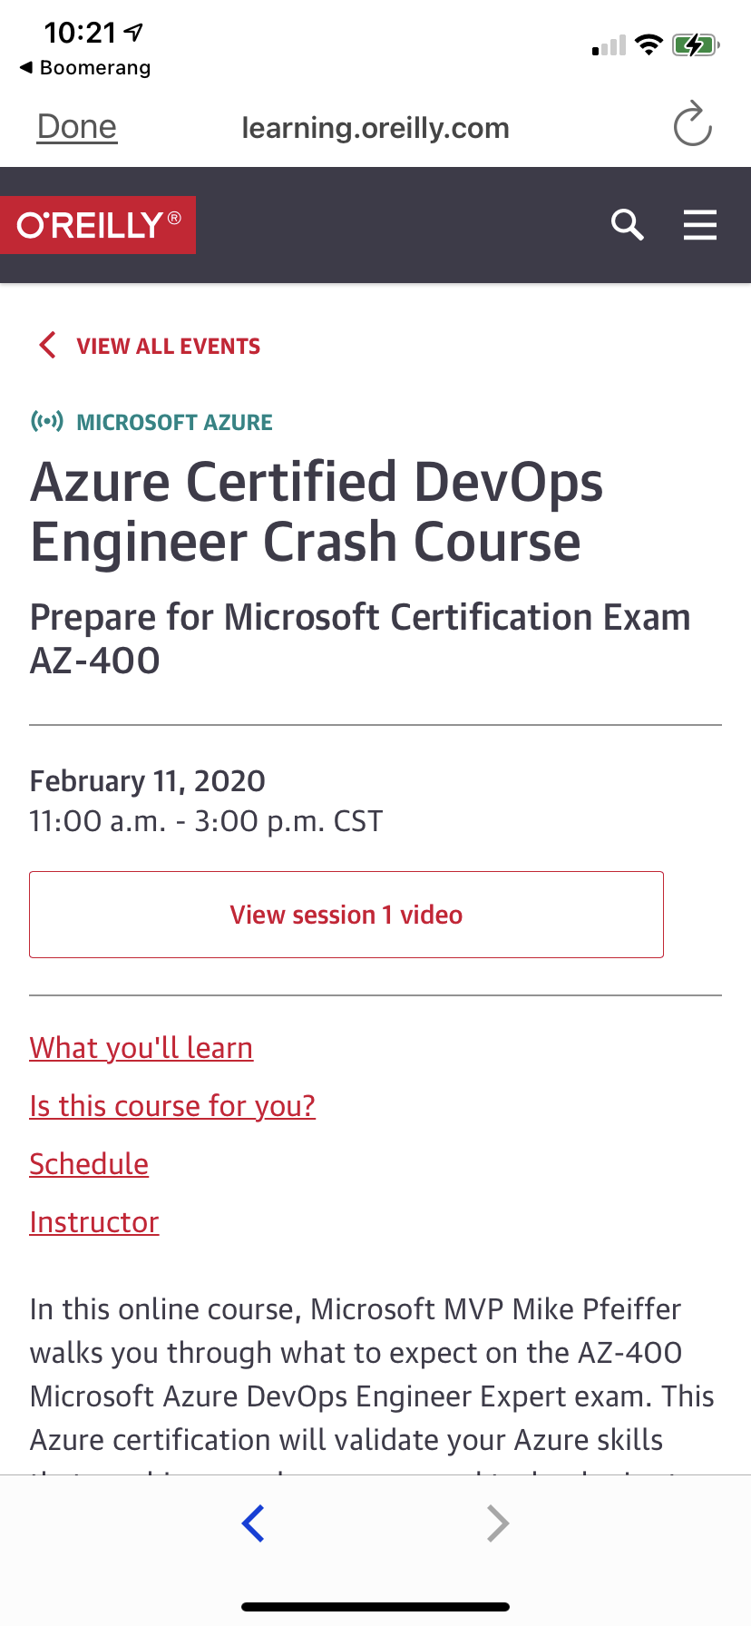
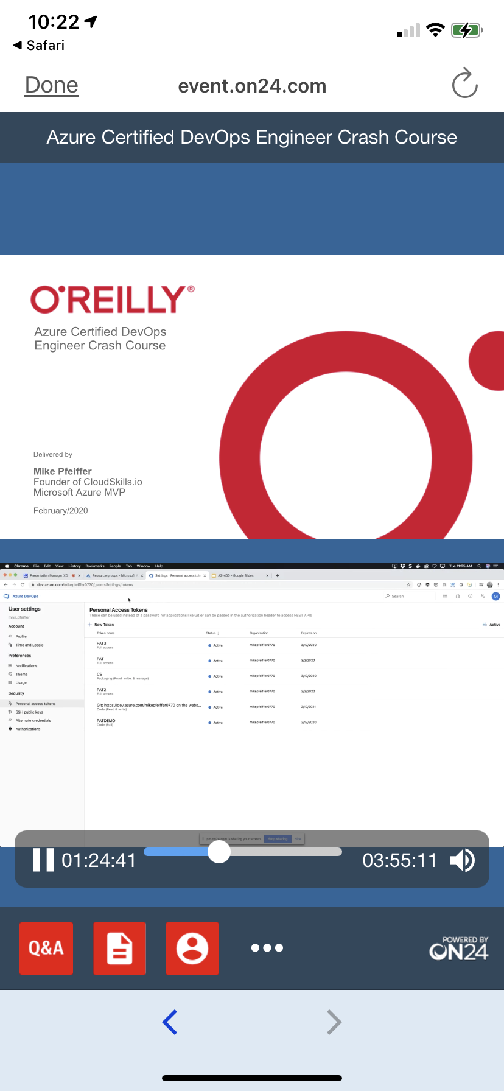
Session Recordings

Slide 11
Thank you!
Course materials: timw.info/az400
Twitter: @TechTrainerTim
Work: timw.info/ps
Web: TechTrainerTim.com

Slide 12
Title

Slide 13
Title

