Slide 1
IBM University Engagement Project Submission
Syllabus & Curriculum Design Optimizer — Problem Statement #14

Slide 2

Project Title – Syllabus & Curriculum Design Optimizer
Domain of Project – Education / Academic Curriculum
Student Name | Recent Passport Photo | Email ID | Mobile number [WhatsApp]
Rishav Raj |  | rajaicte5431@gmail.com | 9430604257 (WhatsApp)

Slide 3
Problem Statement #14 -
Problem Statement : Syllabus & Curriculum Design Optimizer
The Challenge
Faculty and academic institutions struggle to design high-quality, standards-aligned syllabi. Course content often lacks measurable learning outcomes, modern resources, and alignment with accreditation bodies like ABET, NAAC, and NBA. Manual curriculum design is time-consuming and inconsistent, leading to courses that do not fully meet regulatory or academic quality requirements.
The Objective
Build an AI-powered Syllabus & Curriculum Design Optimizer that assists faculty in:
• Analyzing existing syllabi — identifying strengths, gaps, and improvement areas
• Generating new syllabi from scratch — complete with weekly schedule and assessments
• Mapping learning outcomes — to Bloom's Taxonomy and ABET/NAAC/NBA standards
• Recommending resources — curated textbooks, research articles, and online platforms
• Checking accreditation compliance — with detailed per-criterion compliance reports
• Optimizing syllabi — AI-driven rewrites with a full change-log of improvements

Slide 4
Proposed Solution -
Proposed Solution: AI-Powered Syllabus & Curriculum Design Optimizer
The proposed solution is a FastAPI-based web application powered by IBM Granite (ibm/granite-13b-instruct-v2) on IBM watsonx.ai (Cloud Lite). It provides faculty and academic institutions with six AI-driven tools to design, analyze, and improve course syllabi through a clean, browser-based interface.
The backend is built in Python using FastAPI with the ibm-watsonx-ai SDK. A prompt engineering layer (agent.py) constructs task-specific prompts for each curriculum tool. IBM Granite processes these prompts and returns structured, formatted Markdown responses ready for faculty use.
Six core AI tools:
• Analyze Syllabus — Detects strengths, gaps, and gives recommendations aligned with accreditation standards
• Generate Syllabus — Creates a full syllabus: description, outcomes, weekly schedule, assessments, resources
• Map Learning Outcomes — Maps outcomes to Bloom's Taxonomy levels and ABET/NAAC/NBA criteria in a table
• Recommend Resources — Curates textbooks, peer-reviewed articles, MOOCs, and IBM Skills Network labs
• Check Accreditation — Produces a per-criterion compliance score (0–100%) with gaps and action steps
• Optimize Syllabus — Rewrites and improves the syllabus with a detailed change-log of every modification
The frontend is a responsive single-page application served by FastAPI, featuring drag-and-drop file upload (PDF, DOCX, TXT), interactive tag selectors, real-time loading spinners, and copy-to-clipboard output. A demo mode with realistic mock responses makes the full app usable without live IBM credentials.

Slide 5
Technology Used
IBM Granite Model — ibm/granite-13b-instruct-v2
Core LLM for natural language understanding, prompt-based curriculum generation, analysis, and recommendations. Deployed via IBM watsonx.ai Cloud Lite.
IBM watsonx.ai (Cloud Lite)
Secure, scalable cloud platform for deploying and managing the Granite model. Provides REST API access via the ibm-watsonx-ai Python SDK. No credit card required.
FastAPI (Python 3.11+)
High-performance ASGI web framework powering the REST API backend. Serves all 8 endpoints including file upload and AI inference routes. Interactive docs at /docs.
Python Libraries
• pypdf — PDF text extraction • python-docx — DOCX parsing
• pydantic-settings — .env configuration • uvicorn — ASGI server
• aiofiles — async file I/O • httpx — async HTTP client
Vanilla HTML / CSS / JavaScript (Single-Page Frontend)
Served by FastAPI. Includes drag-and-drop file upload, tag selectors, real-time loading spinners, sidebar navigation, and clipboard copy — zero external dependencies.

Slide 6
Key Application Components Used
1) main.py — FastAPI app entry point; registers all routes under /api, enables CORS middleware, ensures uploads/ directory exists, and serves static/index.html at /
2) app/agent.py — AI orchestrator; builds six task-specific prompts and calls IBM Granite via granite_client.py. One function per tool: analyze_syllabus, generate_syllabus, map_outcomes, recommend_resources, check_accreditation, optimize_syllabus
3) app/granite_client.py — IBM Granite API wrapper using ibm-watsonx-ai SDK. Sends prompts to ibm/granite-13b-instruct-v2 with temperature=0.7, top_p=0.95, max_new_tokens=2048. Falls back to mock responses if credentials are missing.
4) app/api/routes.py — Defines 8 FastAPI endpoints: GET /health, POST /upload-syllabus, POST /analyze, POST /generate, POST /map-outcomes, POST /recommend-resources, POST /check-accreditation, POST /optimize
5) app/file_parser.py — Text extraction from uploaded files: PDF (pypdf), DOCX (python-docx), TXT (UTF-8 decode). Raises ValueError for unsupported formats.
6) app/schemas.py + app/config.py — Pydantic v2 request/response models for all endpoints; pydantic-settings reads IBM credentials and app settings from .env file
7) static/index.html — ~900-line single-page frontend: sidebar nav, 6 AI tool panels, drag-and-drop upload, tag selectors, real-time spinners, and clipboard copy

Slide 7

Application Workflow
User (Browser) → static/index.html → HTTP POST /api/<endpoint>
→ FastAPI routes.py → agent.py (prompt builder)
→ granite_client.py → IBM Granite (ibm/granite-13b-instruct-v2) on IBM watsonx.ai
→ AI Response → AIResponse schema → JSON back to frontend → Displayed in result box
File Upload Flow:
User uploads PDF/DOCX/TXT → POST /api/upload-syllabus
→ file_parser.py (pypdf / python-docx) → extracted text → returned to textarea → user submits to any AI tool
Config Flow:
.env file → pydantic-settings (config.py) → Settings singleton → consumed by granite_client.py and routes.py

Slide 8
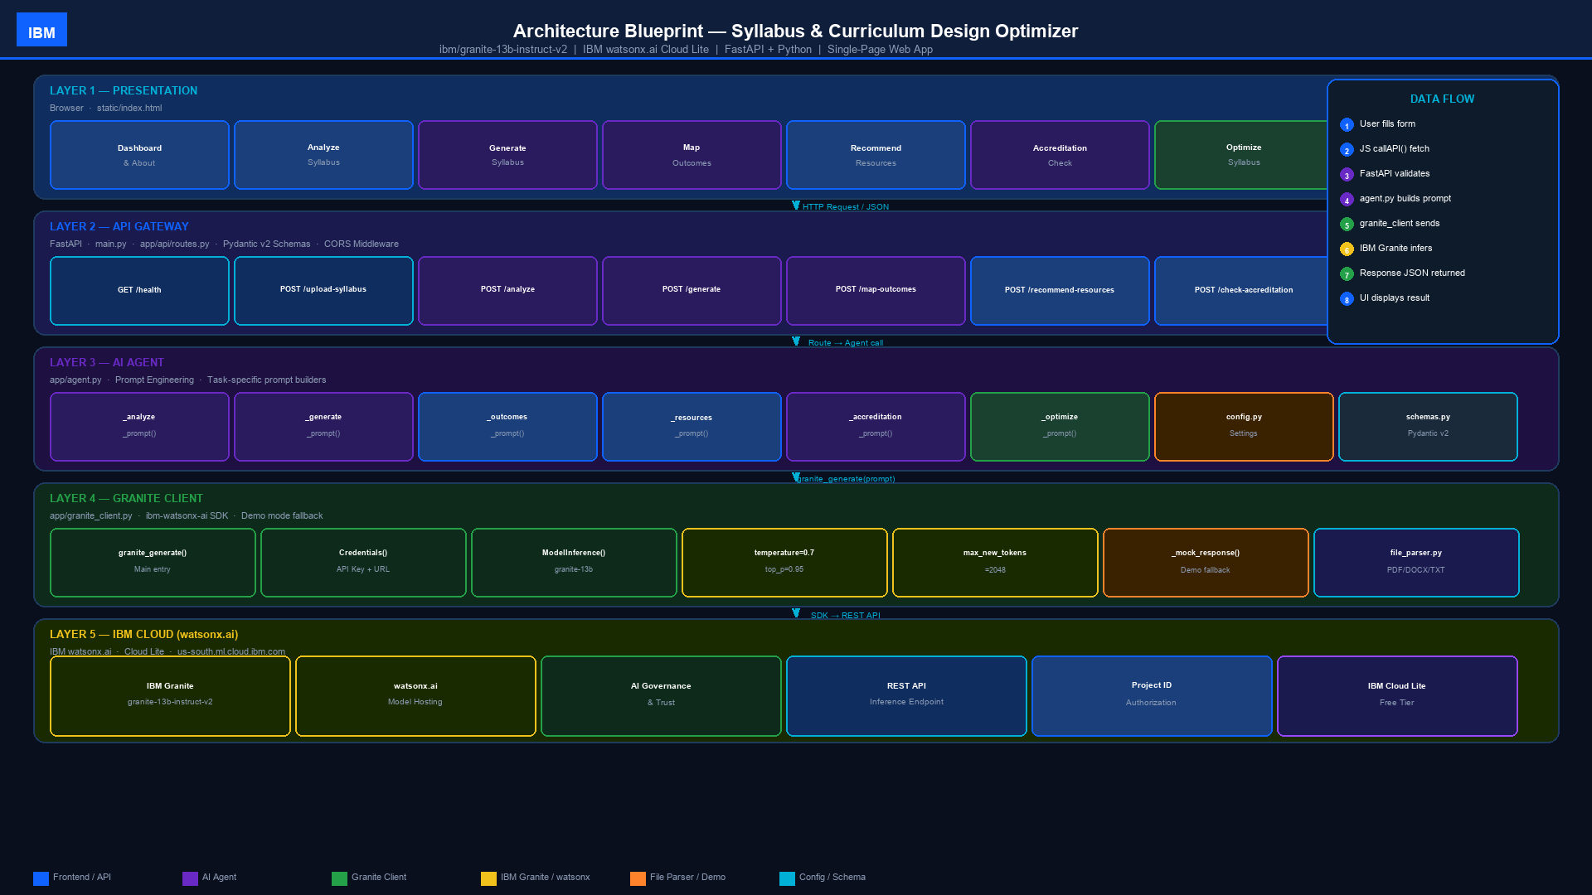
Architecture Blueprint — System Design Diagram

Slide 9

Role of IBM Granite AI in the Solution
IBM Granite as the Intelligence Core
IBM Granite (ibm/granite-13b-instruct-v2) is the intelligence core of the Syllabus & Curriculum Design Optimizer. It drives all six AI-powered curriculum tools through structured, task-specific prompt engineering — no fine-tuning required.
Prompt-Driven Task Execution — Each tool in agent.py constructs a detailed system-level prompt tailored to the specific curriculum task. Granite returns structured Markdown responses (tables, bullet lists, headers) immediately usable by faculty without post-processing.
Domain Expertise via Instruction-Tuned Model — The granite-13b-instruct-v2 model understands academic vocabulary, Bloom's Taxonomy levels, accreditation frameworks (ABET, NAAC, NBA), and curriculum design best practices.
Configurable Inference Parameters — temperature=0.7, top_p=0.95, max_new_tokens=2048 are all exposed via .env, enabling educators to tune creativity vs. precision.
Resilience via Demo Mode — When IBM credentials are absent, granite_client.py returns realistic structured mock responses, enabling full evaluation of all six tools without live API access.
Governance-Ready — Running on IBM watsonx.ai (Cloud Lite) provides IBM AI governance, audit logging, and enterprise-grade security.

Slide 10


Token Usage
~2,048 max tokens per request (configurable via GRANITE_MAX_TOKENS in .env)
Before Prompt
After the Prompt
·
·
·

Slide 11
Novelty and Uniqueness
The Syllabus & Curriculum Design Optimizer stands out by combining IBM Granite's instruction-following power with an educator-first design and instant accreditation alignment.
Six Specialized AI Tools in One Platform — Each tool has a purpose-built prompt with structured output: analysis report, full syllabus, Bloom's table, resource list, compliance score, and an optimized rewrite.
Accreditation-Native Design — The only curriculum tool designed from the ground up to align with ABET, NAAC, and NBA simultaneously, making it globally relevant for institutions worldwide.
Prompt Engineering as Curriculum Expertise — The agent.py layer encodes curriculum design best practices (Bloom's Taxonomy, assessment types, weekly scheduling) directly into prompts — no fine-tuning or training required.
Zero-Dependency Demo Mode — The app runs fully offline with realistic mock responses from granite_client.py, enabling evaluation and demonstration without any cloud credentials.
Drag-and-Drop Multi-Format Input — Faculty upload real syllabi as PDF, DOCX, or TXT and immediately feed them to any of the six AI tools with zero copy-paste effort.

Slide 12
GitHub Repository Link
Please create a public GitHub repository and paste your working URL below.
Repository must contain the following files:
1) app.json — IBM Cloud deployment manifest
2) problem_statement_14.pdf — problem statement document
3) Syllabus_Curriculum_Optimizer_Presentation.pptx — this presentation file
4) All project source files: main.py, requirements.txt, env.txt, README.md, app/ folder, static/ folder
GitHub URL: _______________________________________________
Project folder structure: Project/ > main.py | app/ | static/ | uploads/ | requirements.txt | env.txt | README.md
Run locally: pip install -r requirements.txt then python main.py → open http://localhost:8000
Interactive API docs available at http://localhost:8000/docs (Swagger UI)

Slide 13
Future Scope
Integration with LMS & University Platforms –
The system can be integrated with learning management systems (Canvas, Moodle, Blackboard) to automatically ingest course schedules, syllabus templates, and grading rubrics. This enables real-time curriculum sync and historical course alignment.
2. Automated Accrediting Body Compliance –
Automating end-to-end evaluation against global standards (such as ABET, NBA, and NAAC) through AI-driven Course Learning Outcome (CLO) to Program Outcome (PO) mapping, streamlining institutional accreditation audits.
3. Direct IBM SkillsBuild & Credential Integration –
Embedding live IBM credentialing pathways directly into syllabus topics, recommending verified certifications and hands-on lab modules to boost student employability.
.

Slide 14
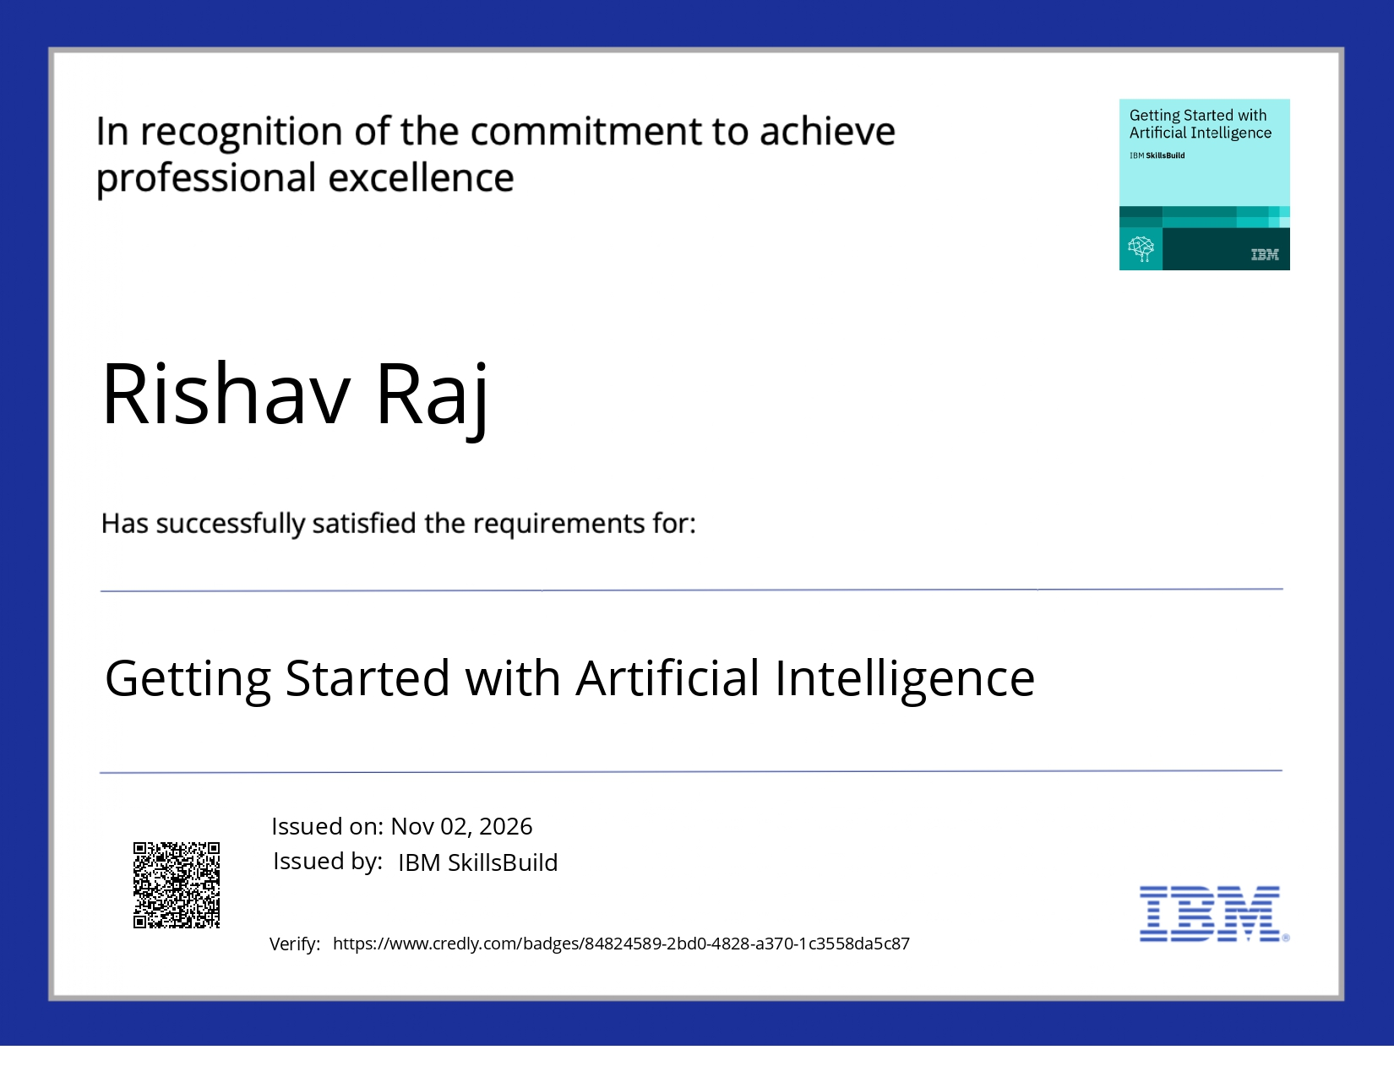
Certificates Earned:
Please add your credly certificate

Slide 15

Certificates Earned:​
Add your IBM BOB Certificate

Slide 16


