Slide 1

SonarQube
Notes:
Business Objective / Project Scope :
1. Provide information about what is the Business Objective of project which includes scope
2. What is written in SOW for this project.
3. What is customer expectation from us.
4. What customer wants/told you.

Slide 2
SonarQube
Introduction of SonarQube
SonarQube is a free and open source code quality measuring and management tool.
Developed using java and maintained by sonar source.
You can download SonarQube, install locally and use it as it is, or else you can develop a customized version by specifying your own rules.
SonarQube can be downloaded through below URL:
https://sonarsource.bintray.com/Distribution/sonarqube/
Notes:
Business Objective / Project Scope :
1. Provide information about what is the Business Objective of project which includes scope
2. What is written in SOW for this project.
3. What is customer expectation from us.
4. What customer wants/told you.

Slide 3
SonarQube
Why SonarQube?
A platform to manage code quality.
Free, Open Source, LGPL, web based portal.
Backed by Sonarsource.
Agreegates well known tools:
Static Analysis (PMD, findbugs, Checkstyle, ReSharper and Fxcop)
Duplicate Code (CPD, SQUID)
Code Coverage (Cobertura, JaCoCo)
Notes:
Business Objective / Project Scope :
1. Provide information about what is the Business Objective of project which includes scope
2. What is written in SOW for this project.
3. What is customer expectation from us.
4. What customer wants/told you.

Slide 4
SonarQube
End Users of SonarQube
Developers:
SonarQube assists not only to improve the code quality but also to improve the coding skills of developers.
It provides a vast knowledge about the coding standards, best practices and etc.
Technical Management:
SonarQube can be configured with version control system to track down the code changes along with developers who made those changes.
This is useful to identify which developers need more training in the team’s coding practices.
Non Technical Management:
Technical debt is important to non technical and financial people.
Technical management wants to see how measurable code quality going on.
Notes:
Business Objective / Project Scope :
1. Provide information about what is the Business Objective of project which includes scope
2. What is written in SOW for this project.
3. What is customer expectation from us.
4. What customer wants/told you.

Slide 5
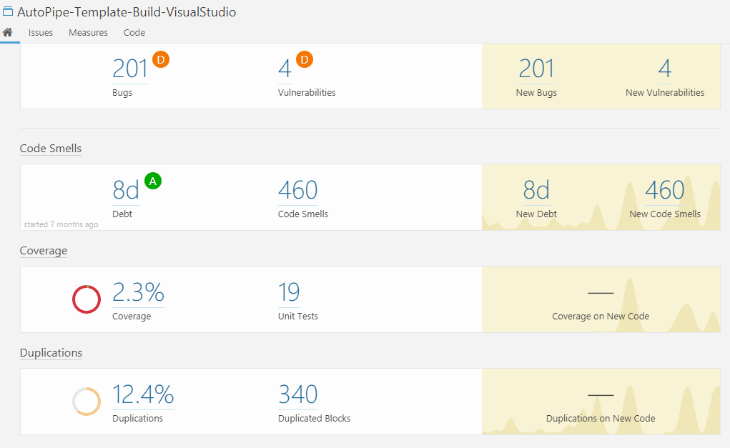
SonarQube
Sonar Portal
Notes:
Business Objective / Project Scope :
1. Provide information about what is the Business Objective of project which includes scope
2. What is written in SOW for this project.
3. What is customer expectation from us.
4. What customer wants/told you.

Slide 6
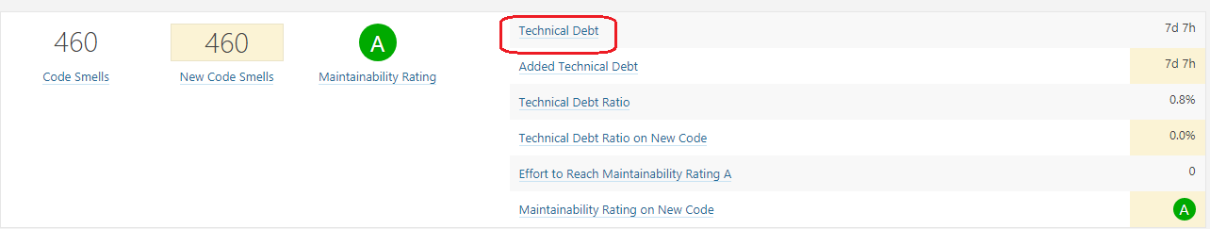
SonarQube
Technical debt (also known as design debt or code debt):
Additional rework caused by choosing an easy solution now instead of using a better approach that would take longer.
Technical debt can be compared to monetary debt.
Debt(in man days) = cost_to_fix_duplications + cost_to_fix_violations + cost_to_comment_public_API + cost_to_fix_uncovered_complexity + cost_to_bring_complexity_below_threshold
Notes:
Business Objective / Project Scope :
1. Provide information about what is the Business Objective of project which includes scope
2. What is written in SOW for this project.
3. What is customer expectation from us.
4. What customer wants/told you.

Slide 7
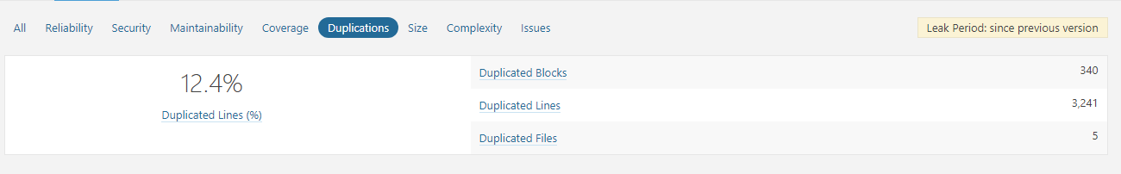
SonarQube
Duplications:
It is the worst one and easiest to make. All developers do code duplications. So they duplicate complexity, lack of unit test coverage and bugs.
Notes:
Business Objective / Project Scope :
1. Provide information about what is the Business Objective of project which includes scope
2. What is written in SOW for this project.
3. What is customer expectation from us.
4. What customer wants/told you.

Slide 8
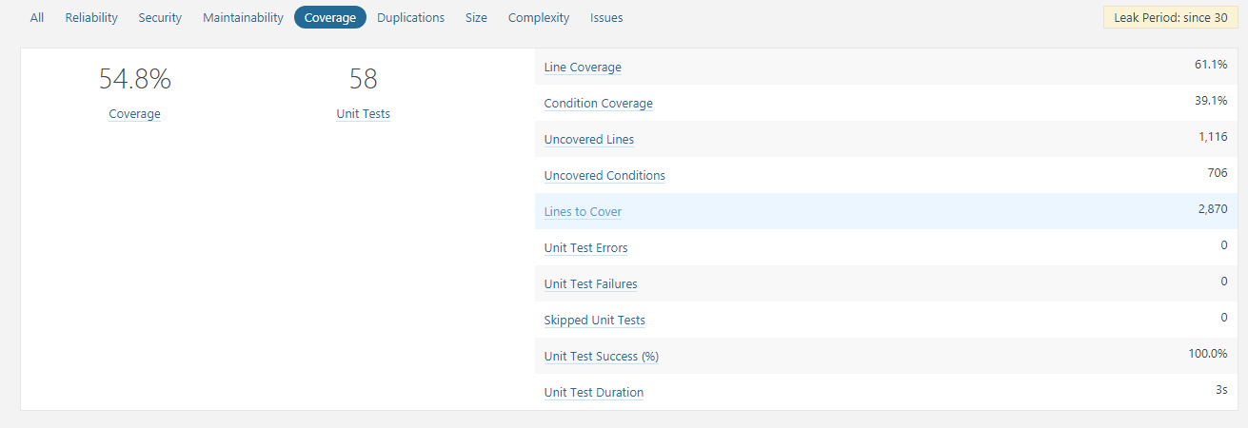
SonarQube
Unit Tests:
They not only provide unit test coverage but also integration test coverage.
Notes:
Business Objective / Project Scope :
1. Provide information about what is the Business Objective of project which includes scope
2. What is written in SOW for this project.
3. What is customer expectation from us.
4. What customer wants/told you.

Slide 9
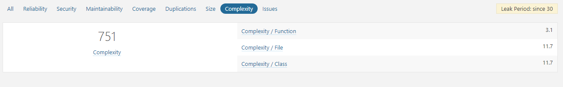
SonarQube
Bad Distribution of Complexity:
They use cyclomatic complexity and lack of cohesion of method, responsibilities for class and class coupling for calculate the complexity.
Notes:
Business Objective / Project Scope :
1. Provide information about what is the Business Objective of project which includes scope
2. What is written in SOW for this project.
3. What is customer expectation from us.
4. What customer wants/told you.

Slide 10
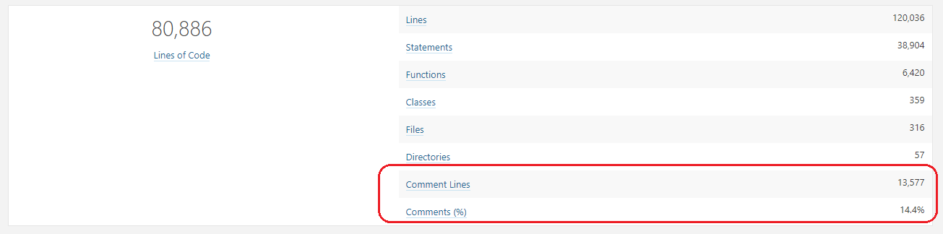
SonarQube
Not enough or Too Many Comments:
This plugin provide the amount of documentation and comments used in your project. Although comments may not be important in agile development, there may be projects which need thorough documentation.
Notes:
Business Objective / Project Scope :
1. Provide information about what is the Business Objective of project which includes scope
2. What is written in SOW for this project.
3. What is customer expectation from us.
4. What customer wants/told you.

Slide 11
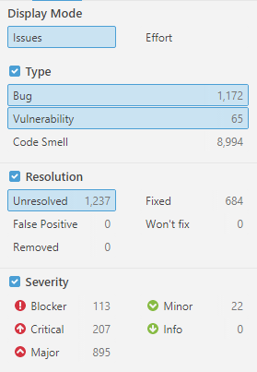
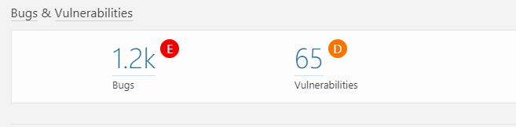
SonarQube
Bugs and Potential Bugs/ Coding Standards Breach:
This plugin shows a summary of coding rule violations which you can drill down to find out further details.
Notes:
Business Objective / Project Scope :
1. Provide information about what is the Business Objective of project which includes scope
2. What is written in SOW for this project.
3. What is customer expectation from us.
4. What customer wants/told you.

Slide 12

SonarQube
Notes:
Business Objective / Project Scope :
1. Provide information about what is the Business Objective of project which includes scope
2. What is written in SOW for this project.
3. What is customer expectation from us.
4. What customer wants/told you.

Slide 13

SonarQube
Notes:
Business Objective / Project Scope :
1. Provide information about what is the Business Objective of project which includes scope
2. What is written in SOW for this project.
3. What is customer expectation from us.
4. What customer wants/told you.

Slide 14

SonarQube
Notes:
Business Objective / Project Scope :
1. Provide information about what is the Business Objective of project which includes scope
2. What is written in SOW for this project.
3. What is customer expectation from us.
4. What customer wants/told you.

