Slide 1


FINAL YEAR PROJECT · PANEL DEFENSE
Advanced Subscription &
Membership Platform
Per-creator digital memberships with Clerk, PostgreSQL, Stripe Checkout, and Cloudflare R2.
Raja Irfan Ahmed
Live demo: localhost:3000
Notes:
Name the stack once. Do not call it a marketplace or a Connect payout product. Do not say Nexora.

Slide 2
SLIDE 2 · PROBLEM & IDEA
What the platform is
Creators publish video, articles, and files (PDF / ZIP / RAR).
Subscribers follow a creator for free, or pay that creator for Basic or Premium.
Access is per (subscriber, creator) pair — not one site-wide plan.
Recurring billing is monthly Stripe Checkout on the platform Stripe account.
Do not claim on the panel
Creators do not get Stripe Connect payouts. Checkout does not split funds. platform_fee_bps is stored on settings (default 10000) but is not used to take a Connect commission.
Advanced Subscription & Membership Platform · FYP Panel Defense
2 / 32

Slide 3
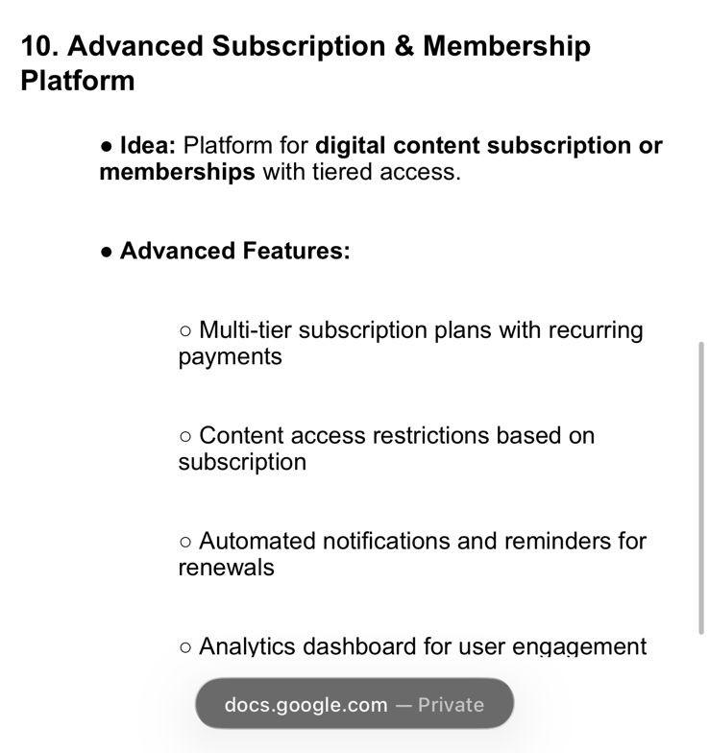
SLIDE 3 · ASSIGNED FEATURES
Objectives → what you can demo
# | Objective | Live proof
1 | Multi-tier + recurring pay | Basic $19 / Premium $49 · Stripe Checkout
2 | Access by subscription | Free plays; Basic 403 until Checkout
3 | Renewal reminders | invoice.upcoming + cron (default 7 days)
4 | Analytics dashboards | Creator + admin + daily rollup
Advanced Subscription & Membership Platform · FYP Panel Defense
3 / 32

Slide 4
SLIDE 4
Scope — honest
Built
Do not claim
Next.js 15.3 App Router, React 19, TypeScript
Clerk v7 (email/password, Google, reset, verify)
PostgreSQL (pg pool, max 10 connections)
Stripe Checkout + Portal + signed webhooks
Cloudflare R2 PutObject (server-side, no client presign)
59 App Router API route handlers
Postgres Row Level Security (RLS) — not in schema.sql
Stripe Connect / connected accounts
MongoDB as the runtime database
Redis / clustered rate limiting
Admin as a public signup role
Advanced Subscription & Membership Platform · FYP Panel Defense
4 / 32

Slide 5
SLIDE 5
Stack as shipped (package.json 1.0.0)
Layer | Package / system
App | next ^15.3.1 · react ^19.1.0
Auth | @clerk/nextjs ^7.3.0
Data | pg ^8.11.5 · DB AdvancedSubscription_MembershipPlatform
Billing | stripe ^22.1.1
Storage | @aws-sdk/client-s3 → Cloudflare R2 region auto
UI | Tailwind CSS 4 · Framer Motion · Lenis
Folder name | src/lib/mongodb/ is a PostgreSQL adapter, not Mongo
Env the panel may ask: DATABASE_URL · ADMIN_EMAILS · STRIPE_* · CLOUDFLARE_R2_* · CRON_SECRET · NEXT_PUBLIC_APP_URL
Advanced Subscription & Membership Platform · FYP Panel Defense
5 / 32

Slide 6
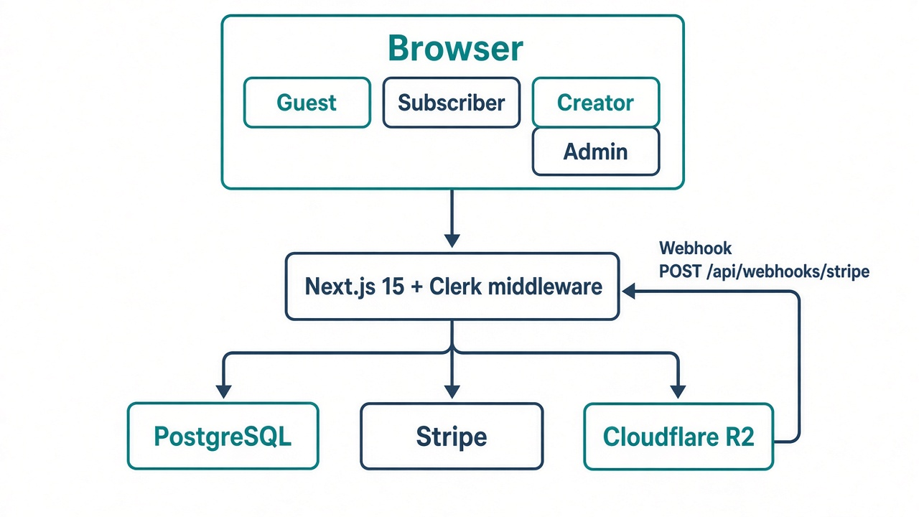
SLIDE 6 · ARCHITECTURE
Request path
Advanced Subscription & Membership Platform · FYP Panel Defense
6 / 32
Notes:
Middleware is the perimeter. Route handlers still re-check role, ownership, and ADMIN_EMAILS.

Slide 7
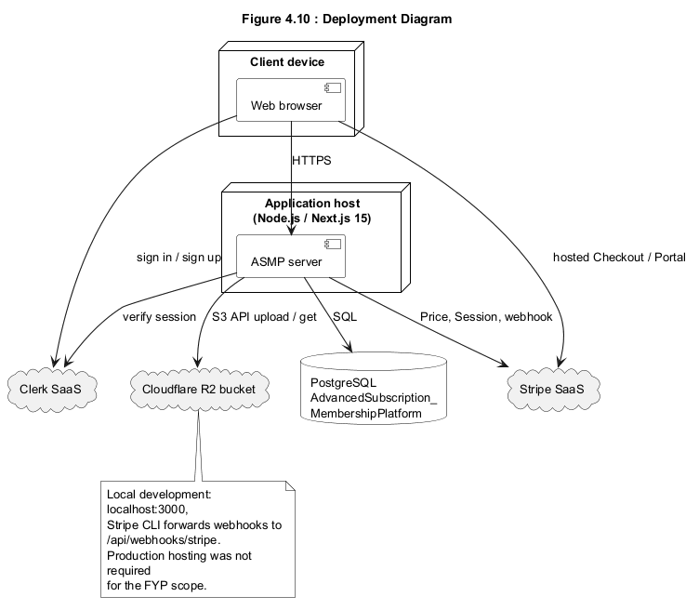
SLIDE 7 · IMAGE
Deployment (report figure 4.10)
Advanced Subscription & Membership Platform · FYP Panel Defense
7 / 32

Slide 8
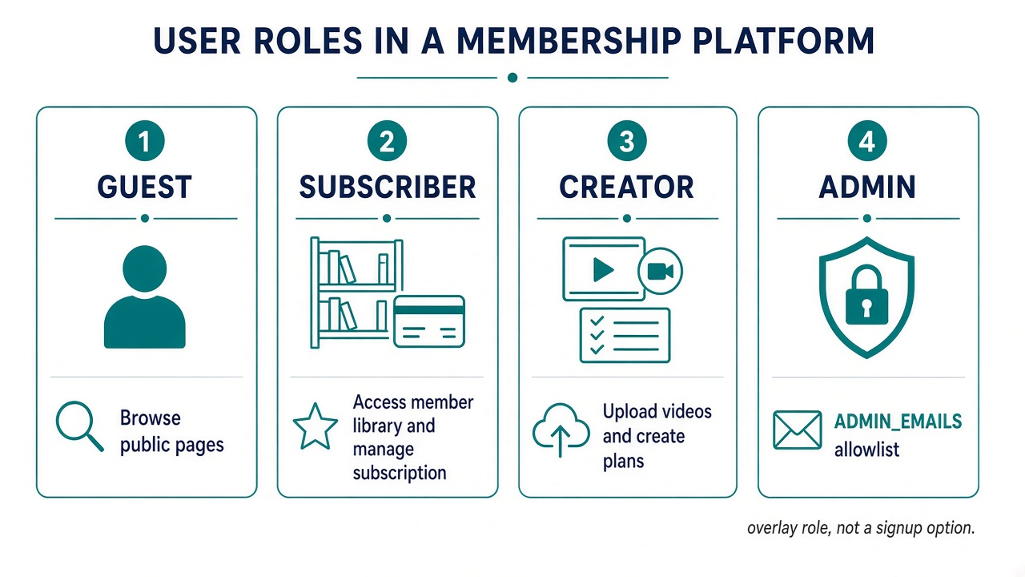
SLIDE 8
Identity model — four roles
Clerk publicMetadata.role is only subscriber | creator. Admin is an overlay: same login, email listed in ADMIN_EMAILS. Set-role never accepts “admin”.
Advanced Subscription & Membership Platform · FYP Panel Defense
8 / 32

Slide 9
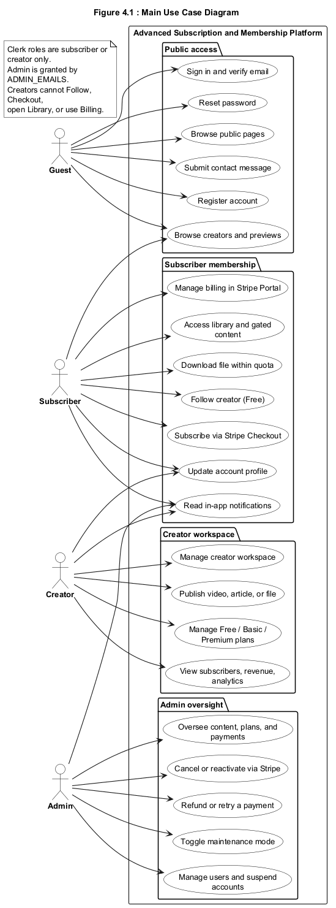
SLIDE 9 · IMAGE
Use cases by role (report figure 4.1)
Advanced Subscription & Membership Platform · FYP Panel Defense
9 / 32

Slide 10
SLIDE 10
Role 1 — Guest
Public pages: / /pricing /about /support /contact /creators /login /sign-up
Public APIs are an explicit allowlist (never /api/auth/(.*) as a glob).
Other /api/* without a session → 401 JSON { error, code: UNAUTHENTICATED }
Session pages → /login?redirect_url=…
Unknown URLs are not forced to login — they 404 on purpose.
Demo
Open /creators signed out. Click a paid item → login. Open /api/checkout in the browser → 401 JSON.
Advanced Subscription & Membership Platform · FYP Panel Defense
10 / 32

Slide 11
SLIDE 11
Role 2 — Subscriber → /library
Can
Cannot / access rules
Follow a creator free (POST /api/subscriptions) — no card
Pay Basic/Premium via POST /api/checkout
Watch GET /api/content/[id]/playback (Range stream)
Download POST /api/content/[id]/download as attachment
Billing Portal, notifications, account
Cannot upload (/api/storage/upload is creator/admin)
Cannot open /creator (middleware redirect /library)
Creators and admin overlay cannot use subscriber Checkout
Grants access: active, trialing, past_due
Denies: canceled, expired; paid period end in the past (+2 min skew)
Advanced Subscription & Membership Platform · FYP Panel Defense
11 / 32

Slide 12
SLIDE 12
Role 3 — Creator → /creator
Workspace: overview, content, plans, subscribers, revenue, analytics, settings.
Ownership: queries include creatorClerkUserId of the signed-in creator.
Default plans: Free / Basic $19 / Premium $49. Paid price $1–$9,999.
Server syncs Stripe Product/Price. Missing stripePriceId → Checkout not ready.
Upload: raw body → POST /api/storage/upload → PutObject. Caps 8 MB / 500 MB / 200 MB.
Middleware blocks /library, /subscription, /billing for creators (admins exempt).
Demo: publish a Basic video → another user sees it locked until Basic Checkout succeeds.
Advanced Subscription & Membership Platform · FYP Panel Defense
12 / 32

Slide 13
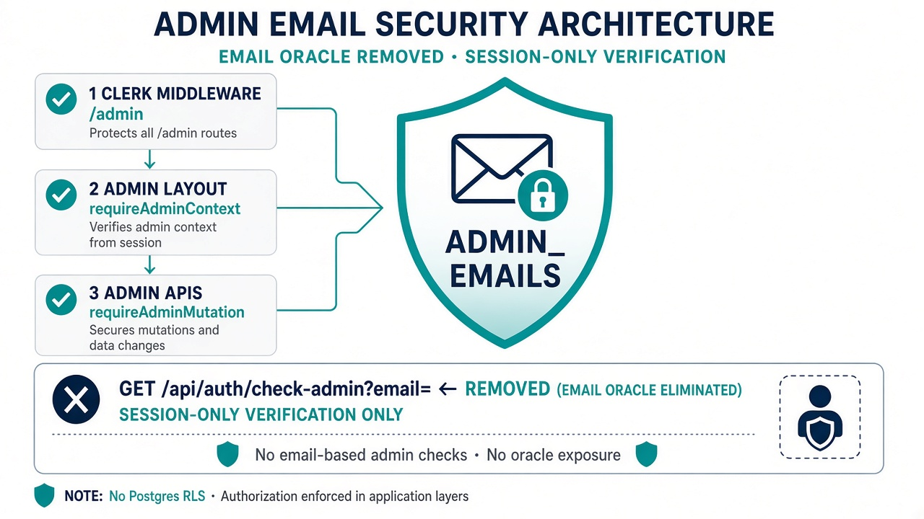
SLIDE 13
Role 4 — Admin overlay (ADMIN_EMAILS)
Comma-separated env emails, trimmed, lowercased. Not NEXT_PUBLIC_.
Three gates: middleware, admin layout requireAdminContext, every /api/admin/*.
GET /api/auth/check-admin is session-only for the caller — not an email oracle.
Mutations: 60 / 15 min. Typed phrases e.g. CANCEL NOW.
Stripe cancel fail-closed: local row unchanged if Stripe fails (502).
Advanced Subscription & Membership Platform · FYP Panel Defense
13 / 32

Slide 14
SLIDE 14
src/middleware.ts perimeter
Contact POST: 5 / 15 min per IP. Throttle API POST: 40 / 15 min.
Maintenance: public → /maintenance or API 503; admins still enter.
Public matcher first. Then session. Then role.
/admin or /api/admin/* without ADMIN_EMAILS → 403 or redirect.
/creator without creator role → /library.
Creator hitting /library /subscription /billing → /creator.
Already signed in on /login → admin /admin, creator /creator, else /library.
Advanced Subscription & Membership Platform · FYP Panel Defense
14 / 32

Slide 15
SLIDE 15 · CRITICAL
Panel Q&A — admin & RLS
Question | Exact answer
Is admin still ADMIN_EMAILS? | Yes. It is the only admin gate. Signup cannot choose admin.
Was the email oracle removed? | Yes. check-admin ignores ?email= and only reads the session user.
Is admin “session-only”? | Identity is Clerk session. Authorization is still ADMIN_EMAILS on the server.
Postgres RLS? | No. Isolation is application filters + unique indexes, not CREATE POLICY.
Advanced Subscription & Membership Platform · FYP Panel Defense
15 / 32

Slide 16
SLIDE 16
Sliding-window rate limits (in-memory)
Key | Limit | Window
auth:login:{ip} | 8 | 15 min
auth:register:{ip} | 5 | 15 min
auth:forgot-password:{ip} | 3 | 15 min
contact:{ip} | 5 | 15 min
admin-mutate:{user}:{ip} | 60 | 15 min
download:{user} / {ip} | 20 / 40 | 15 min
view:{ip}:{contentId} | 8 | 60 min
Honest limit: process-local Map. Restart resets counters. Not Redis.
Advanced Subscription & Membership Platform · FYP Panel Defense
16 / 32

Slide 17
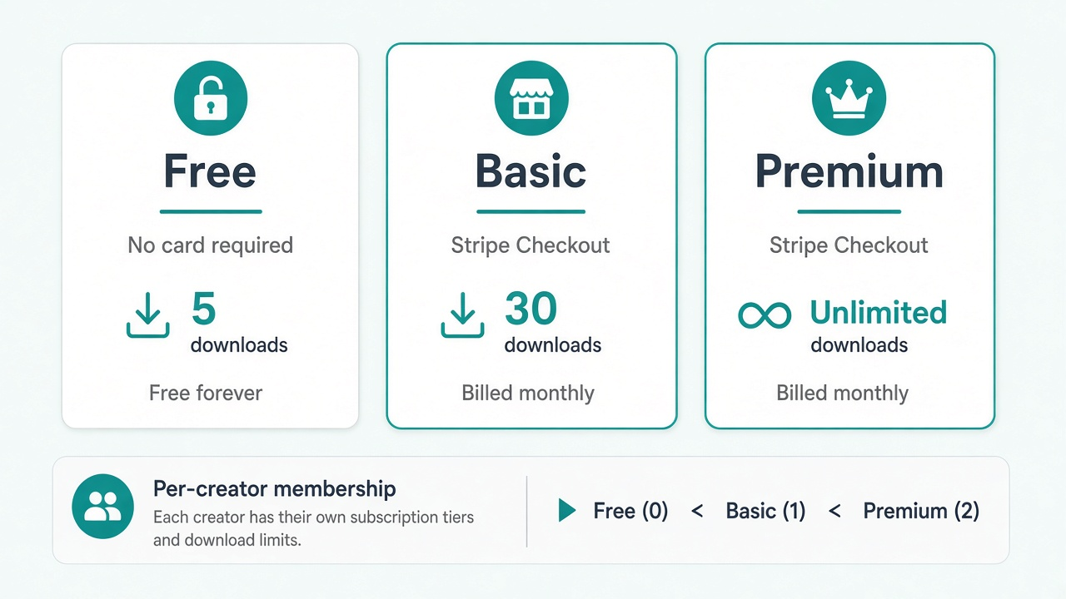
SLIDE 17
One membership per creator
Unique (subscriber, creator). Free→paid always opens hosted Checkout. In-place upgrade only if local membership is already a live paid tier.
Advanced Subscription & Membership Platform · FYP Panel Defense
17 / 32

Slide 18
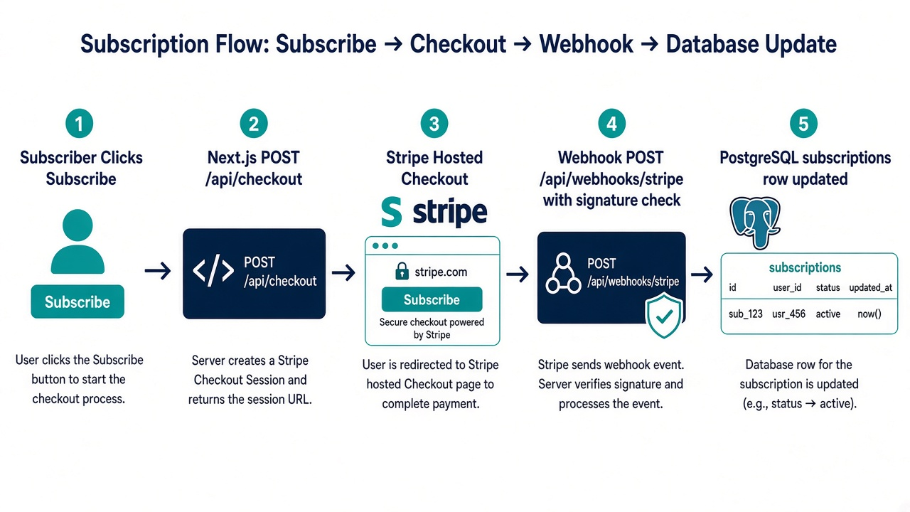
SLIDE 18
Recurring payments — Checkout
Advanced Subscription & Membership Platform · FYP Panel Defense
18 / 32

Slide 19
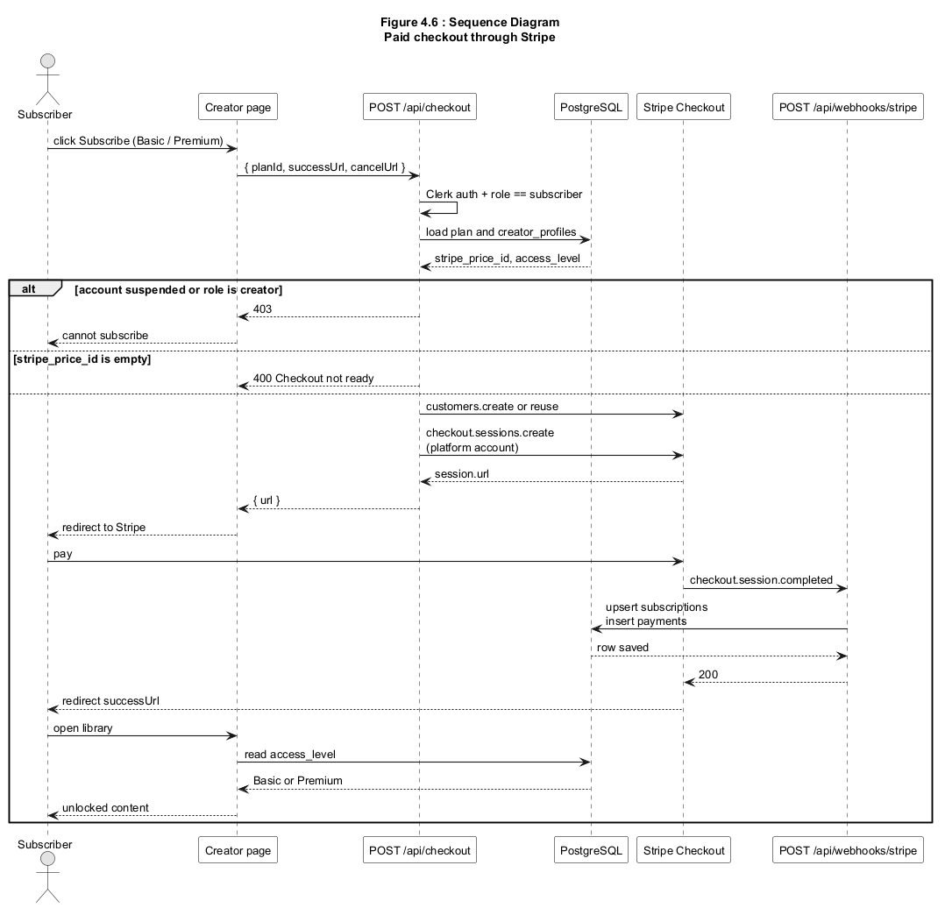
SLIDE 19 · IMAGE
Paid checkout sequence (report figure 4.6)
Advanced Subscription & Membership Platform · FYP Panel Defense
19 / 32

Slide 20
SLIDE 20
Stripe webhooks — exact events
POST /api/webhooks/stripe — raw body + stripe-signature + constructEvent.
Handled: checkout.session.completed · subscription created/updated/deleted · invoice.upcoming · invoice.paid / payment_succeeded · invoice.payment_failed.
Unknown types: HTTP 200 no-op.
Idempotency: stripe_webhook_events.event_id PK. Duplicate → { duplicate: true }.
Success-page race: confirmCheckoutSessionForUser rejects another user’s session id.
No Stripe Connect. Charges hit the platform account.
Advanced Subscription & Membership Platform · FYP Panel Defense
20 / 32

Slide 21
SLIDE 21
Application-level access (not RLS)
Published only. Admin email grants. Suspended viewer/creator denied.
Owner or requiredPlan=free grants. Else live sub for THAT creator + rank.
JSON redacts videoUrl, videoKey, fileUrl, fileKey. Bytes only via playback/download routes.
Creator writes: findOne({ _id, creatorClerkUserId: context.clerkUserId }).
R2 keys must contain that user’s Clerk id (storageKeyBelongsToUser).
Same DB role for all queries — the app attaches the filters.
Advanced Subscription & Membership Platform · FYP Panel Defense
21 / 32

Slide 22
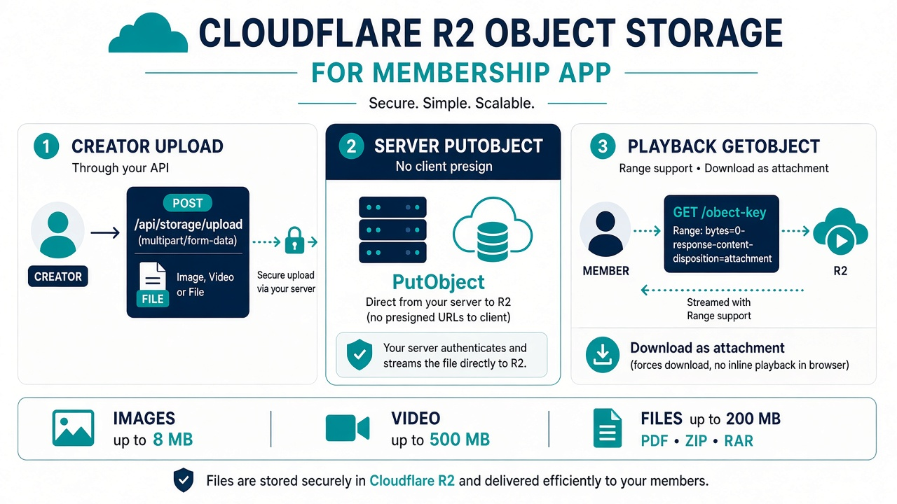
SLIDE 22
Cloudflare R2 — no client presign
Advanced Subscription & Membership Platform · FYP Panel Defense
22 / 32

Slide 23
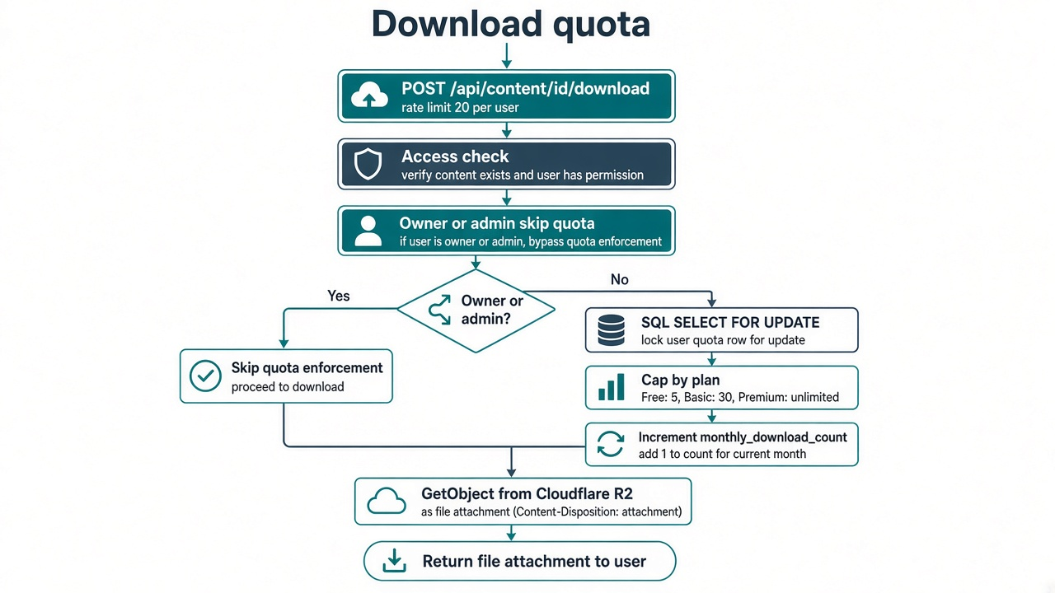
SLIDE 23
Download quota — SELECT … FOR UPDATE
Advanced Subscription & Membership Platform · FYP Panel Defense
23 / 32

Slide 24
SLIDE 24 · OBJECTIVES 3–4
Renewal reminders & analytics cron
invoice.upcoming → in-app renewal notification.
/api/cron/renewal-reminders — Bearer CRON_SECRET (or ?secret= in non-production only).
Lead days from platform_settings, clamped 1–30, default 7. Skips free and cancelAtPeriodEnd.
/api/cron/analytics/daily-rollup writes per-creator snapshots (subs, revenue, views, downloads, churn).
If CRON_SECRET is unset, cron routes return 401.
Advanced Subscription & Membership Platform · FYP Panel Defense
24 / 32

Slide 25
SLIDE 25
PostgreSQL — 19 tables, no RLS
user_profiles · creator_profiles · subscriber_profiles · plans · plan_features · content · subscriptions · payments · notifications · analytics · contacts · platform_settings · stripe_webhook_events · admin_audit_events · plus workspace/preference helpers
user_role enum: subscriber | creator — there is no admin enum.
access_level: free | basic | premium. billing_cycle: monthly only.
UNIQUE membership pair + idx_subscriptions_clerk_pair.
Webhook event_id primary key. Partial unique Stripe invoice id.
Pool: DATABASE_URL, max 10 connections.
Advanced Subscription & Membership Platform · FYP Panel Defense
25 / 32

Slide 26
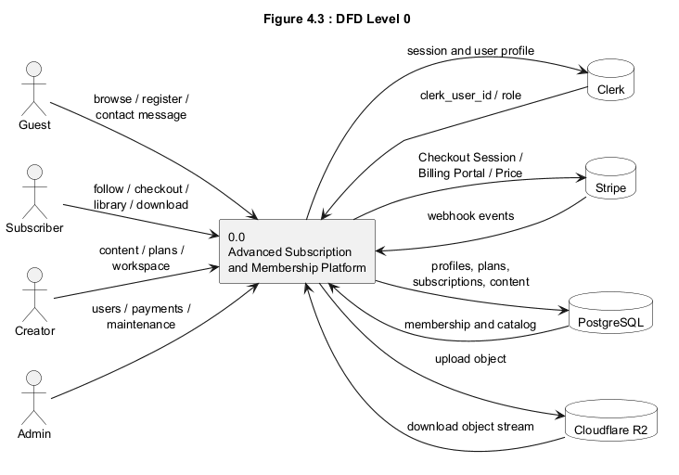
SLIDE 26 · IMAGE
Data flow (report figure 4.3)
Advanced Subscription & Membership Platform · FYP Panel Defense
26 / 32

Slide 27
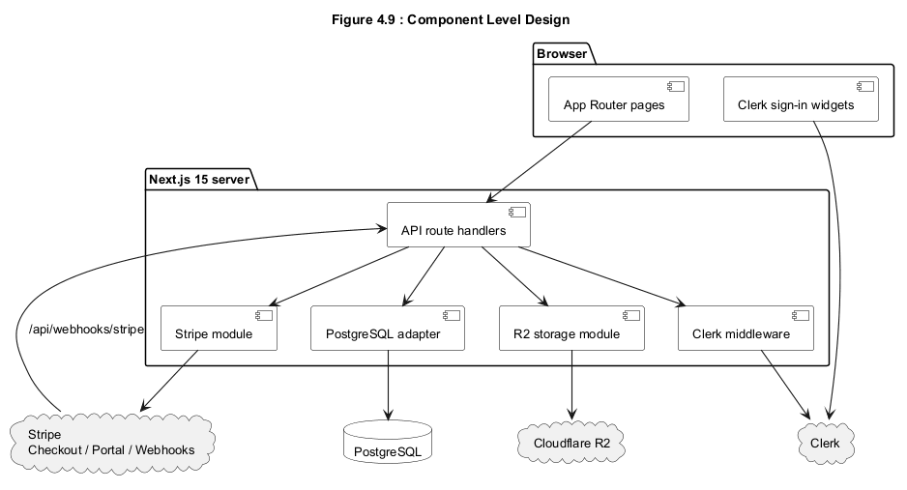
SLIDE 27 · IMAGE
Components (report figure 4.9)
Advanced Subscription & Membership Platform · FYP Panel Defense
27 / 32

Slide 28
SLIDE 28
Security — say only this
Clerk session on protected APIs; guests get 401 JSON.
Admin = ADMIN_EMAILS; check-admin is not an email oracle.
Set-role cannot write admin.
Process-local rate limits on auth, contact, download, views, admin writes.
Stripe webhook signature + claimed event ids. Cron bearer secret.
Ownership filters + R2 key prefix. Media URLs stripped from JSON.
Suspended accounts blocked on checkout, download, upload, playback.
Admin Stripe actions fail closed. We do not store card numbers.
Advanced Subscription & Membership Platform · FYP Panel Defense
28 / 32

Slide 29
SLIDE 29
Live demo order
# | Role | Action → expected
1 | Guest | /creators → published creators only
2 | Guest | Paid item → login?redirect_url=
3 | Subscriber | Follow → Free, no Stripe
4 | Subscriber | Basic Subscribe → checkout.stripe.com
5 | Subscriber | Test card 4242 → Basic unlocks
6 | Subscriber | Play / download → gated stream + quota headers
7 | Creator | Own plans/content only
8 | Admin | /admin with allowlisted email
9 | Non-admin | /admin redirected away
10 | Admin | Maintenance / +7d / Period end / Cancel now
Advanced Subscription & Membership Platform · FYP Panel Defense
29 / 32

Slide 30
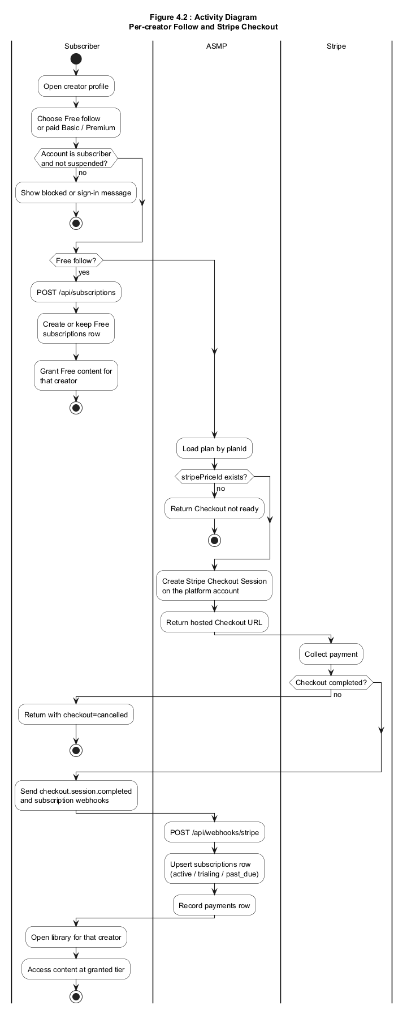
SLIDE 30 · IMAGE
Activity (report figure 4.2)
Advanced Subscription & Membership Platform · FYP Panel Defense
30 / 32

Slide 31
SLIDE 31
Known boundaries
Rate limits are per process, not Redis.
Folder name mongodb is historical; runtime is PostgreSQL.
No Stripe Connect — creators do not receive automatic payouts.
No Postgres RLS.
Anyone who can edit server env can change ADMIN_EMAILS.
Keep stripe listen running so webhooks save paid memberships.
Advanced Subscription & Membership Platform · FYP Panel Defense
31 / 32

Slide 32
Thank you
Questions — demo accounts, Stripe test card 4242, and ADMIN_EMAILS.
Source facts: docs/fyp-panel-defense-slides.md
Manual test list: docs/manual-testing-checklist.md

