Slide 1
ATTRITION ANALYSIS
ATTRITION:
The term attrition refers to gradual but deliberate reduction in staff numbers that occurs as employees leave a company and are not replaced.
ATTRITION RATE:
The attrition rate is the rate at which people leave a company during a particular period of time. It is calculated as numbers of departures/average number of employees*100.
Why is attrition a concern for the company?
It is important that the company identifies reasons of employee attrition to minimise the cost of hiring and training new individuals. It is also important that the company takes actions well in time to maintain a good name in the market.
Our attrition analysis studies 1470 employees of the company..
Further, we are interested in knowing how many people have left the company.
Out of 1470 employees, 237 employees have left the company.
1

Slide 2
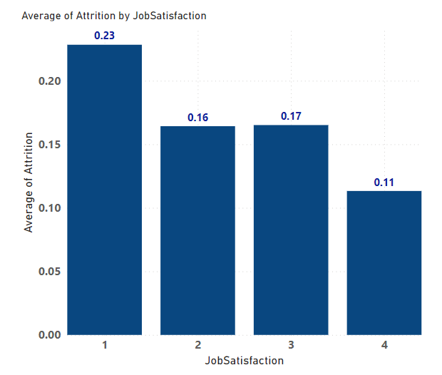
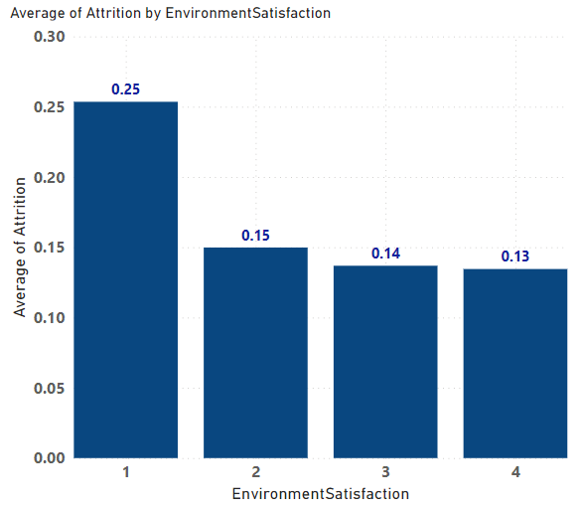
Attributes that are indicative of attrition:
JOB SATISFACTION:
The extent to which an employee feels self-motivated and satisfied with their job
In the company, the job satisfaction of an employee has been measured on a scale of 1 to 4,
1 being the lowest and 4 the highest
Under our analysis, we observe that the attrition rate is seen to be higher among the
employees who are least satisfied with their jobs in the company
ENVIRONMENT SATISFACTION:
how contented a person feels with respect to the physical setting in question
In the company, the environment satisfaction of an employee has been measured on a
scale of 1 to 4, 1 being the lowest and 4 the highest
Under our analysis, we observe that the attrition rate is seen to be higher among the
employees who are least satisfied with the working environment of the company
2

Slide 3
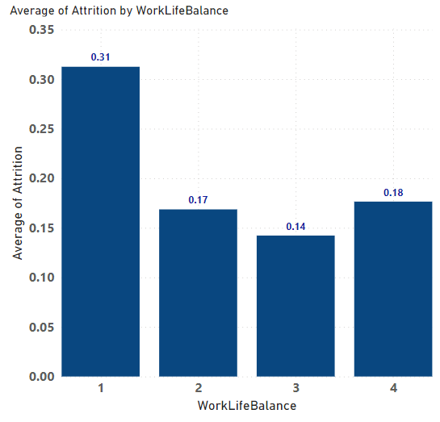
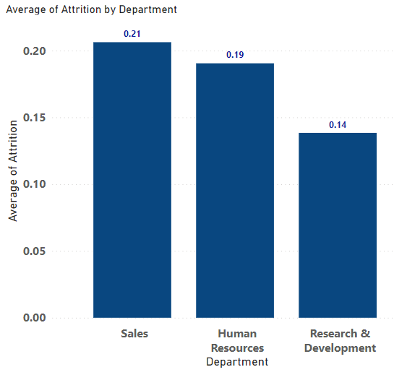
Work Life Balance:
The state of equilibrium where a person equally prioritizes the demands of one's career and the demands of one's personal life
In the company, the work-life balance of an employee has been measured on a scale of 1 to 4, 1 being the lowest and 4 the highest
Under our analysis, we observe that the attrition rate is seen to be higher among the
employees who are poor at managing their work-life balance
Department:
Division of the company based on specific area of activity
Sales, Human Resource and Research and Development are the three departments operating in the company
Under our analysis, we observe that the attrition rate is seen to be the highest in the sales department as compared to the other two departments of the company
3

Slide 4
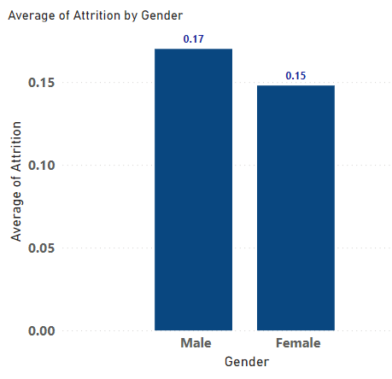
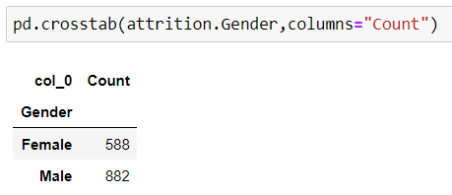
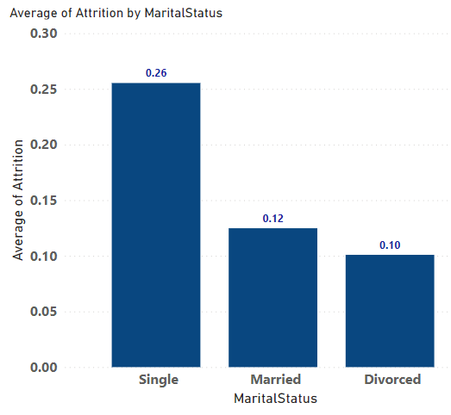
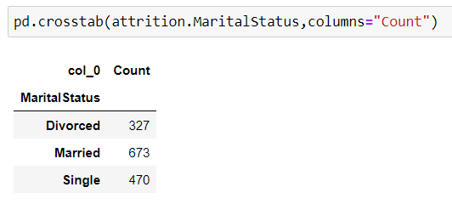
Gender:
Out of the total employees working in the company,
588 employees identify as Females and 882 identify
as Males
Here, we observe that the attrition rate is seen to be higher among the males
employees as compared to the female employees
Marital Status:
Out of the total employees working in the company,
327 employees are divorced, 673 are married and
470 are singles
Here, we observe that the attrition rate is seen to be higher among the single
employees as compared to the married and the divorced ones
4

Slide 5
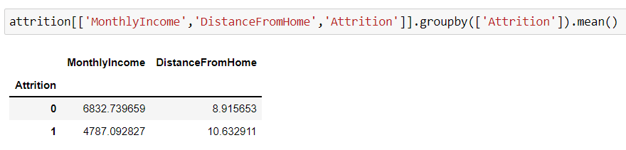
Hypothesis and Inferences:
We think that distance between home and workplace with less pay might be a problem that the employees are facing on a daily basis. Assuming that the company does not provide travel allowance, it is possible that the employees’ savings are not in par with the monthly expenditure. Therefore, it is likely that the employees’ found a job that catered to the above parameters.
Backing the hypothesis with the company’s data at hand:
Through our analysis of the data, we observe that, the attrition rate is higher among the employees who are earning Rs 5000 on an average and are living at a distance of roughly 11 KMs from the company as compared to the employees who are earning comparatively more and are stationed at a shorter distance.
So far, our hypothesis is backed by the data. However to dig deeper into the problem, a detailed study is required.
5

Slide 6
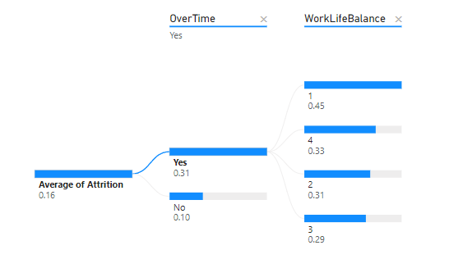
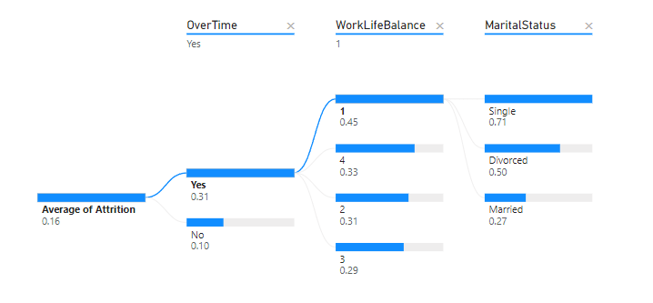
It is possible that the employees who work over time in the company, find it difficult to manage their work-life balance which may include physical and mental health problems.
Backing the hypothesis with the company’s data at hand:
Through our analysis of the data, we observe that the attrition rate is
found to be higher among the employees who work overtime and have
poor work – life balance.
Further drill down to Marital Status:
When we further drill down to Marital Status of the employees who work in the company, the attrition rate is observed to be higher among the employees who are single and are working over time.
Not being able to carry out occupations outside of work such as participating in leisure activities with friends and family because of staying late after office hours could be one of the reasons of poor performance outside of work.
6

Slide 7
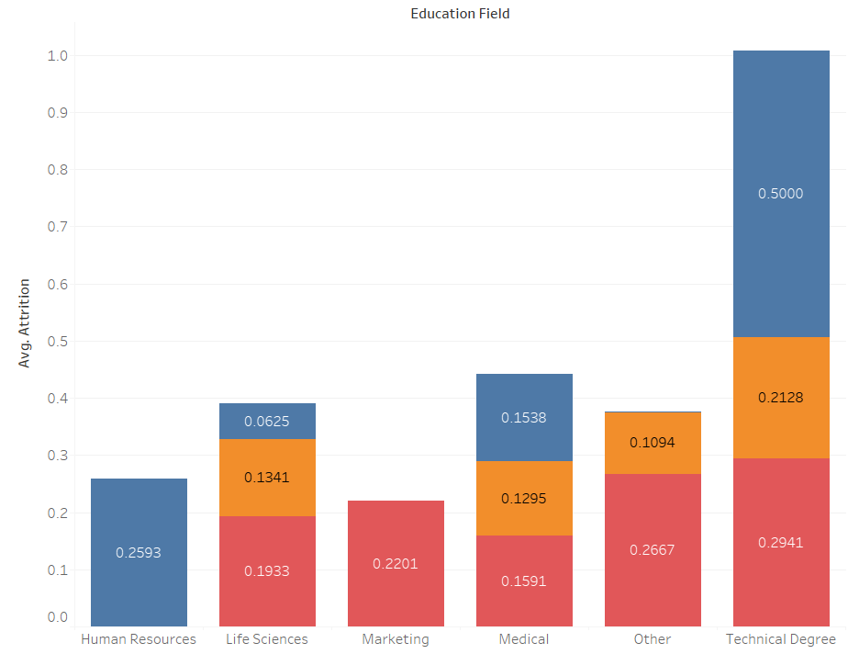

We’re of the opinion that when the education field and the department you’re working in clash, there is possibility of less job satisfaction. It is likely that the employees working in the company are not satisfied with the department they are working in.
Backing the hypothesis with the company’s data at hand:-
Through our analysis, we observe that the attrition rate is found to be in departments where the employees educational field doesn’t match the department work they are involved in.
7

Slide 8
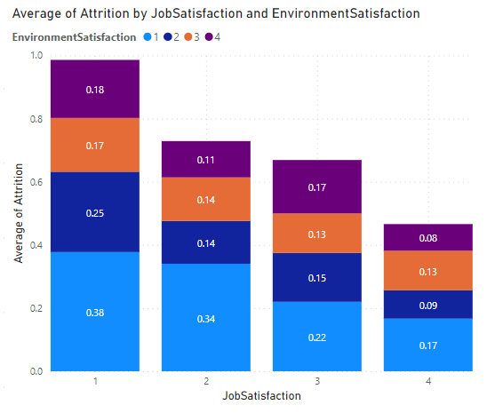
The employees who do not find the working environment
of the company fit and are also not satisfied with the job,
it is likely that they feel discouraged to continue
in the company.
Backing the hypothesis with the company’s data at hand:
Through our analysis, we observe that the attrition rate is higher among the employees of the company who are dissatisfied with the working environment of the company. They are also not happy with the job they do, which adds to their dissatisfaction.
8

Slide 9
Conclusion and Way Forward:
Social, organizational and physical factors are important for task and activity which consequently impact the performance of workers.
Employee retention should go hand in hand with cultivating happiness and goodwill.
It is likely that the constant struggle to manage life and work will clog an employees’ mind. Workshops and conferences on how to better one’s work- life balance can go a long way in improving the state of the employees.
Travel allowance if given to the employees, can help them save money that is spent in commuting. The company can provide bus service to employees sharing a common locality.
Working over time doesn’t measure efficiency! Cultivating the habit of respecting the time of employees can go a long way in offering solutions to problems that arise because of working over time. Bonus for OT can be effective too.
The company should be open to discussions around mental health. This will help employees feel heard and it will also help them build a sense of belonging towards the company. The more vocal the employees are about the problems at hand, the better it will be for the company to cater to them.
A regular feedback form in particular time intervals can help manage the problems well.
9

