Slide 1
The Chenile Framework
Microservices done right!

Slide 2
Why Chenile?
Built on great and proven technology
Write cutting edge micro services
Distills years of building great enterprise applications into one framework
Highly testable
Super Configurable, declarative, visualizable workflows supported by a state machine
Blueprints for different problems
Last mile interception
IoT & offline ready
Rapid Application development

Slide 3
Chenile Application
Anatomy of a Chenile Application
Chenile
Spring Boot

Slide 4





¯
Chenile as an In-VM Enterprise Service Bus
Mqtt
Chenile Entry Point
EXCEPTION
HEADER- PROCESSORS
TRANSFORM
REFERENCE
BODY- PROCESSORS
SERVICE- SPECIFIC
SERVICE IMPL
Service Configuration
(Metadata)
Kafka
Operations with parameter definitions
Service policies
- policy config for each policy
Trajectory overrides
Health checks
Transports exposed (e.g., HTTP) and their configuration
External API Gateway
Service Discovery
E
Authentication / Authorization
HTTP
Rate Limiting
Batch
Scheduler
Chenile Ecosystem – The Main Highway
Chenile Interceptors

Slide 5
Cloud & Edge
Edge Server
Service1
Service4
Service2
Service5
Service3
Service6
EDGE
CLOUD
Same services can run in the cloud and edge
Chenile provides a cloud edge switch that automatically synchs data offline
API Gateway
Internet of Things
Mini Monolith1
Mini Monolith2
…
Service1
Service3
…
Service2
Service4
…

Slide 6
Remote Service
CLIENT INTERCEPTOR1
CLIENT INTERCEPTOR2
…
ChenileEntry point
Service
HTTP
Remote Proxy
Location
Transparency
Chenile Proxy
Is service
local?
Build apps that can work seamlessly
Local Proxy
ChenileEntry point
Service

Slide 7
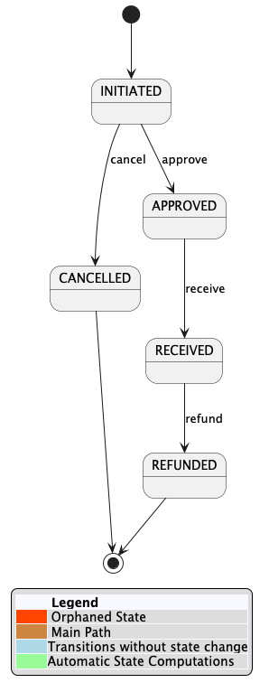
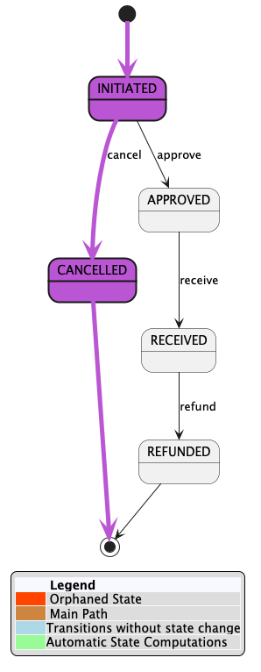
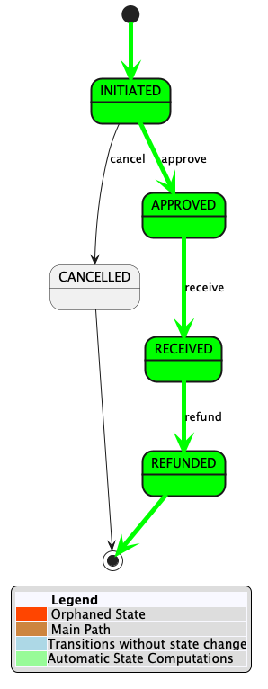
The Chenile
State Transition
Machine
Highly visual workflows that can instantly power state machines
From simple to complex workflows
Support for testcase generation.

