Slide 1
Library Management System
Presented by:
Rajak Putuwar
Rojal Luitel

Slide 2
Introduction
Web-based application designed to maintain, organize, and handle countless books,
Can access the system from any location with an internet connection,
Can track the books taken by the user and their due date for return.

Slide 3
Problem Statement
Loss of precious time,
Keeping of manual record causes loss of record,

Slide 4
Objectives
Reducing the time cost of both parties.
Easy update and adding of books in database.
Remove the need of validation of the same user frequently.

Slide 5
Methodology
Study of existence system
Feasibility study
High level design

Slide 6
Study of existing system
Destiny Library Manager
Can be accessed 24*7 from anywhere anytime,
Build a various print of students
Black Board Management
Dashboard that displays all information of school library.
Allows students to perform query of books.

Slide 7
Feasibility Study
Technical Feasibility
HTML/CSS for frontend,
Laravel for backend,
MySQL for database.
Operational Feasibility
Readable,
User friendly,
Portability ,
Scalability.

Slide 8
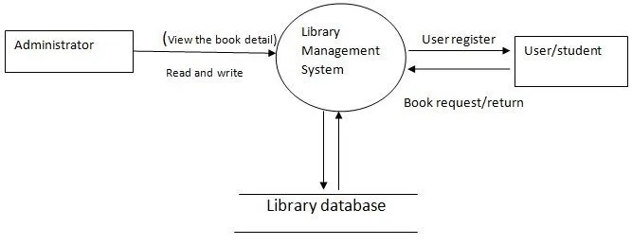
High Level Design
Fig: context diagram of library management system

Slide 9
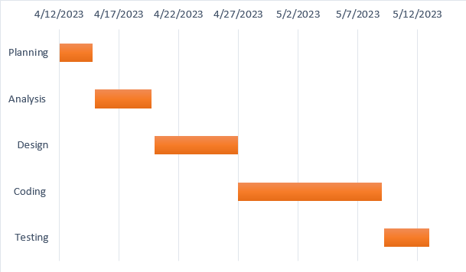
Gantt Chart

Slide 10
Excepted Outcome
Easy to know the availability of the new arrivals of books,
Easy management of ingoing and outgoing of books,
Reduce time as well as effort to search the books available in the library.

Slide 11
Thank You

