Slide 1
MED-APP-APPLICATION FOR HEALTHCARE
Team Members
MANOSHREE B I
RAJALAKSHMI V
RAMAPRIYA R
SHALINI R

Slide 2
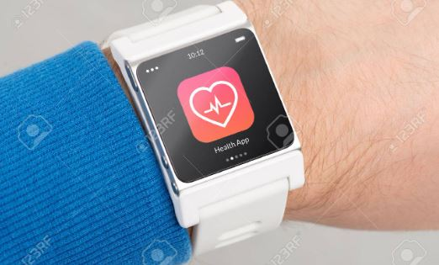
ABSTRACT
Personalized medical assistant :
Our app accepts the symptoms given by the patient and produces a solution based on the health problem
For serious problem it will suggest a specialized doctor in that field .
Smartwatch can be connected via Bluetooth, to monitor the blood pressure, oxygen level, pulse rate and feeds back to the application. These values are also used by our models to produce accurate solution.

Slide 3
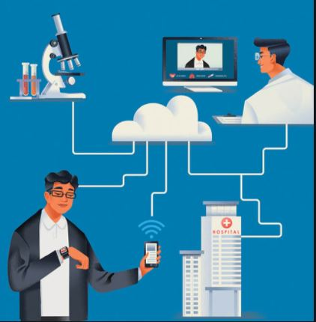
Patient centered information :
This app stores a detailed database information of patients governed by hospitals.
The patients were allowed to access their details digitally provided a secure login and password .
They also get notified about the appointments and availability of medicines in the pharmacy. They can easily access and obtain information

Slide 4
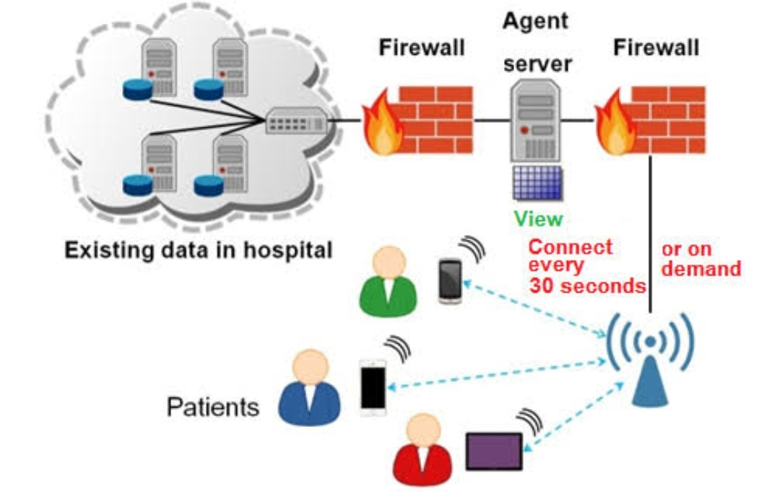

Slide 5



TECHNICAL STACK
Machine Learning(ML)
Framework : Android Studio
Programming Language : Java
Database : Firestore

Slide 6
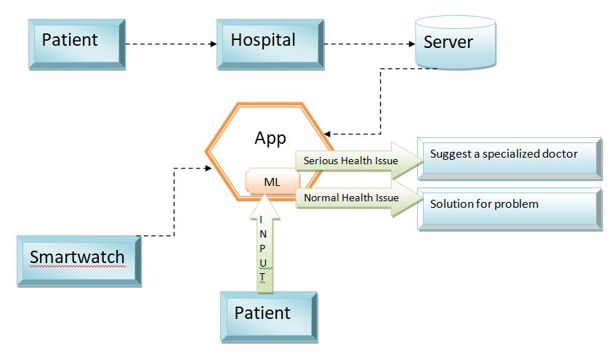
PROTOTYPE MODEL
Architecture Diagram

Slide 7
OUTCOME
access to and retrieval of clinical data to provide safer and more timely, efficient, effective, and equitable patient-centered care, which may also be useful to public health authorities in analyses of the health of the population.
physicians to meet high standards of patient care through electronic participation in a patient's continuity of care with multiple providers.
the time and effort involved in recovering missing patient information, including any duplicate tests required to recover such information is not needed

