Slide 1
Ebola Virus Disease
A deadly viral disease - causes severe, and fatal illness in humans
BIOL – 2404 5005
Rajalaxmi Polarpu
16 March 2015

Slide 2
Outline
About Ebola Virus
Outbreak of Ebola Virus Disease
Symptoms
Transmission of Disease
Diagnosis
Treatment
Prevention

Slide 3
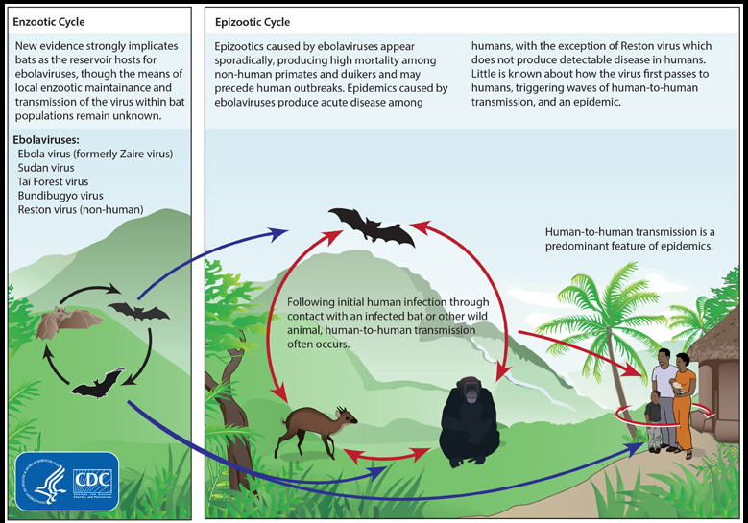
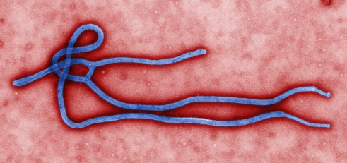
Ebola Virus

Slide 4
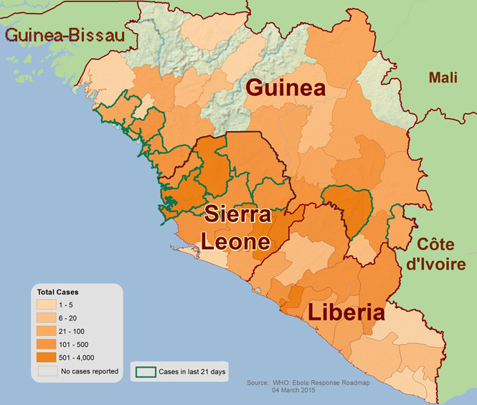

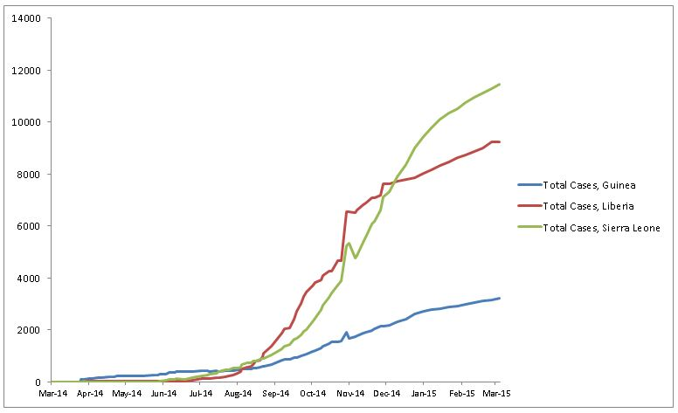
Ebola Outbreak
In West Africa
Guinea
Sierra Leone
Liberia
0 to 12000 cases in a year
Detection of symptoms to death is fast
1 in 2 people who get Ebola died

Slide 5
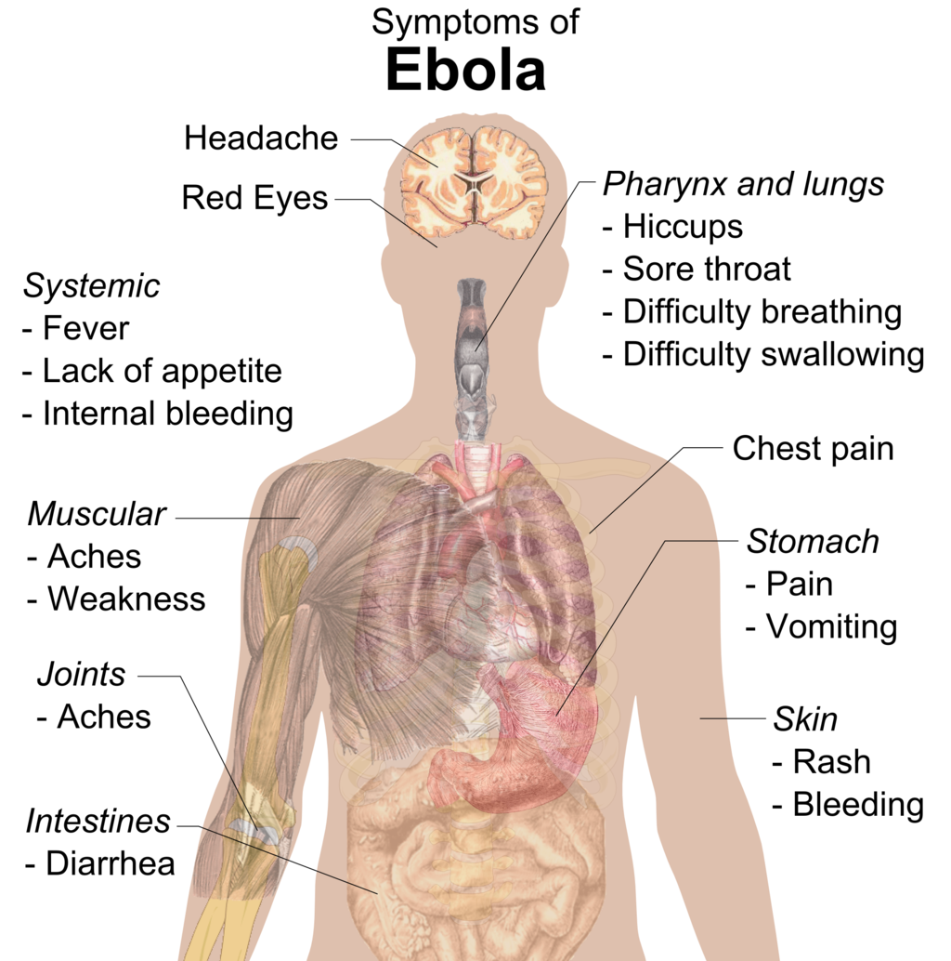
Ebola - Symptoms

Slide 6
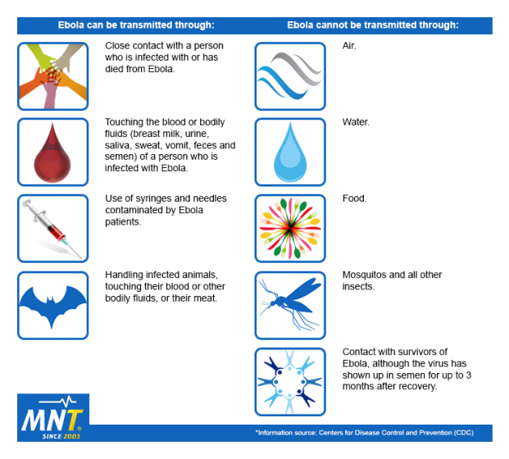
Transmission of disease

Slide 7
Diagnosis
Early diagnose of Ebola virus in a person is difficult.
Onset of symptoms is 2 to 21 days.
Methods for Diagnosis
antibody-capture enzyme-linked immunosorbent assay (ELISA)
antigen-capture detection tests
serum neutralization test
reverse transcriptase polymerase chain reaction (RT-PCR) assay
electron microscopy
virus isolation by cell culture.

Slide 8
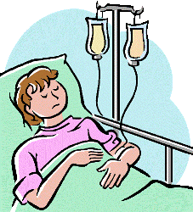

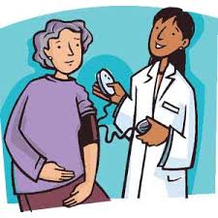
Treatment
Symptoms of Ebola and complications are treated as they appear.
The chances of survival can be improved by:
Providing intravenous fluids (IV) and
balancing electrolytes (body salts)
Maintaining oxygen status and blood pressure
Treating other infections if they occur

Slide 9
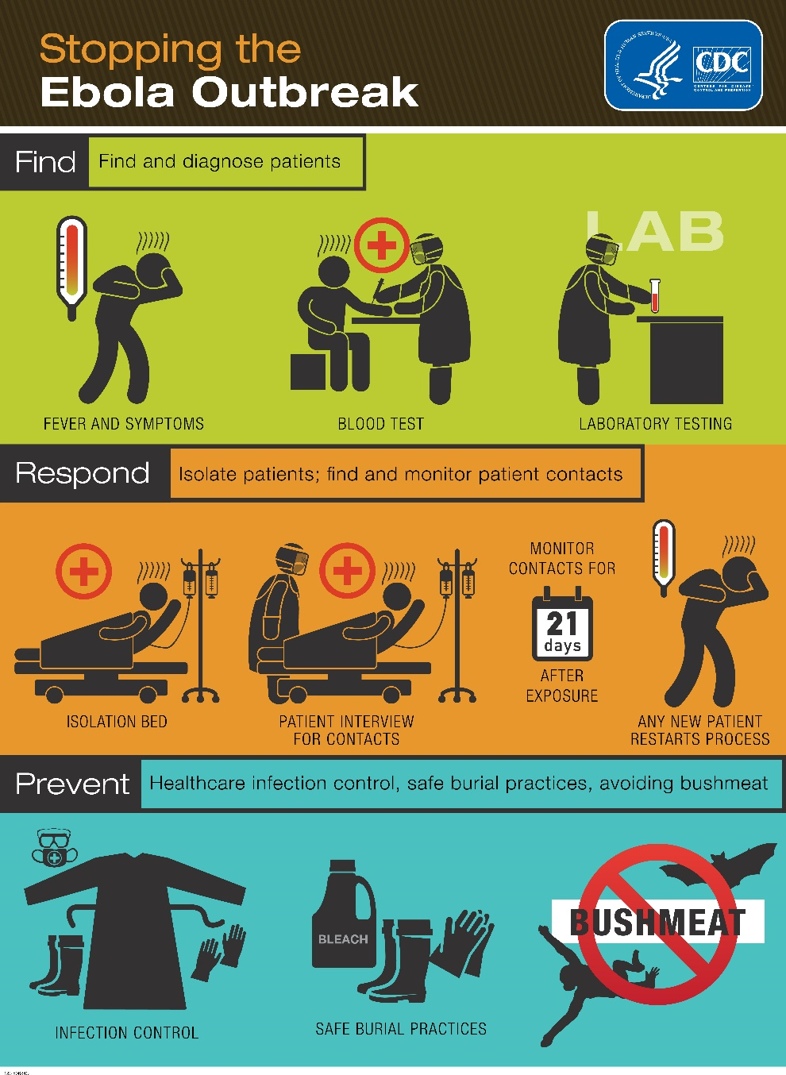
Prevention and Control

Slide 10
Works cited
“Ebola Virus Disease”. Cdc.gov. Centers for Disease Control and Prevention. 2 November 2014. Web. 7 March 2015.
“What is Ebola? How is Ebola Contracted?”. Medicannewstoday.com. Medical News Today. 16 February 2015. Web. 7 March 2015.
“Ebola Virus Disease”. Who.int. World Health Organization. September 2014. Web. 7 March 2015.

