Slide 1
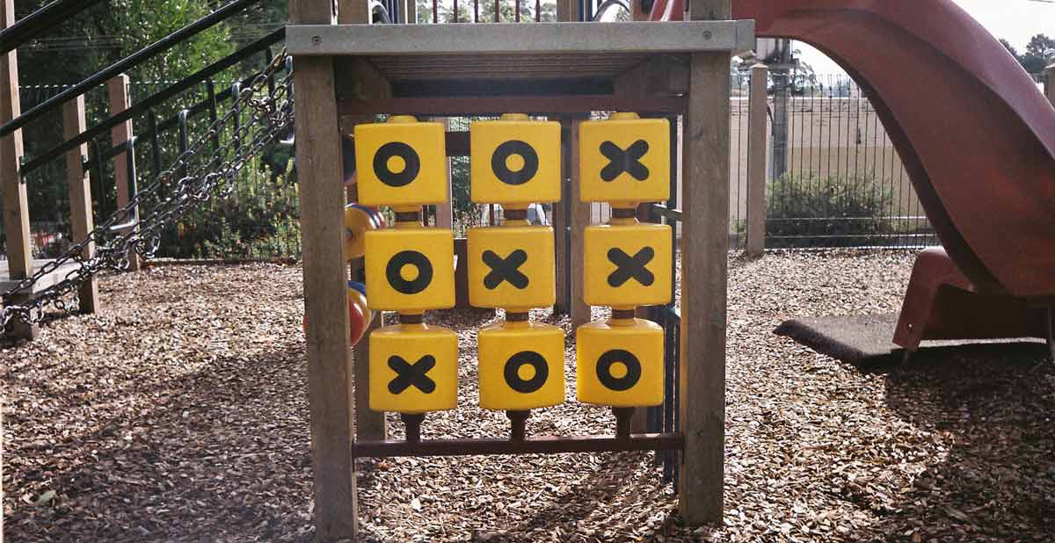
Project Title: Implementation of Multiple Tic-Tac-Toe Agents
Spring 2021
Team Members:
1. Praveen Mandadi
2. Raja Muppalla

Slide 2

Description of Project
The game is played in a 3x3 Grid between any two AI Agents at the same time.
The game is to be played between two people.
One of the player chooses ‘O’ and the other ‘X’ to mark their respective cells.
When any agent completes such a sequence, or when agents fill up the grid without reaching any pattern, the game ends.

Slide 3
Objective of the Agents
The goal for each agent is to win the game by forming a horizontal, vertical, or diagonal line of all X OR all O in a grid in which each agent plays one after the other.
The second goal is to ensure that your adversary is unable to create an X OR O pattern since this is a zero-sum game.

Slide 4
Statement of Project objectives
We're creating four AI agents who will play the game as guests.
The logic of the game is Agent 1 wins against Agent 2 or Agent 2 wins against Agent 1or Tie between Agent 1 and Agent 2.
The user can choose which two agents will compete in a Tic-Tac-Toe tournament.

Slide 5
APPROACH Algorithms Used :
Reinforcement Learning Algorithm
1. Q-learning
Adversarial search Algorithms
1. Minimax algorithm using traditional approach. 2. Minimax algorithm using alpha-beta pruning approach.
3. Expectimax algorithm.

Slide 6
Deliverables
GitHub repository link
YouTube video
PPT slides
Documentation report(README.md)
Developed python programming Algorithms(.py files)

Slide 7

Evaluation methodology
Agents should be conditioned so that the game's performance is as accurate as if it were played by two human brains.
01
While making the next move, none of the agents can freeze or struggle.
03
The success of the project is determined by the successful implementation of four AI algorithms.
02

Slide 8
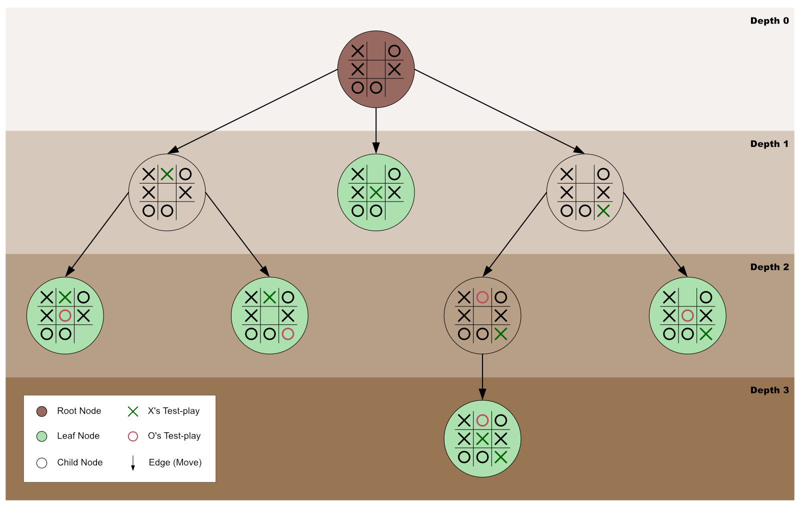
Minimax graph

Slide 9
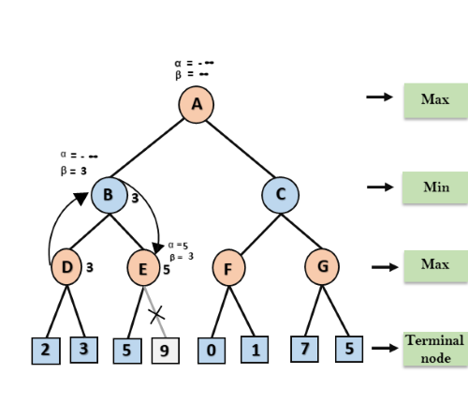
Minimax Alpha-Beta graph

Slide 10
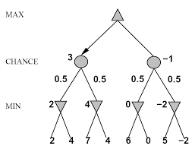
Expectimax graph

Slide 11
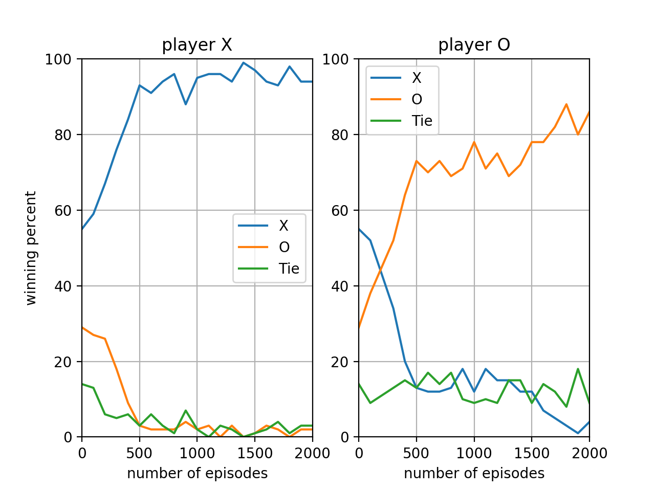
Q-Learning graph

Slide 12

Code Explanation

Slide 13
Thank You

