Slide 1
The LNMIIT Shopping Complex management System (Group-1)
Sub-module : Restaurant

Slide 2
RAGHAV SINGHAL [19UCS022]
RAGHAV BINDAL [19UCS010]
VARDHAN KUMAR [19UCS016]
LAKSHAY CHAUHAN [19DCS010]
RAJAN AGARWAL [19UCS039]

Slide 3
GUI

Slide 4
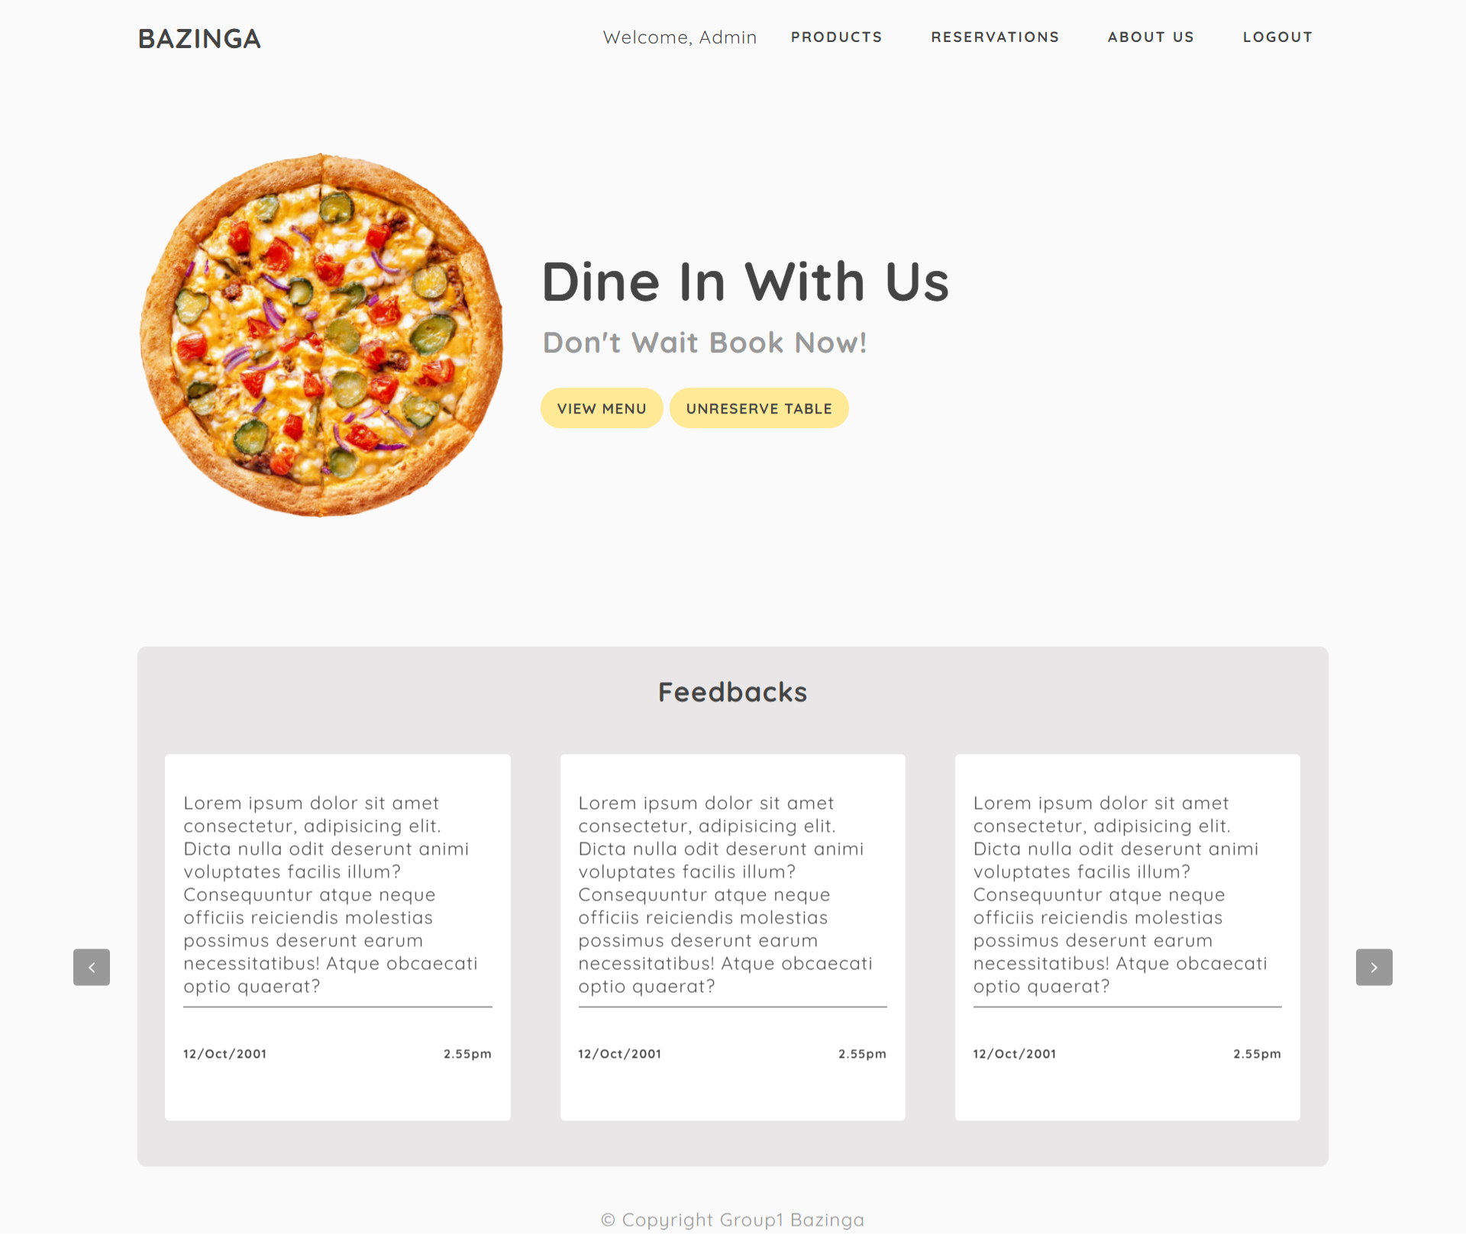

Slide 5
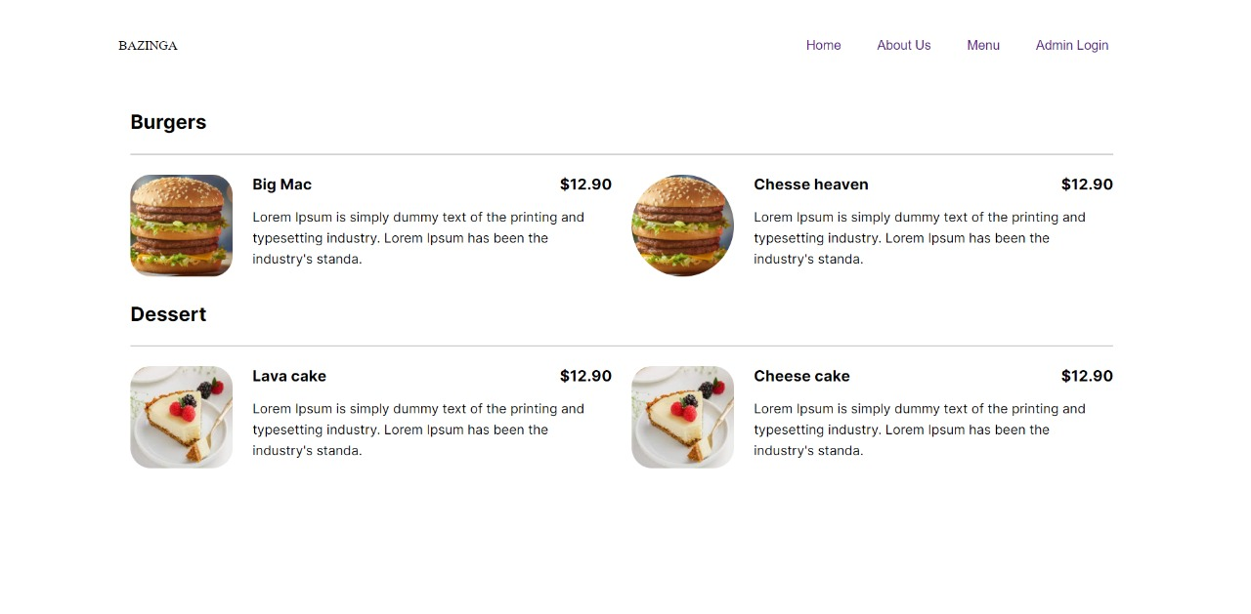

Slide 6
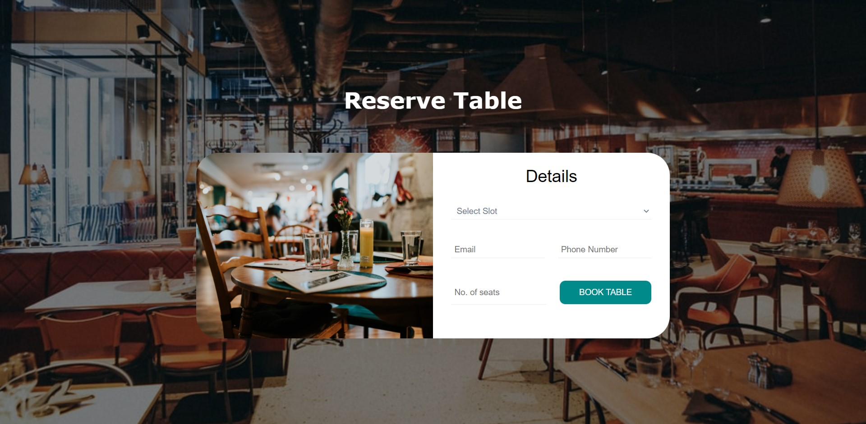

Slide 7
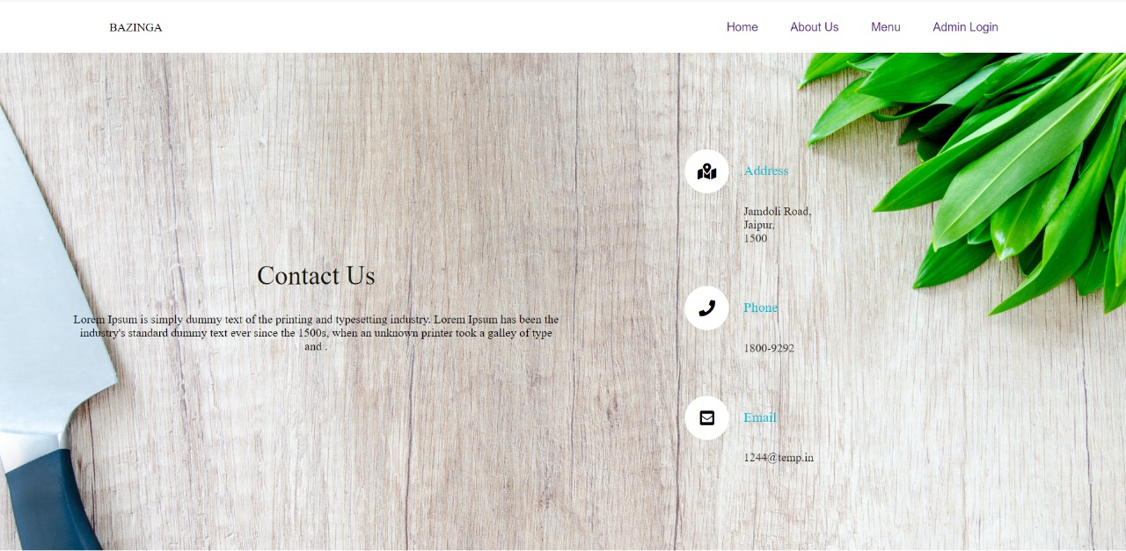

Slide 8
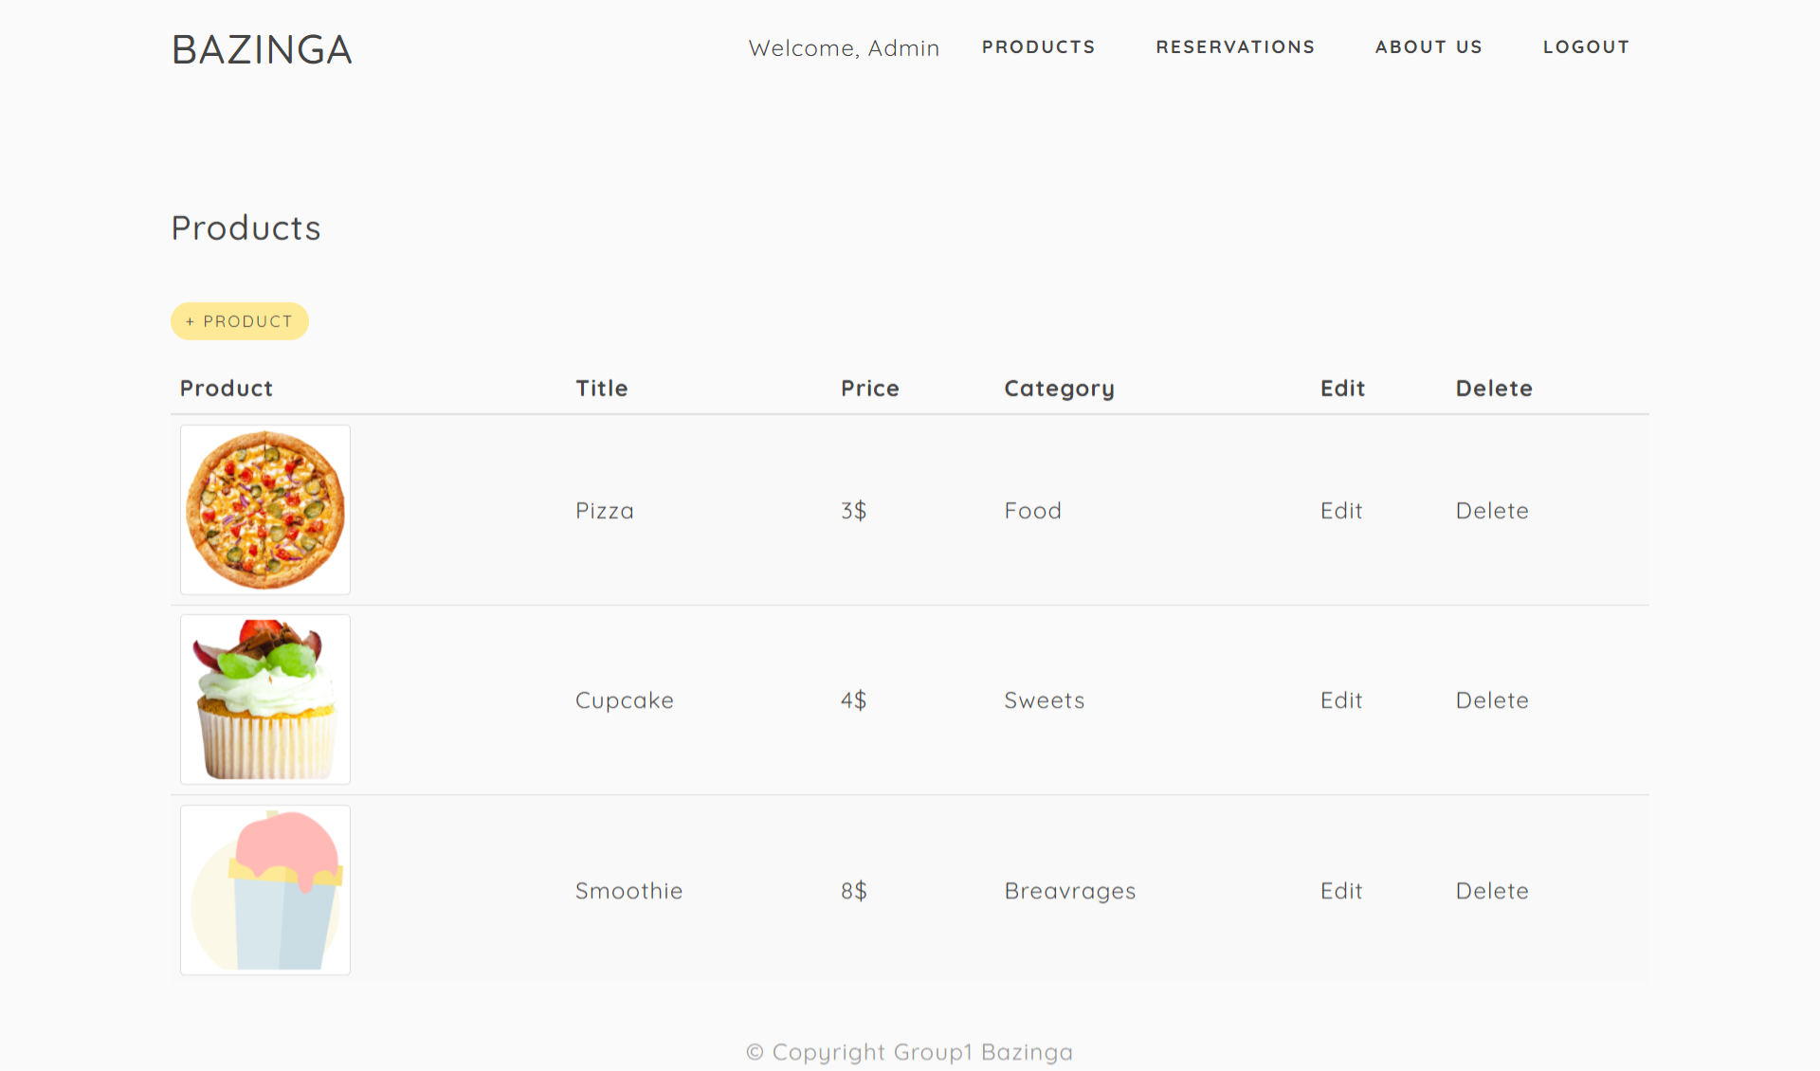

Slide 9
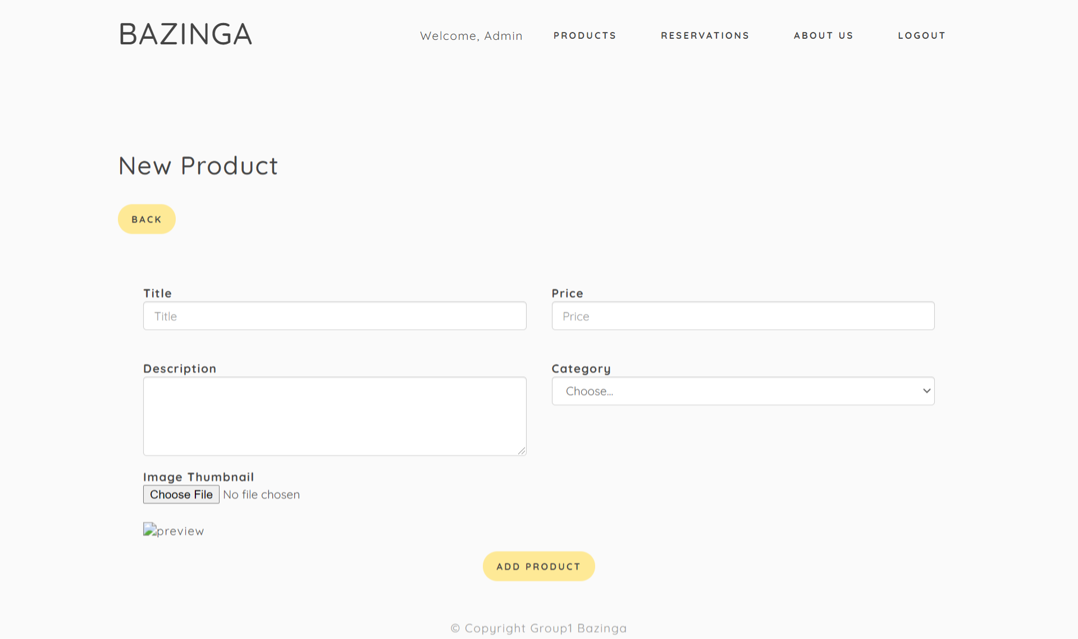

Slide 10
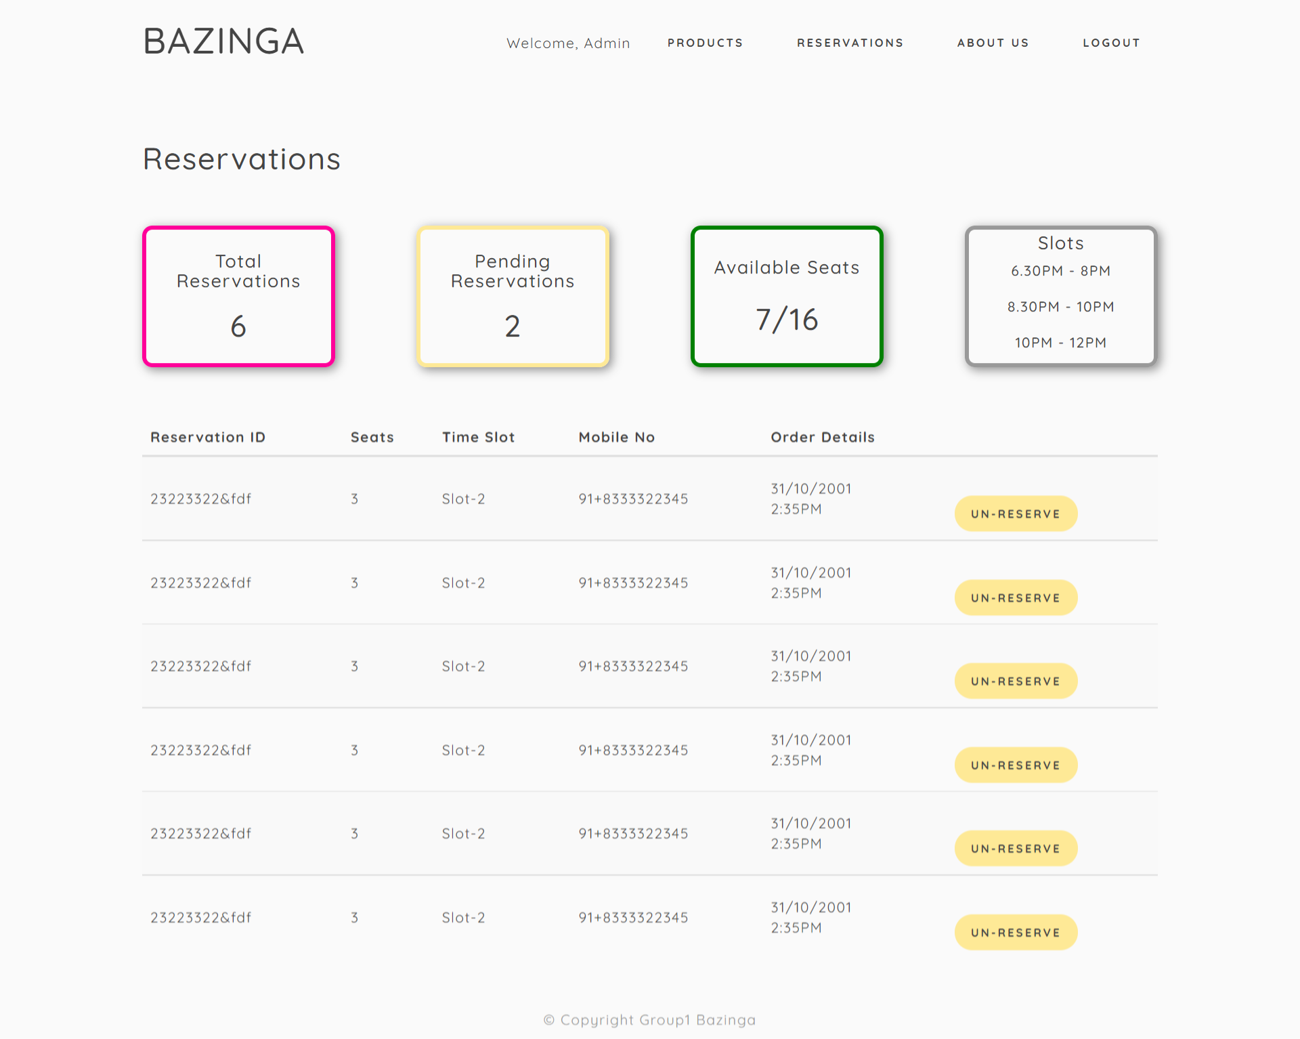

Slide 11
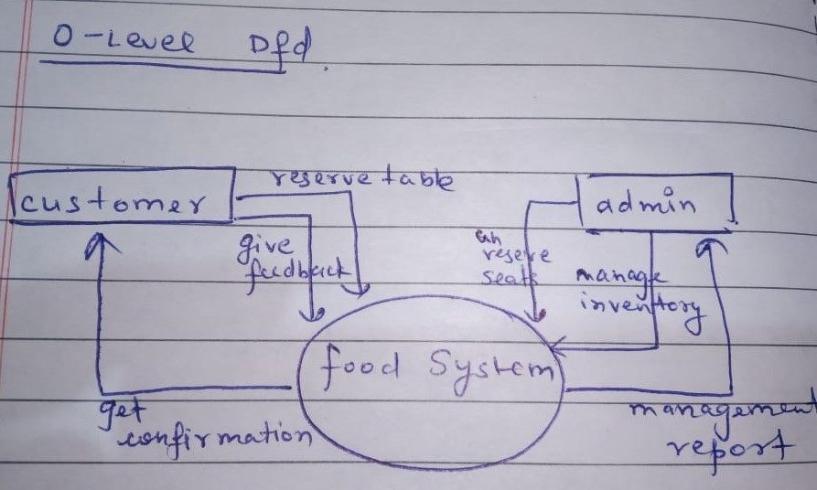
DFD CONTEXT LEVEL 0

Slide 12
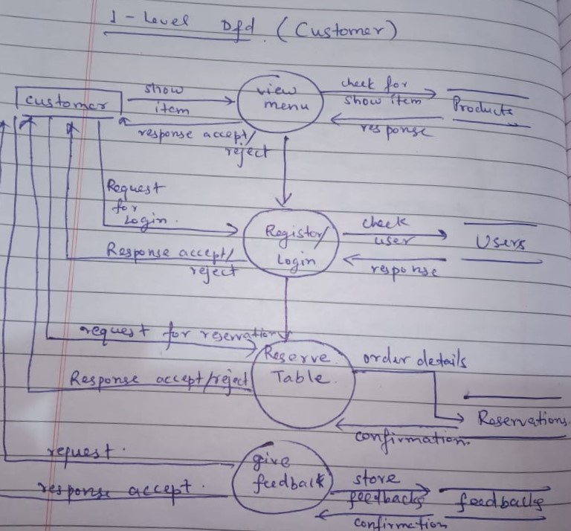
1ST LEVEL DFD
(CUSTOMER SIDE)

Slide 13
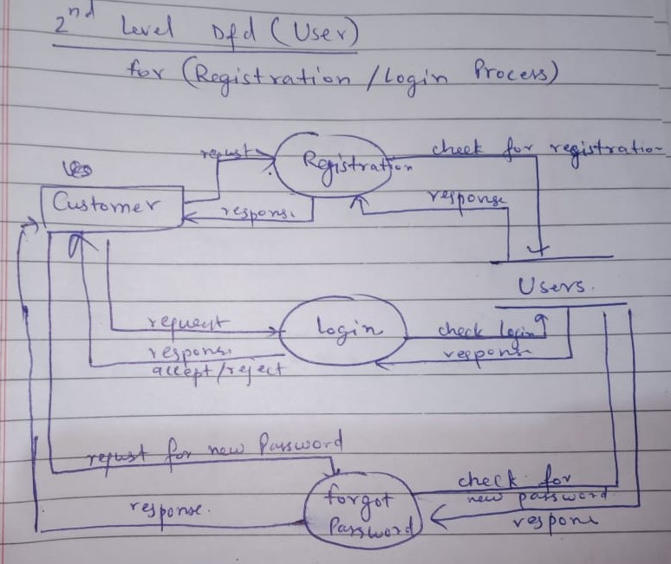
2nd- LEVEL DFD
(CUSTOMER SIDE)
FOR REGISTRATION/ LOGIN PROCESS

Slide 14
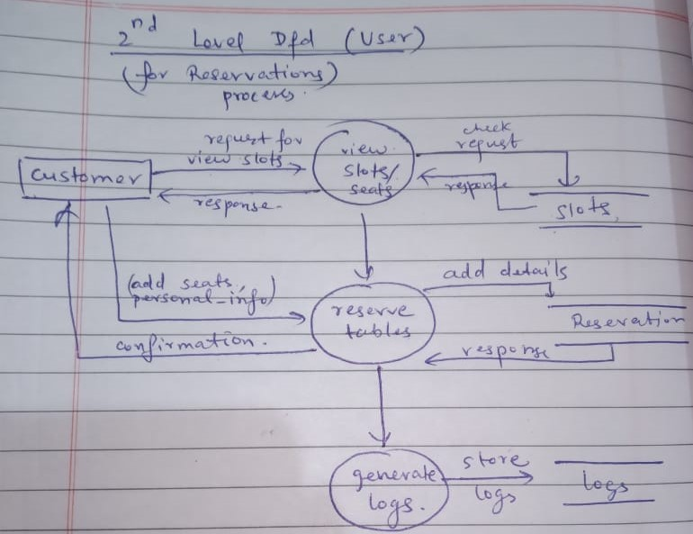
2nd- LEVEL DFD
(CUSTOMER SIDE)
FOR RESERVATION PROCESS

Slide 15
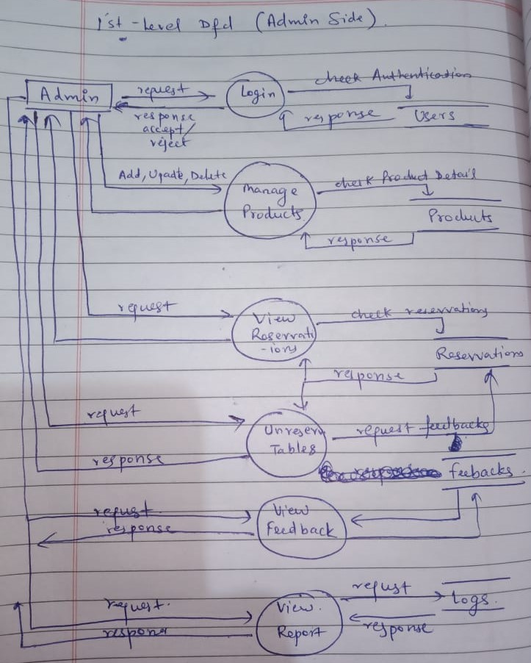
DFD
(ADMIN SIDE)

Slide 16
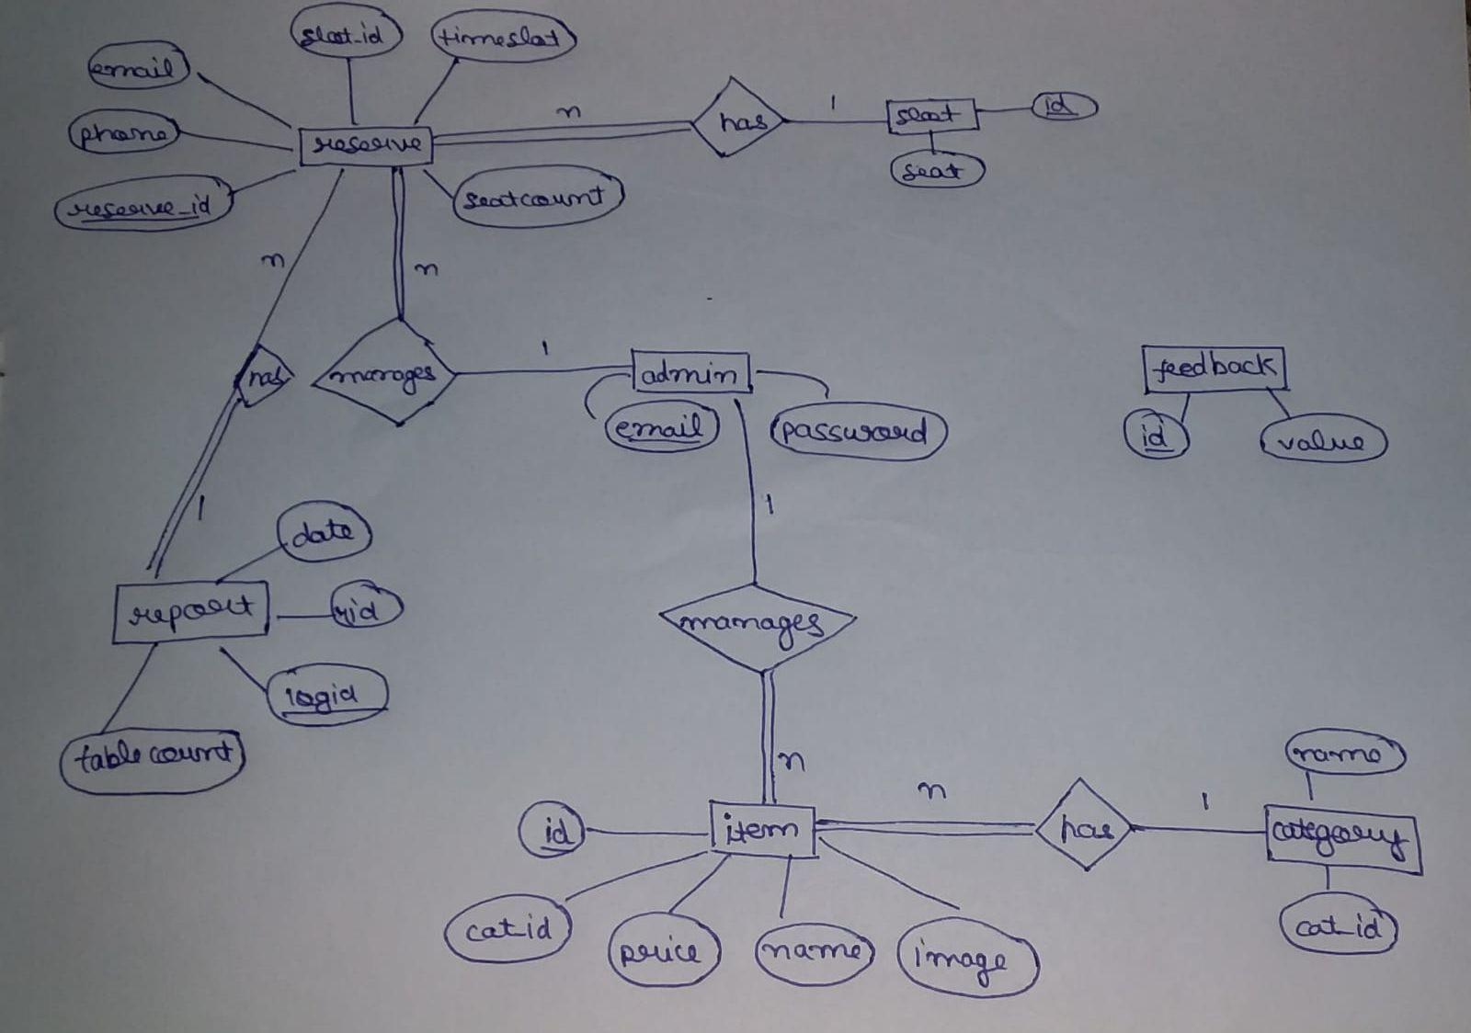
ER DIAGRAM

Slide 17
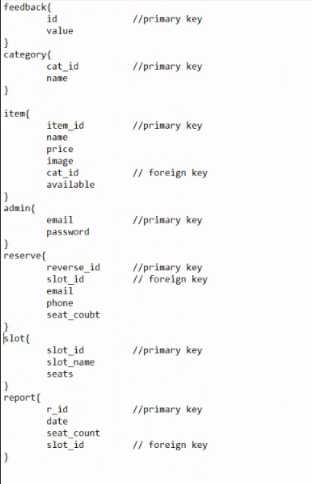
DATABASE DESIGN

Slide 18
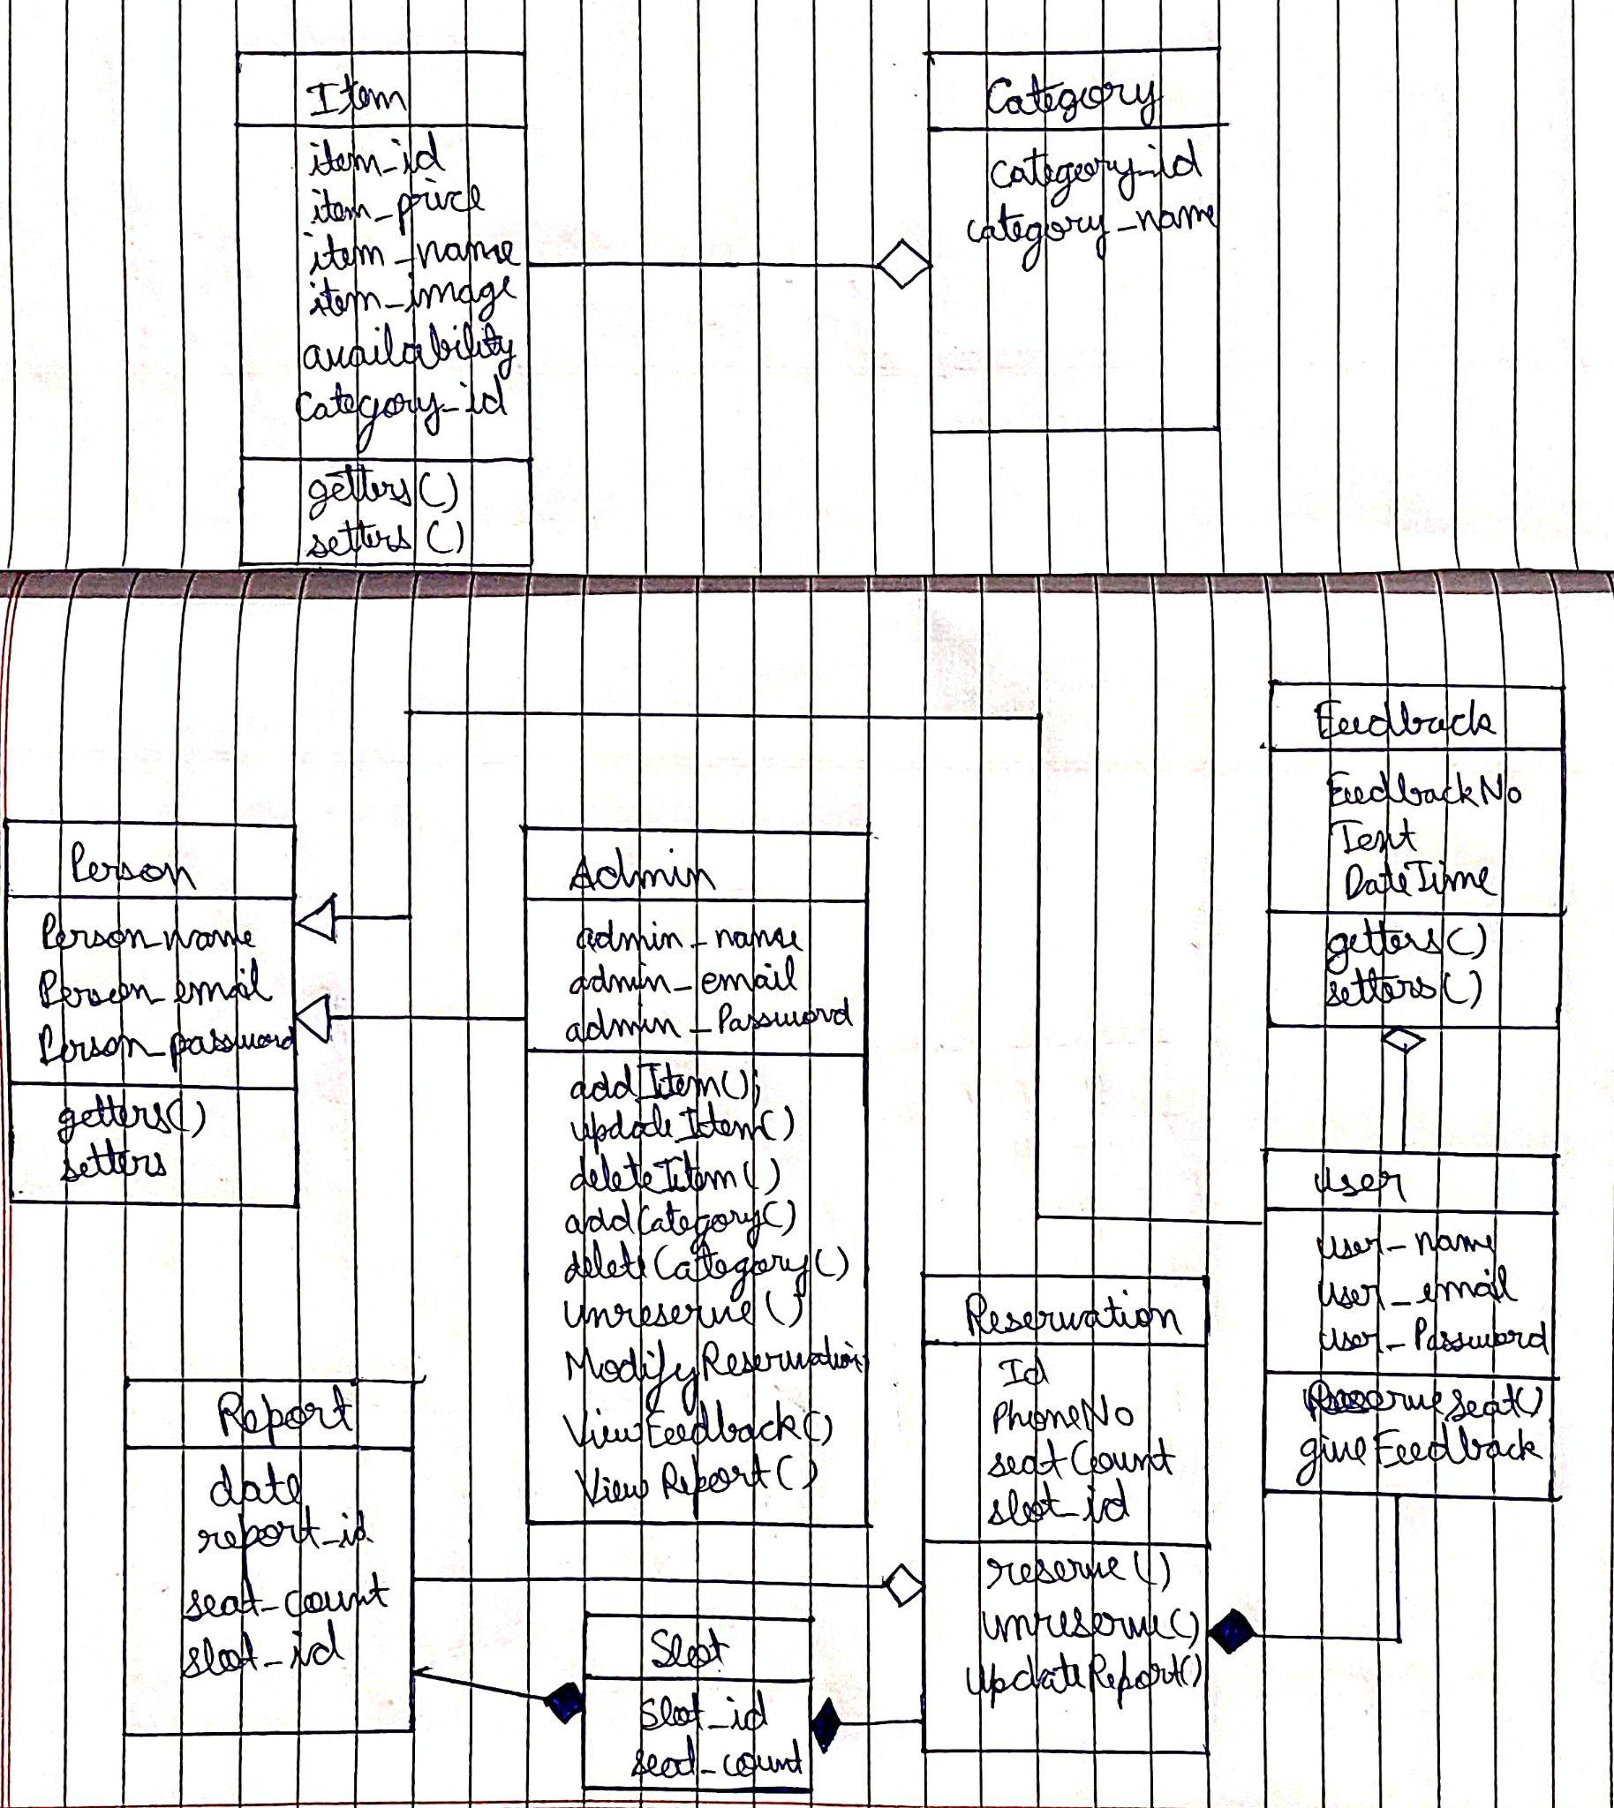
CLASS DIAGRAMS

Slide 19
THANK YOU

