Slide 1

Project - Sample Me
Building Web and Mobile Apps - AI5036
Team - Rajan Chawla, Blin Varﬁ, Ammar Irshad, Usman Aslam, Umar AbdulSattar
Date: 27-02-2020

Slide 2

Content
Introduction to project: Sample Me
Current situation and challenges
Our solution
Project roadmap
Mockups
Tools and technology
Database flow diagram
Documentation
Google Analytics
Demo
Project urls

Slide 3
Introduction: Sample Me
Sample Me is –
Solution for companies looking to gather feedback for their products
Solution for users looking for better quality products in less price
Solution to bring better products in the market

Slide 4

Current situation
Most products fail due to lack of feedback for improvement on them.
Users hesitate to try new products
No platform to solve the current situation!!
Thats why - Sample Me!

Slide 5
Our solution
To build a solution where
Companies can upload products samples
Users can buy samples and share feedback
Companies get feedbacks and bring required changes
Companies uses the database of users for further marketing of their product

Slide 6
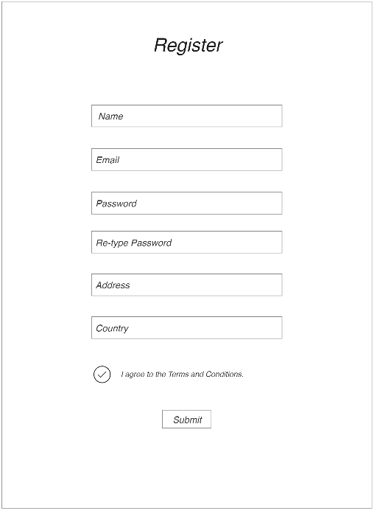
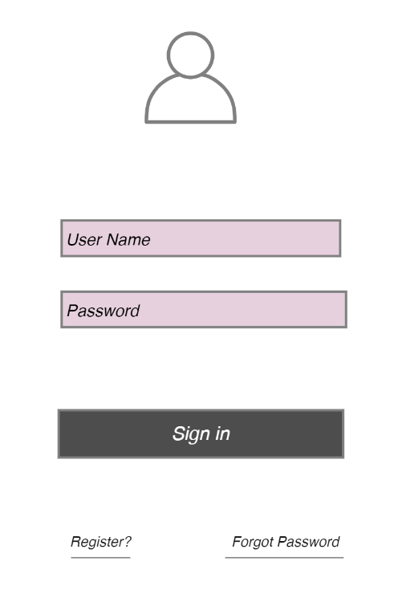
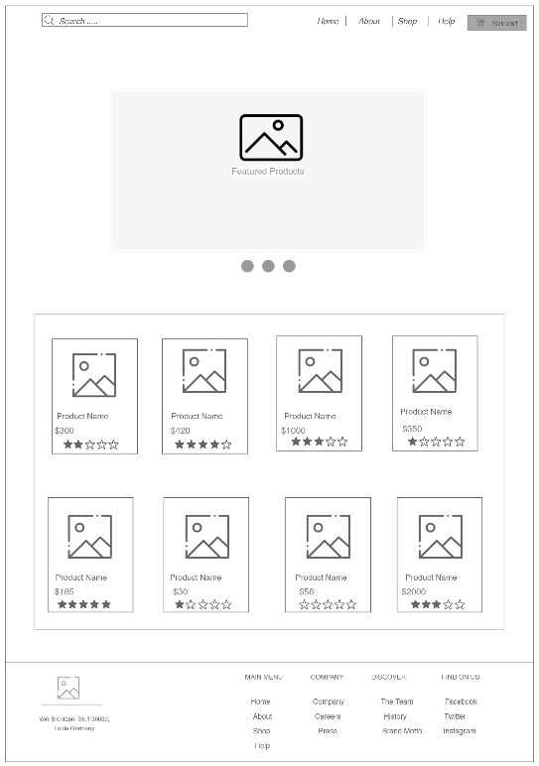
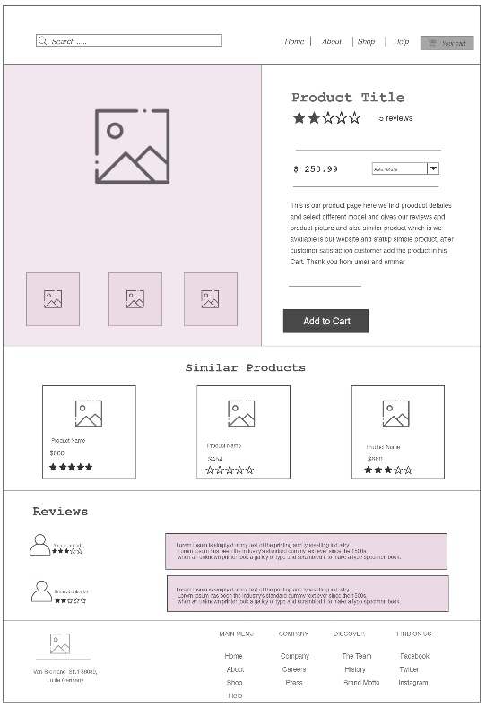
Project roadmap: Mockups
Order sample
Registeration
Login
Samples view

Slide 7









Tools and technology
Tools
Github + sourceTree
Visual studio code
Datagrip
Postman
Technology
Frontend: ReactJS + Bootstrap
Backend: NodeJs
Database: Mysql
Server host: AWS

Slide 8
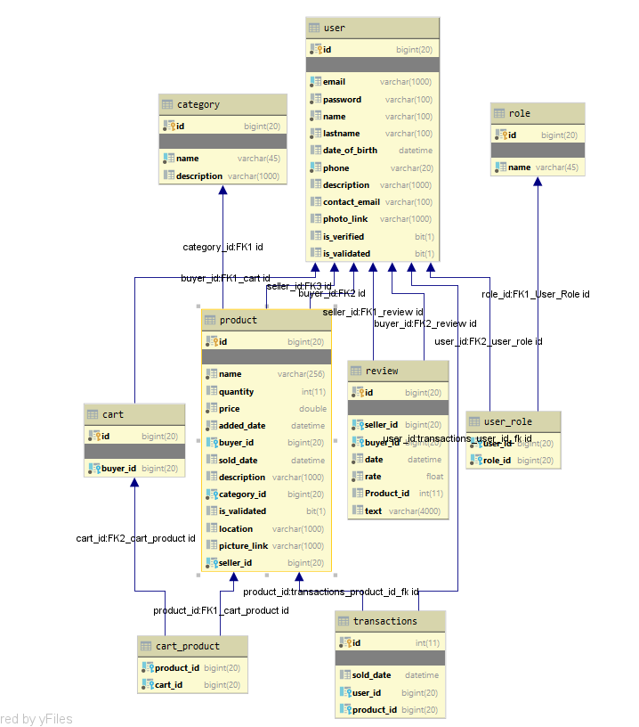

Database flow diagram
Database: Mysql
Host: AWS
Datagrip is used to manage database

Slide 9
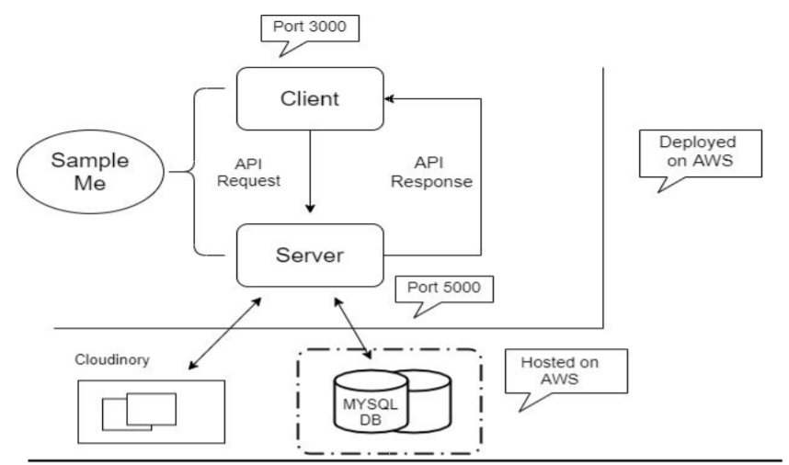
Architecture

Slide 10
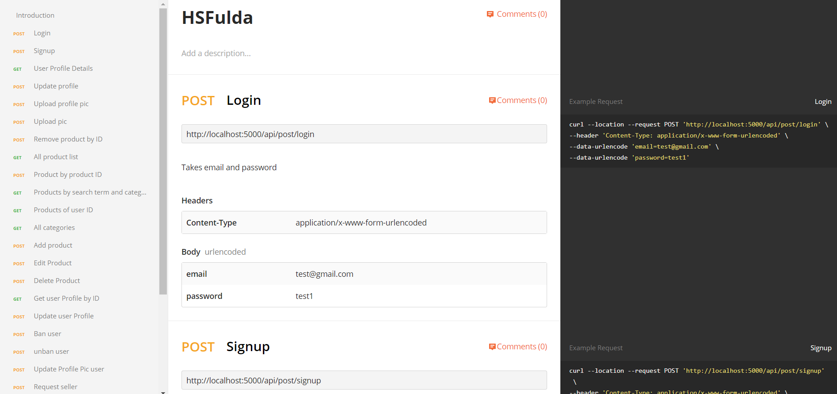
Documentation
Postman is used for API documentation

Slide 11

Google Analytics
Active users can be tracked at:
https://analytics.google.com/analytics/web/#/report-home/a154627567w218151755p208101289

Slide 12
Project Urls
Github repository: https://github.com/rajan-chawla/Build-Web-and-Mobile-App.git
Demo link: http://sampleme-env.rkyupppcqp.us-east-1.elasticbeanstalk.com/
Documentation: https://bold-shadow-2915.postman.co/collections/9281863-d3c6c7f1-f509-4b25-9899-91a103d53238?version=latest&workspace=c97aef81-7f5b-40f7-87f9-92364a469dbc

Slide 13


