Slide 1
Capstone Project-1
EDA Project on Airbnb Booking By:- Rajan Srivastava Sonali Verma

Slide 2
What is Airbnb?
Airbnb, Inc. is an American company that operates an online marketplace for lodging, primarily homestays for vacation rentals, and tourism activities. Based in San Francisco, California, the platform is accessible via website and mobile app.We can relate Airbnb Just like OYO Room.

Slide 3
Overview Of Airbnb.
Since 2008, guests and hosts have used Airbnb to expand on traveling possibilities and present a more unique, personalized way of experiencing the world. Today, Airbnb became one of a kind service that is used and recognized by the whole world. Data analysis on millions of listings provided through Airbnb is a crucial factor for the company. These millions of listings generate a lot of data - data that can be analyzed and used for security, business decisions, understanding of customers' and providers' (hosts) behavior and performance on the platform, guiding marketing initiatives, implementation of innovative additional services and much more.

Slide 4
Problem Statement.
For this project we are analyzing Airbnb’s New York City (NYC) data of 2019. NYC is not only the most famous city in the world but also top global destination for visitors drawn to its museums, entertainment, restaurants and commerce.
Our main objective is to find out the key metrics that influence the listing of properties on the platform. For this, we will explore and visualize the dataset from Airbnb in NYC using basic exploratory data analysis (EDA) techniques.
Data analysis on thousands of listings provided through Airbnb is a crucial factor for the company.
We will be finding out the distribution of every Airbnb listing based on their location, including their price range, room type, listing name, and other related factors.

Slide 5
Understanding the Data
There are around 49,000 observations with various types of field in our dataset.
List of field:
Id Name Host_id Host_name Neighbourhood_group Neighbourhood Latitude Longitude Room_type | Price Minimum_nights Number_of_reviews Last_review Reviews_per_month Calculated_host_listing_count Availability_365

Slide 6
Agenda
We try to answer the following questions for Airbnb:
What can we learn about different hosts and areas?
What can we learn from predictions? (ex: locations, prices, reviews, etc)
Which hosts are the busiest and why?
Is there any noticeable difference of traffic among different areas and what could be the reason for it?
Explore the data and visualize it to recognize the relationship between the dataset.
Which types of room occupied by a neighborhood.
Explore the price prediction.

Slide 7
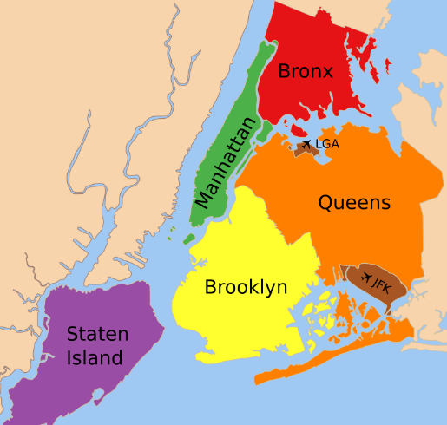
Map of New York City(NYC)

Slide 8
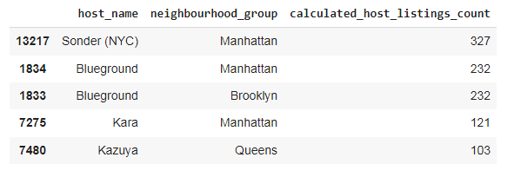
1.What can we learn about different hosts and areas?
Here we can see the most number of listings are from Manhattan created Sonder (NYC).

Slide 9
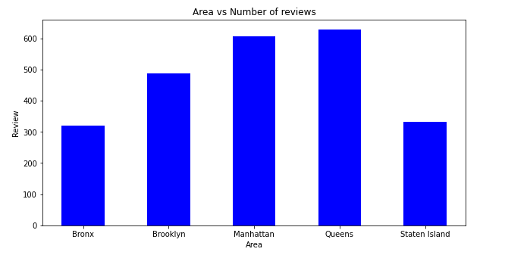
2. What can we learn from predictions? (ex: locations, prices, reviews, etc)
Comparison of Area and Number of reviews we can see the information we got from the graph highest reviews is Queens and the second highest is Manhatthan.

Slide 10
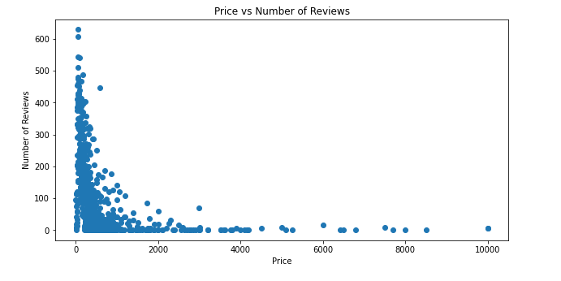
2. What can we learn from predictions? (ex: locations, prices, reviews, etc) (Cont.)
So we can say that most of the people prefer to stay in place where the price is less.

Slide 11
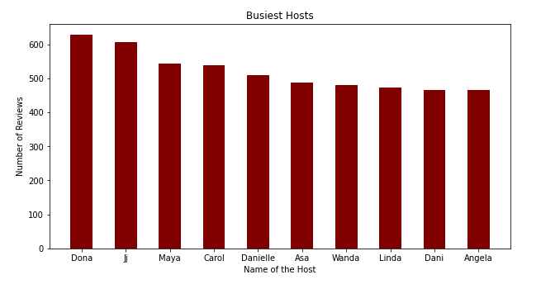
3.Which hosts are the busiest and why?
Busiest Hosts are:
Dona
Ji
Maya
Carol
Danielle
Because these hosts listed room type as Entire home and Private room which is preferred by most number of people.

Slide 12
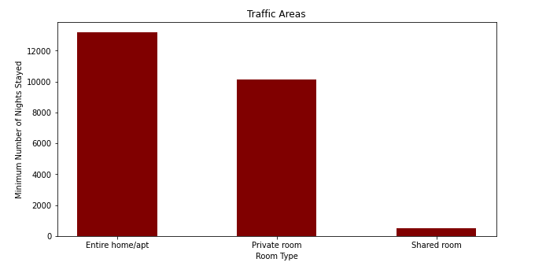
4. Is there any noticeable difference of traffic among different areas and what could be the reason for it?
From the Above Analysis We can Stay that People are preferring Entire home/apt or Private room which are present in Manhattan, Brooklyn, Queens and people are preferring listings which are less in price.

Slide 13
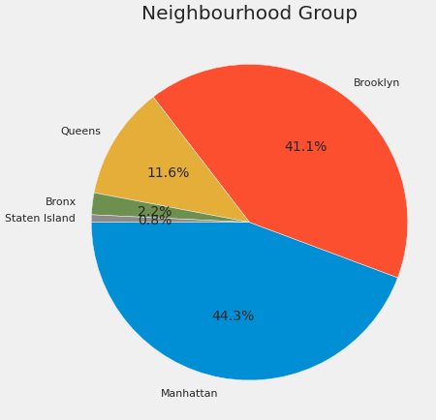
5. Explore the data and visualize it to recognize the relationship between the dataset.
The pie chart above shows that Airbnb Listings in New york are near Manhattan, and Brooklyn has the highest share of hotels. We also know that from this map of Neighborhood Group.

Slide 14
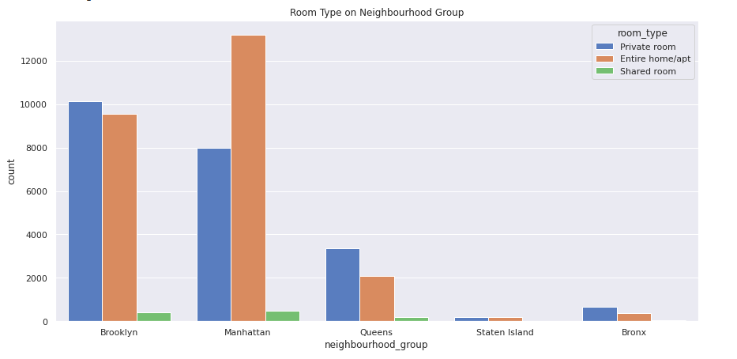
6. Which types of room occupied by a neighborhood.
The graph shows that the Entire Home/Apartment is listed most near Manhattan, while Private Rooms and Apartments Near Brooklyn are Nearly equal.

Slide 15
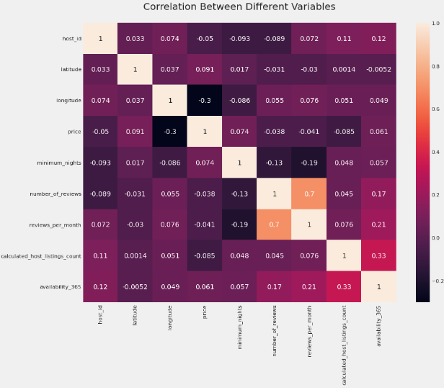
7. Explore the Price Prediction.
From the graph we know that there is not a strong correlation except review_per_month and number_of_review.

Slide 16
Challenges Faced.
Reading the dataset and understanding the meaning of some columns.
For answering some of the questions we had to understand the business model of airbnb that how they work.
handling Nan values,null values and duplicates.
Designing multiple visualization to summarize the information in the dataset and successfully communicate the results and trends to the reader.

Slide 17
We definded some points which can help airbnb in their business.
Manhattan is the most focused place in New York for hosts to do their business.
People stay for longer duration of time in Private rooms in Brooklyn and Manhatthan.
More customer preferred Manhattan location for night stay than Brooklyn.

Slide 18
Conclusion:
1. The people who prefer to stay in Entire home or Apartment they are going to stay bit longer in that particular Neighborhood only.
2. The people who prefer to stay in Private room they won't stay longer as compared to Home or Apartment.
3. Most of the people prefer to pay less price.
4. If there are more number of Reviews for particular Neighborhood group that means that place is a tourist place.
5. If people are not staying more then one night means they are travellers.

Slide 19
Thank You

