Slide 1
Venues/Business Analysis in India

Slide 2
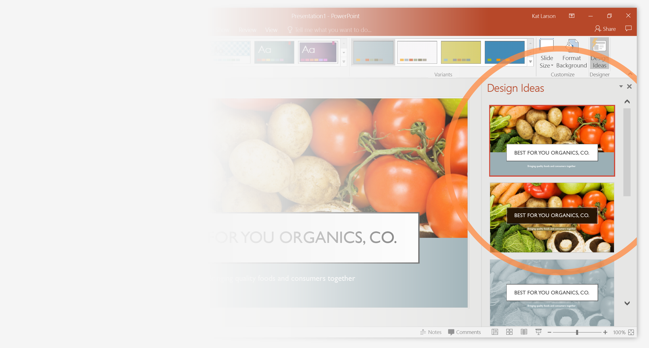
Introduction
In today’s world where it is becoming challenging for earning good money from a job.
So, people are mostly thinking of starting a business, but they are always confused and ask me to tell me some solution which can give them some idea about the location and business to start in a location.
This project is about doing a business and strategizing the location and business. Sometimes, it is challenging for the investors to invest the money. It will help in doing the analysis for them and help in taking better business decisions.

Slide 3
Business Problem
Whenever people are thinking about doing a business it is always challenging to work from scratch and find out a location and the type of business. Most of the time they heard from people about the business and location without doing any analysis which i am afraid to say that people used to fail multiple times only because of this reason.
Nowadays, Investors are looking forward to investing their money in good start-ups which help both to get succeeded but they may take wrong decisions as they don't know the competition in that city or area. This project will give a good insight to all the people who want to explore and study more about the existing businesses along with help them to do analysis first further take any decision.
It will provide the information about the similar cities in an area to determine the same kind of opportunities in different locations.

Slide 4
Data section
For this purpose, this project contains the data of India and based on the requirements it will analysis the state and give the result in the form of Data Frames and maps with proper location. Here, one example of state i.e. Andhra Pradesh has been taken. It will generate all the businesses present in Andhra Pradesh state with city information as well.
Data will analyse the top 10 venues/businesses which are present in the respective city and classify them using K-Means algorithm to give the better recommendation of the businesses which a person can think about it. It will prove the complete report about the cities and will help to understand the similar cities in terms of business.
Here, Folium library is used for plotting the maps and Foursquare API is used to get the venues information and extracting the features related to venues. We can explore more on Foursquare API to get the results about the items on a venue along with the ratings and comments etc.

Slide 5
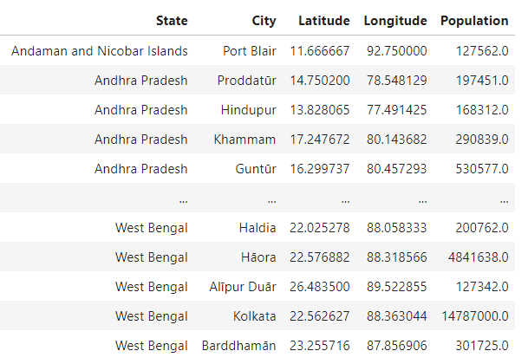
Methodology
How it works:
1
For this project, Data is gathered from https://simplemaps.com/data/in-cities which provides the information about the major Cities, States, Population, Latitude and Longitude information of India.
2
Data pre-processing step is done where the data will contain only the useful information’s. Post this step the data is in the below mentioned format.
Data has been displayed in the maps form for better understanding about the location of the business and the distance between them to do better analysis and making good decision.
3

Slide 6
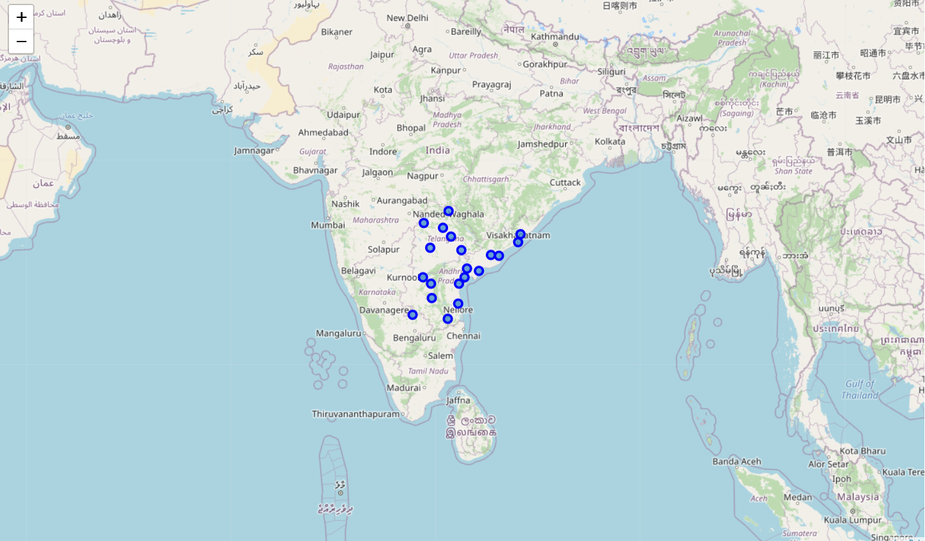

Slide 7
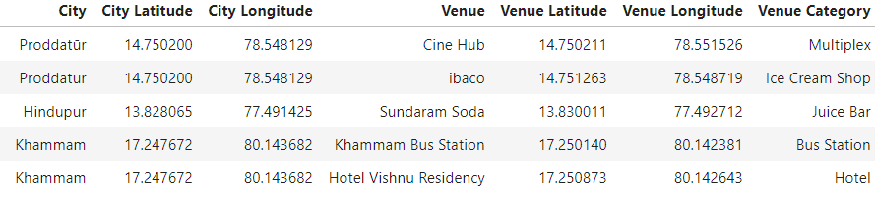
For getting the information about all the businesses, Foursquare API is been used which will give the information about the cities we have and existing venues/business.

Slide 8
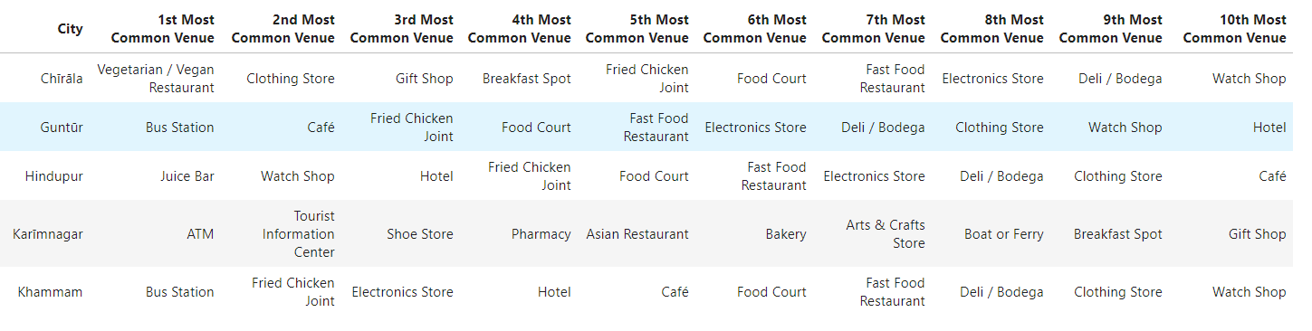
Data is formatted again in a tabular format with the required columns. Later analysis is done on this data using folium map’s and data frames to get the top 10 venues/businesses in a city to compare and take the decision about their similarity and the most commonly used businesses in a city.

Slide 9
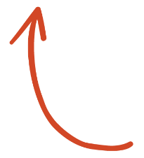
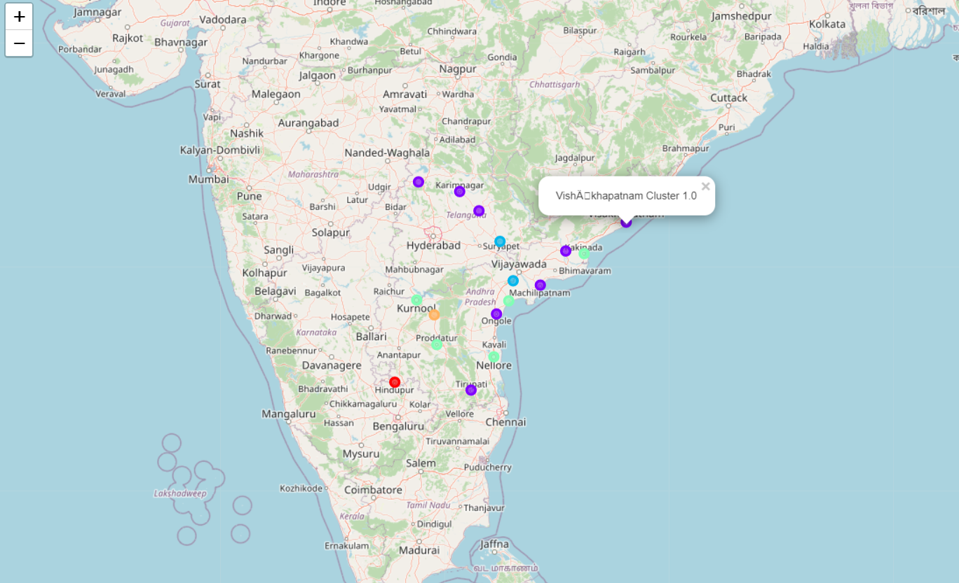
Results
Using k-means algorithm and clustering the data is combined and the analysis is done. Using K-means the data is split into 5 clusters. Some cities we are having very few businesses and some of the city are having a good number of businesses. It will provide the complete insight about all of them.
SELECT ME

Slide 10
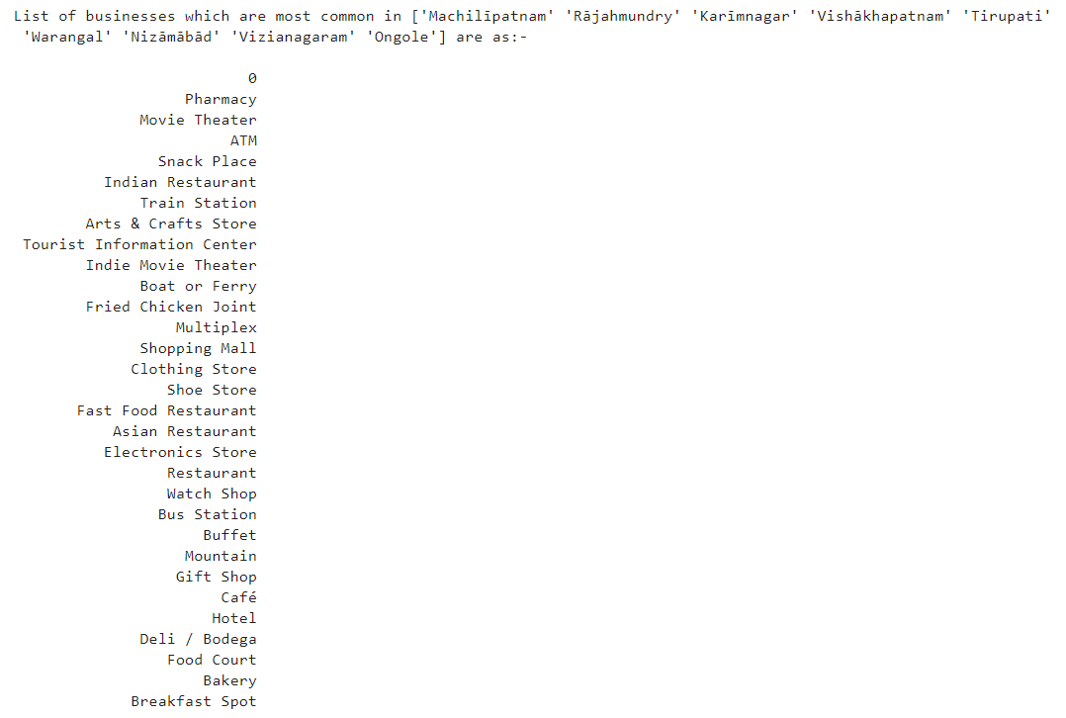
Explore without leaving your slides
It will also provide the information about the similar cities where same kind of business can be setup based on the financial cost and other benefits.

Slide 11
Conclusion
The results it displayed are correct and have been confirmed by the people who want to use it. Here it is specific to Andhra Pradesh, but it can be used to compare two cities, two states etc. It can provide more information about the other cities as well which are a part of India.

Slide 12
Thank you

