Slide 1
(ICPECTS 2020IN COMPUTER INTERFACE)
HOME AUTOMATION USING BCI (BRAIN COMPUTER INTERFACE)
PROJECT MEMBERS/AUTHOR
ECE B-TECH 2020 BATCH
SHAIK CHINNA HUSSAIN VALI
ANAND RAJ
ADITI GOGOI
PROJECT SUPERVISOR
Mr.M.Rajmohan, M.Tech.
ASST.PROFESSOR (S.G)
Electronics and Communication Engineering
Hindustan University

Slide 2
CONTENT
Introduction
Objective
Literature survey
Existing Method-Block Diagram
Problem Formulation
Proposed Method-Block Diagram
Proposed Method- Explanation
Result and Discussions
Conclusion

Slide 3
INTRODUCTION
Lets connect human brain to micro controller through which we will control home appliances.
The Brain Computer Interface(BCI) technology integrates with it to provide an elegant way to control home appliances.
BCI based home automation system provides silent way of interaction to achieve the daily life task of switching any appliances with in its range.
BCI system work by acquiring brain signal then preprocessing, feature extracting and state predicating by algorithm which then actuate the device.
Implementing this technology will simplify the lifestyle as it will reduce physical effort and it would also prove as a boon for physically disabled people.
Elderly people can live independently with privacy.

Slide 4
OBJECTIVE
To make reliable ,efficient and low cost wireless brain computer interfacing (WBCI) system to be applied for home automation.
This project proposes a new model to control the home appliances with minimal physical activity. Especially for highly disabled persons

Slide 5
LITERATURE REVIEW
SERIAL NO: | PAPER DETAILS | YEAR | PROPOSED METHOD | DRAWBACK
1 | Wireless Brain Computer Interface for Smart Home and Medical System © Springer Science+Business Media, LLC, part of Springer Nature 2018 | 2018 | The research paper contains BCI application. It is achieved by two microcontroller and neurosky headband. It uses Arduino board to detect the parameter . It also uses the same to control the appliances. | Less data acquiring which there after reduces the number controllable device. Only using eyeblink Uses lot of Bluetooth module

Slide 6
LITERATURE REVIEW
SERIAL NO: | PAPER DETAILS | YEAR | PROPOSED METHOD | DRAWBACK
2 | Controlling Home Appliances through Thought Commands Sri Lanka. 2018 International Conference on Advances in ICT for Emerging Regions (ICTer) : 309 - 315 | 2018 | It uses neurosky headband which is non invasive type to collect raw data then sends wirelessly to mobile for processing . Then the data is processed and sent to respective indicator placed which is used as reference to toggle device. | Less data acquiring due to simple programming. Set of rules is not there but uses controller box for indication which increases hardware requirement a lot. More attention of user is needed and should be in front of indicator box while controlling.

Slide 7
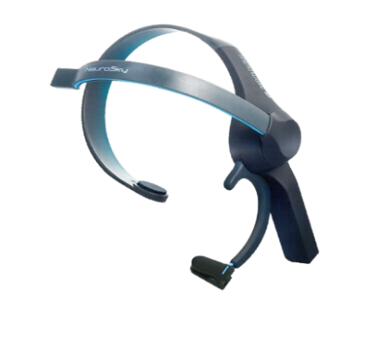
EXISTING METHOD BLOCK DIAGRAM
Light bulb
Bluetooth module
Arduino UNO
Neurosky EEG headset
Wireless data transfer
fan
Stationary part
Wireless communication
BP monitor
Bluetooth module
Arduino
UNO
Smart phone
Wireless data receiver
Therapy belt
Mobile part

Slide 8
EXISTING METHOD
Generally the readymade sensor products like neurosky or brain sense are used to generate raw data and process it further in processor to generate and detect the level of parameter which in turn is used to trigger the relay of the appliance.
Most important section is processing where we found a lot of issues which make it less user-friendly and less productive in utilization factor.
MAJOR DRAWBACKS OF EXISTING MODEL:
Need to be Infront of interface unit while controlling.
No way to shut down/ sleep system by brain interface.
Utilizes high cost Neurosky headband .

Slide 9
PROBLEM FORMULATION
Less operational Features.
More attention of user is needed and should be in front of indicator box while controlling.
Uses lot of Bluetooth module.
Processor is either bulky or less processing ability.

Slide 10
PROPOSED METHOD
The main aim is to overcome the problems and limitations of existing method to make the system more efficient.
Processing in android device to make system portable.
The main area to modify is the GUI section where we will enhance the system user interface.
Our motive is to control at least 4 appliances as for demonstration.
Range will be 10 meter from the central device.
Introducing new functions like background mode, auto-shut.

Slide 11
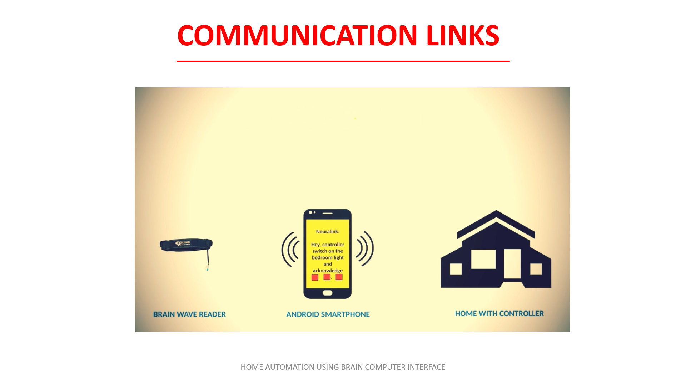

Slide 12
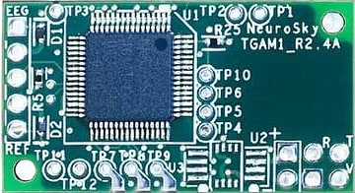
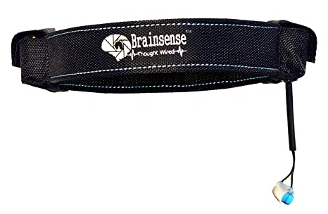
SENSING METHOD AND SENSOR DETAILS
TGAM: ThinkGear ASIC Module
• Non invasive and dry electrode (as opposed to conventional medical wet sensors)
• One EEG channel with three contacts: EEG; REF; and GND.
seconds, or if it is receiving a poor signal for seven consecutive seconds
• Advanced filtering technology with high noise immunity
• Low power consumption suitable for portable battery-driven applications
• Max power consumption 15mA @ 3.3 V
• Raw EEG data output at 512 bits per second
Measures below parameters:
• Raw brainwave signal
• Processing and output of EEG power spectrums (Alpha, Beta, etc.)
• Processing and output of NeuroSky proprietary eSense meter for Attention, Meditation, and other future meters
• EEG/ECG signal quality analysis (can be used to detect poor contact and whether the device is off the head)
• Eyeblink detection
ASIC CHIP used inside Brainsense
Brainsense Sensor headset

Slide 13
CIRCUIT OF SENSOR WITH BLUETOOTH MODULE
POWER SOURCE
3.3 VOLT REGULATOR
BLUETOOTH MODULE
THINKGEAR MODULE
The thinkgear module process the data and for transmitting the data Bluetooth is used as communication module.
Bluetooth module
HC-05

Slide 14
RELATION BETWEEN MAJOR WAVES AND E-SENSE PARAMETER
Attention( Dominancy of gamma waves)
The Attention Meter algorithm indicates the intensity of mental “focus” or “attention.” The value ranges from 0 to 100. The attention level increases when a user focuses on a single thought or an external object, and decreases when distracted.
Meditation(Alpha and beta dominance)
The Meditation Meter algorithm indicates the level of mental “calmness” or “relaxation.” The value ranges from 0 to 100, and increases when users relax the mind and decreases when they are uneasy or stressed.
Blink Detection
The Blink Detection algorithm signals a user’s blinks. A higher number indicates a “stronger” blink, while a smaller number indicates a “lighter” or “weaker” blink. The frequency of blinking is often correlated with nervousness or fatigue. Eye blinks are akin to a standard on/off binary system and therefore are valuable for controls that require definitive responses.

Slide 15


PROPOSED METHOD BLOCK DIAGRAM
Interface and Processor section:
Brainsense READER
DATA ACQUISTION
AND
PROCESSING UNIT
BLUETOOTH module
ANDROID DEVICE

Slide 16
BLOCK DIAGRAM
Controller section:
Indicator 1
APPLIANCE1
MICROCONTROLLER
Indicator 2
BLUETOOTH module
APPLIANCE2
Indicator 3
APPLAINCE 3

Slide 17
REQUIREMENTS OF HARDWARE AND SOFTWARE
HARDWARE:
Android device
Headband Sensor set(non invasive type)
Bluetooth module
Microcontroller(Arduino)
Relay set
Power source(adapter)
Bulbs and fans
SOFTWARE:
Android studio
Arduino IDE

Slide 18
FLOW CHART
start
Input stream raw, attention, meditation data
Listening for blink
Level 0
No
Is blink is detected
Yes
Listening for blink
Is blink is detected
Level 1
No
Yes
No
If time
t<2&t>0.2
Yes
double blink
registered
Level 2
selection table showed up
No
Is blink is detected
Yes
Connector 1
0

Slide 19
Yes
Connector 1
0
No
Is
t<27
Yes
0<t<3
0<t<12
18<t<21
No
3<t<6
12<t<15
21<t<24
No
6<t<9
18<t<21
24<t<27
level 3
No
Yes
Yes
Yes
Device 1
selected
Device 2
selected
Device 3
selected
Timer started t=0
Yes
Listening for attention value
Ys
No
Is
T<20sec
No
Is attention
>65%
Level 4
Yes
device toggle

Slide 20
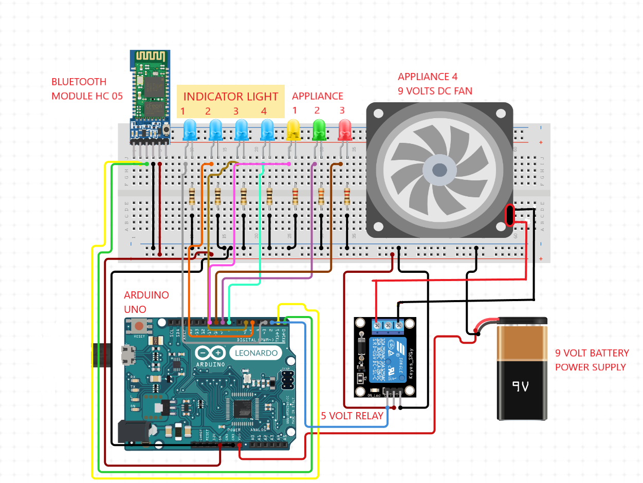
Controller Section:
It takes response from central processor and act as programmed to toggle appliance and to send acknowledgement signal back to processor.

Slide 21
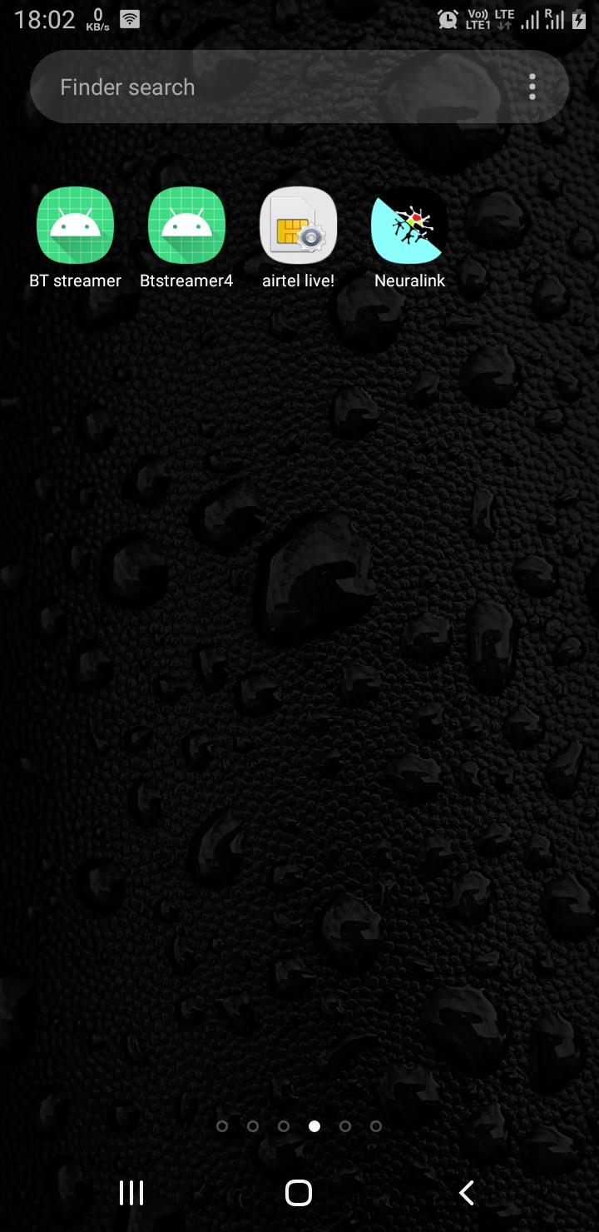
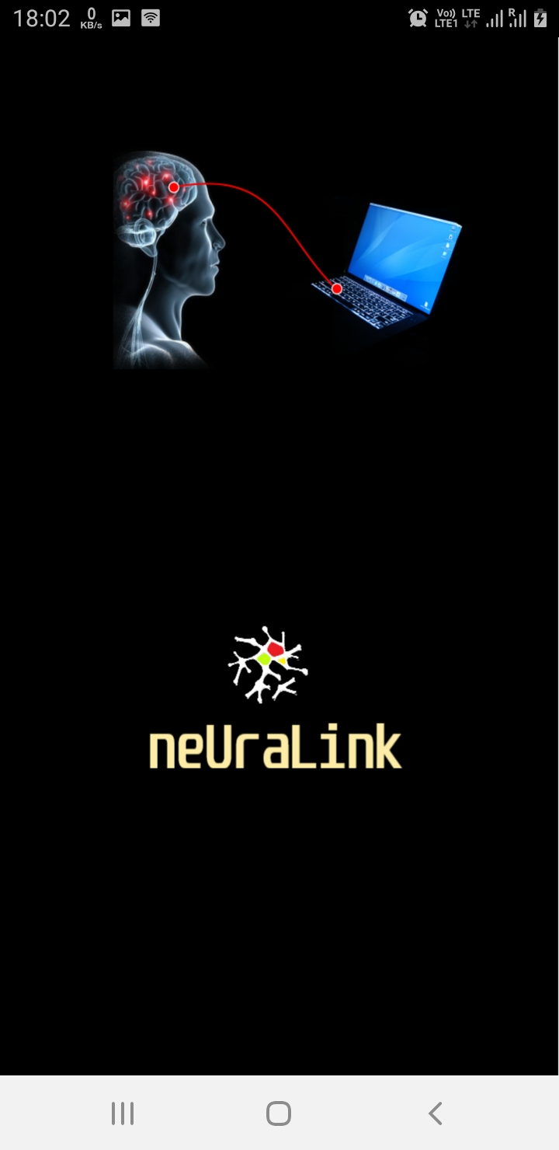
FIND YOU APP IN APP LIST
This is the splash screen when app resources are being loaded you will see this screen.(at most 2 second) Depends on device performance.
Here is your app.

Slide 22
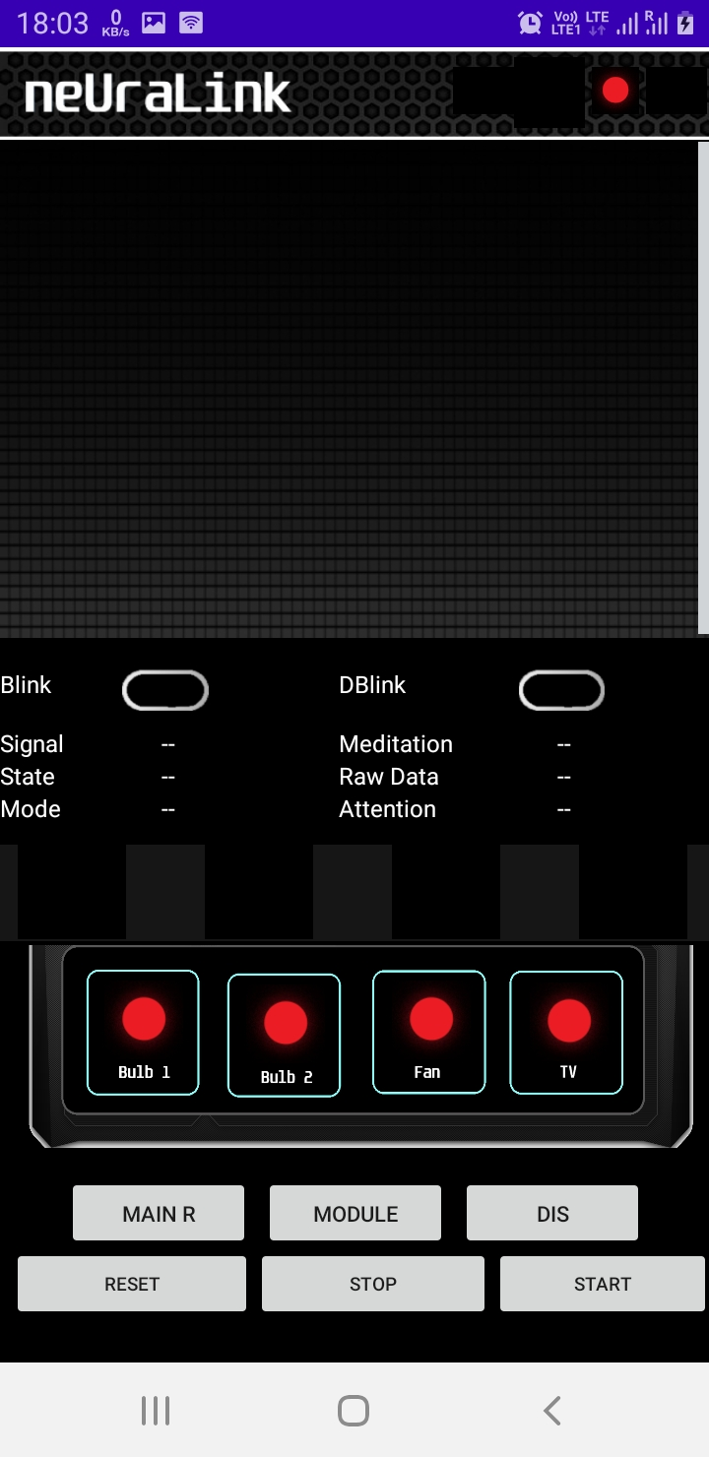
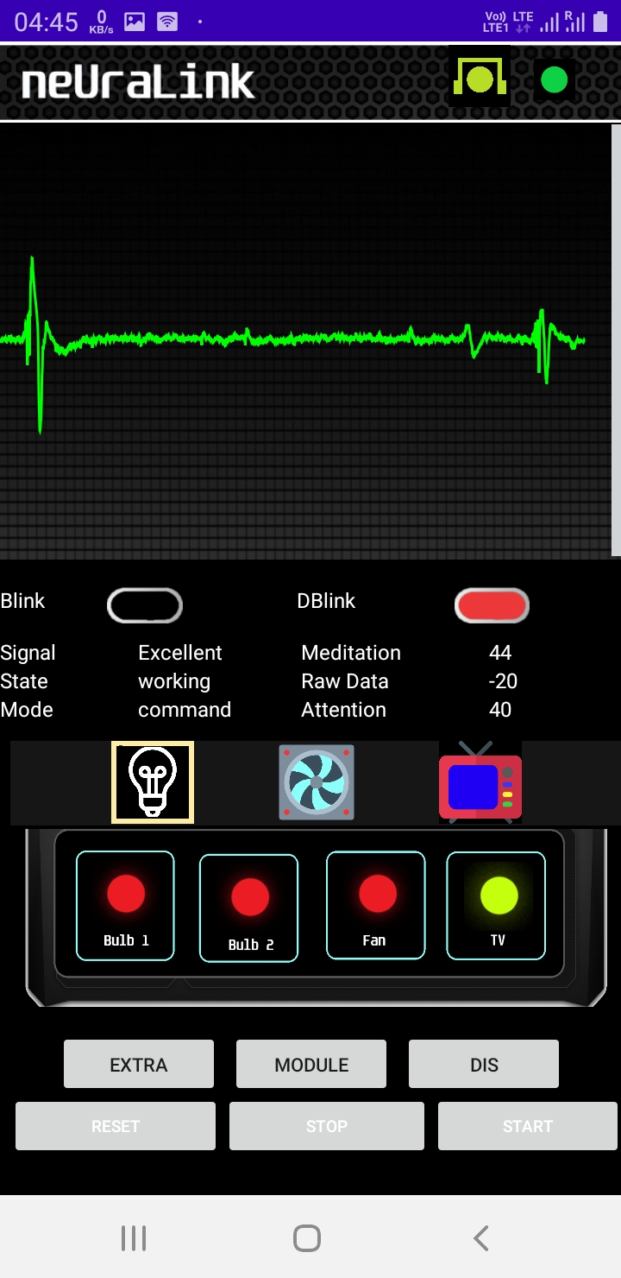
FIRST LOADED SCREEN
HEADER SECTION
GRAPH PLOT
GUI IN ACTION
DATA LOG PANEL
DEVICE CYCLE PANEL
CONTROL PANEL
BUTTON GROUP

Slide 23
TEST PARAMETER EXPLANATION
Intended toggle means user wanted to toggle the device and successfully toggle it.
False toggle means user doesn’t wanted to toggle but due to automated biological response of subject toggled the device.
Discarded trail means system listener was not in sync with the eyeblink event when occurred.
False toggle percentage is calculated as no of false toggles by total no of trails eliminating discarded trails * 100.
User complexity is rated from 0 -10 level where 0 is easiest and 10 is hardest.

Slide 24
RESULT AND DISCUSSION
No of tester | No of trails | Intended toggle | False toggle | Discarded trail | False toggle percentage | Was it hard to operate?
Person1 (male) | 30 | 26 | 0 | 4 | 0 | 3
Person2 (male) | 30 | 26 | 1 | 3 | 3.8 | 5
Person3 (female) | 30 | 25 | 0 | 5 | 0 | 4
 |  |  |  | Average data: | 1.27 | 4
Revived basic model:
Quad level system , user can reach at 1st level just by eyeblinkand 2nd level by consecutive eyeblink under 2 second, for 3rd level he need to eyeblink again for device selection and 4th level to do toggle the device user needs to cross the attention above 65%.
Constraint: moderate eyeblink , eyeblink under 2 sec to enter 2nd level , 65% of attention under 20 seconds at 4th level.

Slide 25
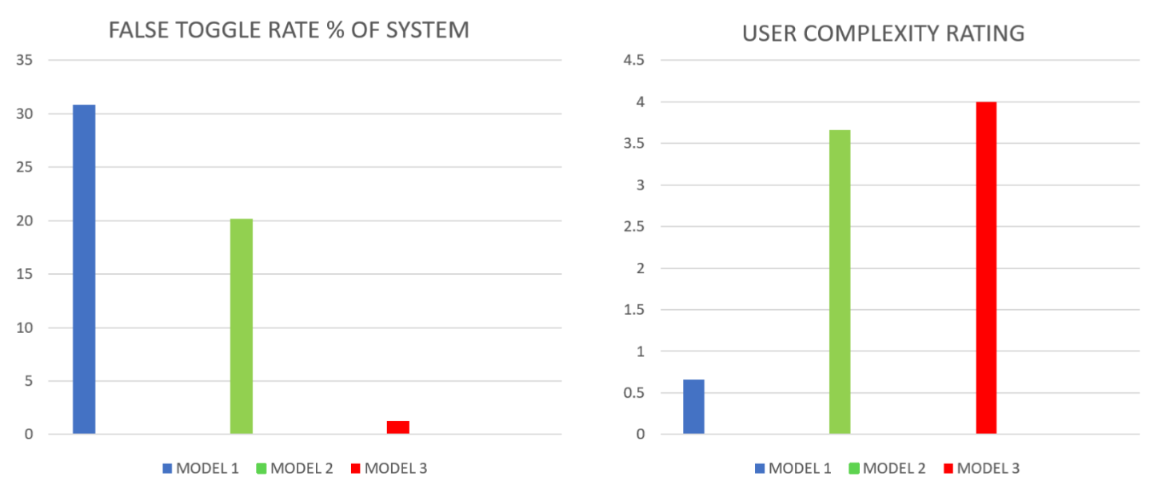
ANALYSING TESTED DATA AMONG ALL MODELS

Slide 26
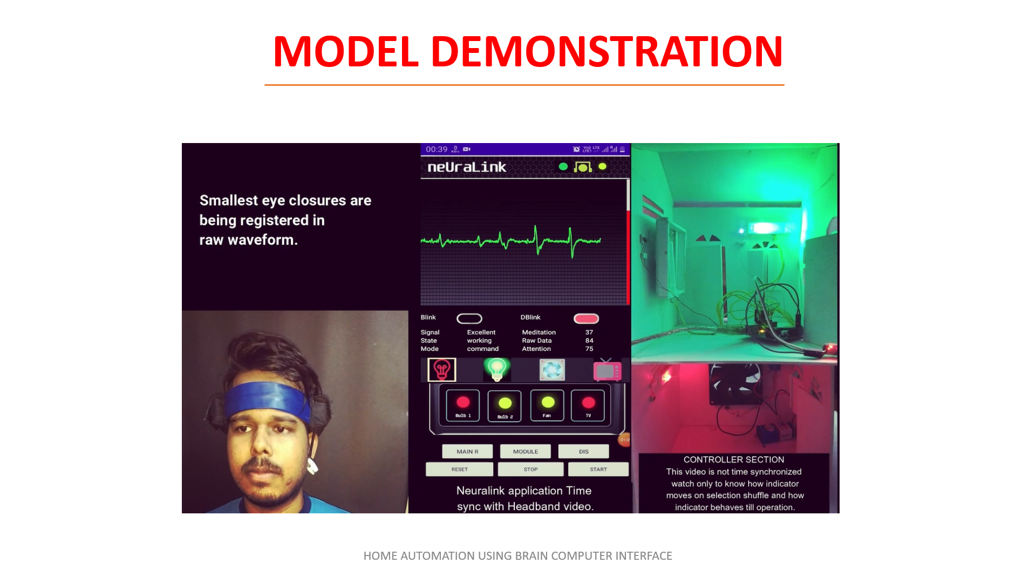

Slide 27
KEY IMPROVEMENTS IN THE PROPOSED METHOD
Need not be In front of control device
Using code technique we can reset activity
With training facility
Better user GUI
Sleep system -It doesn’t trigger by unwanted brain activity
Coding technique implementation to control more devices- (coding here means arranging parameters in specific ways with specific rules so we can get more combination with available parameter)

Slide 28
COMPARISON TABLE
EXISTING METHOD | PROPOSED METHOD
Average GUI. | Icon based GUI for better user interaction.
No security from external or unauthorised access to control. | Special sequence to control device which is hard to known to others.
Unwanted activity can trigger the system. | Special sequence to control prohibits this effect and error/exception handling can prevent it.
Background working not possible . | Can work in background.
Need to be Infront of device to control the appliance. | Could be anywhere under the range but should know the parameter sequence to activate that device, three ways to control.
Most Utilises high cost neurosky(cost Rs 14000) band but some also use brain sense(cost Rs 6000) that are used by us. | Uses self assemble sensor kit with same circuit board which reduces cost about 60%.(Rs 6000)

Slide 29
CONCLUSION
We finally created an App that does all the function explained above and have a file size of 15mb in apk format which can be installed in any android phones.
It takes minimum time of 7 second to toggle a device state if person is trained well and for new user it takes around 20 second to toggle a device.
According to the test false toggle rate is 1.27% and blink detection accuracy is around 80%(means 1 out of 5 blink is not sensed by system), we can improve these factors in future scope of this project.
User can use any brain signal reading device manufactured by Neurosky company as the application is based on their SDK(software development kit).
Currently handle 4 application but can be customized according to the user need.

Slide 30
FUTURE WORK
Adding of setting page in GUI layout from where we can tune the system setting as per requirements, currently we are doing these task by modifying internal code
Web interfacing of module which will make it of operable at any range.
Modifying blink filter to reduce number of discarded trails as sometimes blink listener fail to detect the blink.
Decreasing the weight of the headband by using rechargeable lithium-polymer battery it will also increase the backup time of sensor module.

Slide 31
1. Wireless Brain Computer Interface for Smart Home and Medical System Syed Rehan Abbas Jafri1 · Tehreem Hamid1 · Rabia Mahmood1 ·Muhammad Asjad Alam1 · Talha Rafi1 · Muhammad Zeeshan Ul Haque2 ·Muhammad Wasim Munir2 © Springer Science+Business Media, LLC, part of Springer Nature 2018 2. Controlling Home Appliances through Thought Commands Karunarathne, K.A.T.A. #1, Ekanayake, H.E.M.H.B. #2 #University of Colombo School of Computing,UCSC Building Complex,35, Reid Avenue, Colombo 7 Sri Lanka. 2018 International Conference on Advances in ICT for Emerging Regions (ICTer) : 309 - 315 website links: https://www.irjet.net/archives/V5/i4/IRJET-V5I4927.pdf http://developer.neurosky.com/docs/doku.php?id=thinkgear_communications_protocol http://www.ijettjournal.org/2016/volume-34/number-7/IJETT-V34P261.pdf https://ieeexplore.ieee.org/document/8409863
REFERENCES

