Slide 1
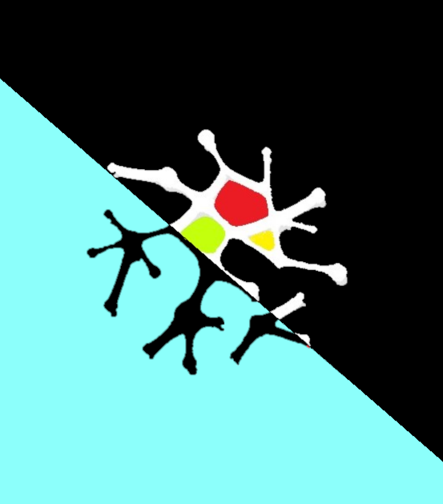
NEURALINK
MANUAL GUIDE FOR THE APP
(basic overview)

Slide 2
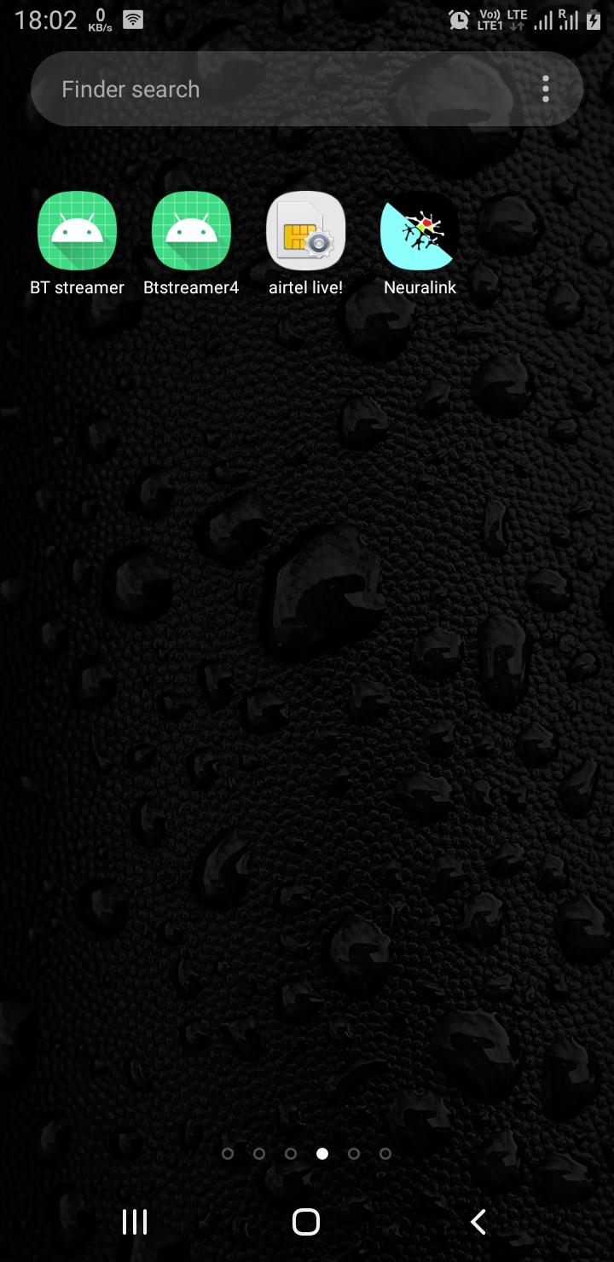
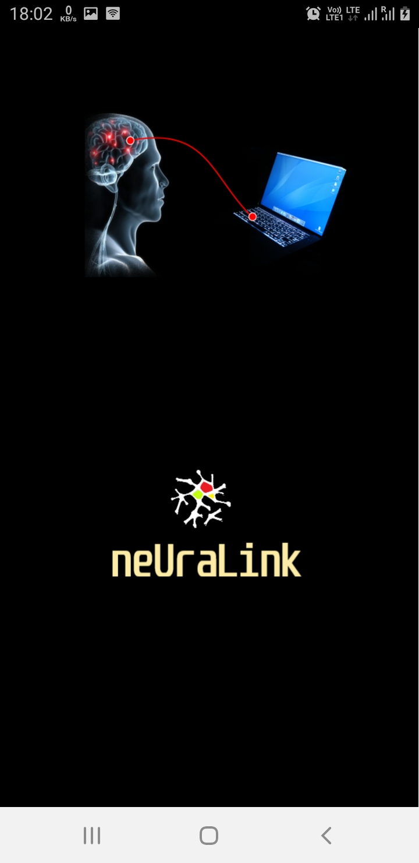
Find you app in App list:
Here is your app.
This is the splash screen when app resources are being loaded you will see this screen.(at most 2 second) Depends on device performance.

Slide 3
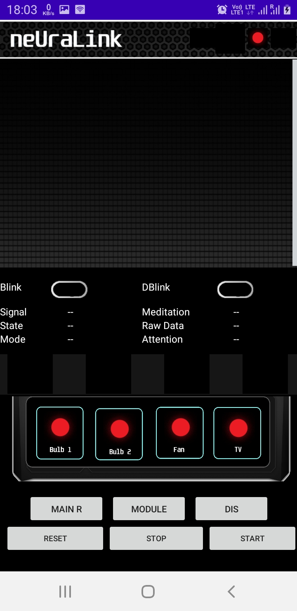
First loaded screen:
This the window where you will land after selecting the app it takes around 2-3 second to load the app and its resources .once you are on this page you are ready to connect and start the operation.
This is one of the indicator in the four indicator placed in the header section. This is module indicator means telling us that controller module is not connected it will turn green once it got connected.
This is the graph window where you will see the real time raw data plotted over.
This is data log panel where you will see the different types of data which will define the working behavior of system
This is the device cycle panel where your device will show once you reached at that level.
This is the control panel where you will see the current state of the all device in real time.
This is the button group consists of six button you will see its uses in detail in upcoming slide.

Slide 4
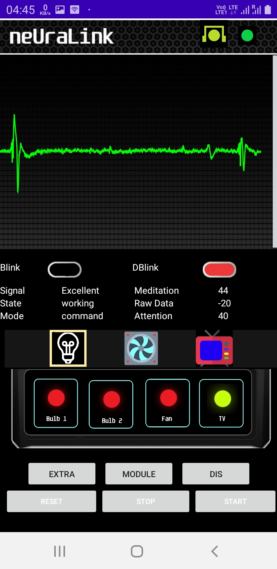
Graph layout and device cycle panel:
As per this image only three device is shown in selection cycle but control panel shows 4 device as this screen shot is of previous version of the application. In new version one more bulb is added.
+4000
As raw data being plotted and sudden peak indicates the eyeblink phenomena . The window have maximum 4000 unit in positive y direction and -4000 in negative y direction. Signal above this range is will appear clipped and have very rare chance to appear. 5000 data is plotted on the graph (it takes around 7 sec) then it erases and starts plotting again.
0
-4000
This is the progress bar of the attention it ranges from 0 to 100, full bar filled with red filler color is 100 and currently showing 0.
Double blink indicator
The selection (square yellow ring) is currently over the bulb. It moves on each three second from one device to another device on this stage . It show the current state of device as you can see the tv is on with blue screen . You can verify same from control panel green light is on in the tv section.

Slide 5
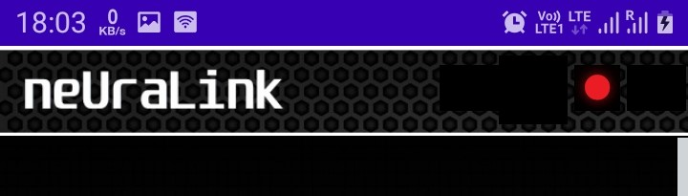












Header indicator with its meaning:
HEADER
This remains most time empty but when you remove headset in operation without switching off or disconnecting the headset it will kill the main switch so device don’t show abrupt control actions.
1
 | means
 | Main switch triggered you can’t control any thing until it is regained.
 | Functionality regained.(by pressing -Main R- switch .
Controller module connection.
It shows the SDK working state of (software that is responsible for data undocking from the headset ).
 | means
 | Device not connected.
 | Device connected.
color | What it means
 | State working.
 | State stopped.
 | State failed
 | State disconnected
 | State timed out.
 | State error.
 | Indicator yet to show up.
Indicator for brain sense connection.
 | meaning
 | No signal.
 | Connected.
 | Indicator yet to show .
 | Connecting.

Slide 6
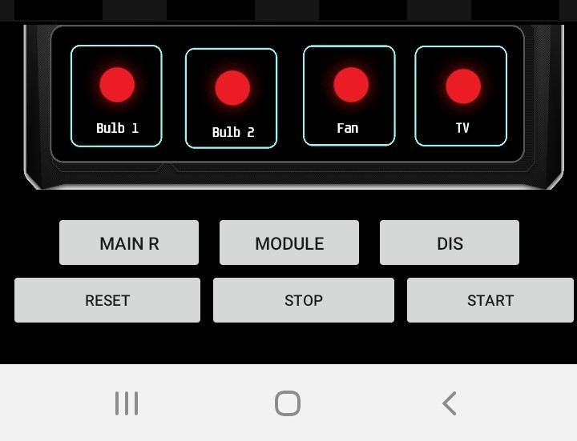
Control panel and switches:
This is known as main regain , when the functionality get locked known as main off automatic due to disturbance in raw signal either due to improper wearing of headset or headset removal during operation. This will regain the control and make the system operatable again as normal.
Control panel with for device indicator if indicator is its in off status if its
then that device is on status. It has memory means if you make on some device earlier it will retain the status of that device.
Reset button will boot the system means the device position will be set to off position for all device.
While connected to module if you reset it will also make all the appliance off physically.
It will connect the headset also initiate the SDK working to undock data, graph must appear if connected successful and SDK started working. It must be pressed after module connection if module available and the brain sense must be turned on before pressing this button.
Module button will try to connect the controller module to the application it must always initiated before the headset connection.
This will disconnect the brain sense and stop the working state of SDK but module connection won’t be affected you can resume again and connecting head band by start button.

Slide 7
SETUP
This slide teaches you to setup the systems and connections here module refers to controller module which have JDY 30 bluetooth module onboard and headset refers to the neurosky headband which have hc-05 Bluetooth module for upstream.
Setup splits in two section one for training and other for the operation . In training operator will simply learn how to turn on and off the device without connecting to the module. The app will work simply without sending any command to activate the device as its not connected to the app. Most functionality will work well.
As training will over person can connect the module and start the real operation of the device now the module is connected it will receive the command and work according to that if the operation goes wrong operator can reset the system.
STEPS TO SETUP: ( training)
Module should not with connected.
Open the app.
Start the brain sense device check the red blink light is blinking or not in brain sense device.
Now press the start button to connect the app to device.
Based on indicator knowledge you can know the working state of device it should plot data if started and sound if you blink the eye.
STEPS TO SETUP: ( OPERATION)
Power the module(we must supply power to module at least during operation at most always).
Open the app and connect to module, upon successful connection module indicator will turn red to green and toast message would be seen “module connected”
Turn on the Brainsense and press start button, upon successful connection the graph will appear and indicator will change according to its state.
NOTE: In case of battery low of module or not turned on the state will fail to connect and indicator will show the same with respective message
Note: Always connect the module first and then Brain sense if in operation mode.Dont remove the Headset without disconnecting or turning it off otherwise it will trigger the main kill switch.

Slide 8
Operation:
After successful setup the effective operation is efficient way to handle its command and troubleshooting.
System model is explained below in points:
The model is created on levels it means you must reach one level to another for further controls like in games.
There are 4 levels we also called them modes of operation that are standby, D blink, command, focus.
When you will start the app you would be on the standby mode in this mode system is waiting for a moderate intensity eyeblink to proceed on next level . When Raw value passes over (above -600 to +600) we call it moderate blink level . if it detects blink it will move to second level that is D blink mode.
As this level will start the system will start to make alarming sound for the next two second . In that two second its assuring that that was intended response by you by registering a second eyeblink of moderate level but it must be responded under that 2 second period. Two condition happens here either you provide the blink when it was beeping or you left , if it registers the blink in appropriate time range it will move to next level else will land you on first level.
Lets Assume you successfully reached third level that is command mode in command mode the system will show the device with selection moving over each in each 3 second and at same time the indicator light near the appliance will be on and try to move there also in sync with the application. You can select the appliance either by the indicator or seeing the application . To select the device you need to blink with moderate level . As the Device will be selected it will play a tune that will indicate that you moved on 4th level and by indicator the indicator of that particular device where selection happened will blink once at show static glow . If you didn’t eye blinked on any device the selection will roll three times than slides back to standby mode.
You reached the 4th level where you need to focus that’s use of you attention if it reaches above 65 out of 100 it will toggle the device from its initial state. If You cant able to make it then will look for 20 sec then will slides to standby mode. During whole period a tune to focus is played on the application and particular indicator glows whole period. As the 20 sec is over or the attention above 65 is detected the indicator will turn off and song will be stopped .
Note:
you will notice each level have automatic slide to standby level based on time this is due to avoid stucking at certain levels.
At each level you have sound or any notification so you know the navigating level well.
When user will remove the headset during operation without making it off the main kill switch takes action and off the data feed going to the control structures of the code which prevent it from unwanted triggers.
It may look like too much to toggle a device but if you trained will you can toggle a device under 10 second. Total of 3 blink (2 consecutive and 1 for selecting device) and attention level above 60 is needed to achieve this.

Slide 9
Why leveled design of the system:
Brain signal are random in nature and low level eye blink happens around 20-40 times a minute. Which can trick our system as intended response. Level design restricts it reaching at the level top where toggling happens by demanding specific type of response at specific time.
It increases the complexbility of the use by view point of user but reduces the false triggering of the system or making any device on or off with intention of user. So a trade off between user complexity to operate and false triggering is set.
At this point be assure the false triggering have very low chance and a trained user will not face a lot of issue as he will just feel it like a levels in game .

Slide 10
That’s all about basics and UI of the application.

