Slide 1


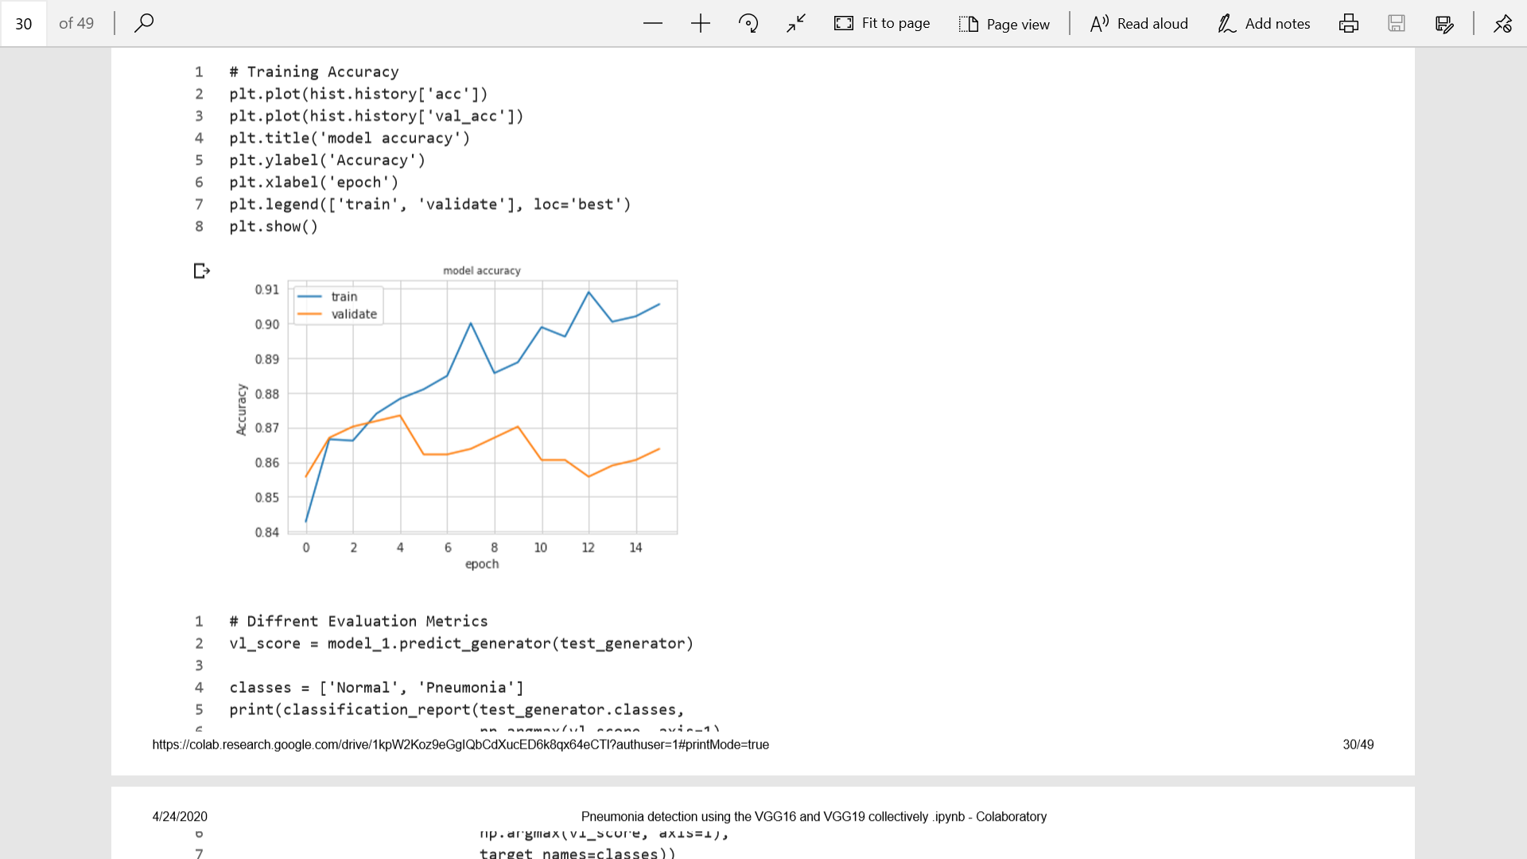
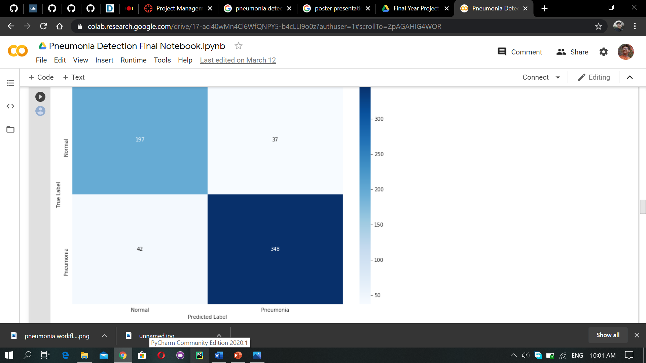
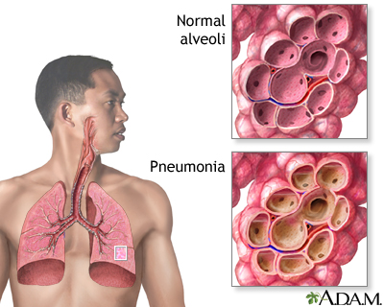
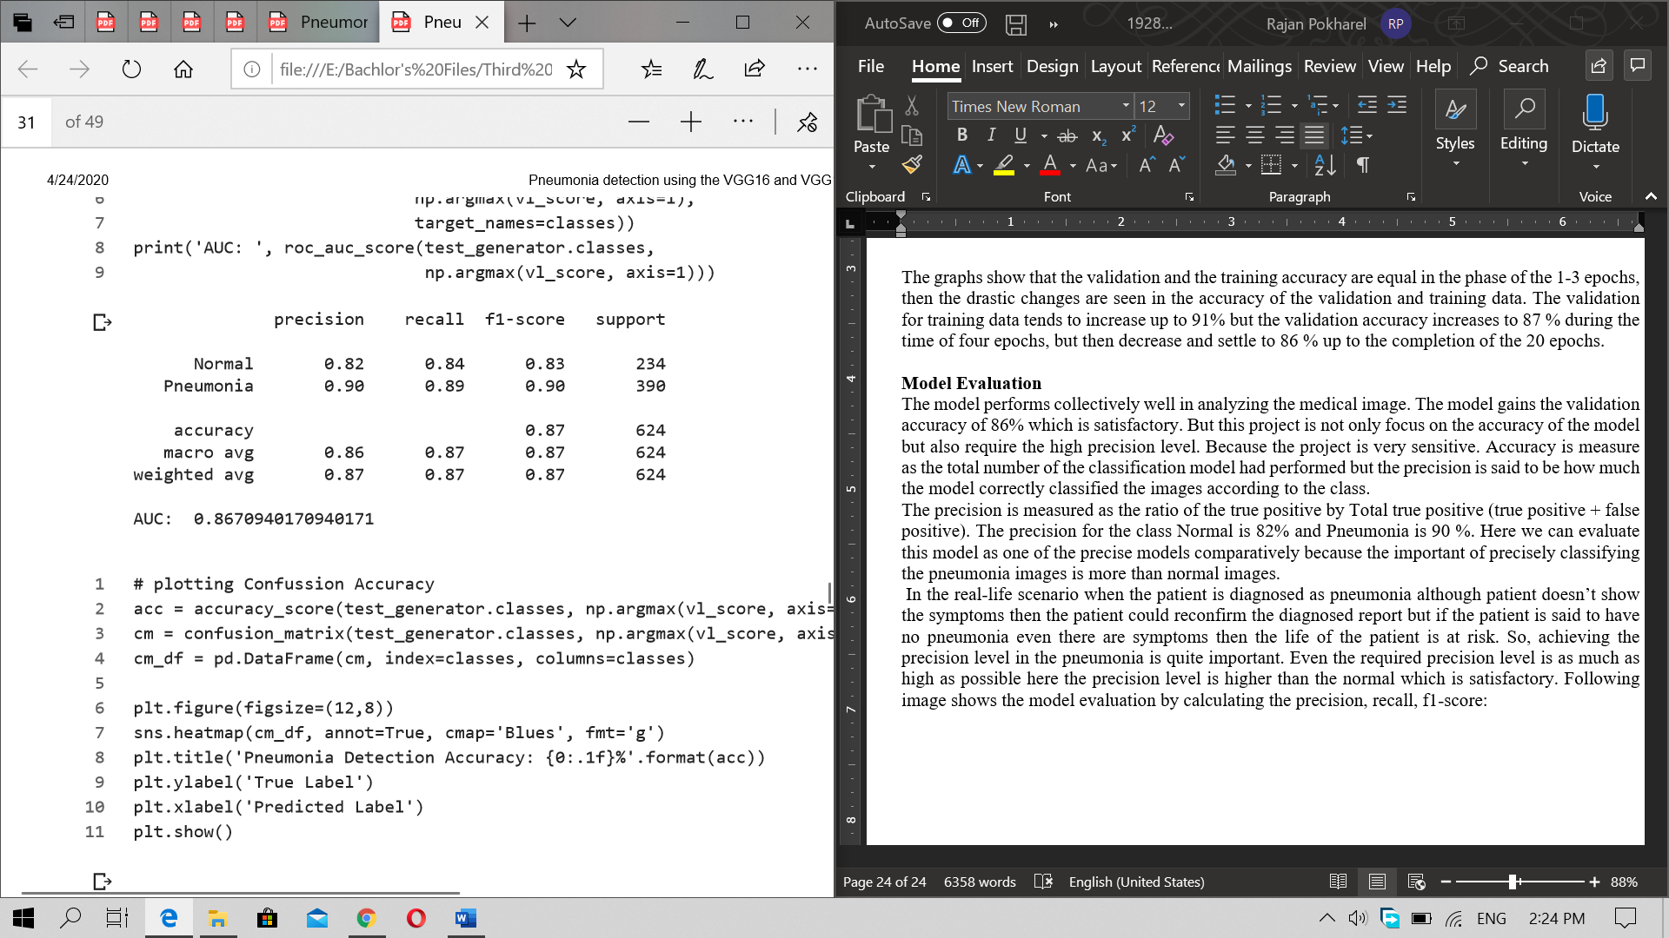
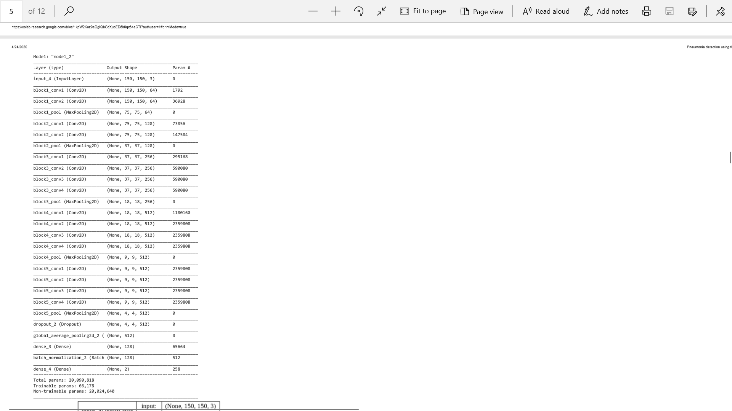
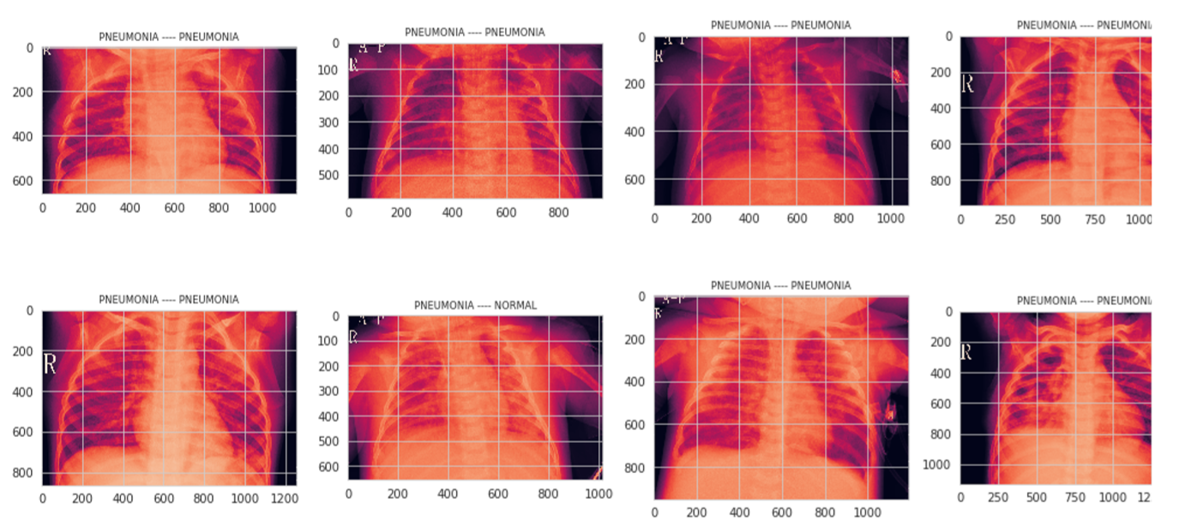
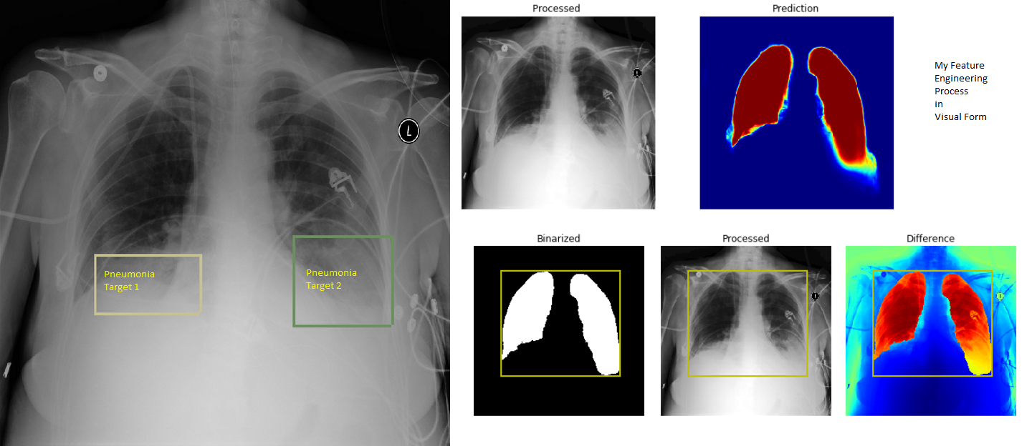
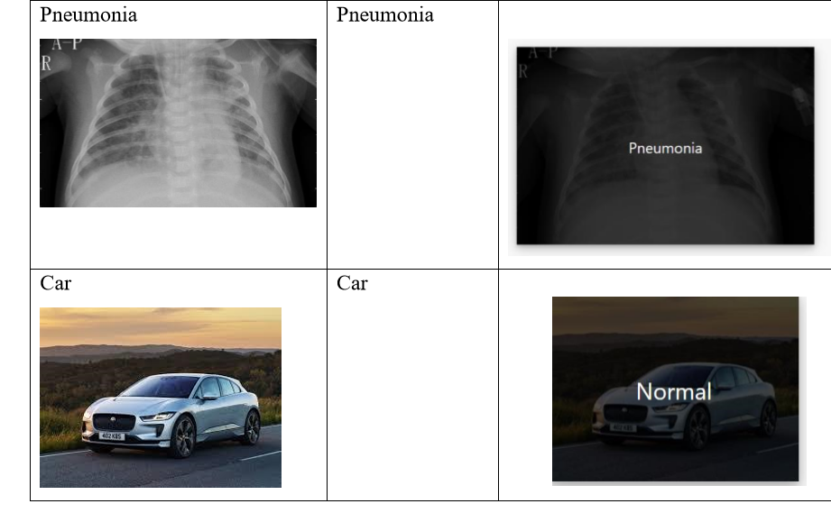
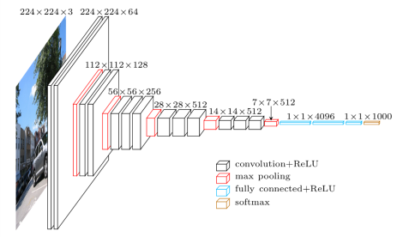
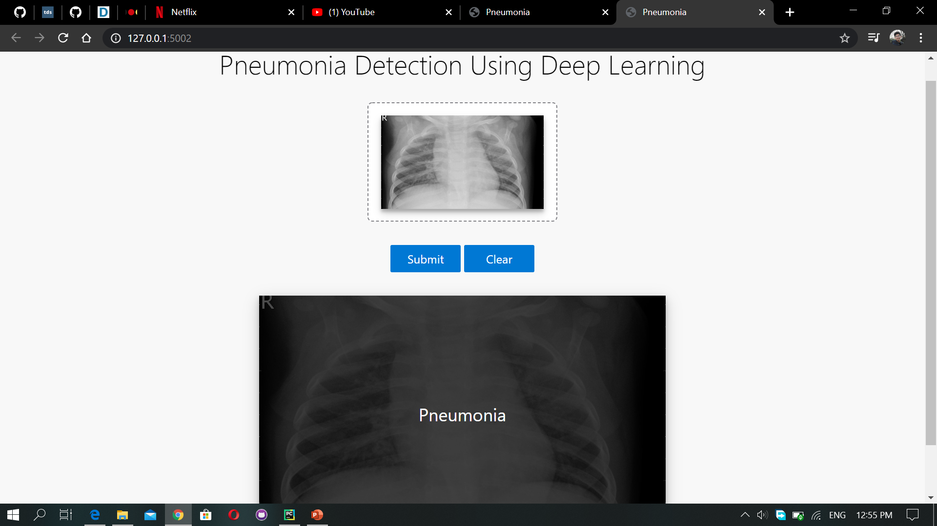
Pneumonia Detection Using The Deep Learning
Student Name: Rajan Dulal || Student ID: 1928440
^{Supervised By: Rupak Koirala}
^{Herald College Kathmandu}
Overview
Literature review
Evaluation Matrix
What is Pneumonia?
Pneumonia is the state of the lungs where the air sacs and alveoli of the lungs is filled with the fluid or liquid.
Around 2.56 million people die in the world which consists of around 25000 children along from Nepal
It isn’t the fatal disease but timely diagnosis is need for effective treatment
Academic Questions
To find out the effectiveness of the deep learning for clinical diagnosis of Pneumonia
To find out which architecture of the model is effective for medical image segmentation
Aim of the project
Solve the existing problem of the ambitious medical image analysis i.e. accuracy and well interpretation of the images for the disease diagnosing even more faster and more precisely
Objectives of the project
To provides the full functioning system.
To enhance the knowledge in the field of project development.
Helps to solve the tedious process of examining the medical images.
To provide the system for Pneumonia detection.
To increase the information and learning in the field of artificial intelligence.
Projects | Dataset Used | Data Preprocessing | Deep learning structure | Accuracy
CheXNet: Radiologist-Level Pneumonia Detection on the chest x-rays with deep learning | 112,120 frontal view of X-ray of 30,805 different patients | Resized into 224*224, randomly flipped into horizontal | Trained on pretrained ImageNet model with final layer replacement for binary classification | 76%
An efficient Deep learning Approach to pneumonia classification in healthcare | 5856 x-ray images of the pediatric patients | Resized into 225*225, rotation 40 degree along with the horizontal flip | Developed from scratch. extractor layers consist of the conv3×3, 32; conv3×3, 64; conv3×3, 128; conv3×3, 128 layers | 93%
Detecting Pneumonia in Chest X-rays with Supervised Learning | 112,120 x-rays by NIH | Resized into 32*32 and 224*224 and trained separately | Uses the CheXNet model for training the dataset | 0.609 AOC
Deep Learning Approach for prediction of pneumonia | 5863 images of the patients | Resized into 128*128, 256*256 and 512*512 and trained separately | Uses the pretrained ResNet34 along with the modification of the last layer | 92.9%
Detecting Pneumonia with Convolutional Neural Networks | 29000 images of x-rays | Resized into 128*128 no other transformation was done | Two normal Convolutional layers were used | 78%
Evaluation matrices for this project are model accuracy, confusion matrix, and Precision
Dataset and Data feature abstraction
All the X-rays were acquired from the Kaggle Chest X-ray repository.
2570 training data and 624 testing images including Normal and Pneumonia
All the images were resized into 150 and all the pre processing like random flip, zoom, horizontal flip height shift, width shift were done to avoid the over fitting.
Classification Model
47 layers 19 learnable weight 16 convolutional layers with 3 fully connected layers
Modified flattened 128 neurons with 0.5 drop out with relu
Last dense layer 2 neurons for classification
Optimizer Adam, Loss function binary cross entropy trained for 30 epochs, steps per epoch as training data, validation step testing data
Conclusions and Discussion
Based on research and development the pneumonia detection is performed
Model performs quite well in the prediction of the Pneumonia or Normal image
Making the algorithms from scratch could be even more precise but requires more computational power
Making the custom data preprocessing argument feature in application can be even more better
If the model is improved according to the feature abstraction understanding the model can be clinically used as the reference
Proper diagnosis could be done easily using the project integrated into the hospital management system

