Slide 1
Data Analysis & Machine Learning with Python
Project 4 - Mobile Phones Price Range Prediction
Nuvula Rajani

Slide 2
Mobile Phones Price Range Prediction
(Classification analysis)
Problem Statement:
Mobile prices are an important reflection of the Humans and some ranges are of great interest for both buyers and sellers. In the competitive mobile phone market, companies want to understand sales data of mobile phones and factors which drive the prices. Price estimation and prediction is an important part of consumer strategy. Deciding on the correct price of a product is very important part for the market success of a product. So the objective is to find out some relation between features of mobile phone and its selling price.
This Project will classify the price range of the mobile price indicating how high the price is.

Slide 3
- Pandas – data handling
- Numpy – numerical operations
- Matplotlib & seaborn – data visualization
- Scikit-learn – machine learning models
LIBRARIES USED

Slide 4
Data Description
Data Wrangling
1.Talking about the mismatch columns and its handling
2.Outlier
Exploratory Data Analysis
Correlation Analysis
Model’s List and their evaluation metrics
Model Selection
Challenges faced
Conclusion
CONTENT

Slide 5
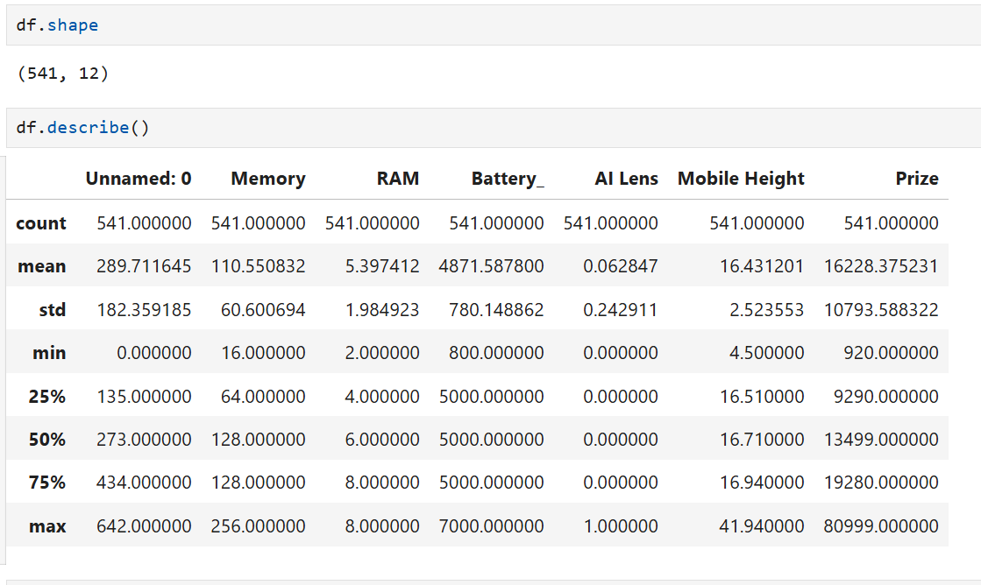
Data Description:
Mobile price Predication data
Categorical columns | Numerical Columns | Target Feature
Model | Memory | Price_range
Colour | RAM
Rear Camera | Battery_
Front Camera | AI Lens
Processor_ | Mobile Height
 | Prize
Take a peek at the dataset
This dataset Contains 541 Rows and 12 columns.
No missing values in any column.
There are categorical features such as Model, Colour, Rear Camera, Front Camera, and Processor_.
Numerical features include Memory, RAM, Battery, AI Lens, Mobile Height, and Prize.
The column Unnamed: 0 seems to be an index column and can be dropped.

Slide 6
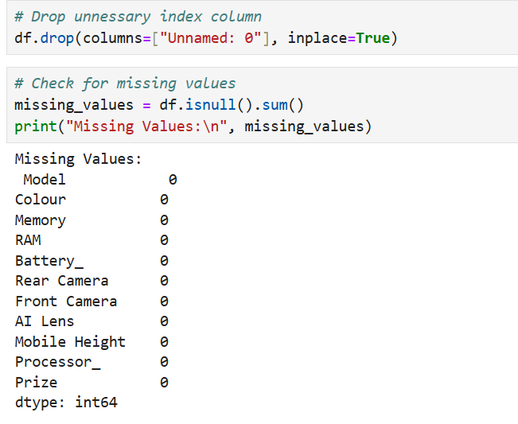
Data Wrangling:
Data Cleaning & Preprocessing Summary:
Handle Categorical Data:Convert categorical variables (e.g., Model, Colour, Rear Camera, Processor) into numerical format using encoding techniques.
Check for Missing Values: The dataset appears to have no missing values.
Feature Engineering: Converting camera specifications into numerical values (e.g., extracting megapixel values).
Outlier Detection: Checking for extreme values in numerical features.
Categorical Encoding:Convert Model, Colour, and Processor_ using one-hot encoding.
Convert Rear Camera and Front Camera to numerical values.

Slide 7
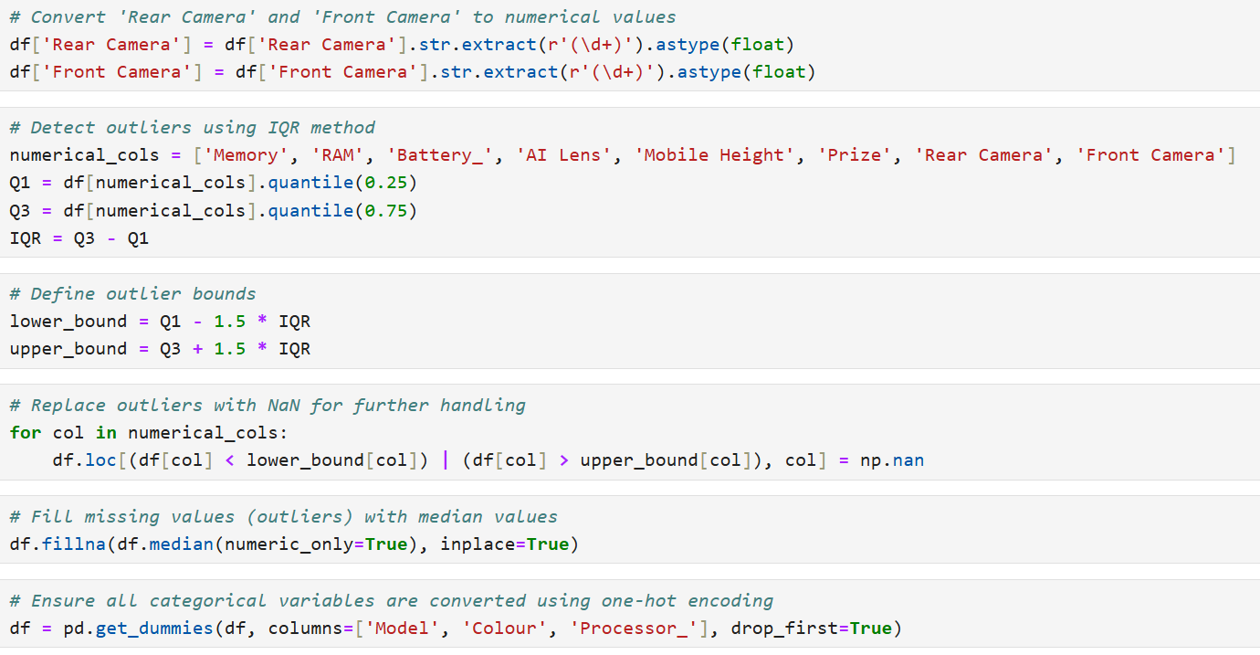
Data Cleaning & Pre-processing Summary:
Dropped the unnamed : 0 column (index)
Converted 'Rear Camera' & 'Front Camera' to numerical values.
Detected and handled outliers in numerical columns using the IQR method.
Filled missing values with median values.
Applied one-hot encoding to categorical variables (Model, Colour, Processor_), increasing the total number of columns to 590.

Slide 8
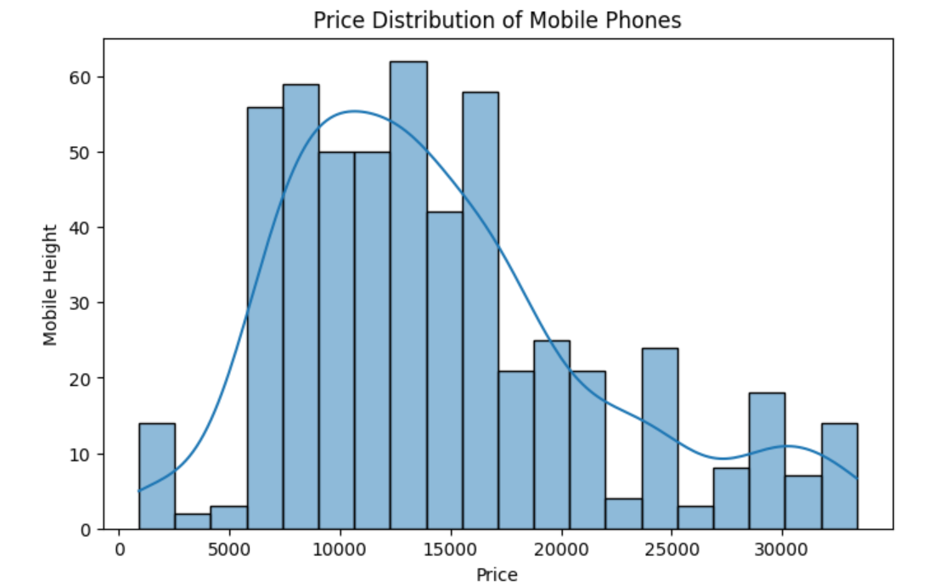
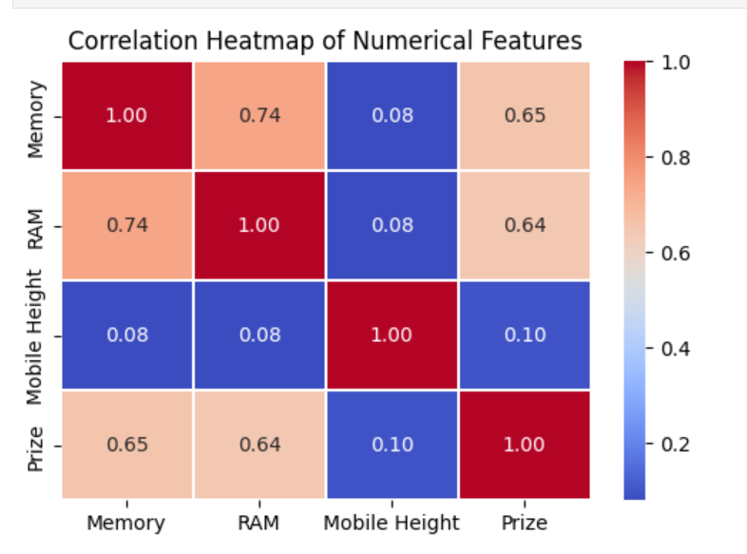
Data Visualization
DISTRIBUTION OF PRICES- MOBILE HEIGHT VS PRICE
"Mobile Height": There is an unusually high max value (41.94), suggesting a potential outlier.
Price Range: The price varies widely from ₹920 to ₹80,999, indicating a significant spread.
FEATURE EXTRACTION TECHNIQUES, INCLUDING:
Correlation Analysis – Identify the most correlated features with price.
It shows the relationships between the numerical features in dataset.

Slide 9
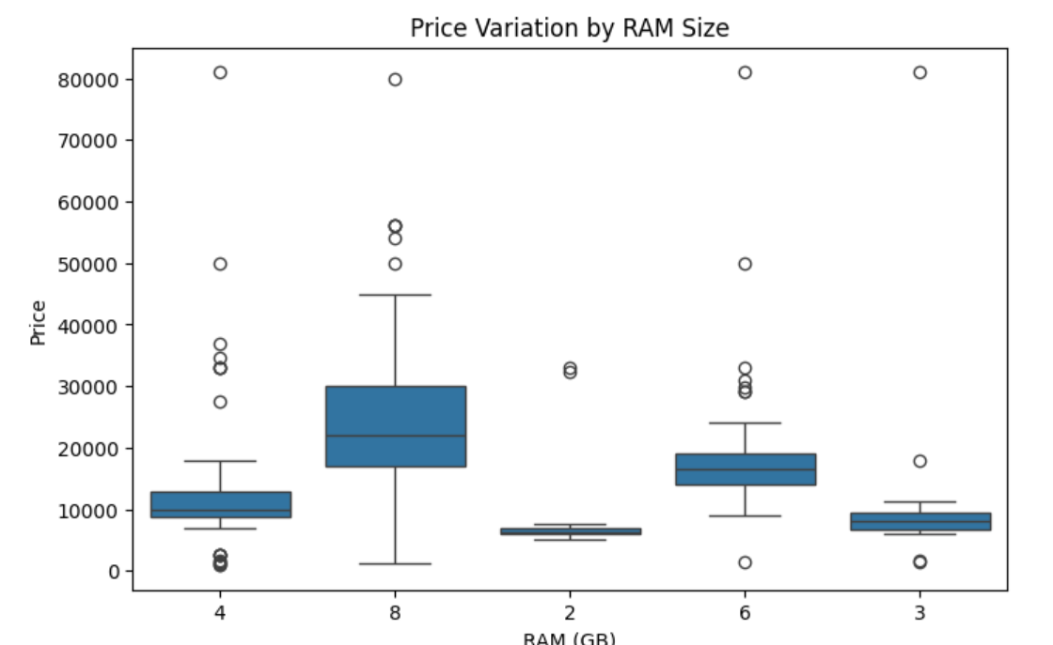
The boxplot shows potential outliers in Mobile Height and Prize:
Mobile Height: Likely outliers above 25 cm.
Prize: A few extreme values above ₹60,000.
Removing the outliers using the interquartile range (IQR) method to ensure better model performance. ​​
After outlier removal, 489 rows remain (down from 541), meaning 52 rows were removed.

Slide 10
Now, the dataset is cleaned and ready for model training.
The next step is to split the data into training and testing sets and build a predictive model for price estimation.

Slide 11
Model Building: Split the dataset into training and testing sets.
The dataset includes various features related to mobile phones, such as:
Model: Phone model name
Colour: Phone color
Memory: Storage capacity (in GB)
RAM: RAM size (in GB)
Battery_: Battery capacity (in mAh)
Rear Camera: Rear camera resolution
Front Camera: Front camera resolution
AI Lens: Whether the phone has an AI lens
Mobile Height: Phone height (in cm)
Processor_: Type of processor
Prize: Price of the phone (target variable)

Slide 12
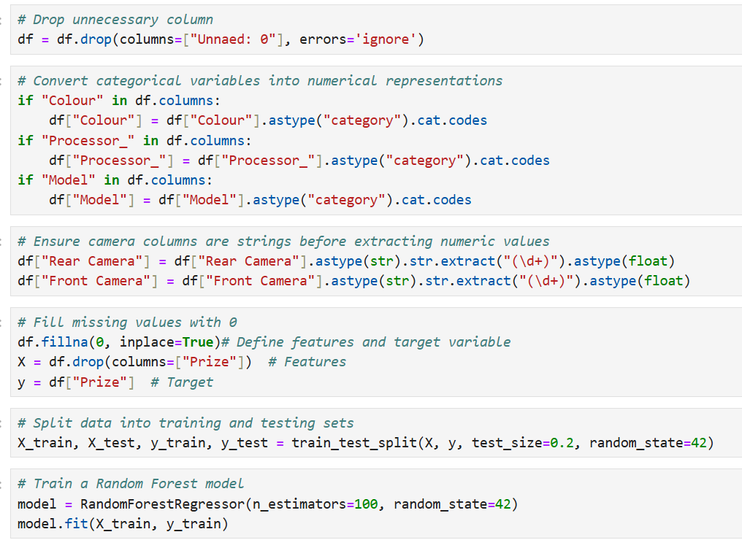
Data Cleaning: Handle missing values, remove unnecessary columns (like "Unnamed: 0"),and convert categorical features into numerical values.
Feature Selection: Choose relevant features for price prediction.
Model Training: Split the data into training and testing sets, then train a machine learning model.

Slide 13
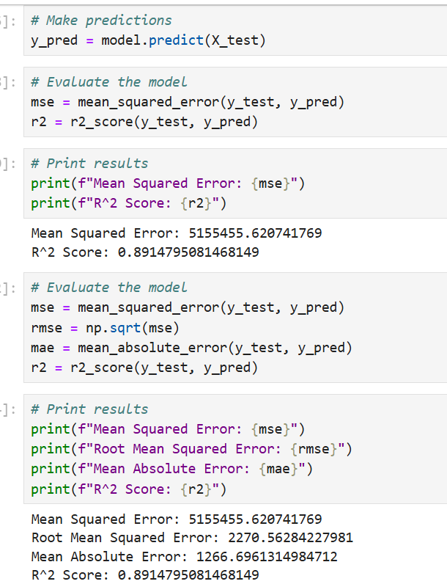
Model Performance:
Mean Absolute Error (MAE): ₹1,243.76 → On average, the model's predictions are off by about ₹1,244.
Mean Squared Error (MSE): ₹4,212,778 → Measures squared error impact.
R² Score: 0.917 → Indicates that the model explains 91.7% of the variance in mobile phone prices.
This is a strong performance, showing the model predicts price quite accurately. Next steps could involve hyperparameter tuning or testing other models like XGBoost for potential improvements.

Slide 14
Challenges We Faced:
Faced some challenge while handling mismatch values in few columns.
Felt little challenging when I start working on different algorithms and its metrics and also choosing quite number of algorithms to work upon.
Deciding about the best model for prediction.

Slide 15
Insights from Feature Importance Analysis and Model Evaluation
1. Key Features Impacting Mobile Phone Prices
Using the Random Forest model, we identified the top 10 most important features affecting mobile phone prices. These features contribute significantly to predicting price variations:
RAM & Memory: Higher RAM and storage typically increase the price due to better performance and multitasking capabilities.
Battery Capacity: Phones with higher battery capacity often cost more, as longer battery life is a key selling point.
Rear & Front Camera: Higher camera resolutions tend to increase the price, aligning with consumer demand for better photography capabilities.
Mobile Height: This could be indirectly related to screen size, as larger displays tend to be more expensive.
Processor Type: Different processor brands and models can significantly impact pricing, with high-performance processors leading to higher costs.

Slide 16
2. Model Performance Insights
We evaluated multiple models—Linear Regression, Decision Tree, Random Forest, and Gradient Boosting—using Mean Absolute Error (MAE), Mean Squared Error (MSE), Root Mean Squared Error (RMSE), and R² Score:
Random Forest and Gradient Boosting performed the best, as they effectively capture non-linear relationships in the data.
Linear Regression had the lowest performance, suggesting the price prediction is influenced by complex interactions among features.
Decision Tree showed decent performance, but it might be prone to overfitting.
3. Feature Reduction Insights from PCA
The first few principal components explain most of the variance, meaning we could reduce the number of features while retaining most of the information.
This could help simplify the model while maintaining accuracy, making it more efficient.

Slide 17
4. Recommendations for Further Improvement
Hyperparameter tuning (e.g., adjusting the number of trees in Random Forest) could further optimize model performance.
Additional feature engineering (e.g., deriving new features from existing ones, like a "performance score" combining RAM and processor strength).
Handling feature correlations: If some features are highly correlated, removing redundant ones might improve model generalization.

Slide 18
THANK YOU

