Slide 1
Chaos Monkeys
Chaos Engineering Tool Kit
Kunalsing Thakur, Onkar Parihar, Inderdeep Sidhu
Rajesh Radhakrishnan,Rajanikanthsingh Viswanathan
Hackathon 2K25

Slide 2
Problem Statement
Chaos Monkeys
Modern distributed systems are complex and often fail in unpredictable ways. Traditional testing cannot always uncover weaknesses that only appear under real-world conditions such as network outages, node failures, or resource exhaustion.

Slide 3
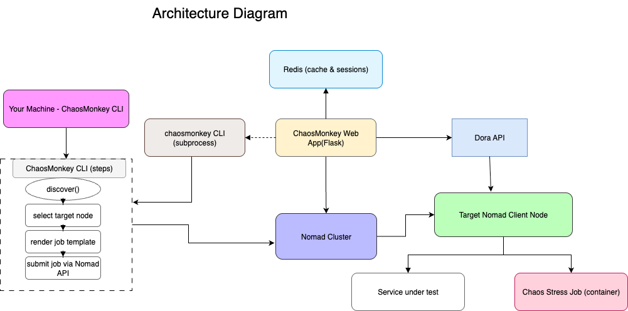
Solution Overview
Proposed Solution

Slide 4
Detailed Solution & Tech Stack

Slide 5
Feasibility & Resources

Slide 6
Business & Customer Impact

Slide 7
Team

Slide 8
Thank You!
Hackathon 2K24

