Slide 1
Rockbuster Insights Report
Key Findings and Strategic Recommendations
By: Rajani Negapula
rajaninegapula.bali@gmail.com

Slide 2
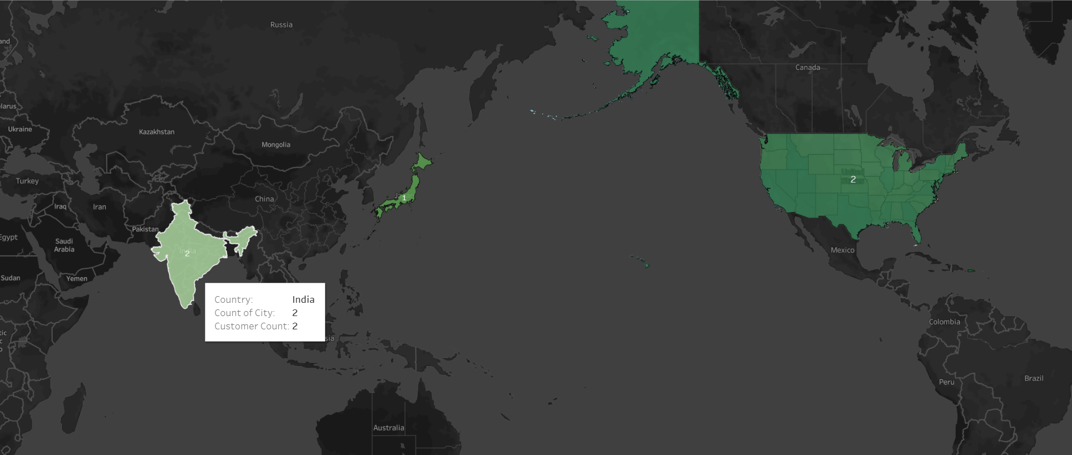
Key Findings
Top Cities for Revenue and Engagement
Our data analysis reveals the cities in countries like India, Japan and The USA are with the highest customer activity and revenue. These regions represent valuable markets for Rockbuster to strengthen our customer engagement and optimize marketing spend.
Tableau url: https://public.tableau.com/app/profile/rajani.negapula/viz/Rockbuster_17315074648600/Top3countries

Slide 3
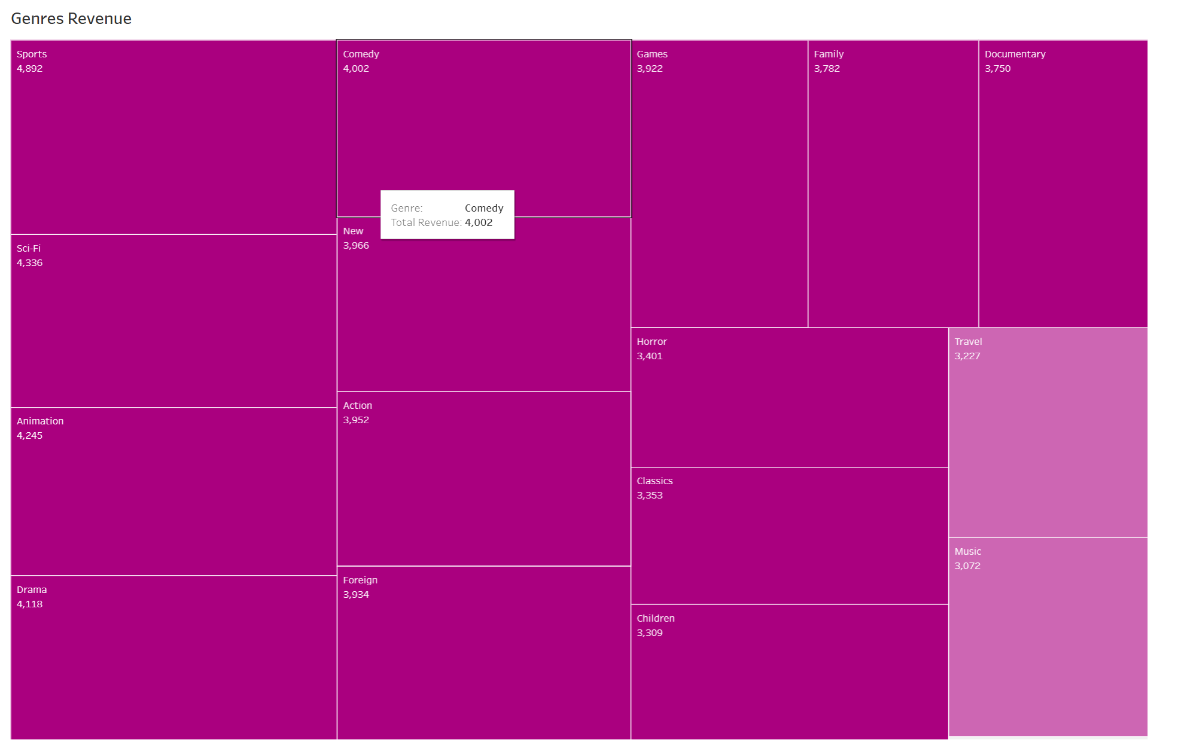
Top Genres Driving Revenue
The analysis shows that certain genres like Sports, Sci-Fi, Animation, Drama and Comedy consistently outperform others in revenue generation. By expanding our inventory in these popular genres, we can cater to customer interests and maximize sales.
Tableau url: https://public.tableau.com/app/profile/rajani.negapula/viz/GenresRevenue_17315077819890/Genres

Slide 4
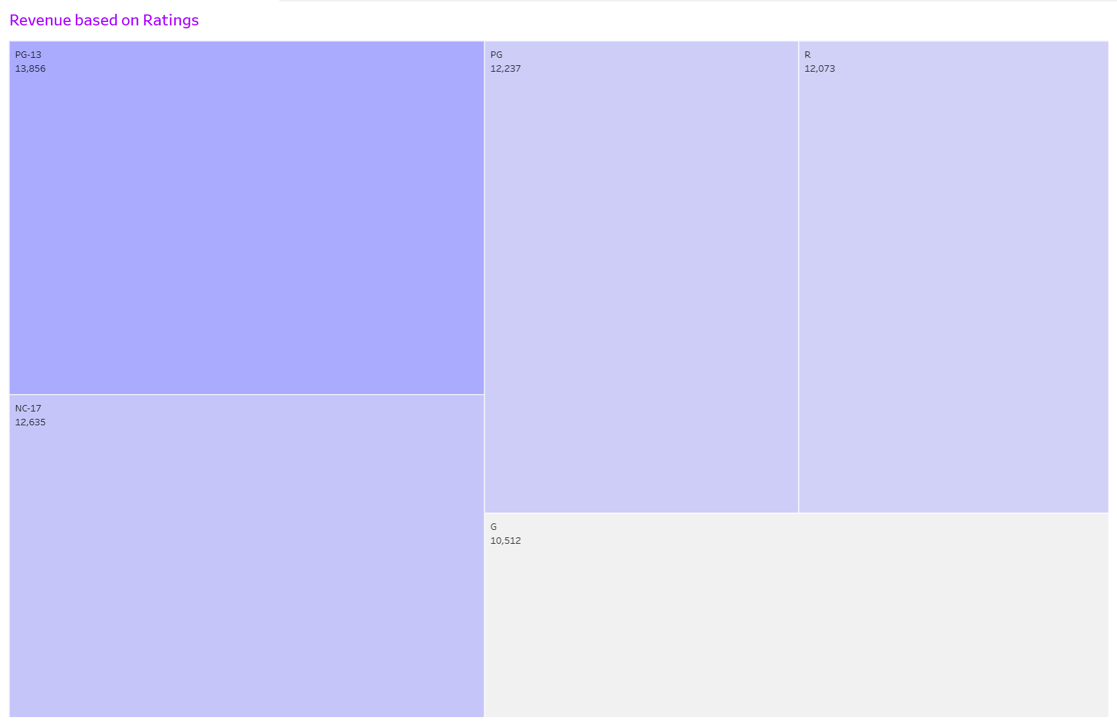
Ratings and Revenue Trends Films with specific content ratings, particularly PG-13, tend to generate higher revenue. This trend indicates a demand for content that aligns with specific ratings, offering a strategic direction for future content acquisitions.
Tableau url: https://public.tableau.com/app/profile/rajani.negapula/viz/RevenueBasedonRatings/Rating?publish=yes

Slide 5
Recommendations:
Targeted Marketing
Focus on top-performing cities to increase revenue through tailored marketing and localized promotions.
Content Curation Strategy
Prioritize acquiring films in popular genres and ratings categories that align with customer preferences.
Promotional Opportunities
Boost engagement by creating targeted promotions around high-demand genres, especially in regions with the most active users.

Slide 6
Next Steps:
Implement Regional Marketing Campaigns
Refine Content Acquisition
Monitor Performance Monthly

Slide 7
Technical Report for Rockbuster Staff Rockbuster Technical Insights Data Quality, Querying, and Efficiency Recommendations
Technical Recommendations
Data Optimization
Maintain regular data profiling to catch duplicates and maintain data integrity.
Query Optimization
Leverage indexed columns for efficient retrieval in future reports.
Automation & Monitoring
Automate monthly reports to track top genres, high-revenue cities, and customer preferences for real-time insights.
Data Profiling & Cleaning
Data Quality
Missing, duplicate, and non-uniform data were identified and addressed.
Data cleaning ensured integrity for accurate insights.
Key Steps
Standardized non-uniform entries (e.g., inconsistent ratings).
Deduplicated customer and city data for clean, reliable metrics.
Next Steps for Technical Team
Schedule Monthly Reports
Refine Indexing and Database Maintenance
Coordinate with Marketing for Targeted Outreach Based on Data

