Slide 1
How many hours do you spend on social media daily?

Slide 2
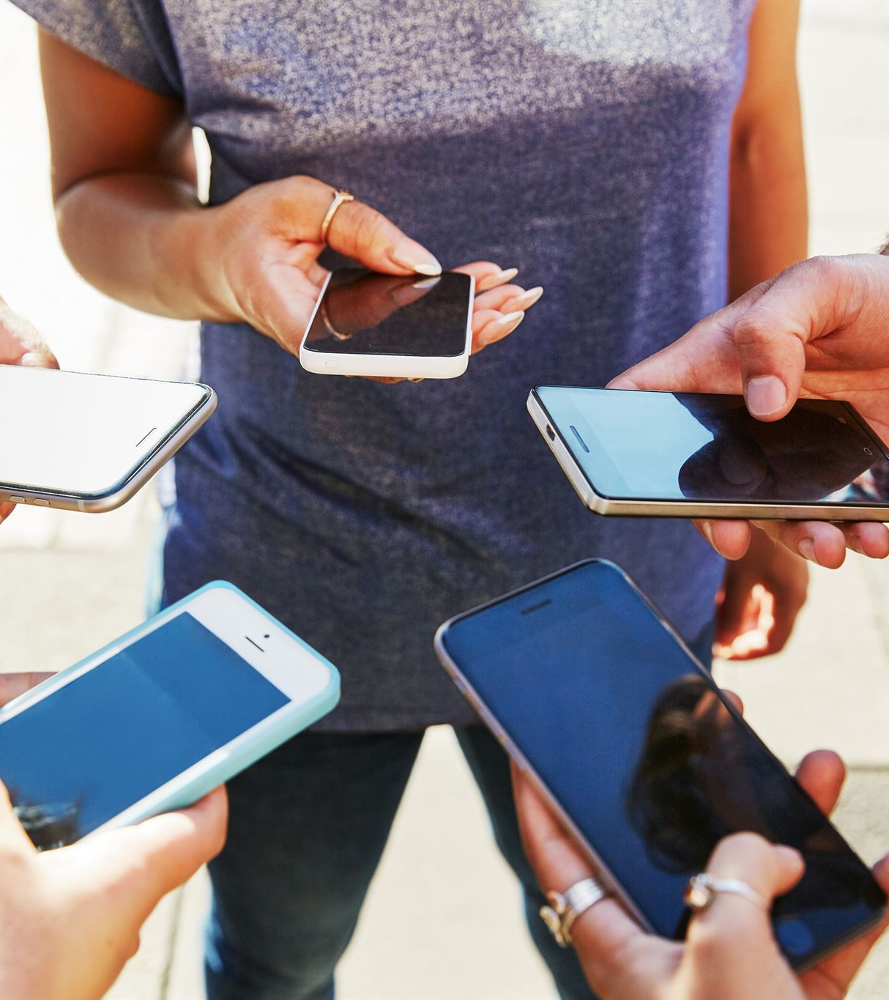
Social Media: is a Boon or Bane?
Exploring impacts of digital communication on society
Notes:
AI-generated content may be incorrect. ---

Slide 3
Introduction
Notes:
Definition and Importance of Social Media

Slide 4
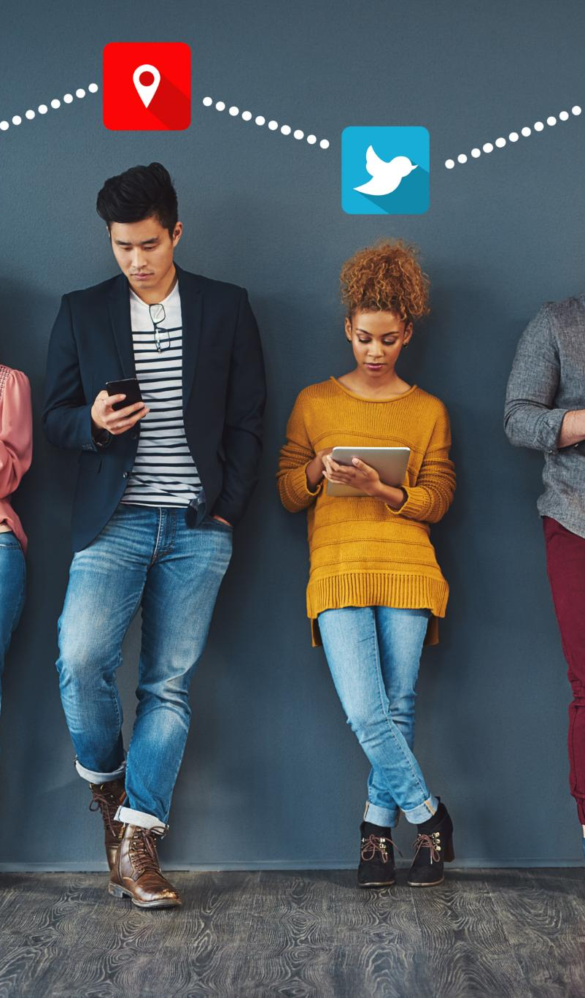
Definition and Importance of Social Media
Social Media Definition
Social media platforms enable users to create, share, and interact with content and communities online globally.
Global Connectivity
Social media breaks geographical barriers, connecting people worldwide instantly and fostering communication.
Benefits for Individuals and Organizations
Offers individuals creative expression and relationship building; empowers organizations with marketing and engagement tools.
Challenges and Risks
Issues include privacy concerns, mental health impact, and authenticity of shared information on social media.
Notes:
Social media refers to digital platforms and applications that enable users to create, share, and interact with content and communities online. These platforms include popular networks like Facebook, Instagram, Twitter, LinkedIn, and TikTok, among others. Social media has become an integral part of modern life, influencing communication, business, education, and entertainment. Its importance lies in its ability to connect people globally, break down geographical barriers, and provide instant access to information. For individuals, it offers opportunities to maintain relationships, discover new interests, and express creativity. For organizations, it serves as a powerful marketing and engagement tool, allowing brands to reach targeted audiences and build loyalty. However, its widespread use also raises questions about privacy, mental health, and the authenticity of shared information. Understanding social media's role in society is essential for leveraging its benefits while mitigating its risks.

Slide 5
Pros of Social Media
Notes:
Advantages and Opportunities

Slide 6
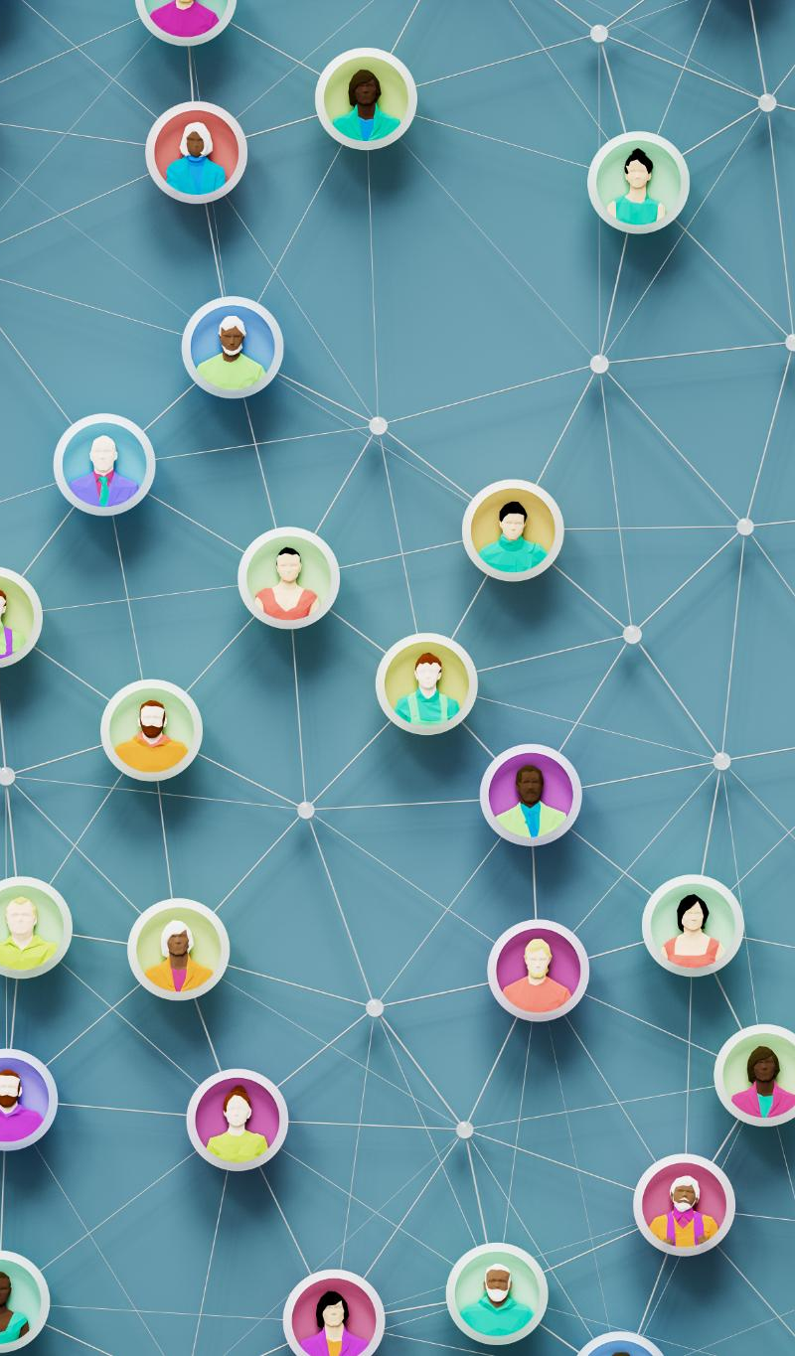
Advantages and Opportunities
Global Connectivity
Social media enables people to maintain personal and professional connections worldwide, breaking distance barriers.
Information and Awareness
Platforms provide real-time news, trends, and social issue updates, keeping users informed and aware.
Business Marketing
Businesses use social media to build brands, market products, and engage customers cost-effectively.
Learning and Creativity
Users access tutorials, webinars, and share creative content, fostering education and entertainment.
Notes:
Social media offers numerous benefits that have transformed personal and professional interactions. One of the most significant advantages is connectivity; it allows individuals to stay in touch with family and friends regardless of distance, fostering global relationships. Additionally, social media serves as a hub for information and awareness, providing real-time updates on news, trends, and social issues. Businesses leverage these platforms for marketing, brand building, and customer engagement, often at a fraction of traditional advertising costs. Educational opportunities abound, as users can access tutorials, webinars, and expert insights to enhance their skills. Furthermore, social media encourages creativity and entertainment through content creation, enabling users to share art, music, and videos with a wide audience. These benefits collectively make social media a powerful tool for communication, learning, and growth when used responsibly.

Slide 7
What is your Experience on Socila media

Slide 8
Challenges and Negative Impacts
Social Media Addiction
Excessive social media use causes addiction leading to reduced productivity and significant time wastage.
Mental Health Issues
Social media contributes to anxiety, depression, and low self-esteem through comparison and cyberbullying.
Privacy Risks
Personal data on social media is frequently exposed to breaches or misuse, posing serious privacy risks.
Spread of Misinformation
Misinformation and fake news spread rapidly on social media, confusing the public and influencing opinions.
Notes:
Despite its advantages, social media poses several challenges that can negatively impact individuals and society. One major concern is addiction, as excessive use often leads to reduced productivity and time wastage. Mental health issues such as anxiety, depression, and low self-esteem are increasingly linked to social media, primarily due to constant comparison and cyberbullying. Privacy risks are another critical issue, with personal data frequently exposed to breaches or misuse. The rapid spread of misinformation and fake news on these platforms can influence public opinion and create confusion, making it difficult to distinguish fact from fiction. Additionally, social media can diminish real-life communication skills, as virtual interactions sometimes replace meaningful face-to-face conversations. These drawbacks highlight the need for mindful usage and regulatory measures to ensure that social media remains a positive force rather than a source of harm.

Slide 9

Strategies for Responsible Engagement
Time Management
Setting daily limits on social media usage helps prevent addiction and boosts productivity.
Fact-Checking Information
Verifying information before sharing combats misinformation and encourages responsible communication.
Privacy and Security
Adjusting privacy settings and cautious data sharing protect users from breaches and identity theft.
Content Curation and Breaks
Following positive accounts and taking breaks enhances mental well-being and reduces harmful exposure.
Notes:
To maximize the benefits of social media while minimizing its risks, adopting healthy usage habits is essential. Time management is a key strategy; setting limits on daily usage can prevent addiction and ensure productivity. Fact-checking information before sharing helps combat misinformation and promotes responsible communication. Adjusting privacy settings and being cautious about personal data sharing can protect users from security breaches and identity theft. Additionally, curating content by following positive and educational accounts can enhance mental well-being and reduce exposure to harmful material. Taking regular breaks from social media and engaging in offline activities fosters balance and prevents over-reliance on virtual interactions. By implementing these practices, individuals can enjoy the advantages of social media without compromising their mental health or personal security.

Slide 10
Conclusion
Notes:
Final Thoughts and Call to Action

Slide 11

Thanks

