Slide 1




Smart Home Energy Prediction Model
Supervised Machine Learning — Regression
Objective: Predict household energy consumption (kWh) using household and environmental features.
Input
Daily household data (features + date)
Model
Supervised regression (Ridge final)
Output
Predicted Energy_Consumption_kWh

Slide 2
Dataset & Data Preparation
Dataset summary:
Feature | Type / Notes
Household_Size | Numeric — occupants
Avg_Temperature_C | Numeric — daily average
Has_AC | Binary (1/0)
Peak_Hours_Usage_kWh | Numeric — strong predictor
Date-derived features | Day, Day_of_Week, Is_Weekend
90,000 records — April 1–30, 2025 (daily)
~3,000 households (simulated household-level data)
Target: Energy_Consumption_kWh
Key preprocessing steps:
Removed Household_ID
Date → datetime; extracted Day, Day_of_Week, Is_Weekend
Encoded Has_AC (Yes=1, No=0); no missing values
StandardScaler applied; 80/20 train-test split
Visual: Raw Data → Cleaning → Feature Engineering → Model-Ready Data

Slide 3
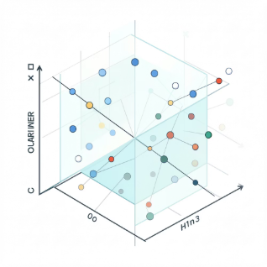
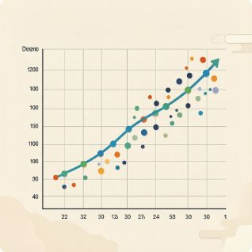
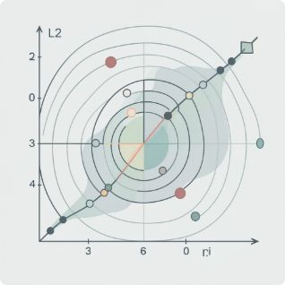
Machine Learning Methodology
Workflow (concise): Dataset → Preprocessing → EDA → Feature selection → Train-test split → Scaling → Model training → Comparison → 5-fold CV → Grid search → Final Ridge → Flask
Multiple Linear Regression
Polynomial Regression (degree 2)
Ridge Regression
L2 regularization to control coefficient magnitude and improve stability.
Baseline linear model — interpretable coefficients.
Captures simple nonlinearities via quadratic terms.

Slide 4
Model Evaluation & Results
Metrics used: MSE, RMSE (kWh), R², 5-fold CV. Note: R² is NOT called "accuracy".
0.6200
0.7874 kWh
MSE (test)
RMSE (test)
Mean squared error on test set
Root mean squared error — interpretable in kWh
0.9798
0.9794
R² (test)
CV R² (5-fold)
Proportion of variance explained
Cross-validated R²
Final Ridge Model: Best alpha = 1
Actual vs Predicted (concept)
X: Actual Energy Consumption — Y: Predicted Energy Consumption

Slide 5

Optimization & Deployment
Flask Deployment
Model Optimization
User Input
Flask App
5-fold CV
Select Alpha
Assess model stability
Best alpha = 1
Household features entered via web form
Loads energy_model.pkl and routes input to model
Grid Search
Train Final
Prediction
Test Ridge alphas
Fit Ridge model
5-fold CV assessed stability; grid search tested alpha values and selected alpha = 1 based on CV R².
Model returns predicted kWh to the user interface
http://127.0.0.1:5000 (local run)

Slide 6
Conclusion
Conclusions
Supervised regression model developed for household energy forecasting.
Compared Linear, Polynomial (degree 2), and Ridge; Ridge (alpha=1) selected.
Final test performance: R² = 0.9798, RMSE = 0.7874 kWh (MSE = 0.6200).
Model persisted as energy_model.pkl and integrated into a Flask app for interactive predictions.
Limitations
Simulated dataset limited to April 2025 — temporal scope narrow.
Limited household/appliance features; Peak_Hours_Usage_kWh strongly correlated with total consumption.
High R² partly explained by strong predictor; real-world generalization not guaranteed.

