Slide 1
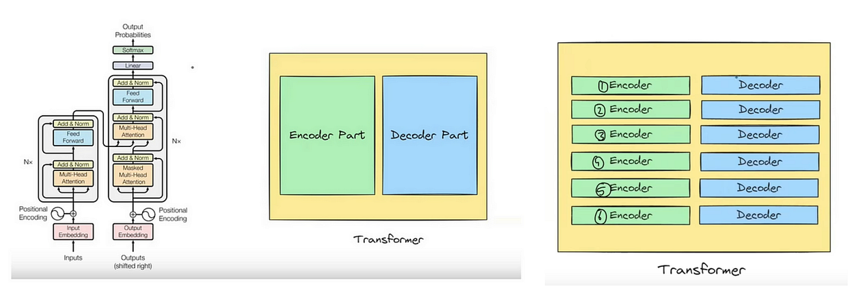
Transformers in Deep Learning: How They Work
Presented by Dr. Ghulam Gilanie

Slide 2




The Revolution in AI: Why Transformers Matter
A New Paradigm
Introduced in 2017 by Vaswani et al. in "Attention is All You Need", Transformers marked a pivotal moment in AI.
Parallel Processing
They revolutionised sequence processing by enabling parallel computation, a significant leap from traditional Recurrent Neural Networks (RNNs).
Powering Modern AI
Transformers are the core technology behind models like OpenAI’s GPT, Google’s BERT, and DeepMind’s AlphaStar, driving unprecedented advancements.
Broad Impact
Their influence spans Natural Language Processing (NLP), computer vision, speech recognition, and many other domains, transforming AI capabilities.

Slide 3
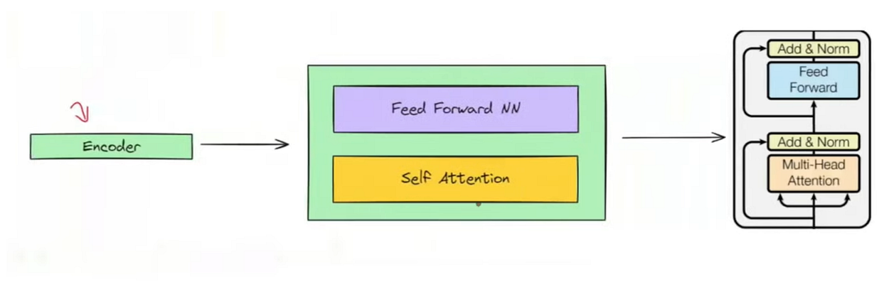

Slide 4
From Words to Numbers: Embeddings & Positional Encoding
Tokenisation
Input text is first broken down into smaller units called tokens, which can be individual words or subwords.
Semantic Embeddings
These tokens are then converted into dense numerical vectors, known as embeddings, which capture the semantic meaning of each token.
Preserving Order
Crucially, positional encodings are added to these embeddings to ensure the model retains information about the original word order, overcoming the lack of recurrence found in RNNs.
Contextual Understanding
This process allows the Transformer to understand the sequence's context despite processing all tokens simultaneously.

Slide 5
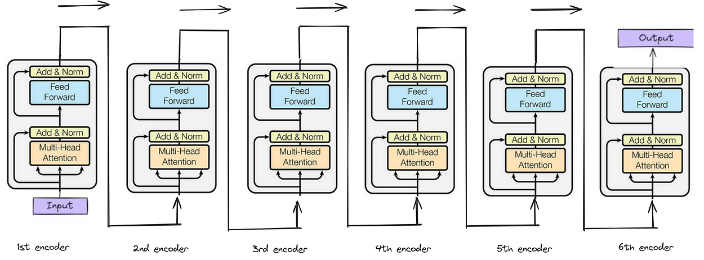

Slide 6


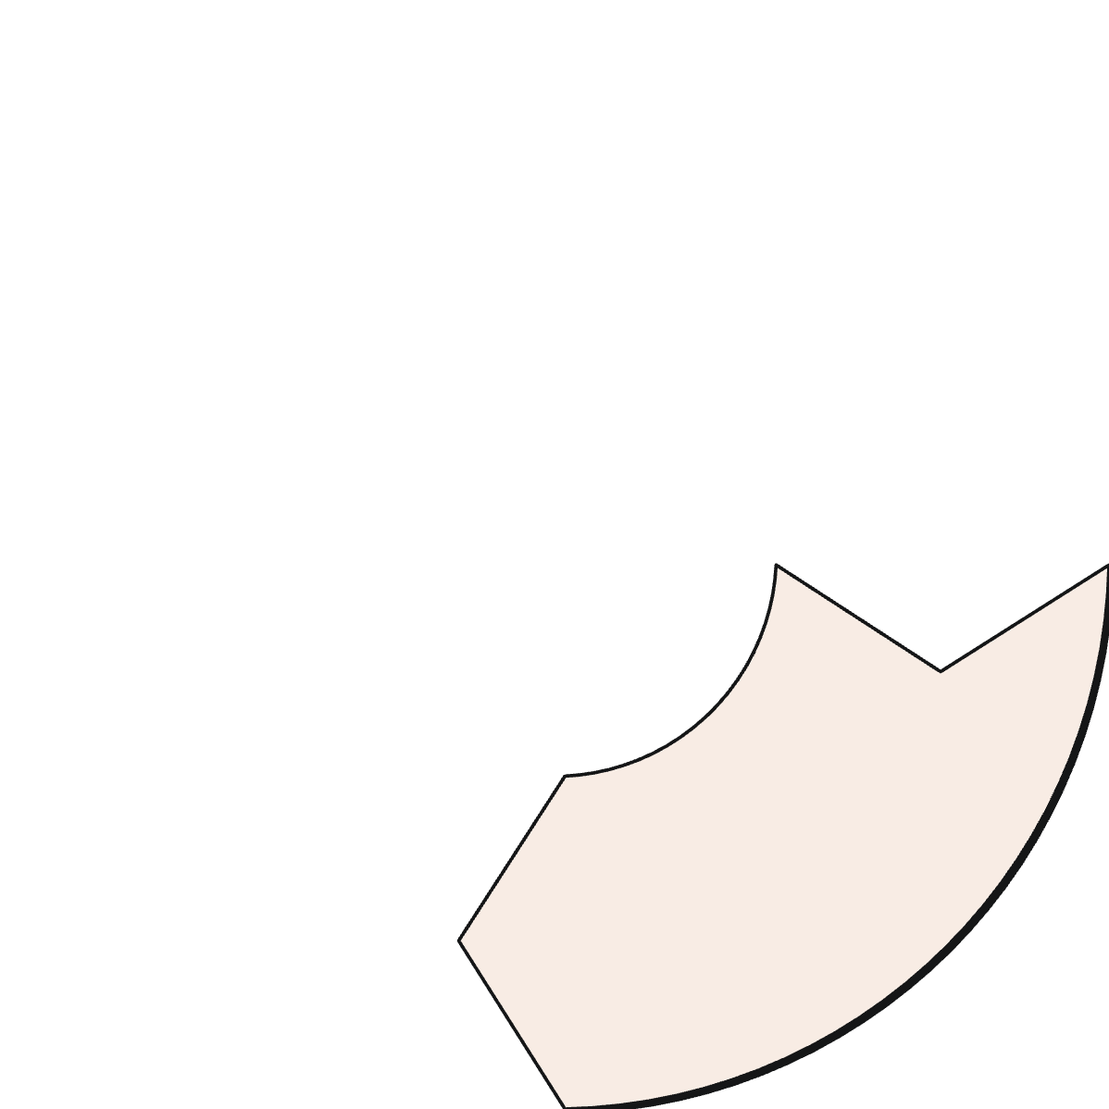





The Heart of the Transformer: Self-Attention Mechanism
Attention Scores
Token Relationships
The mechanism calculates attention scores, assigning weights to indicate the importance of other tokens to the current one.
Each token within a sequence "attends" to every other token, determining its relevance.
Long-Range Dependencies
Global Context
Self-attention replaces the sequential memory of RNNs with a far more powerful global context awareness.
This innovative approach effectively captures long-range dependencies and complex contextual relationships within the data.

Slide 7
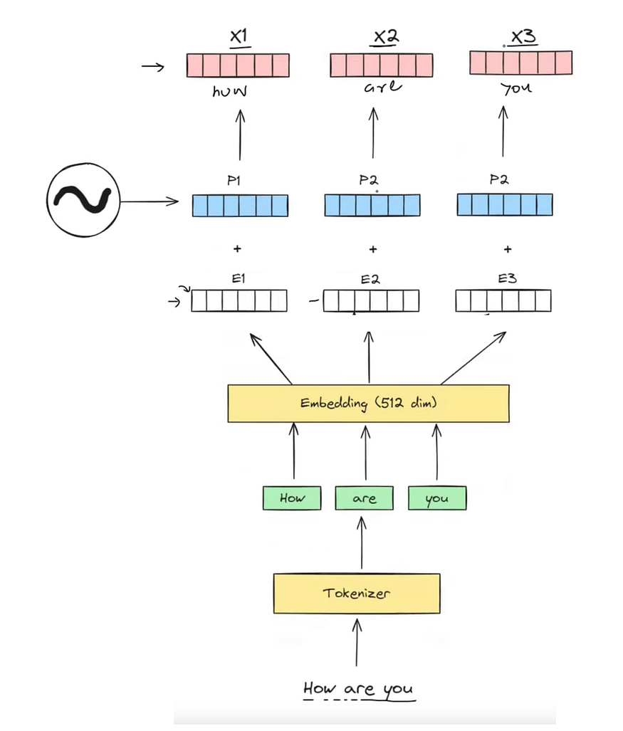

Slide 8
Multi-Head Attention: Seeing Context from Multiple Angles
Parallel Insights
Multi-head attention employs several "attention heads" that operate in parallel. Each head is trained to focus on different aspects or relationships within the input.
Diverse Representations
This allows the model to jointly attend to information from various representation subspaces, akin to looking at the same problem through multiple lenses.
Enhanced Learning
By combining these diverse perspectives, multi-head attention significantly improves the model's ability to learn complex patterns and capture the nuances of language and data.
Richer Understanding
It provides a richer, more comprehensive understanding of the context, crucial for sophisticated AI tasks.

Slide 9
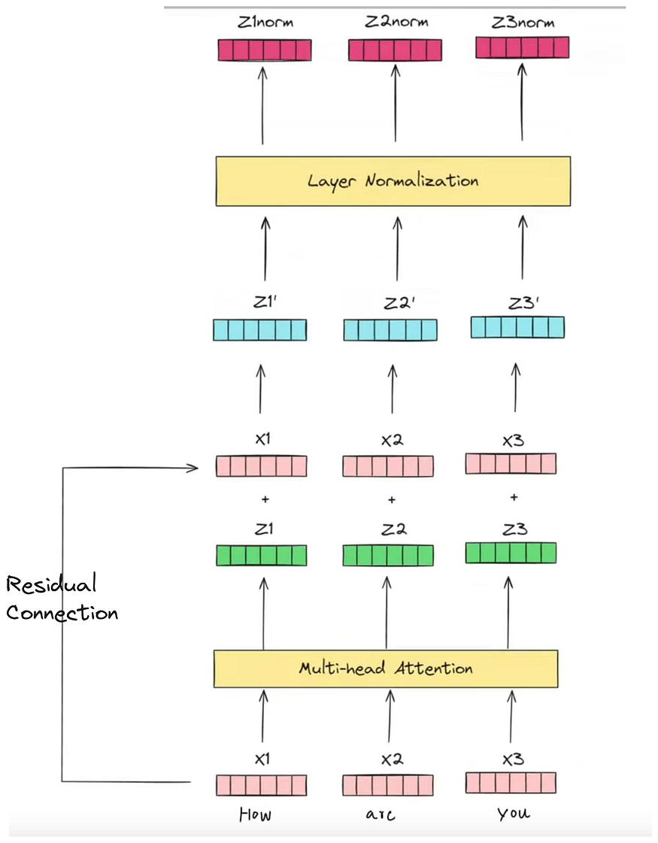




Slide 10
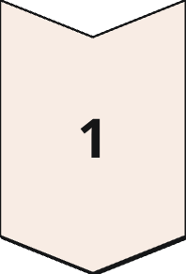
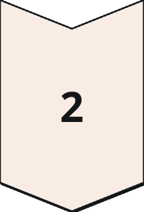
Transformer Architecture: Encoder and Decoder Blocks
Encoder: Input Processing
The Encoder block takes the input sequence and processes it to build rich, contextual embeddings, understanding the input thoroughly.
Decoder: Output Generation
The Decoder block then generates the output sequence, leveraging the encoder's outputs and attending to previously generated tokens for coherent generation.
Stacked Layers
Residual Connections
Each block is composed of multiple layers, including self-attention, feed-forward networks, residual connections, and normalisation layers.
Residual connections facilitate gradient flow, enabling the training of very deep networks.
Layer Normalisation
Layer normalisation stabilises training and accelerates convergence.

Slide 11
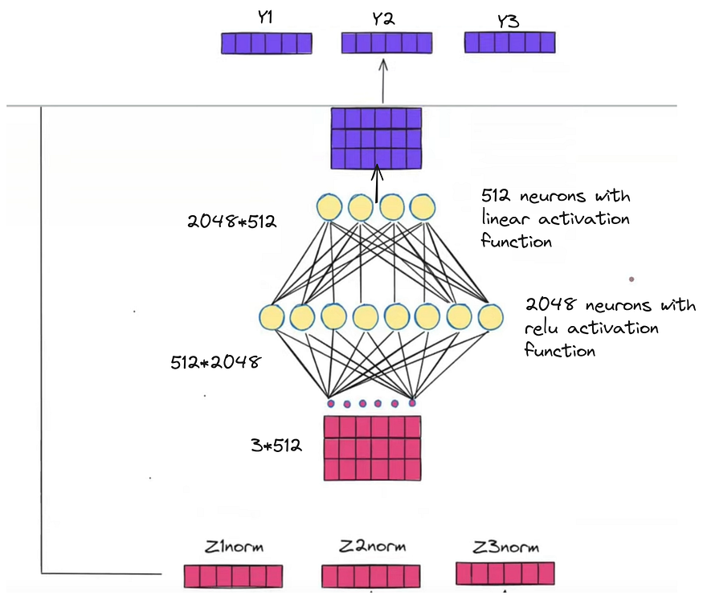
How Transformers Generate Text: Next-Token Prediction
Predictive Power
Given an initial prompt, the Transformer model predicts the most statistically probable next token, building text word by word.
Learned Patterns
This prediction is based on intricate patterns and relationships learned from vast corpora of text data during its training phase.
Autoregressive Decoding
Through an autoregressive decoding process, each new token is generated sequentially, constantly conditioning on all previously generated outputs to maintain coherence and context.
Foundation of AI Chatbots
This fundamental mechanism is the driving force behind sophisticated large language models like GPT, enabling AI assistants such as ChatGPT to produce human-like text.

Slide 12
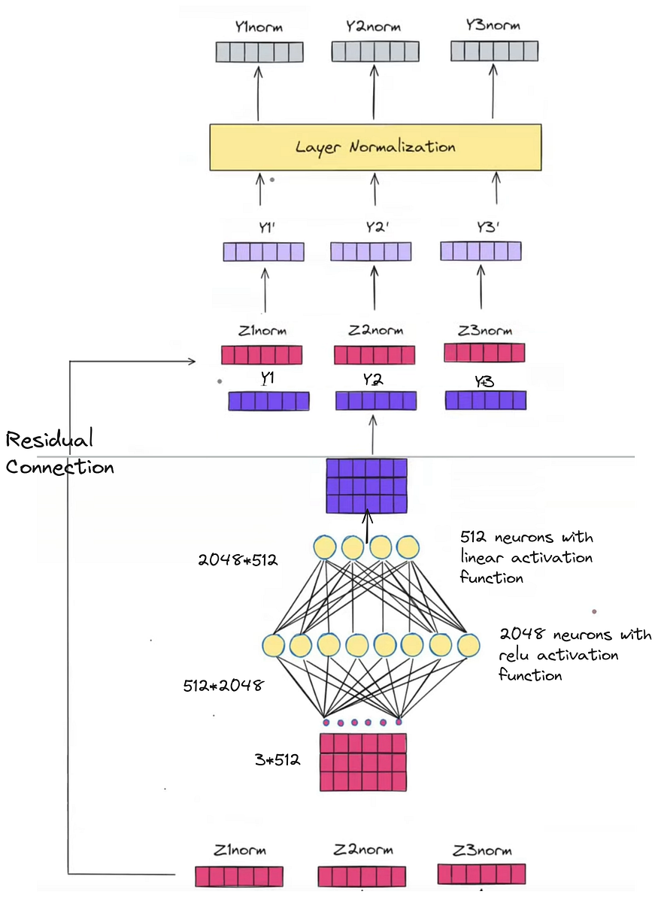




Beyond Text: Transformers in Vision, Audio, and More
Transformers, initially designed for natural language, have proven their versatility across a multitude of domains.
Vision Transformers (ViTs)
In computer vision, ViTs have demonstrated superior performance, often outperforming traditional Convolutional Neural Networks (CNNs) in image recognition tasks.
Bioinformatics
They are also successfully applied in complex scientific fields such as protein folding, revolutionising drug discovery and understanding biological structures.
Speech Recognition
In audio processing, Transformers have significantly enhanced the accuracy and robustness of speech recognition systems, from voice assistants to transcription services.
Gaming AI
Transformers are making strides in game-playing AI, enabling more intelligent and adaptive agents in complex virtual environments.

Slide 13
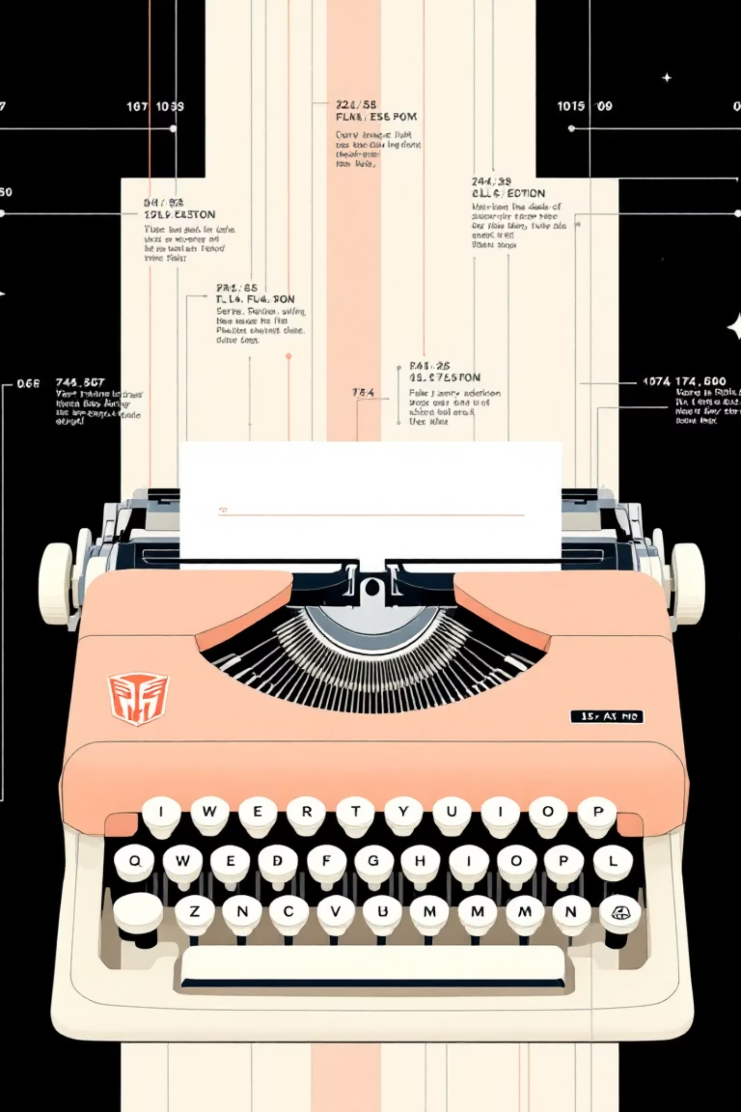
Key Milestones & Models to Know
2018: GPT
The introduction of the first Generative Pre-trained Transformer (GPT) marked a major breakthrough for various NLP tasks, showcasing its generative capabilities.
2019: BERT
Bidirectional Encoder Representations from Transformers (BERT) revolutionised contextual understanding by processing text bidirectionally, significantly improving search and question-answering.
2020+: GPT-3 & Successors
With billions of parameters, GPT-3 and its subsequent versions demonstrated astonishing human-like text generation, opening new possibilities for creative and conversational AI.
2024: Gemini, LLaMA & Beyond
Current large-scale models like Google's Gemini and Meta's LLaMA continue to push the boundaries of AI, integrating multimodal capabilities and enhancing performance across diverse benchmarks.

Slide 14
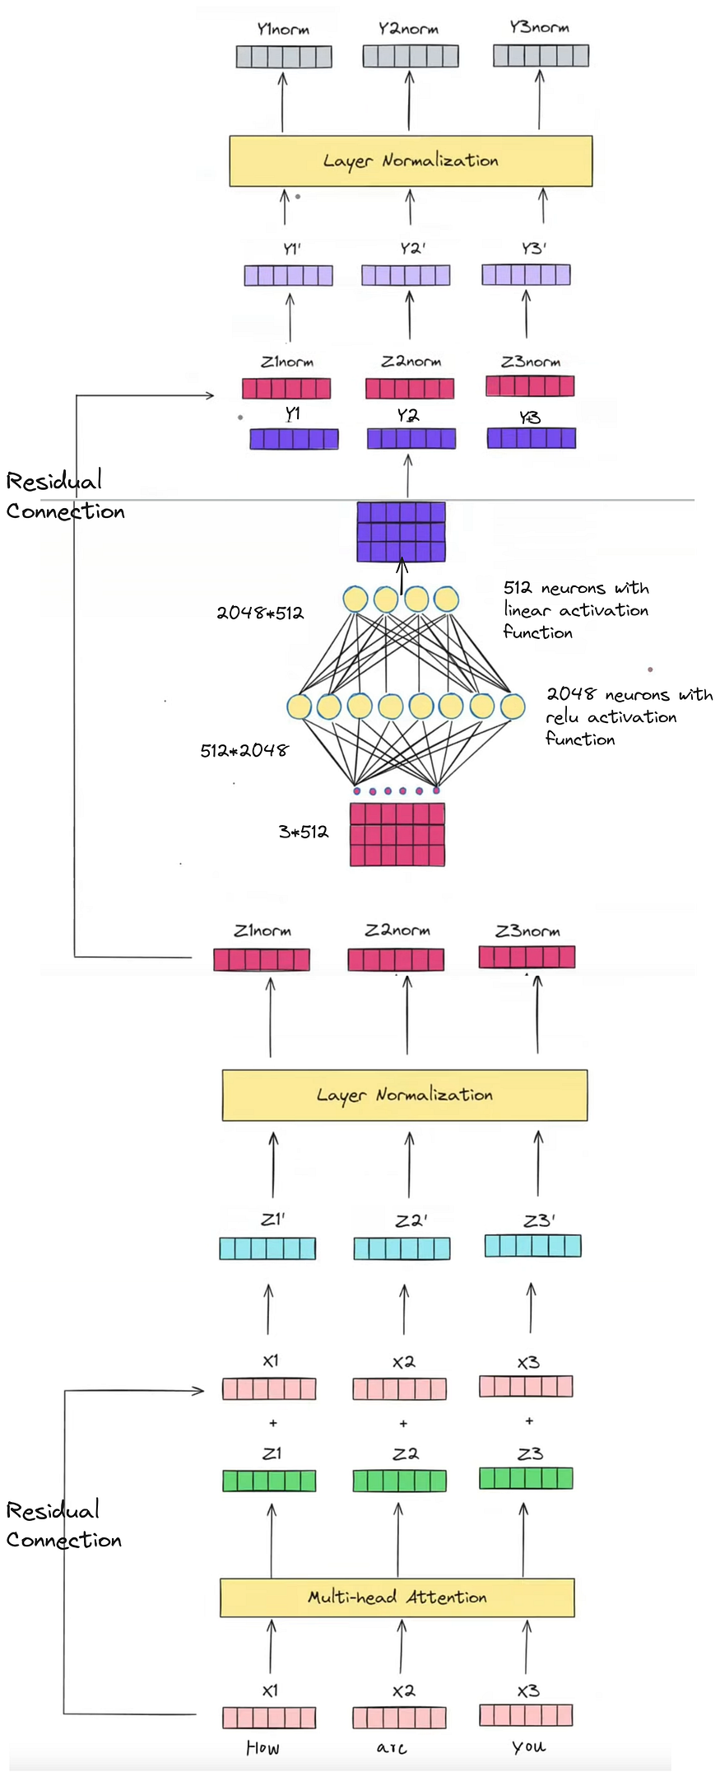
The Future of Transformers: Expanding AI Horizons
Enhanced Efficiency
Continued research focuses on improving the efficiency and scalability of Transformers, making them more accessible and powerful for a broader range of applications.
Multimodal Integration
The integration of Transformers with diverse data types—including text, images, and audio—promises richer AI understanding and more human-like interaction.
Driving Generative AI
Transformers are at the forefront of generative AI, facilitating breakthroughs in creative content generation, robotics, and complex scientific discovery.
Foundation for Innovation
As a foundational technology, Transformers will continue to underpin the development of tomorrow’s most intelligent and transformative AI systems.

