Slide 1
T-MEM: Temporal-aware Memory
Module 1 — Temporal relevance scoring over A-MEM (Xu et al., NeurIPS 2025)
LoCoMo-style simulation • Self-contained demo (no LLM API)

Slide 2
Motivation
A-MEM retrieval ranks memories by cosine similarity only (paper Eq. 9).
No explicit temporal signal — strong on Temporal LoCoMo category but improvable.
T-MEM adds a decay / usage / link-structure relevance term blended with cosine.
Setting α = 1 recovers A-MEM exactly for baseline comparison.

Slide 3
Memory note (A-MEM Eq. 1 + T-MEM)
Paper fields
c — content
t — timestamp
K — keywords
G — tags
X — contextual sentence
e — embedding of concat(c,K,G,X)
L — linked note IDs
T-MEM extensions
access_count — retrieval hits
last_accessed — bookkeeping
relevance_score — optional cache
Links simulated: cosine > 0.5 on e (LLM linking proxy)

Slide 4
Temporal relevance and retrieval
r_i = decay(m_i) × reinforce(m_i) × link_bonus(m_i)
decay = exp(−λ × age) [age = month-equivalents: elapsed days / 30]
reinforce = 1 + β × log(1 + access_count)
link_bonus = 1 + γ × (|L_i| / max_j |L_j|)
score(q, m_i) = α × cos(e_q, e_i) + (1 − α) × r̂_i
r̂_i = min-max normalize r_i over all memories M
Defaults: λ=0.1, β=0.5, γ=0.3, α=0.7 • Encoder: all-MiniLM-L6-v2

Slide 5
Simulation (thesis demo)
~30 memory notes across 10 sessions (weeks–months timeline).
Scenarios: job change (Google→Meta), relocation (NYC→Seattle), photography hobby, Japan trip, contradictions.
Photography notes get higher access_count (spacing / reinforcement).
7 evaluation queries across temporal, multi-hop, adversarial, single-hop, open-domain.

Slide 6
Results: ground-truth rank (lower is better)
Category | Query (trunc.) | A-MEM | T-MEM | vs A-MEM
temporal | Where does Alice currently work? | 3 | 1 | improved
temporal | Where does Alice live now? | 2 | 1 | improved
multi_hop | What hobby did Alice pick up after she mov… | 2 | 1 | improved
adversarial | Does Alice still work at Google? | 2 | 1 | improved
adversarial | Is Alice still living in NYC? | 6 | 5 | improved
single_hop | What camera does Alice use? | 12 | 2 | improved
open_domain | What did Alice and Bob plan to do in Japan… | 1 | 1 | same

Slide 7
Aggregate (this run)
T-MEM improved correct-answer best rank on 6 / 7 queries; 1 tie; 0 worse.
Mean rank delta (A-MEM rank − T-MEM rank): ≈ 2.3 positions.
Per-category @1/@3 accuracy: see chart + summary_stats.txt in presentation folder.
Re-run with real MiniLM (omit TMEM_ALLOW_HASH_ENCODER) for paper-aligned embeddings.

Slide 8
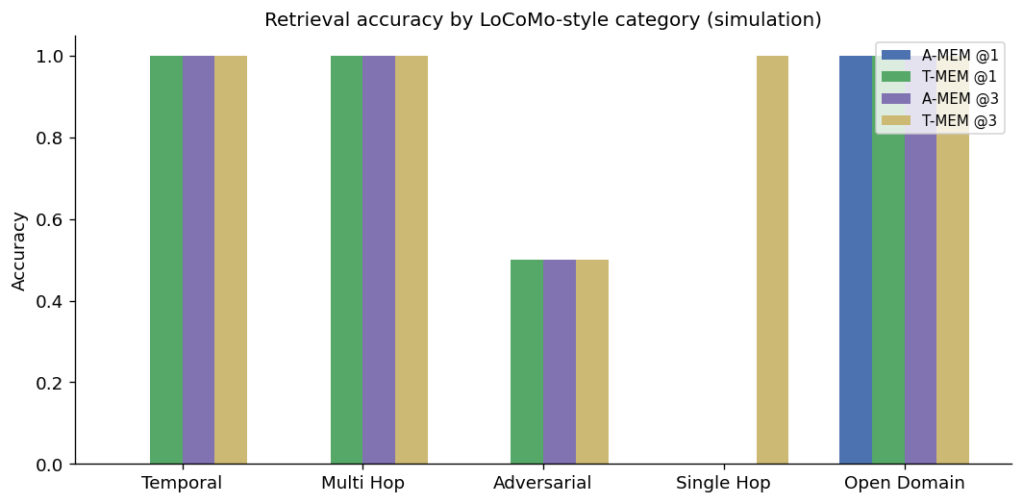
Retrieval accuracy by category

Slide 9
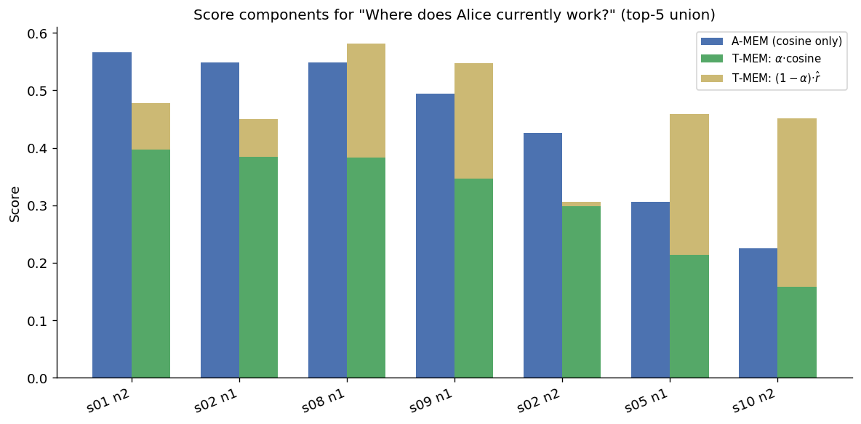
Score breakdown: “Where does Alice currently work?”

Slide 10
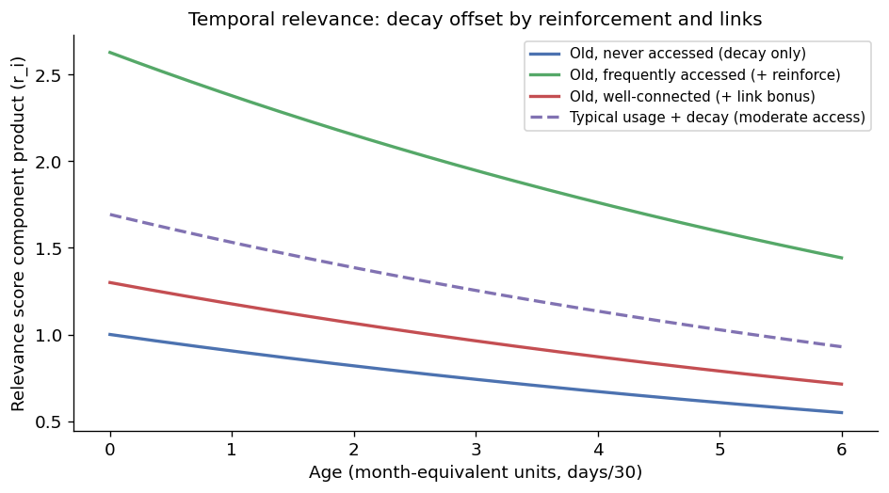
Decay, reinforcement, and link scenarios (illustrative)

Slide 11
Takeaways & limitations
T-MEM is a controlled extension: same note pipeline, modified ranking only.
Decay uses month-equivalent age so λ stays meaningful over long corpora — document in thesis.
Global r̂ can favor high-access topics; tune β / access simulation for your data.
Baseline retrieval is full-memory cosine (Eq. 9), not Chroma neighbor expansion from A-mem-sys.

