Slide 1
INDIA EV CHARGING INFRASTRUCTURE
2030 Investment Opportunity — Executive Summary
A state-wise sizing of India's EV charging demand-supply gap through 2030, ranking investment opportunity by scenario-adjusted demand, infrastructure shortfall, and market concentration.
19.22M
77.16K
81.1%
Base-case EVs
by 2030
2030 charging
infrastructure gap
Gap concentrated in
top 10 states
PRIORITY MARKETS
RECOMMENDATION
Uttar Pradesh & Maharashtra
Sequence charging-network capital into Uttar Pradesh and Maharashtra first — together they represent the largest and most concentrated 2030 infrastructure shortfall in the base case.
Opportunity scores of 0.92 and 0.51 — more than 1.7x the next-ranked state, Bihar.

Slide 2
THE BUSINESS PROBLEM
Why EV Charging Infrastructure Matters
India's EV parc is scaling faster than public charging capacity. Left unaddressed, that gap throttles adoption in exactly the states where demand is growing fastest — and it hands a durable first-mover advantage to whichever operator deploys capital there first.
Q
The Business Question
A
What This Analysis Determines
Which Indian states offer the highest-return charging-infrastructure investment opportunity through 2030 — balancing scale of EV demand against severity of the supply shortfall?
A ranked, state-wise investor opportunity score built from three inputs: projected 2030 EV demand, the resulting charging-infrastructure gap, and each state's share of national demand.

Slide 3
APPROACH
Market & Methodology
A seven-stage pipeline: historical EV registrations were modeled into 2030 scenarios in Python, translated into a state-wise infrastructure gap and opportunity score, cross-checked in SQL, and surfaced through an interactive Power BI dashboard.
1
2
3
4
5
6
7
Historical
EV Data
Python
Analysis
2030
Scenarios
Infrastructure
Gap
Investor
Opportunity Score
SQL
Validation
Power BI
Dashboard
Power BI
Dashboard
Three demand scenarios (Conservative / Base / Aggressive) were built to stress-test the opportunity ranking, so recommendations hold even if EV adoption undershoots or overshoots the base case.

Slide 4
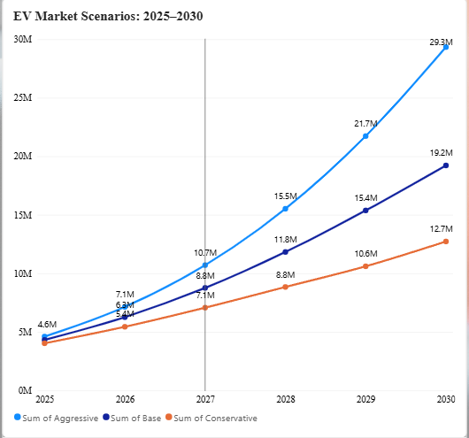
DEMAND MODELING
India EV Market Outlook, 2025–2030
Historical registration growth was projected forward under three adoption scenarios. The base case — used throughout this analysis — reaches 19.22M EVs on the road by 2030.
CONSERVATIVE
12.72M
BASE CASE
19.22M
AGGRESSIVE
29.33M

Slide 5
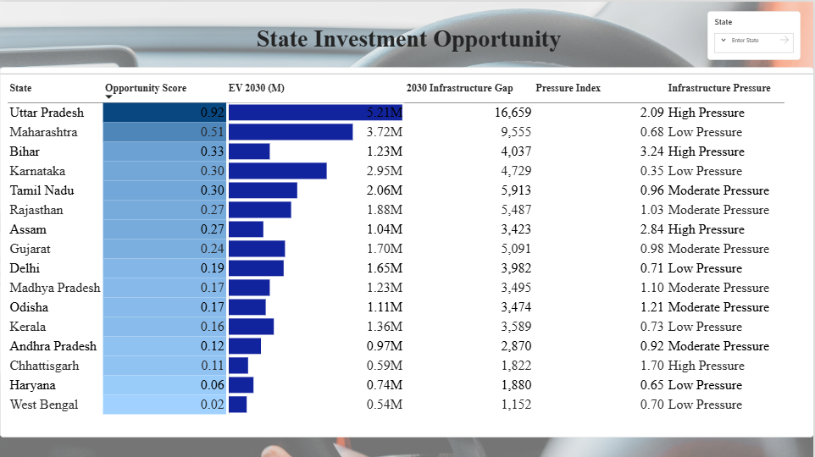
STATE-LEVEL RANKING
State Investment Opportunity
WHY UP, MAHARASHTRA & BIHAR STAND OUT
Uttar Pradesh — 0.92 score
Largest projected 2030 EV base (5.21M) and largest absolute gap (16,659 units), at High Pressure.
Maharashtra — 0.51 score
Second-largest demand (3.72M EVs) with a comparatively Low-Pressure index — an easier build-out.
Bihar — 0.33 score
Smaller EV base but the highest Pressure Index in the top 10 (3.24) — supply is critically behind demand.
Pressure Index = 2030 gap relative to existing base — a proxy for how urgently a state needs new capacity, independent of its size.
Power BI — State Investment Opportunity page

Slide 6
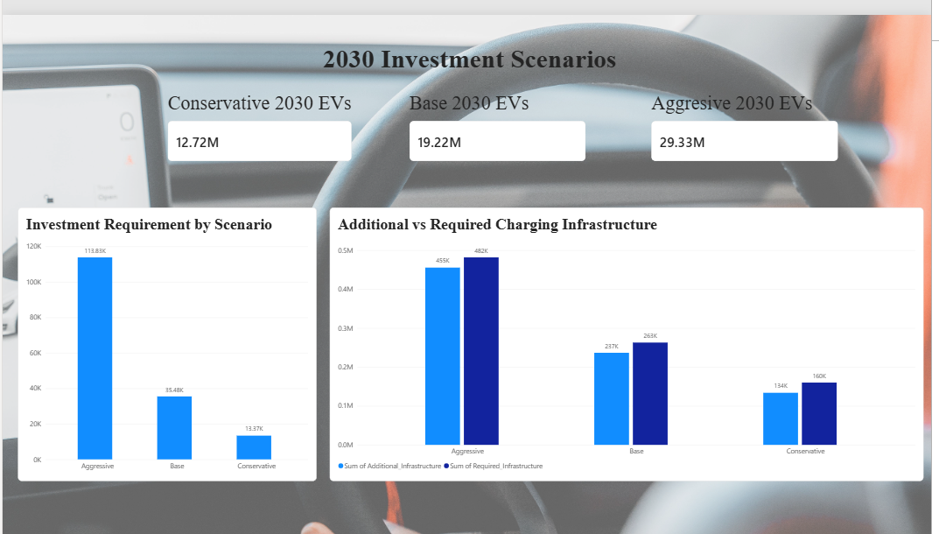
SIZING THE OPPORTUNITY
Infrastructure & Investment Scenarios
INFRASTRUCTURE REQUIREMENT
482K → 160K
Required charging points range from 160K (Conservative) to 482K (Aggressive) by 2030.
INVESTMENT REQUIREMENT
13.4K Cr → 113.8K Cr
Capital need scales non-linearly with adoption — Aggressive demands 8.5x Conservative-case spend.
SCENARIO COMPARISON
3 Cases Modeled
Additional infrastructure tracks tightly with required infrastructure in every scenario — the gap is a supply problem, not a demand-forecasting one.
Power BI — 2030 Investment Scenarios page

Slide 7
CLOSING
Prioritization & Assumptions
01 — PRIORITIZE
UTTAR PRADESH
MAHARASHTRA
Uttar Pradesh & Maharashtra
0.92
0.51
Together, these markets represent the strongest combination of projected EV demand and infrastructure shortfall.
ASSUMPTIONS
EV Adoption
Charging Infrastructure
Investment
2020–2024 historical EV registrations form the basis for the 2030 forecast.
Future infrastructure requirements are estimated from the modeled EV-to-charging relationship.
Investment requirements use scenario-specific estimated CAPEX assumptions.
Three adoption scenarios are modeled: Conservative, Base and Aggressive.
The base case indicates a 77.16K charging-infrastructure gap by 2030.
Estimates represent potential infrastructure CAPEX, not actual investment commitments.
Base case reaches 19.22M EVs by 2030.

Slide 8
CLOSING
Model Limitations & Next Steps
MODEL LIMITATIONS
1
Forecast uncertainty — 2030 EV adoption may diverge from historical growth patterns.
2
State-level aggregation — State averages can mask differences between cities, highways and individual locations.
3
Utilization not modeled — The model estimates infrastructure need but does not account for charger utilization, peak demand or queueing.
4
Cost variability — Actual CAPEX depends on land, electricity connection, charger type, installation and operating costs.
5
Policy & competition — Subsidies, regulations, existing operators and competitive intensity are not fully incorporated into the opportunity score.
NEXT STEP
Validate the highest-priority states through site-level feasibility analysis before capital deployment.
Utilization
Land availability
Electricity cost
Competition
Unit economics

