Slide 1

--------------------------
E-COMMERCE APPLICATION ON CLOUD FOUNDRY
TEAM MEMBERS:
RAJAPRIYANKA R (au821321104028)
ALEENSHYLAJA K (au821321104001)
MADESHWARAN K (au821321104016)
SAIRA BEGAM S (au821321104031)
PREETHIKA V (au821321104025)

Slide 2

AGENDA
PROJECT REVIEWS
WISHLISTS
PERSONALIZED RECOMMENTATIONS

Slide 3

PRODUCT REVIEW
A product review in e-commerce is a detailed analysis or critique provided by a customer who has purchased and used a specific product available for sale on an online retail platform. These reviews typically include a combination of text, star ratings, photos, and sometimes videos to convey the customer's experiences, opinions, and feedback regarding the product's quality, performance, features, and overall value.

Slide 4
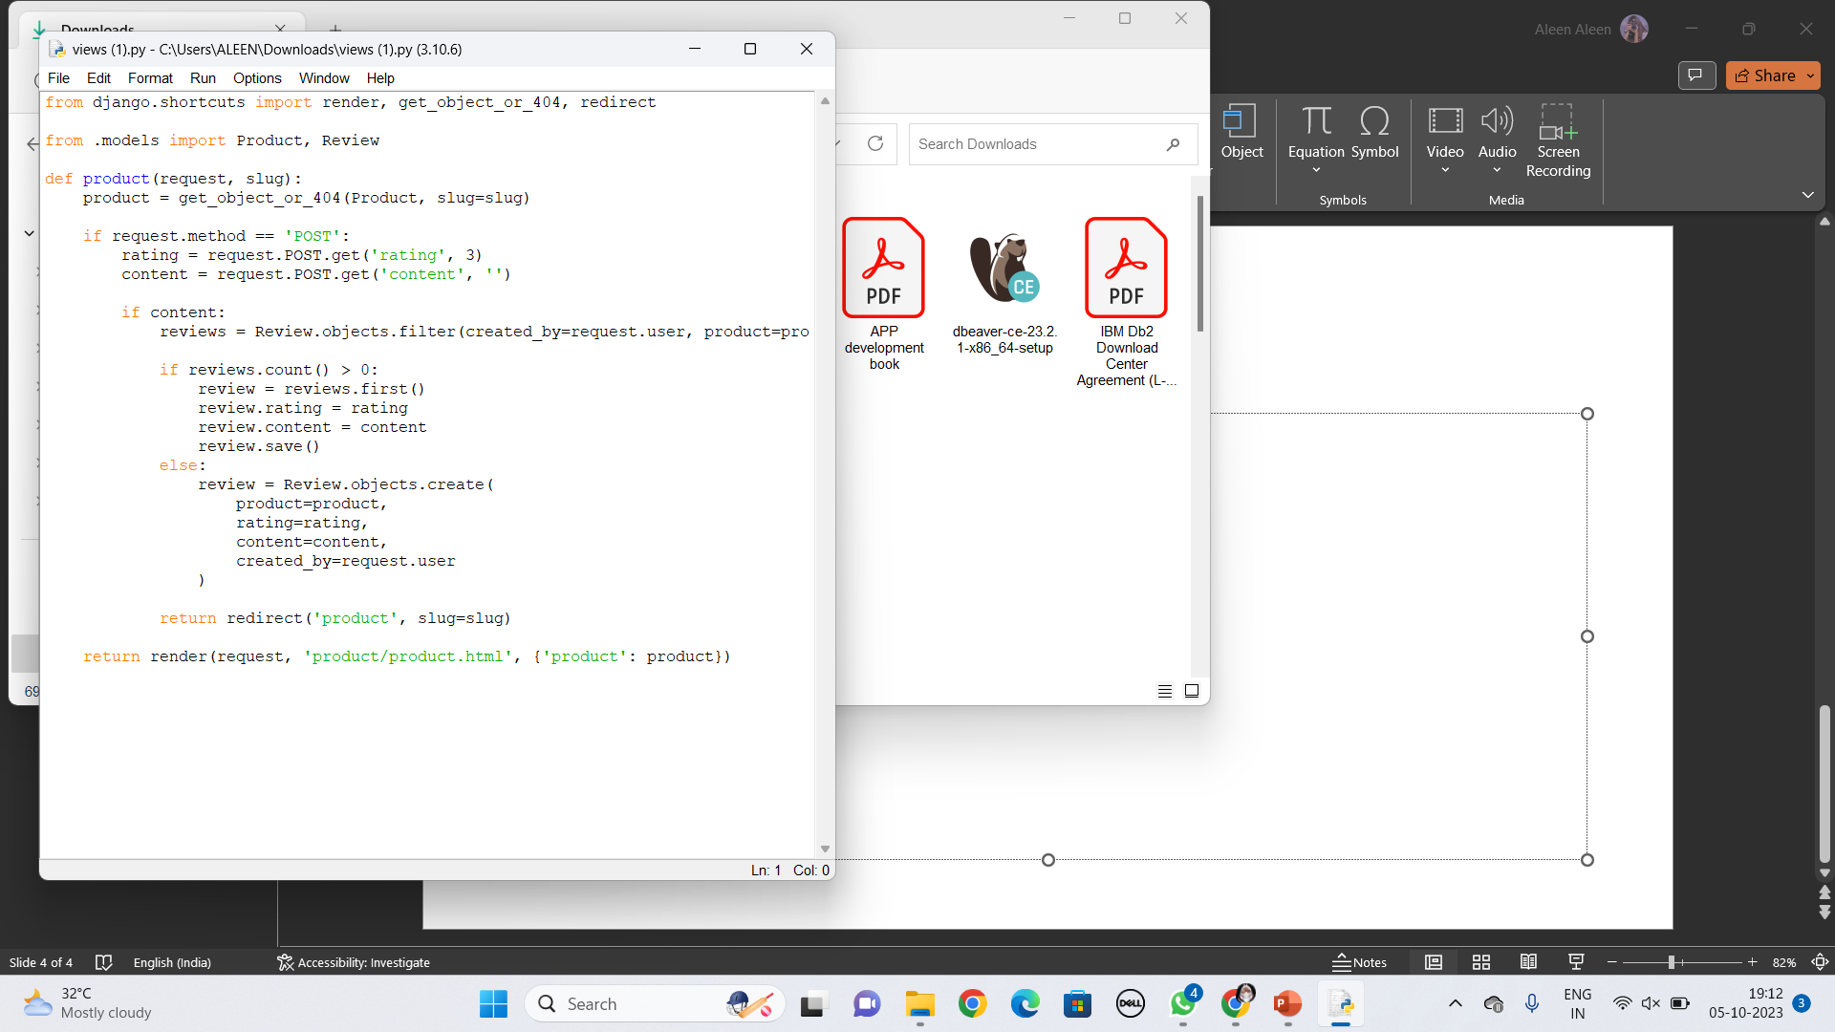
IMPLEMENTATION
Algorithm
Random Forest for Feature Importance:
Random Forest algorithms can be used to determine the importance of features extracted from reviews. This can help identify which aspects of a product are most influential in determining customer satisfaction.

Slide 5

WISHLIST
Wishlists are a valuable tool for both customers and e-commerce businesses. For customers, they enhance the shopping experience by offering a convenient way to curate and manage their desired items. For businesses, wishlists can provide insights into customer preferences and intentions, helping them tailor marketing efforts and product recommendations.

Slide 6
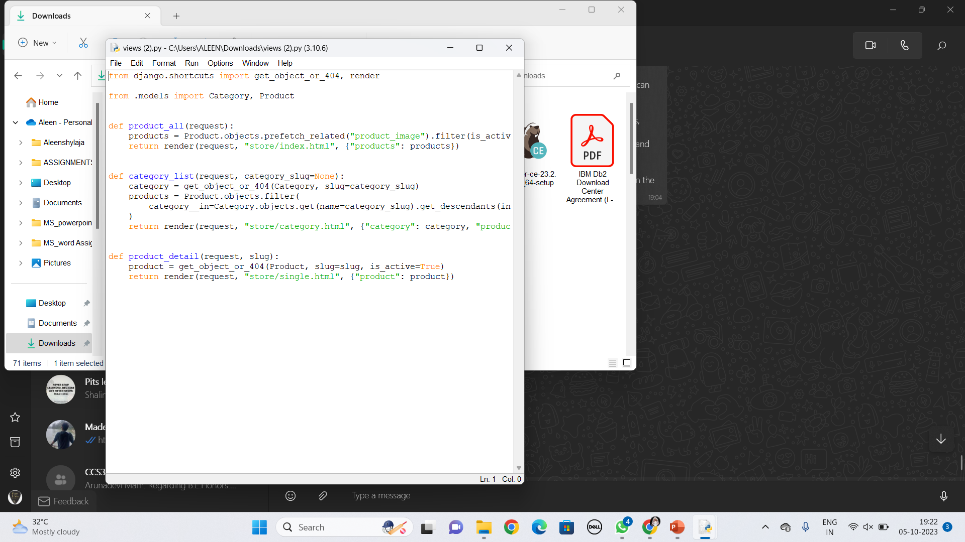
IMPLEMENTATION

Slide 7

PERSONALIZED RECOMMENTATIONS
“Personalization recommendations" refer to the practice of using customer data, preferences, and behavior to provide individualized product suggestions and content to shoppers. These recommendations aim to enhance the shopping experience by showing customers products and content that are most relevant and appealing to them.

