Slide 1







Chapter: 1
Supervised ML Algorithms: Decision Tree

Slide 2
About the Course
“
Decision trees in machine learning provide an effective method for making decisions because they lay out the problem and all the possible outcomes. It enables developers to analyze the possible consequences of a decision, and as an algorithm accesses more data, it can predict outcomes for future data.
“

Slide 3

Learning Objectives
You will learn in this lesson:
Introduction to ML
Pipeline of machine learning
Concept of decision tree
Confusion matrix
Metrics of decision tree
Implementation

Slide 4
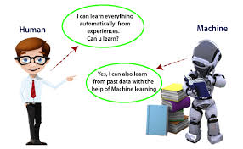
Introduction to ML
Machine learning is a branch of artificial intelligence where computers learn from data and improve their performance over time without being explicitly programmed, using algorithms to find patterns and make predictions.
Arthur Samuel first used the term "machine learning" in 1959.
Source :
https://www.javatpoint.com/machine-learning

Slide 5
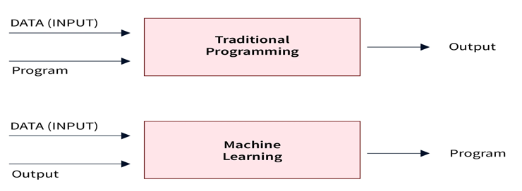
Traditional & Machine Learning Programming

Slide 6
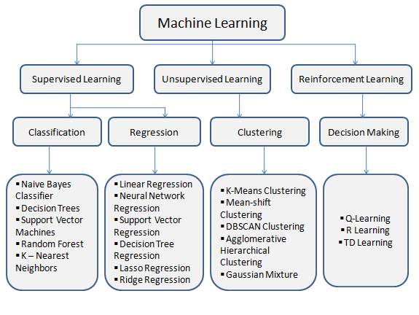
Types of Machine Learning Programming
Source :https://www.smartkarrot.com/resources/blog/ml-machine-learning-types/

Slide 7
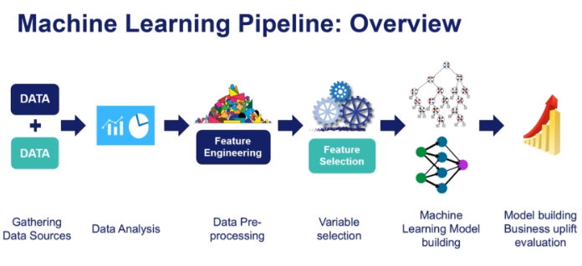
Pipeline of Machine Learning
Source

Slide 8
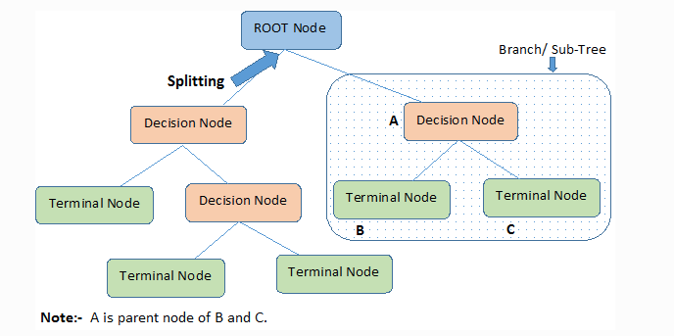
Concept of Decision Tree
Terminologies
Root Node
Splitting
Decision Node
Leaf / Terminal Node
Pruning
Branch / Sub-Tree
Parent and Child Node

Slide 9
Why Use Decision Trees?
Decision Trees usually mimic human thinking ability while making a decision, so it is easy to understand.
The logic behind the decision tree can be easily understood because it shows a tree-like structure.

Slide 10
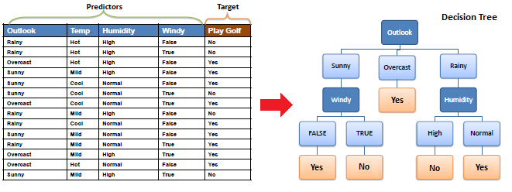
Example of a decision tree

Slide 11
How does the Decision Tree algorithm Work?
Step-1: Begin the tree with the root node, says S, which contains the complete dataset.
Step-2: Find the best attribute in the dataset using Attribute Selection Measure (ASM).
Step-3: Divide the S into subsets that contains possible values for the best attributes.
Step-4: Generate the decision tree node, which contains the best attribute.
Step-5: Recursively make new decision trees using the subsets of the dataset created in step -3. Continue this process until a stage is reached where you cannot further classify the nodes and called the final node as a leaf node.

Slide 12
ASM
We have two popular attribute selection measures:
Information Gain
Gini Index
Entropy

Slide 13
Entropy
Entropy is a measure of the randomness in the information being processed.
The higher the entropy, the harder it is to draw any conclusions from that information.
Flipping a coin is an example of an action that provides information that is random.

Slide 14
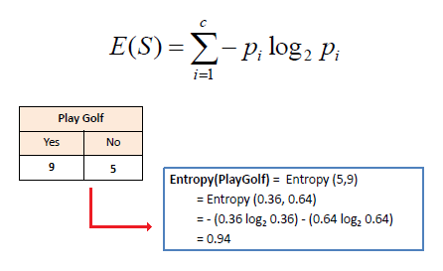
Entropy

Slide 15
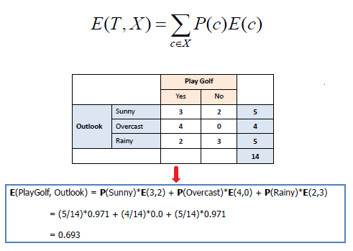
Entropy
T is the output attribute,
X is the input attribute,
P(c) is the probability w.r.t the possible data point present at X, and
E(c) is the entropy w.r.t ‘True’ pertaining to the possible data point.

Slide 16
Information Gain
Information gain or IG is a statistical property that measures how well a given attribute separates the training examples according to their target classification.
Constructing a decision tree is all about finding an attribute that returns the highest information gain and the smallest entropy.

Slide 17
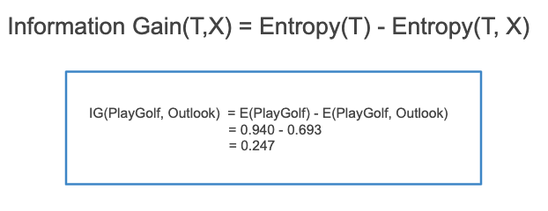
Information Gain
Mathematically, IG is represented as:

Slide 18
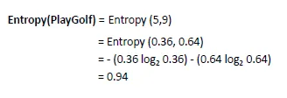
Information Gain
Step 1: Calculate entropy of the target.

Slide 19
Information Gain
Step 2: The dataset is then split on the different attributes. The entropy for each branch is calculated. Then it is added proportionally, to get total entropy for the split. The resulting entropy is subtracted from the entropy before the split. The result is the Information Gain, or decrease in entropy.

Slide 20
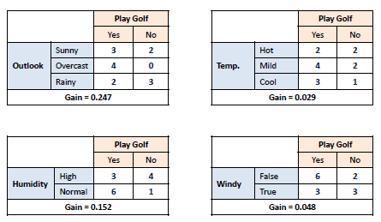
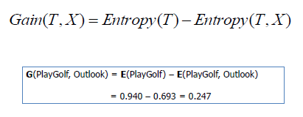
Information Gain

Slide 21
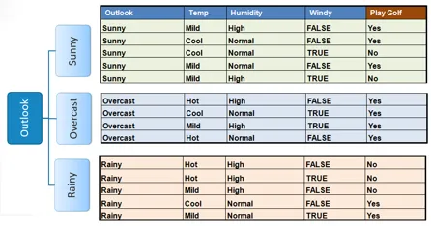
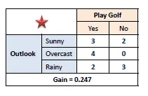
Information Gain
Step 3: Choose attribute with the largest information gain as the decision node, divide the dataset by its branches and repeat the same process on every branch.

Slide 22
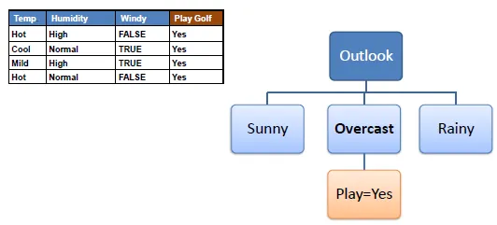
Information Gain
Step 4a : A branch with entropy of 0 is a leaf node.

Slide 23
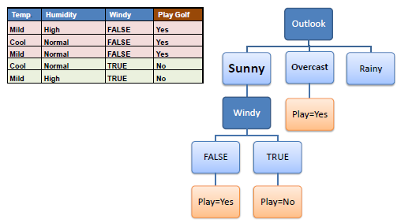
Information Gain
Step 4b : A branch with entropy more than 0 needs further splitting.

Slide 24
Gini Impurity
Gini Index or Gini impurity measures the degree or probability of a particular variable being wrongly classified when it is randomly chosen.
But what is actually meant by ‘impurity’?
If all the elements belong to a single class, then it can be called pure. The degree of Gini Index varies between 0 and 1,
where,
'0' denotes that all elements belong to a certain class or there exists only one class (pure), and
'1' denotes that the elements are randomly distributed across various classes (impure).
A Gini Index of '0.5 'denotes equally distributed elements into some classes.

Slide 25

Gini Impurity
Gini impurity = 1 – Gini
Here is the sum of squares of success probabilities of each class and is given as:
Considering that there are n classes.

Slide 26
Pruning
Pruning is a process of deleting the unnecessary nodes from a.
A too-large tree increases the risk of overfitting, and a small tree may not capture all the important features of the dataset.
Therefore, a technique that decreases the size of the learning tree without reducing accuracy is known as Pruning.
Cost Complexity Pruning
Reduced Error Pruning.

Slide 27
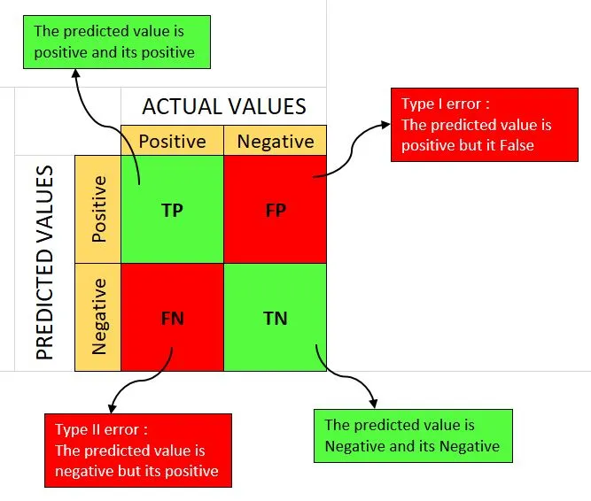
Confusion Matrix

Slide 28
Confusion Matrix
 |  | Predicted
 |  | Dog | Not Dog
Actual | Dog | True Positive (TP =5) | False Negative (FN =1)
 | Not Dog | False Positive (FP=1) | True Negative (TN=3)

Slide 29
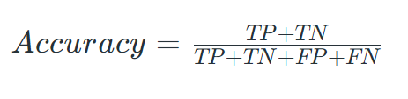
Metrics based on Confusion Matrix Data
1. Accuracy
Accuracy is used to measure the performance of the model.
For the above case:
Accuracy = (5+3)/(5+3+1+1) = 8/10 = 0.8

Slide 30

Metrics based on Confusion Matrix Data
2. Precision
Precision is a measure of how accurate a model’s positive predictions are.
For the above case:
Precision = 5/(5+1) =5/6 = 0.8333

Slide 31

Metrics based on Confusion Matrix Data
3. Recall
Recall measures the effectiveness of a classification model in identifying all relevant instances from a dataset.
For the above case:
Recall = 5/(5+1) =5/6 = 0.8333

Slide 32

Metrics based on Confusion Matrix Data
4. F1-Score
F1-score is used to evaluate the overall performance of a classification model.
For the above case:
F1-Score: = (2* 0.8333* 0.8333)/( 0.8333+ 0.8333) = 0.8333

Slide 33

Metrics based on Confusion Matrix Data
5. Specificity:
It measures the ability of a model to correctly identify negative instances.
Specificity=3/(1+3)​=3/4=0.75

Slide 34
Lab: Implementation of Decision tree.

Slide 35

Summary
Well done! You have completed this course and now you have understand about:
Machine Learning
Concepts of DT
Confusion matrix
Metrics of DT
How to implement and classify the data with multiple ASM methods.
Notes:
35

Slide 36


Quiz
1. Machine Learning algorithms build a model base on sample data, known as_________​
Validation Data​
Training Data​
Testing Data​
Transfer Data​
​
Answer: B
Notes:
36

Slide 37
Quiz
2. Which of the following is not a Decision tree algorithm? a) ID3 b) C4.5 c) DBSCAN d) CART
​
Answer: c
​
Notes:
37

Slide 38
Quiz
3. What is the goal of a decision tree algorithm during training?
a. To maximize accuracy
b. To minimize impurity
c. To minimize error
d. To maximize precision
​
Answer: b
​
Notes:
38

Slide 39
Reference
Put any reference site links here
Notes:
39

Slide 40
Thank you!
Notes:
40

