Slide 1

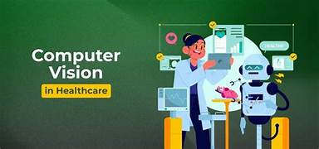
COMPUTER VISION IN HEALTHCARE
NAME: RAJA RAJESHWARI M
REG NO: 192421253
COURSE CODE & NAME: ITA0517 – COMPUTER VISION

Slide 2

INTRODUCTION
Branch Of AI That Enables Computers To Understand Medical Images.
Assists Doctors In Diagnosis.
Improves Accuracy And Speed.
Reduces Human Error.
Used In Hospitals And Research.

Slide 3
Tools Used in Computer Vision for Healthcare
OpenCV: Image preprocessing and feature extraction.
TensorFlow: Develops AI models for medical image classification.
PyTorch: Builds deep learning models for image analysis.
CNN: Detects and classifies diseases from medical images.
DICOM: Stores and transfers medical imaging data.

Slide 4
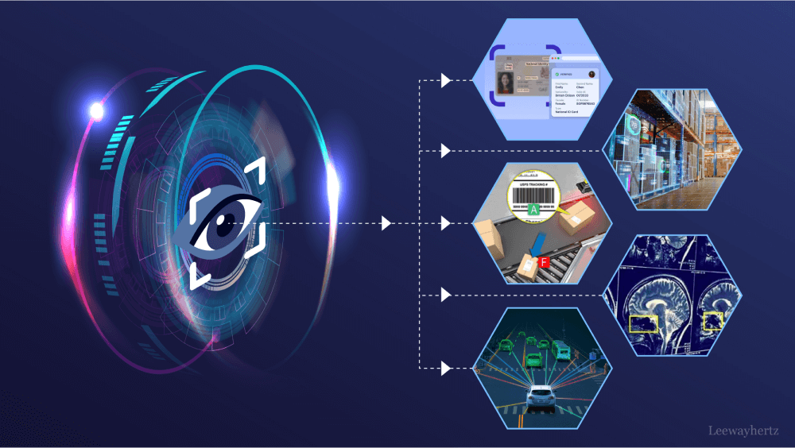
HOW COMPUTER VISION WORKS IN HEALTHCARE
1. Image Acquisition (X-ray, MRI, CT).
2. Image Preprocessing.
3. Feature Extraction.
4. AI Disease Detection.
5. Diagnosis Report.

Slide 5
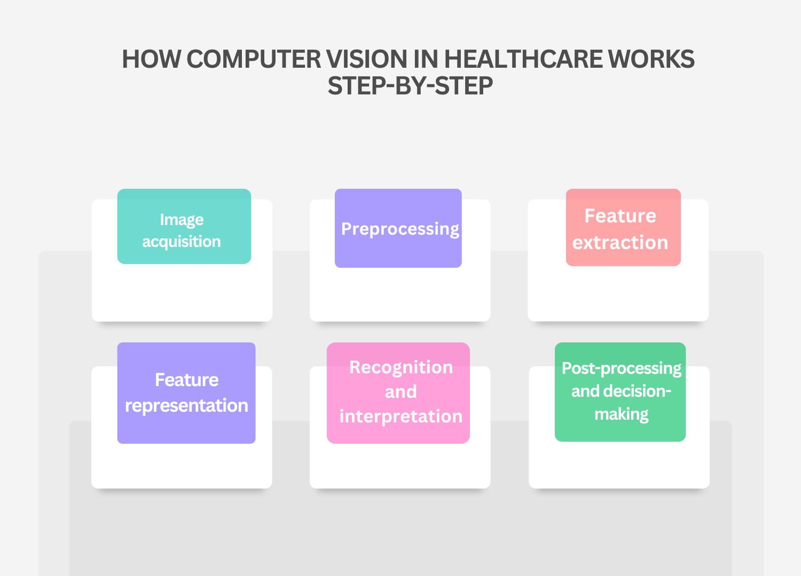

Slide 6
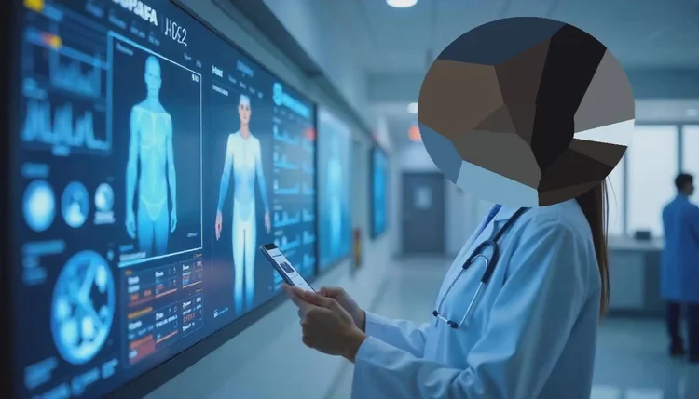
APPLICATIONS
Cancer Detection: Identifies tumors and abnormal cells from medical images for early diagnosis.
Brain Tumor Detection: Detects and locates brain tumors using MRI and CT scans.
Diabetic Retinopathy Detection: Examines retinal images to identify diabetes-related eye diseases.
Fracture Detection: Detects bone fractures quickly and accurately from X-ray images.
Surgical Assistance: Provides real-time image guidance to improve surgical precision.
Patient Monitoring: Tracks patient movements and vital conditions for continuous care.
Telemedicine: Enables remote diagnosis and consultation through AI-based medical image analysis.

Slide 7
ADVANTAGES
Faster Diagnosis: Detects diseases quickly using AI.
High Accuracy: Provides accurate analysis of medical images.
Early Disease Detection: Identifies diseases at an early stage.
Reduces Human Error: Minimizes mistakes in diagnosis.
Saves Doctors' Time: Automates image analysis for faster decisions.
Better Patient Care: Improves treatment quality and patient outcomes.

Slide 8
CHALLENGES
Requires Large Datasets: Needs a large amount of medical data for accurate training.
High Implementation Cost: Requires expensive software, hardware, and maintenance.
Privacy Concerns: Patient medical data must be protected from unauthorized access.
Needs Powerful Hardware: Requires high-performance computers and GPUs for processing.
Depends on Image Quality: Poor-quality images can reduce detection accuracy.
Ethical Issues: AI decisions must be fair, transparent, and used responsibly.

Slide 9
CONCLUSION
Improves healthcare through AI.
Supports doctors, not replaces them.
Enhances diagnosis and treatment.
Future of smart healthcare.

