Slide 1
🤖
Building Local AI Agents and Automation with n8n
Dr Ramkumar Lakshminarayanan
n8n · Ollama · Docker · Qdrant · PostgreSQL
7 Exercises
CPU Only
No API Keys
Free & Open
Ganpat University

Slide 2
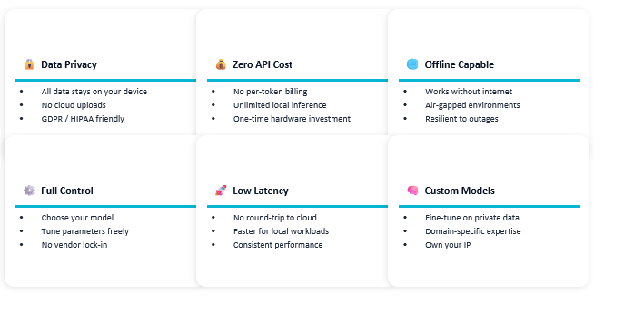
🐳 Why Local AI ? Necessity & Importance
Ganpat University · Local AI Workflows with n8n

Slide 3
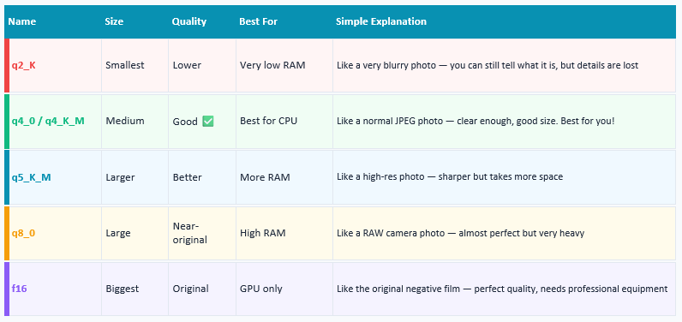
🐳 Quantization
Ganpat University · Local AI Workflows with n8n

Slide 4
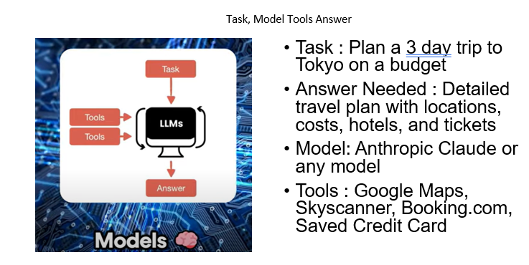
🐳 AI Agent
Ganpat University · Local AI Workflows with n8n

Slide 5
🐳 What is Docker?
Container
An isolated environment with everything a program needs to run — code, libraries, settings. Runs identically on any machine.
Image
A blueprint for a container. The n8n starter kit includes images for n8n, Ollama, PostgreSQL, and Qdrant.
docker compose up
One command that starts ALL services together. No manual setup for each service.
Why Docker for AI?
Ollama, Qdrant, and n8n each have complex dependencies. Docker packages them so they work together instantly.
Ganpat University · Local AI Workflows with n8n

Slide 6
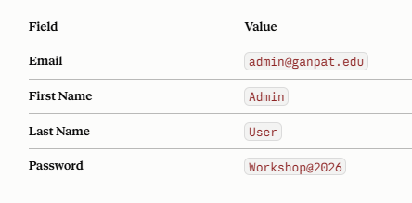
🐳 Recommended Username and Password
Ganpat University · Local AI Workflows with n8n

Slide 7
🚀 n8n AI Starter Kit
n8n
Ollama
PostgreSQL
Qdrant
Workflow automation platform
Local AI model runner
Relational database
Vector database
Runs at http://localhost:5678
Runs at http://localhost:11434 (internal)
Internal port: 5432
Runs at http://localhost:6333
Build workflows visually — no code required
Models run on CPU — no GPU, no API key, no cost
Stores n8n workflow data and execution history
Powers the RAG pipeline in Exercise 7
Ganpat University · Local AI Workflows with n8n

Slide 8
⚙️ Common Setup Commands
Start all services
Stop all services
docker compose --profile cpu up -d
docker compose --profile cpu down
Check containers running
Open n8n in browser
docker ps
http://localhost:5678
View n8n logs
Open Qdrant dashboard
docker logs n8n
http://localhost:6333/dashboard
Ganpat University · Local AI Workflows with n8n

Slide 9
🔥 Warm-Up: Pull All AI Models
docker exec -it ollama ollama pull tinyllama
~600 MB · Exercise 1 — AI Code Reviewer
docker exec -it ollama ollama pull phi3:mini
~2.3 GB · Exercises 2 & 3 — ELI5, File Summariser
docker exec -it ollama ollama pull qwen2.5:3b
~1.9 GB · Exercises 5 & 6 — Calculator, Logger
docker exec -it ollama ollama pull mxbai-embed-large
~669 MB · Exercise 7 — RAG embeddings
Ganpat University · Local AI Workflows with n8n

Slide 10
📁 File Handling Commands — Exercise 3
Containers have isolated file systems. Files on Windows are NOT visible inside Docker — use docker cp to transfer.
Create folder (run after every Docker restart)
docker exec -it n8n mkdir -p /home/node/.n8n-files
Upload file from Windows to n8n container
docker cp document.txt n8n:/home/node/.n8n-files/document.txt
Download file from n8n container to Windows
docker cp n8n:/home/node/.n8n-files/summary.txt .
List files inside the container
docker exec -it n8n ls /home/node/.n8n-files/
⚠️ The .n8n-files folder is lost on every Docker restart — always re-create it at the start of each session.
Ganpat University · Local AI Workflows with n8n

Slide 11
🔍 Exercise 1 — AI Code Reviewer
Webhook + Basic LLM Chain + Ollama
Webhook → Basic LLM Chain → Respond to Webhook
What is new in this exercise:
Key parameters:
▸ HTTP Webhook trigger
HTTP Method: POST
▸ Basic LLM Chain node
Path: roast-my-code
▸ Ollama Model sub-node
Response Mode: Response Node
▸ Respond to Webhook node
Model: tinyllama
Ganpat University · Local AI Workflows with n8n

Slide 12
🔍 Exercise 1 — AI Code Reviewer · Test & Output
📥 Input / Test
📤 AI Output
def divide(a, b):
return a / b
📋 CODE REVIEW: Missing error handling...
⚠️ ISSUES: Division by zero not handled
💡 IMPROVEMENTS: Add try/except block
💡 How to Test This Exercise
Open code_reviewer_tester.html in browser. Submit code → AI reviews it and returns structured feedback.
⏱ 15 min
🤖 tinyllama
📄 JSON file: 1.json
Ganpat University · Local AI Workflows with n8n

Slide 13
🧠 Exercise 2 — Explain Like I'm 5
Webhook + Basic LLM Chain + Prompt Eng
Webhook → Basic LLM Chain → Respond to Webhook
What is new in this exercise:
Key parameters:
▸ Prompt engineering — system message
HTTP Method: POST
▸ Expression mode in prompt field
Path: explain-eli5
▸ phi3:mini model
Prompt: Expression mode ({{ $json.body.topic }})
▸ Browser tester HTML page
System: You are a friendly teacher...
Ganpat University · Local AI Workflows with n8n

Slide 14
🧠 Exercise 2 — Explain Like I'm 5 · Test & Output
📥 Input / Test
📤 AI Output
"What is RAM in a computer"
"RAM is like your brain's short-term memory. When you open a program, it goes into RAM so your computer can use it quickly. When you close it, it disappears from RAM — just like forgetting something you were just thinking about."
💡 How to Test This Exercise
Open eli5_tester.html in browser. Select phi3:mini → type any CS topic → click Explain It!
⏱ 15 min
🤖 phi3:mini
📄 JSON file: 2.json
Ganpat University · Local AI Workflows with n8n

Slide 15
📂 Exercise 3 — AI File Summariser
Manual Trigger + File + LLM Chain
Manual Trigger → Read File → Extract → LLM Chain → Convert → Write
What is new in this exercise:
Key parameters:
▸ Manual Trigger
Operation: Read File(s) From Disk
▸ Read/Write Files from Disk
File: /home/node/.n8n-files/document.txt
▸ Extract from File
Prompt: Expression mode (={{ $json.data }})
▸ docker cp file transfer
Model: phi3:mini
Ganpat University · Local AI Workflows with n8n

Slide 16
📂 Exercise 3 — AI File Summariser · Test & Output
📥 Input / Test
📤 AI Output
docker cp document.txt n8n:/home/node/.n8n-files/document.txt
"A computer network connects devices to share resources. Networks are classified as LAN, WAN, or MAN. The internet is the largest WAN using TCP/IP."
💡 How to Test This Exercise
After Execute Workflow: docker cp n8n:/home/node/.n8n-files/summary.txt . → type summary.txt
⏱ 15 min
🤖 phi3:mini
📄 JSON file: 3.json
Ganpat University · Local AI Workflows with n8n

Slide 17
🌐 Exercise 4 — Simple HTTP Request
Chat Trigger + HTTP Request + Edit Fields
Chat Trigger → HTTP Request → Edit Fields
What is new in this exercise:
Key parameters:
▸ Chat Trigger
Method: GET
▸ HTTP Request node (GET method)
URL: https://catfact.ninja/fact
▸ Edit Fields node
Edit Fields: Name=fact, Value={{ $json.fact }}
▸ Reading JSON responses
Ganpat University · Local AI Workflows with n8n

Slide 18
🌐 Exercise 4 — Simple HTTP Request · Test & Output
📥 Input / Test
📤 AI Output
"give me a cat fact"
"Cats have 230 bones in their body, while humans only have 206."
💡 How to Test This Exercise
Open Chat → type any message → the API is called automatically and the fact appears in the chat.
⏱ 5 min
🤖 Public API
📄 JSON file: 4.json
Ganpat University · Local AI Workflows with n8n

Slide 19
🧮 Exercise 5 — AI Calculator
Chat Trigger + AI Agent + Calculator Tool
Chat Trigger → AI Agent (Chat Model + Memory + Calculator Tool)
What is new in this exercise:
Key parameters:
▸ AI Agent node
System Message: You are a helpful financial assistant
▸ Chat Model slot + Memory slot + Tool slot
Model: qwen2.5:3b
▸ Built-in Calculator Tool
Memory: Context Window = 10
▸ Conversation memory
Calculator Tool: no parameters needed
Ganpat University · Local AI Workflows with n8n

Slide 20
🧮 Exercise 5 — AI Calculator · Test & Output
📥 Input / Test
📤 AI Output
"What is 128 divided by 4, then multiplied by 3?"
"128 ÷ 4 = 32, then 32 × 3 = 96. The final answer is 96."
💡 How to Test This Exercise
Open Chat → ask any maths question → the AI Agent calls the Calculator Tool for exact results.
⏱ 10 min
🤖 qwen2.5:3b
📄 JSON file: 5.json
Ganpat University · Local AI Workflows with n8n

Slide 21
💾 Exercise 6 — AI Interaction Logger
Chat Trigger + AI Agent + Code Tool + DB
Chat Trigger → AI Agent → Insert Row (Data Table)
What is new in this exercise:
Key parameters:
▸ Code Tool (JavaScript)
question: ={{ $('When chat message received').item.json.chatInput }}
▸ n8n Data Table
answer_summary: ={{ $json.output.slice(0, 200) }}
▸ Insert Row node
word_count: ={{ $json.output.trim().split(/\s+/).length }}
▸ Persistent data storage
timestamp: ={{ new Date().toISOString()... }}
Ganpat University · Local AI Workflows with n8n

Slide 22
💾 Exercise 6 — AI Interaction Logger · Test & Output
📥 Input / Test
📤 AI Output
"What is a binary search tree?"
question: What is a binary search tree?
answer_summary: A binary search tree is...
word_count: 112
session_count: 6
timestamp: 2026-08-22 17:41:08
💡 How to Test This Exercise
Open Chat → ask a question → go to Tables in n8n sidebar → see the row saved in ai_interaction_log.
⏱ 15-20 min
🤖 qwen2.5:3b
📄 JSON file: 6.json
Ganpat University · Local AI Workflows with n8n

Slide 23
🔍 Exercise 7 — RAG Pipeline
Two Workflows: Ingest PDF + Chat Q&A
Workflow 1: n8n Form → Qdrant (insert)
Workflow 2: Chat Trigger → AI Agent → Qdrant (retrieve)
What is new in this exercise:
Key parameters:
▸ Two-workflow architecture
Collection: rag_collection
▸ Qdrant vector database
Vector Size: 1024, Distance: Cosine
▸ mxbai-embed-large embeddings
Chunk Size: 200, Overlap: 50
▸ Retrieve-as-tool mode
Tool Name: retriever, Embeddings: mxbai-embed-large
Ganpat University · Local AI Workflows with n8n

Slide 24
🔍 Exercise 7 — RAG Pipeline · Test & Output
📥 Input / Test
📤 AI Output
"What are the five steps of RAG?"
"RAG works in five steps: First, ingest — documents are split into chunks. Second, embed — chunks become vectors. Third, store — vectors go to Qdrant. Fourth, retrieve — question finds similar chunks. Fifth, generate — AI answers from those chunks."
💡 How to Test This Exercise
Workflow 1: upload PDF via form. Workflow 2: open chat → ask questions about the document content.
⏱ 15-20 min
🤖 mxbai + qwen2.5:3b
📄 JSON file: 7.json
Ganpat University · Local AI Workflows with n8n

Slide 25
🎉
All 7 Exercises Complete!
All workflow .json files are provided — import, explore, and modify to learn.
✅ 1. AI Code Reviewer
✅ 5. AI Calculator
✅ 2. Explain Like Im 5
✅ 6. AI Interaction Logger
✅ 3. AI File Summariser
✅ 7. RAG Pipeline
✅ 4. Simple HTTP Request
Ganpat University · Local AI Workflows with n8n

