Slide 1



KONGU ENGINEERING COLLEGE
PERUNDURAI ERODE-638060
DEPARTMENT OF COMPUTER APPLICATION
TITLE : Website for Online Medical Retail Shop
GUIDED BY :
Dr. K.CHITRA MCA,M.Phil.,PhD
TEAM NO: 35
PRESENTED BY ,
RAJARAM S(24MCR080)
SACHIN S(24MCR084)
SANGEETHA M(24MCR089)
24-12-2024
Notes:
8 October 2024
1-59
1

Slide 2


2
ABSTRACT
Medicare Shop is an online platform that streamlines medical supply procurement using React.js for the frontend and Firebase for real-time backend services. It provides real-time updates on stock availability and pricing, ensuring transparency and efficiency.
This is user-friendly interface that minimizing delays and enhancing accessibility, Medicare Shop optimizes the purchasing process, delivering a smooth and reliable experience for those seeking essential medical supplies.
24-12-2024
Notes:
2

Slide 3
3
EXISTING DISADVANTAGE
Users are limited to local inventory and must visit physical stores.
Many e-commerce platforms lack features specific to healthcare, making it hard to find the right products.
The interfaces of many online medical stores are confusing and hard to use.
Many platforms do not have proper security measures, making users hesitant to share sensitive information.
24-12-2024
Notes:
2

Slide 4
4
PROPOSED ADVANTAGE
Users can view products, but they cannot purchase items that are out of stock.
Items in the cart are reserved during checkout to prevent others from buying them.
Users are notified when out-of-stock products are restocked.
Customers can save their cart for later, offering more time to decide.
Instant updates on stock and price changes enhance transparency and build trust.
24-12-2024
Notes:
2

Slide 5
5
MODULE DESCRIPTION
ADMIN MODULE:
The Admin module allows the system administrator to manage products, view user details, set product prices and descriptions, assign unique product IDs, and ensure product availability and updates.
USER MODULE:
The User module enables new customer registration, secure login, browsing medical products, adding items to the cart, and viewing product details such as price and description.
24-12-2024
Notes:
2

Slide 6
6
ORDER MODULE:
The Order module allows users to add items to their cart, review their selection, and proceed with checkout. It ensures accurate processing of selected products for purchase.
PAYMENT MODULE:
The Payment module enables secure online payments, allowing users to choose their preferred payment method. After processing, the order is confirmed, and the amount is debited.
24-12-2024
Notes:
2

Slide 7
7
DATAFLOW DIAGRAM
ADMIN
Product
details
DATABASE
Product
details
USER
Manage
Products
Place
order
Data Flow Diagram (Level 0)
24-12-2024
Notes:
3

Slide 8
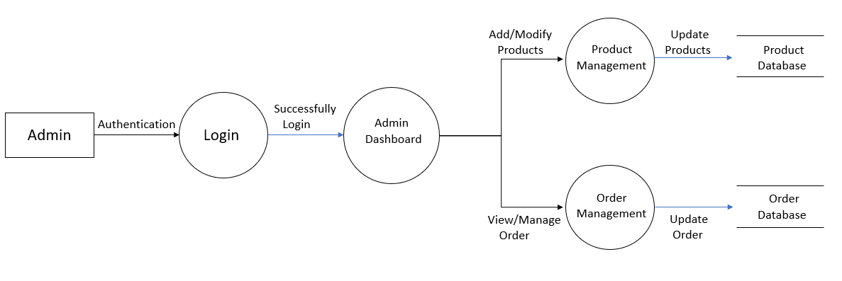
8
Data Flow Diagram (Level 1 Admin side)
24-12-2024
Notes:
3

Slide 9
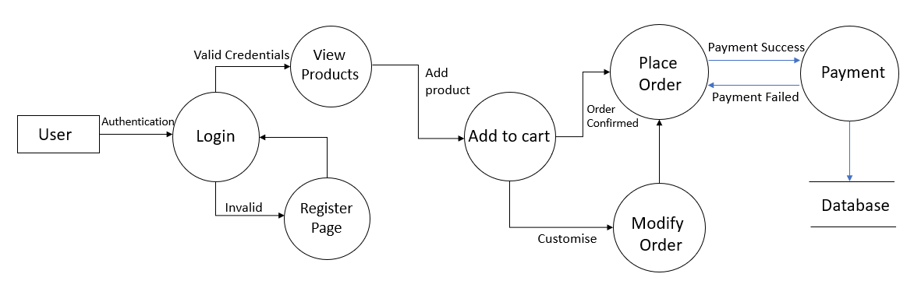
9
Data Flow Diagram (Level 1 user side)
24-12-2024
Notes:
3

Slide 10
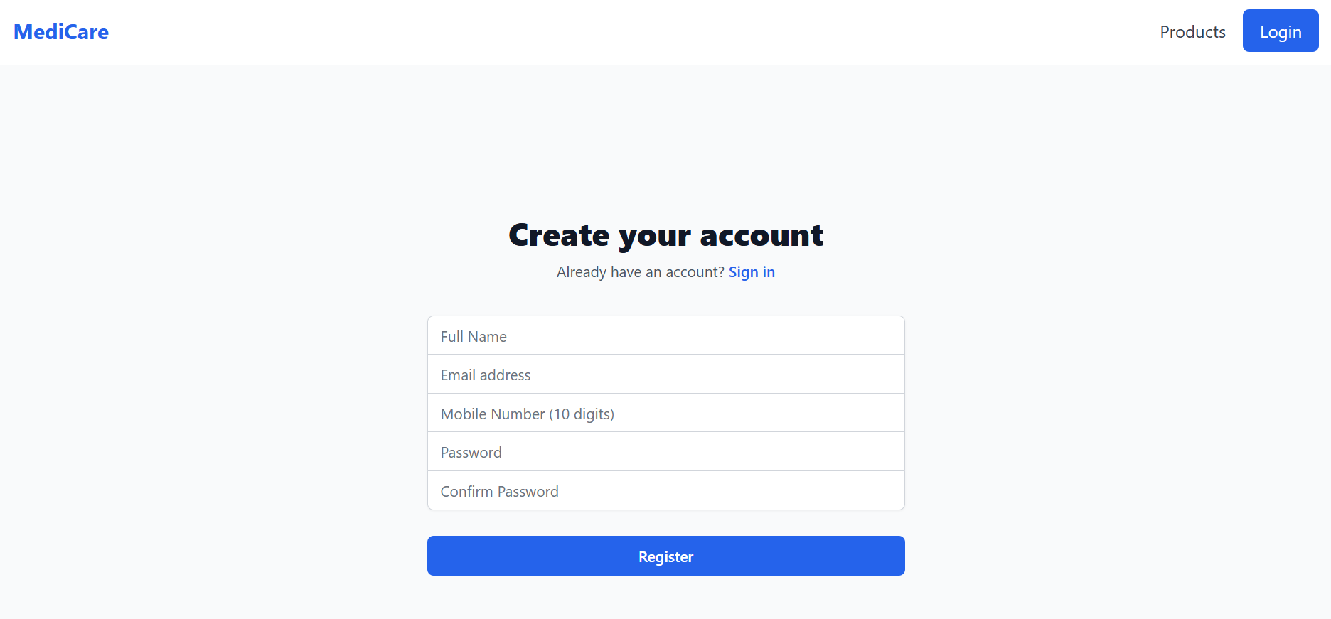
10
SCREENSHOTS
User Registration Page
24-12-2024
Notes:
4

Slide 11
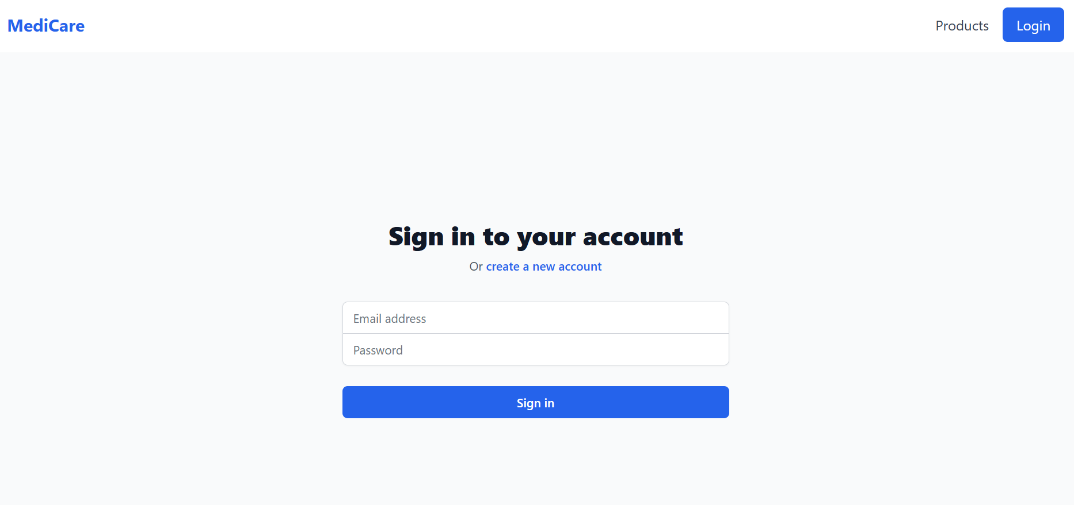
11
User Login Page
24-12-2024
Notes:
4

Slide 12
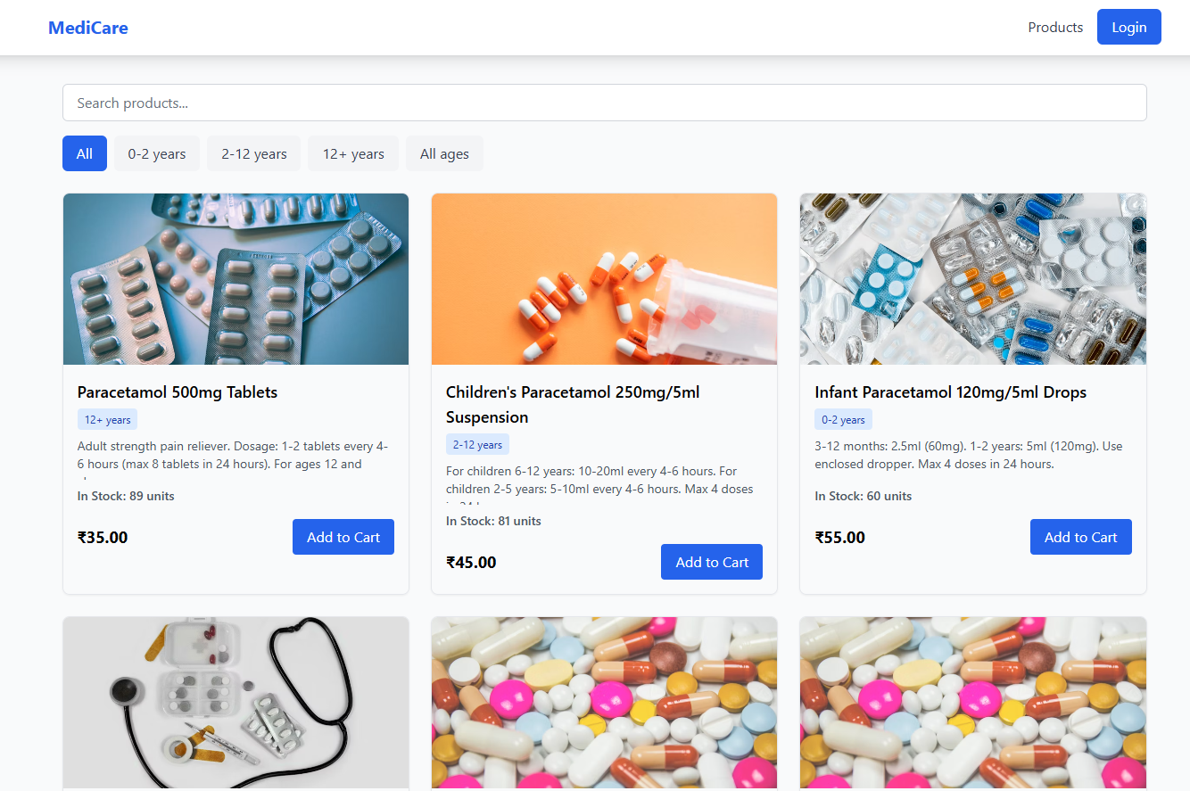
12
Home Page
24-12-2024
Notes:
4

Slide 13
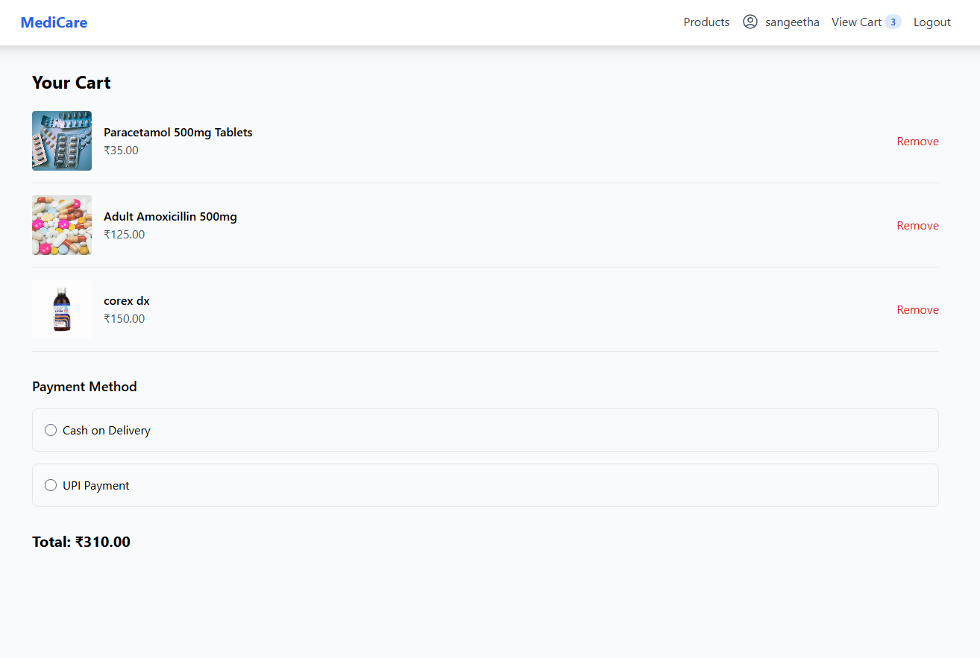
13
Cart Page
24-12-2024
Notes:
4

Slide 14
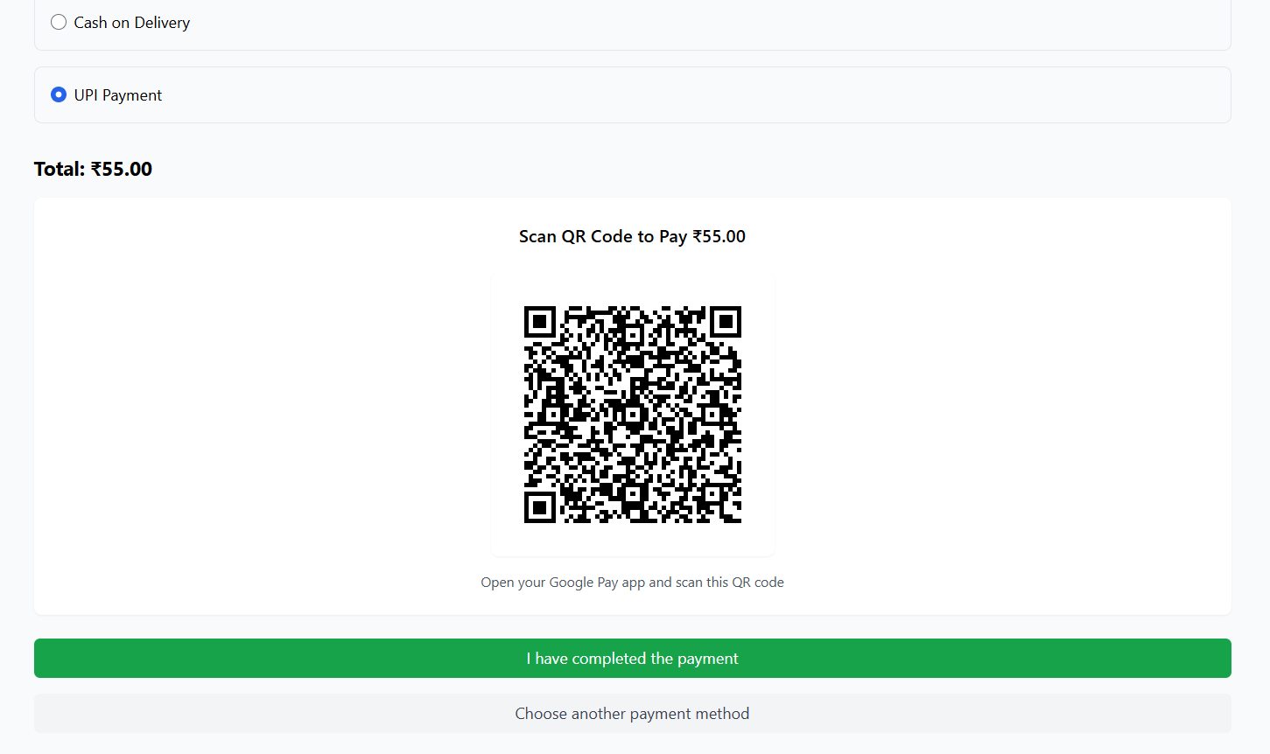
14
Payment Page
24-12-2024
Notes:
4

Slide 15
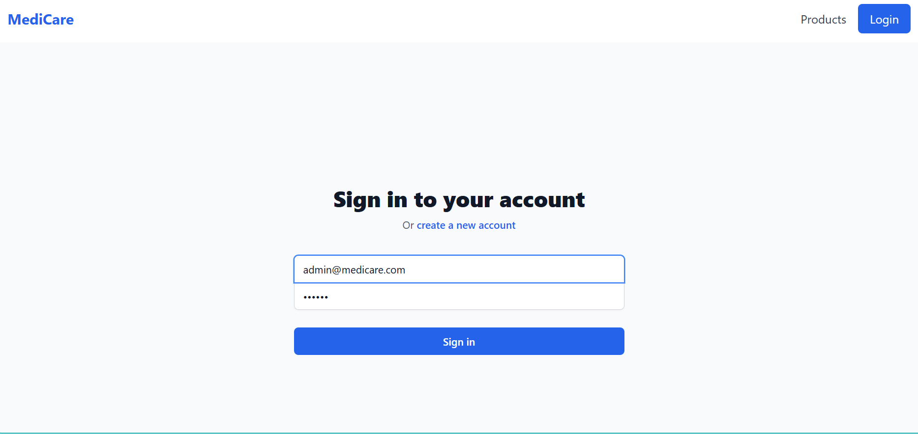
15
Admin Login Page
24-12-2024
Notes:
4

Slide 16
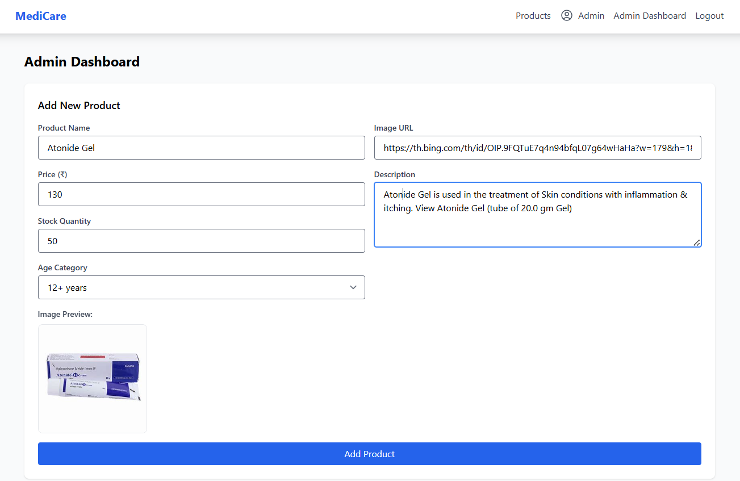
16
Admin Dashboard Page
24-12-2024
Notes:
4

Slide 17
17
REFERENCES
Choi, D., &amp; Gorman, K. R. (2019). Full-Stack React, TypeScript, and Node:Build Scalable Web Apps with React, Node.js, Express, and MongoDB. Packt Publishing.
Lau, K. (2016). Building Firebase Applications: Developing Cloud-Enabled Web Apps with Firebase. O&#39;Reilly Media.
Naz, S. (2019). Full-Stack React Projects. Packt Publishing.
https://reactjs.org/docs/getting-started.html
https://firebase.google.com/docs
https://www.codecademy.com/learn/paths/build-web-apps-with-react
24-12-2024
Notes:
4

Slide 18
Thank You !!
24-12-2024
Notes:
4

