Slide 1
Products To Boycott
Raja Rao DV
Hack for Change – Hackathon
July 28th -29th 2012
@rajaraodv

Slide 2
‘Hack For Change’ Hackathon Theme: Build something that will ‘change the world’

Slide 3
Making a BIG change
One of the quickest ways to affect a BIG change is “some-how” empower common-people to change politics and policies.

Slide 4
Problem
But, large corporations and billionaires control politics & policies.

Slide 5
Problem (conti.)
They don’t necessarily care about YOUR causes or YOUR Rights as long as they make money.
If you buy THEIR products, you are giving them money & you are essentially going against yourself and things you care!

Slide 6
Solution 1
One way to help solve this is by creating petitions, like what change.org is doing.

Slide 7
Solution 2
What if there is a way for people to know:
Which products such billionaires and large companies make,
What policies, politicians etc. they support
…and easily Boycott them?

Slide 8
DEMO
Introducing ‘Products 2 Boycott’ app

Slide 9
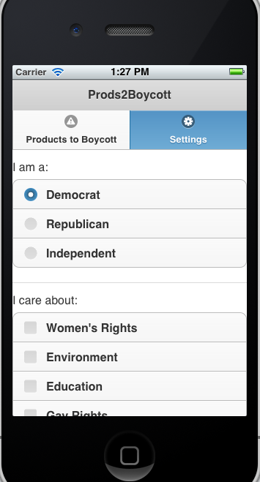
1. Select your political affiliation. 2. Select rights (women’s rights, Gay rights, etc.) and things (environment, Education etc.) you care about.

Slide 10
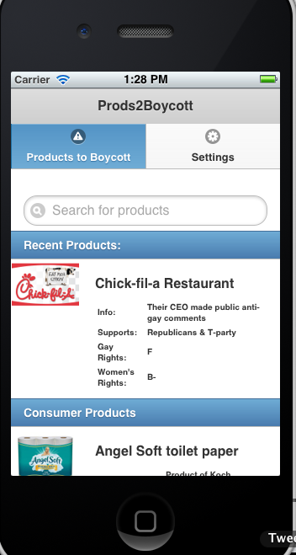
1. It will show list of ‘Products to Boycott’ based on the settings. 2. Allows you to search & make sure the products (say Groceries, house-hold products etc.) are good to buy.

Slide 11
Products To Boycott
Raja Rao DV
Hack for Change – Hackathon
July 28th -29th 2012
@rajaraodv

