Slide 1
FilterCompare – Aviary Editor hack
Raja Rao DV
@rajaraodv / rajaraodv100@yahoo.com
Hackathon - Photo Hack Day 3 (#phd3)
July 14th & 15th 2012 http://photohackday.org

Slide 2

Problem: Too many filters!
Problem 1: Hard to see results of multiple filters side-by-side
Problem 2: Hard to compare the 2-3 (out of 15) we like

Slide 3
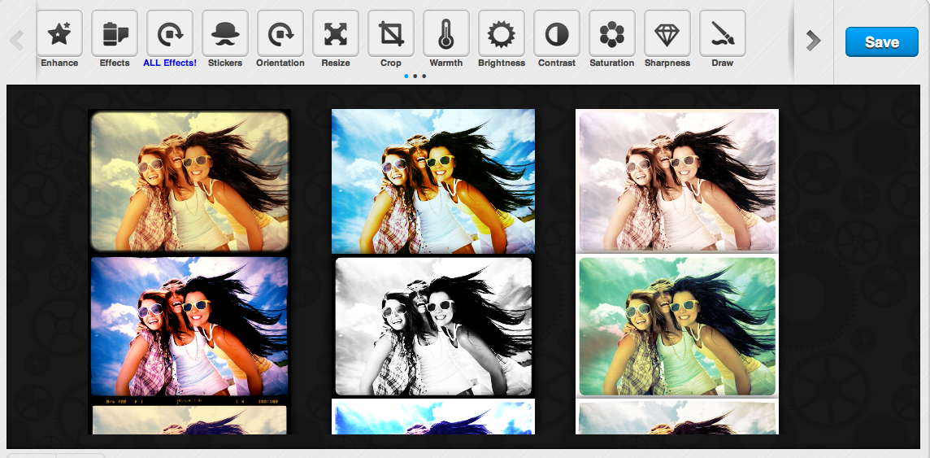
Solution: ‘All Effects’ to the rescue
Solution 1: Hack the editor-itself & add a new “All Effects” button
that applies filters & shows all the variations side-by-side in a grid

Slide 4
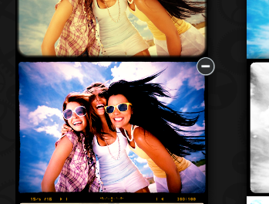
Delete filters you don’t like
Solution 2: You can delete filters w/in the grid you don’t like

Slide 5
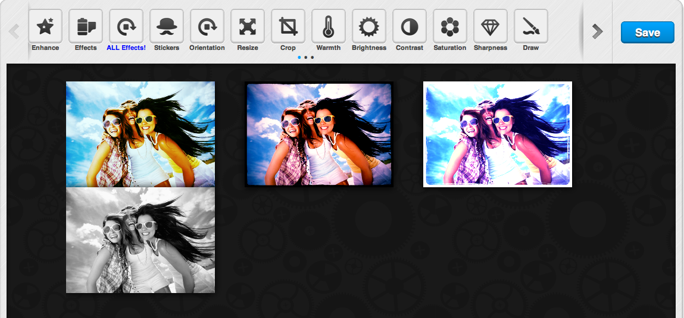
Solution 2 (continued):
See & compare only those filters you like with ease!

