Slide 1

Apache Spark (pyspark)

Slide 2
What is Apache Spark ?
Apache Spark is a general purpose platform for quickly processing large scale data that is developed in Scala programming language.
A framework for distributed computing
In-memory, fault tolerant data structures
API that supports Scala, Java, Python, R, SQL
Open source
Apache Spark is a unified computing engine and a set of libraries for parallel data processing on computer clusters.

Slide 3
Unified: Unified platform for developing big data applications. Within the same platform you can perform data loading, SQL query, data transform, machine learning, streaming, computation. (RDD)
Computing Engine: perform computations over data somewhere (cloud, file, SQL database, Hadoop, Amazon S3 etc.). Not store it.
Libraries: self and external libraries. Core engine changes little. SparkSQL, MLLib, Streaming, GraphX

Slide 4
Map - Reduce
Map: capture data in a convenient structure for data analysis
Reduce: make analysis at captured data.
Analogy to RDMS(Relation Data Management System):
Map: select the wanted fields with SELECT clause and filter with WHERE clause.
Reduce: make calculations on data with COUNT, SUM, HAVING etc. clauses.

Slide 5
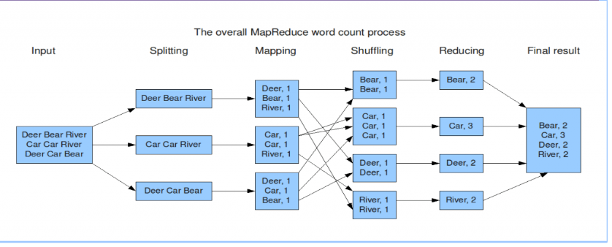

Slide 6
Apache Spark General Usage Areas
Interactive Query
Enterprise-scale data volumes accessible to interactive query for business intelligence (BI)
Faster time to job completion allows analysts to ask the “next” question about their data & business
Large-Scale Batch
Data cleaning to improve data quality (missing data, entity resolution, unit mismatch, etc.)
Nightly ETL processing from production systems
Complex Analytics
Forecasting vs. “Nowcasting” (e.g. Google Search queries analyzed en masse for Google Flu Trends to predict outbreaks)
Data mining across various types of data

Slide 7
Event Processing
Web server log file analysis (human-readable file formats that are rarely read by humans) in
near-real time
Responsive monitoring of RFID-tagged devices
Model Building
Predictive modeling answers questions of “what will happen?”
Self-tuning machine learning, continually updating algorithms, and predictive modeling

Slide 8
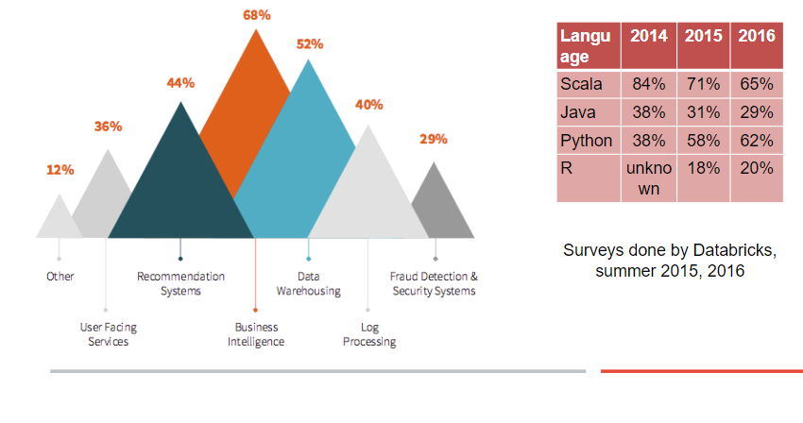

Slide 9
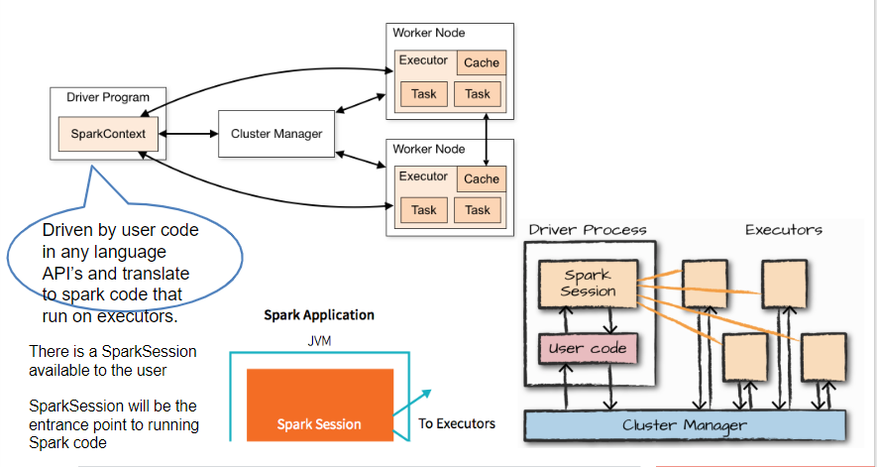
Apache Spark structure and architecture

Slide 10
Driver Process:
runs main function and user codes are in this process.
Maintain all relevant information about spark application
Give responses to user program and its inputs
Distribute the jobs to executors and put the jobs in order
Executor Process:
run the jobs assigned by Driver
Runs the code assigned by driver.
Inform the driver about the status of jobs that is assigned to it.
Cluster Manager:
Controls physical machine and allocate resources to spark applications.
Cluster Managers: spark standalone cm, YARN, Mesos, Kubernetes

Slide 11
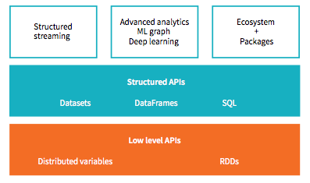
Apache Spark API

Slide 12
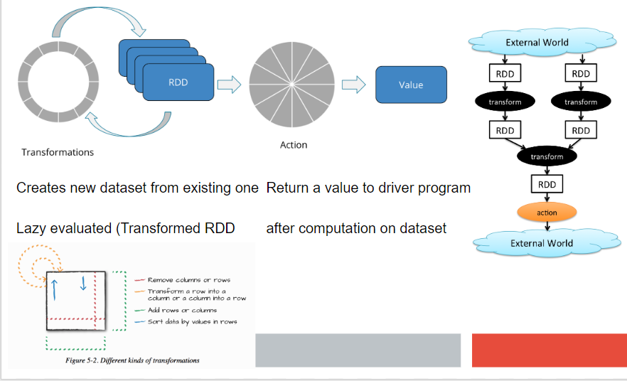
Apache Spark Data operation

Slide 13
Installation of pyspark
Installation of java-8 (sudo apt-get install jdk-8)
Installation of scala (sudo apt-get install scala)
Install jupyter notebook (pip3 install jupyter notebook)
Install py4j (pip3 install py4j)
download and unzip apache spark in home directory (download from official website)

Slide 14
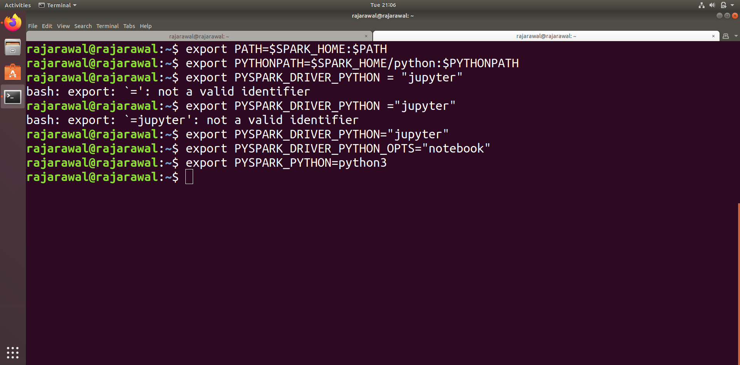
Setting Spark path

Slide 15
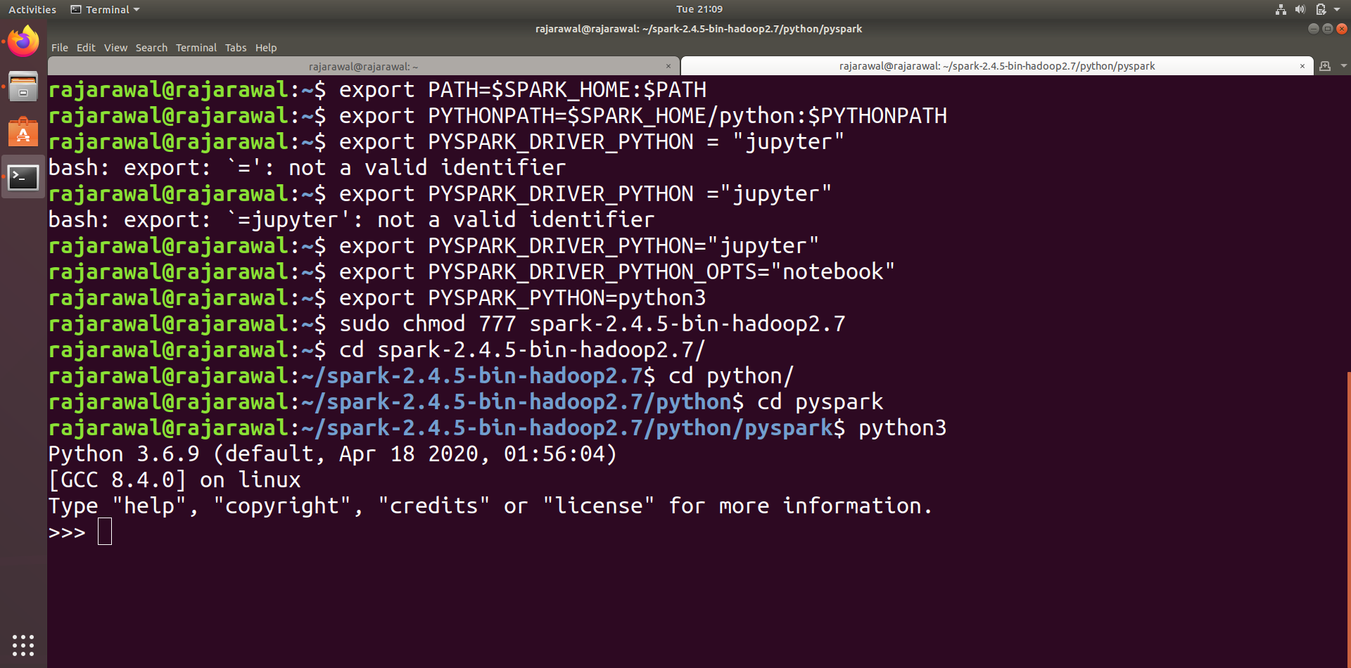
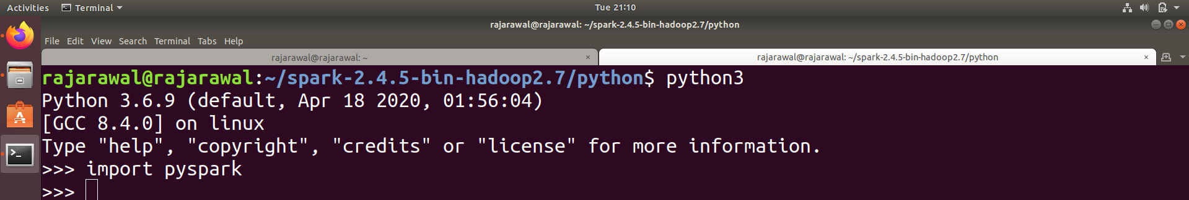
Importing pyspark inside spark directory

Slide 16
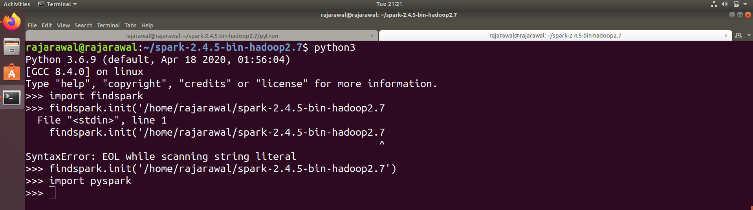
Install findspark
Findspark is generally use for setting path of spark , each time no need of go inside spark folder and run python3
Installation of findspark (pip3 install findspark)

Slide 17
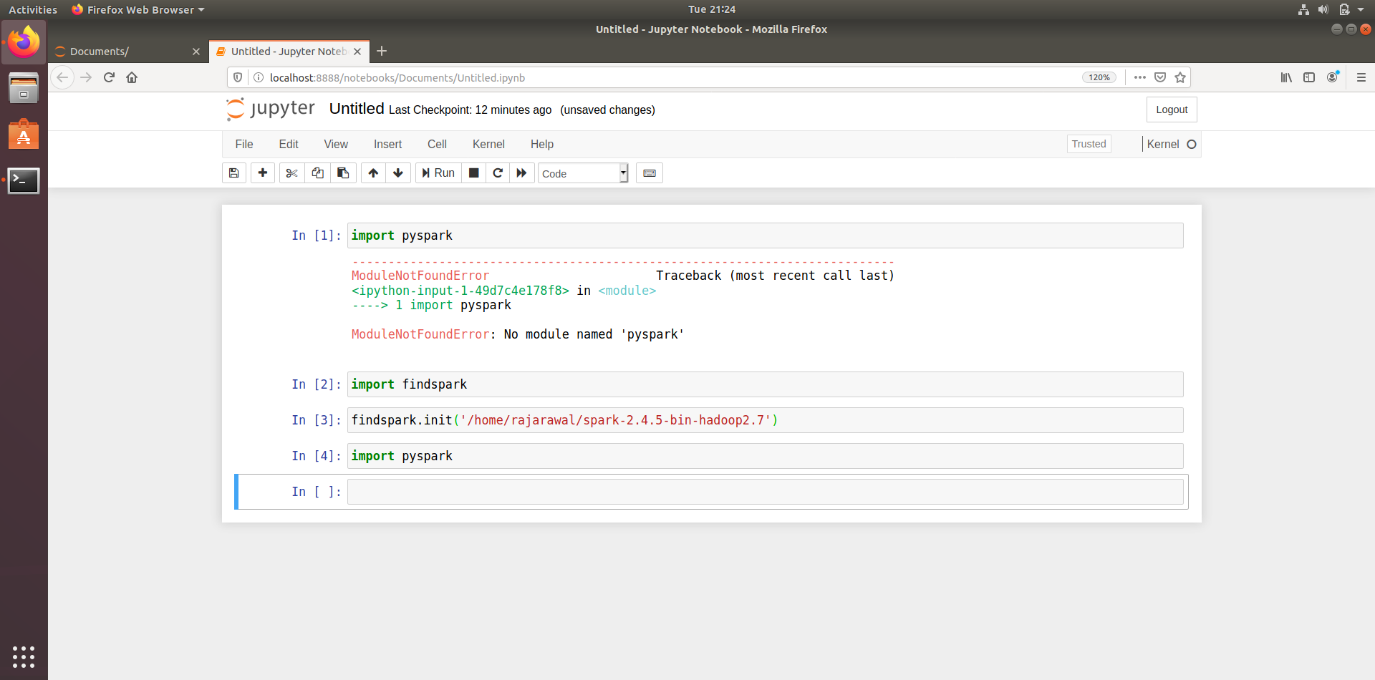
Running inside jupyter notebook

Slide 18
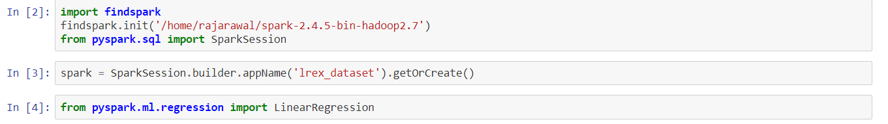
Linear regression using Mllib of spark

Slide 19
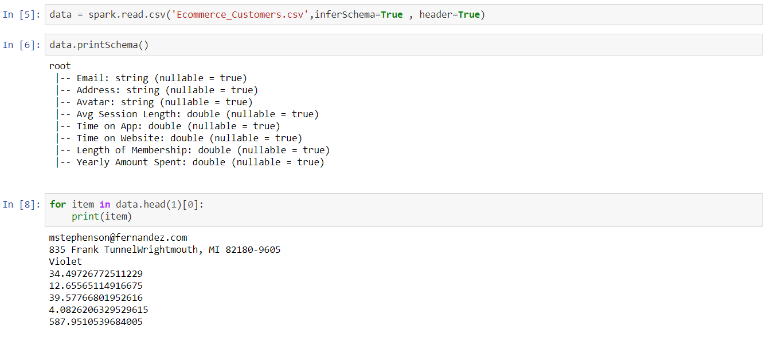
Dataset schema and sample data

Slide 20
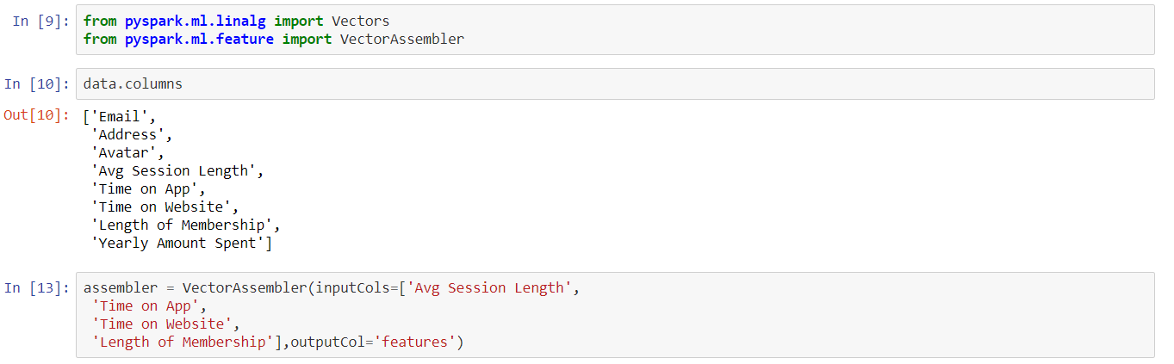
Pre-processing of data
Selecting numeric data for prediction
'Avg Session Length’, 'Time on App’, 'Time on Website’, 'Length of Membership'

Slide 21
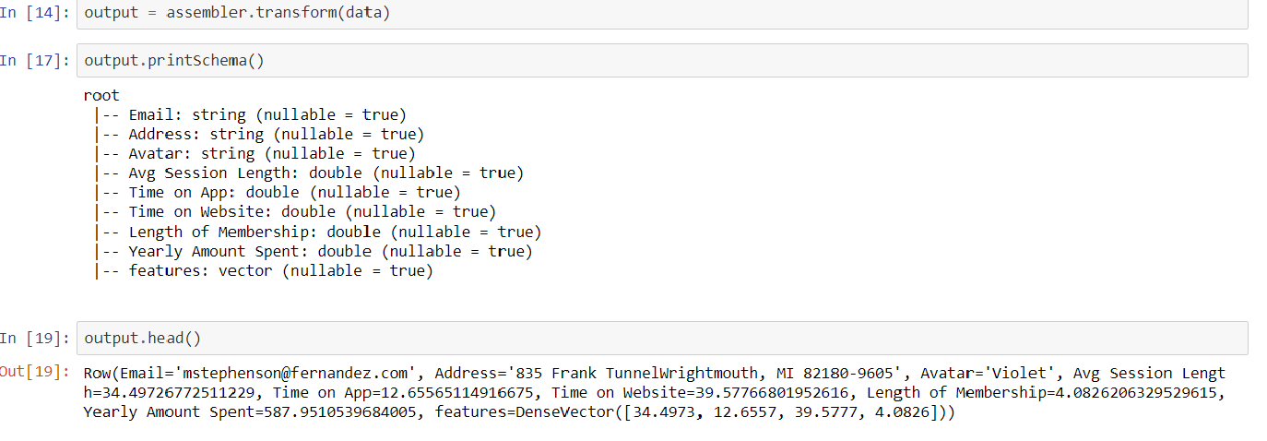
Transform dataset and see schema

Slide 22
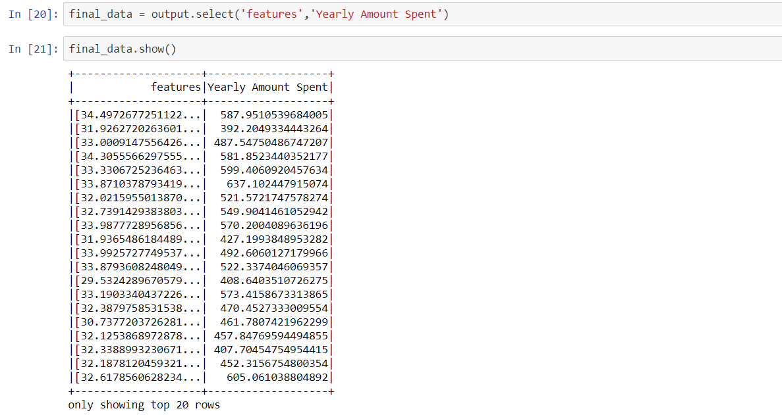
Feature vector and label of data

Slide 23
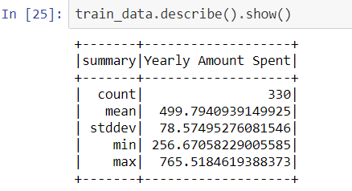
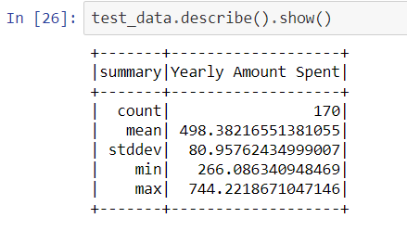
Split data into train_data , test_data & description

Slide 24
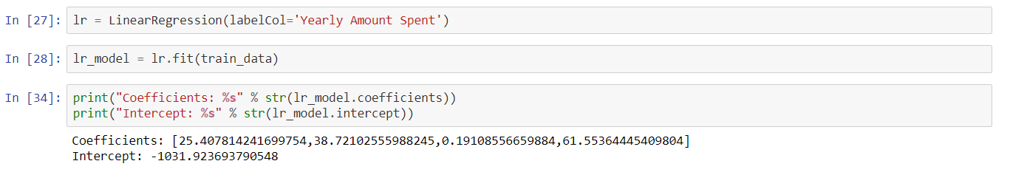
Applying regression on final data

Slide 25
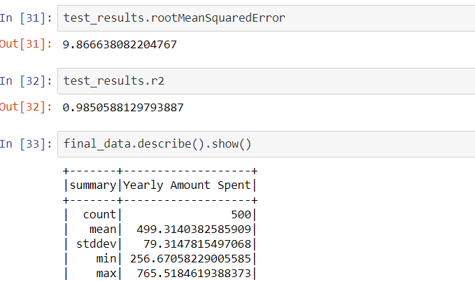
Error & final data description

Slide 26
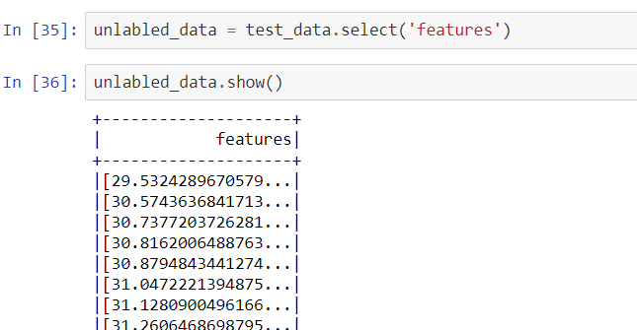
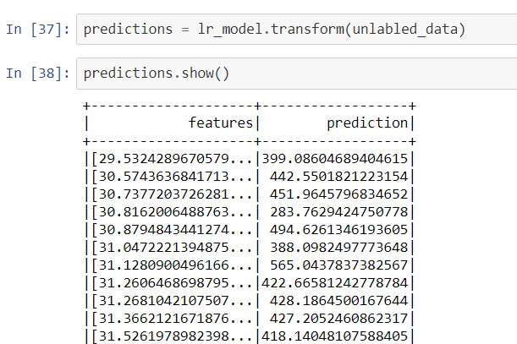
Prediction of unlabelled data

