Slide 1
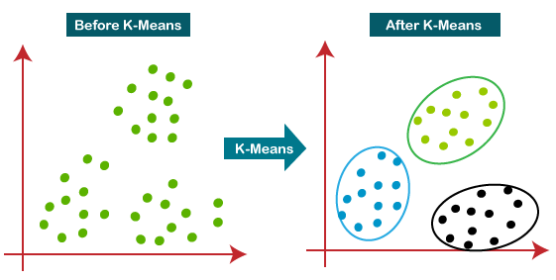
K-means Clustering in CUDA
Arsheya Raj
Sunjil Gahatraj
CSS535-HPC
University of Washington Bothell

Slide 2
Overview
K-means clustering is a type of unsupervised machine learning algorithm used for partitioning a set of data points into K clusters, where K is a predetermined number of clusters. The algorithm works by iteratively assigning each data point to its nearest centroid (cluster center) and then recomputing the centroid of each cluster based on the newly assigned data points. The process is repeated until convergence, where the assignments no longer change.
Sequential algorithm is limited by computationally and memory bottleneck
Parallel algorithm in CUDA supports highly optimized computation on large data dataset

Slide 3
Hardware and Software Specification
Hardware
I7-7700HQ @ 2.8GHz (8 CPUs)
NVIDIA GeForce GTX 1050 Ti
Pascal
SM 52
Software
Window 10
Visual Studio 2022
CUDA 12.0

Slide 4
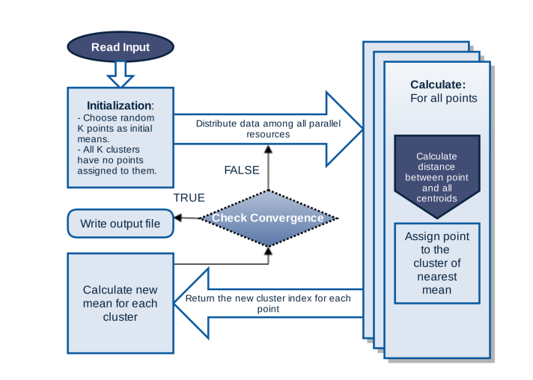
Program Design
1. Initialize K centroids randomly.
2. Divide the data into small subsets.
3. For each subset, assign each data point to its nearest centroid and update the centroid of each cluster.
4. Merge the resulting clusters from each subset to produce the final clusters.
5. Repeat steps 2-4 until convergence.

Slide 5
CUDA Code
kMeansClusterAssignmentusingdistance_parallel processes each 2D points to one cluster. This kernel function assign to each thread for computing the task of calculating the distance between one single data point to each centroid to find closest centroid. It returns the cluster number as output
After every iteration all the points centroid are updated
Distance between points are calculated using Euclidean distance formula

Slide 6
Project Scope
K-means clustering is widely used clustering algorithm in every domain of computer science. For example: Document clustering, market segmentation, clustering of community etc.
Goals
Optimize K-mean clustering algorithm by parallelizing task and overcome limitation of CPU using CUDA and GPU

Slide 7
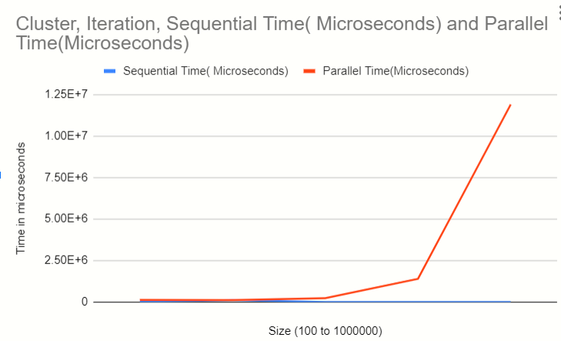
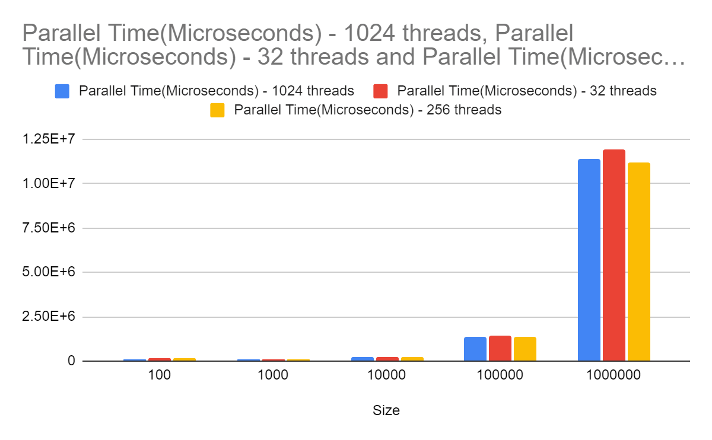
Results
*disclaimer: Sequential run only up to 1000 points

Slide 8
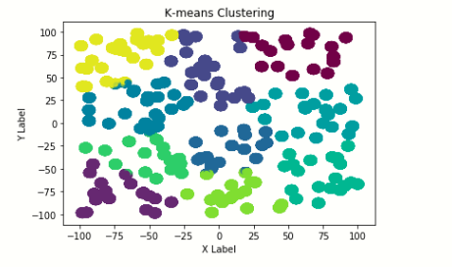
Results
Our application produced the result as expected.
All the points are assigned to their nearest cluster.
This visualization was done in python for million points with 10 clusters based on the output file produced by our code.

Slide 9
Future Work
-Implement optimized version
-Implement the algorithm to work with modularity clustering using Krylov solver
-Use it in machine learning application
- Test application performance on different operating system and GPU architecture

Slide 10
References
http://nucsrl.coe.neu.edu/sites/nucsrl.coe.neu.edu/files/janki/HPEC'15-Janki.pdf
https://docs.nvidia.com/cuda/
https://www.youtube.com/watch?v=4b5d3muPQmA

