Slide 1

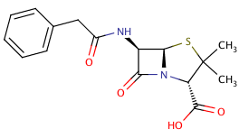
Fingerprinting Chemical Structures
Rajarshi Guha

Slide 2
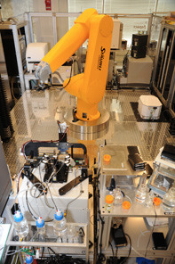
High Throughput Screening
Test thousands to hundreds of thousands of compounds in one or more assays
Biochemical, genetic, pharmacological assays
Employs a robotic platform
Rapidly identify novel modulators of biological systems

Slide 3
Goal of HTS
Rapidly screen large compound collections
Efficiently identify real actives
Test them in slower, accurate, expensive screens
Use the data to learn what types of compounds tend to be active
Use the model to suggest more compounds to screen

Slide 4
HTS Data Types

Slide 5
Fingerprint Representation
Lots of types of ﬁngerprints
Indicates the presence or absence of a structural feature
Length can vary from 166 to 4096 bits or more
Fingerprints usually compared using the Tanimoto metric

Slide 6
Comparing Data Sets
How do we compare two sets of chemical structures?
Sizes may be different, and very large
Pairwise?
O(N²) running time
Need to aggregate the resultant pairwise values

Slide 7
Comparing Data Sets
How do we compare two sets of chemical structures?
Sizes may be different, and very large
Distributions?
Of what?
Can lead to multiple ways to generate a comparison
Data fusion?

Slide 8
Bit Spectrum
Vector summary of the fingerprints for a dataset
Defined as the fraction of times a bit position is set to 1, for each bit position

Slide 9
Bit Spectrum
Now comparison of two datasets is a O(1) operation – independent dataset size
Simply take the difference of two bit spectra
## make two subsets and generate bit spectra
fps1 <- fps[ 1:(length(fps)*0.3) ]
fps2 <- fps[ (length(fps)*0.3 +
1):length(fps) ]
bs1 <- bit.spectrum(fps1)
bs2 <- bit.spectrum(fps2)
## display a difference plot
bsdiff <- bs1-bs2
d <- data.frame(x=1:length(bs), y=bsdiff)
ggplot(d, aes(x=x,y=y))+
geom_bar(stat='identity')+
xlab('Bit Position')+ylab('Difference')+
ylim(c(-1,1))

Slide 10
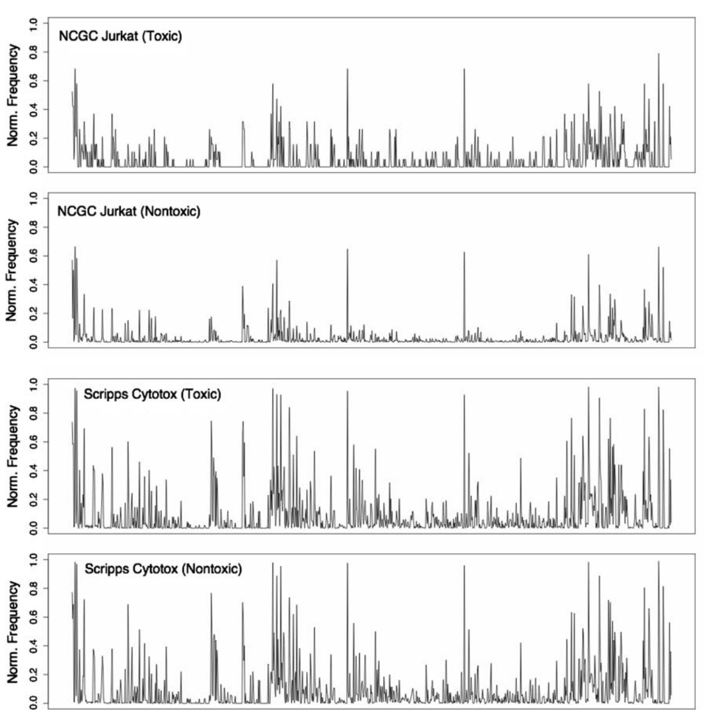
Explaining Poor Model Performance
Training set for model
Poor predictions on test set
Both test set classes look like the toxic class in the training set
Guha & Schurer, J. Comp. Aided. Molec. Des., 2008, 22, 367

