Slide 1

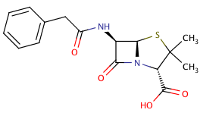
Fingerprinting Chemical Structures
Rajarshi Guha
https://github.com/rajarshi/ctpa-fingerprints

Slide 2
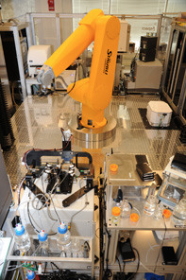
High Throughput Screening
Test thousands to hundreds of thousands of compounds in one or more assays
Biochemical, genetic, pharmacological assays
Employs a robotic platform
Rapidly identify novel modulators of biological systems

Slide 3
Goal of HTS
Rapidly screen large compound collections
Efficiently identify real actives
Test them in slower, accurate, expensive screens
Use the data to learn what types of compounds tend to be active
Use the model to suggest more compounds to screen

Slide 4
HTS Data Types
Categorical – active/inactive or toxic/nontoxic
Continuous
Single point
Dose response
Multiple readouts
Might read at different wavelengths or timepoints
More complex when dealing with imaging
These (usually) represent the independent variable

Slide 5
Independent Variable(s)
HTS is testing activity of a molecule – the molecule is our “independent variable”
Need to describe the molecular structure
Various discrete or real-valued descriptors
Surfaces (3D)
Binary fingerprints

Slide 6
Fingerprint Representation
Lots of types of ﬁngerprints
Indicates the presence or absence of a structural feature
Length can vary from 166 to 4096 bits or more
Fingerprints usually compared using the Tanimoto metric

Slide 7
Fingerprints in R
The fingerprint package supports I/O, manipulation, similarity methods, and various utility methods
A fingerprint is a S4 object
Create them manually
Read them in from files
new("fingerprint", nbit = 1024, bits = c(1,4,5,100,200))
fp.read('data/cdk.fp', size=1024, lf=cdk.lf)

Slide 8
Getting Fingerprints
You can also generate fingerprints from chemical structures using the rcdk package
If you’re not doing cheminformatics you can read in your own FP data by implementing a line reader
See cdk.lf, moe.lf, bci.lf

Slide 9
Random Fingerprints
Useful for benchmarking, generating null distributions, exploring effects of bit density
## How long does a similarity matrix calculation take as a function of fp length?
nfp <- 300
sizes <- c(64, 128, 512, 1024, 4096, 8192)
times <- sapply(sizes, function(size) {
fps <- lapply(1:nfp, function(i) random.fingerprint(size, size * 0.35))
system.time(junk <- fp.sim.matrix(fps))[3]
})
## For a given length, how does bit density affect calculation time?
densities <- c(0.1, 0.25, 0.5, 0.75, 0.95)
times <- sapply(densities, function(density) {
fps <- lapply(1:nfp, function(i) random.fingerprint(1024, 1024 * density))
system.time(junk <- fp.sim.matrix(fps))[3]
})

Slide 10
Random Fingerprints

Slide 11
Predicting with Fingerprints
Read in fingerprints & convert to matrix form
See
data/solubility.csv
data/solubility.maccs
33,182 observations of solubility
57,857 fingerprints
Requires some data wrangling before modeling
OOB estimate of error rate: 22.37%
Confusion matrix:
high low medium class.error
high 181 52 621 0.78805621
low 35 5611 4598 0.45226474
medium 89 2029 19965 0.09591088

Slide 12
Predicting with Fingerprints
sol <- read.csv('data/solubility.csv', header=TRUE)
fps <- fp.read('data/solubility.maccs', header=FALSE, size=166,
lf=function(line) {
toks <- strsplit(line, " ")[[1]]
title <- toks[1]
bits <- as.numeric(toks[2:length(toks)])
list(title, bits, list())
})
## Extract fingerprint for which we have a label
common <- which( sapply(fps, function(x) x@name) %in% sol$sid )
fps <- fps[common]
## Order the fingerprints & data
sol <- sol[order(sol$sid),]
fps <- fps[order(sapply(fps, function(x) as.integer(x@name)))]
## Make X matrix
fpm <- fp.to.matrix(fps)
## Model!
library(randomForest)
m1 <- randomForest(x=fpm, y=as.factor(sol$label))

Slide 13
Clustering with Fingerprints
Generate a distance matrix directly from a list of fingerprints
fps <- fp.read('data/cdk.fp',
size=881,
lf=cdk.lf)[1:500]
sims <- fp.sim.matrix(fps)
dmat <- as.dist(1-sims)
clus <- hclust(dmat)
par(mar=c(1,4,1,1))
plot(clus, label=FALSE, xlab='', main='’)

Slide 14
Comparing Data Sets
How do we compare two sets of chemical structures?
Sizes may be different, and very large
Pairwise?
O(N²) running time
Need to aggregate the resultant pairwise values

Slide 15
Comparing Data Sets
How do we compare two sets of chemical structures?
Sizes may be different, and very large
Distributions?
Of what?
Can lead to multiple ways to generate a comparison
Data fusion?

Slide 16
Bit Spectrum
Vector summary of the fingerprints for a dataset
Defined as the fraction of times a bit position is set to 1, for each bit position
~ 10K molecules

Slide 17
Bit Spectrum
Now comparison of two datasets is a O(1) operation – independent dataset size
Simply take the difference of two bit spectra
## make two subsets and generate bit spectra
sol.idx <- which(sol$label == 'high')
insol.idx <- which(sol$label != 'high')
sol.bs <- bit.spectrum(fps[sol.idx])
insol.bs <- bit.spectrum(fps[insol.idx])
## display a difference plot
bsdiff <- sol.bs - insol.bs
d <- data.frame(x=1:length(sol.bs), y=bsdiff)
ggplot(d, aes(x=x,y=y))+geom_line()+
xlab('Bit Position')+
ylab('Normalized Frequency')+
ylim(c(-1,1))

Slide 18
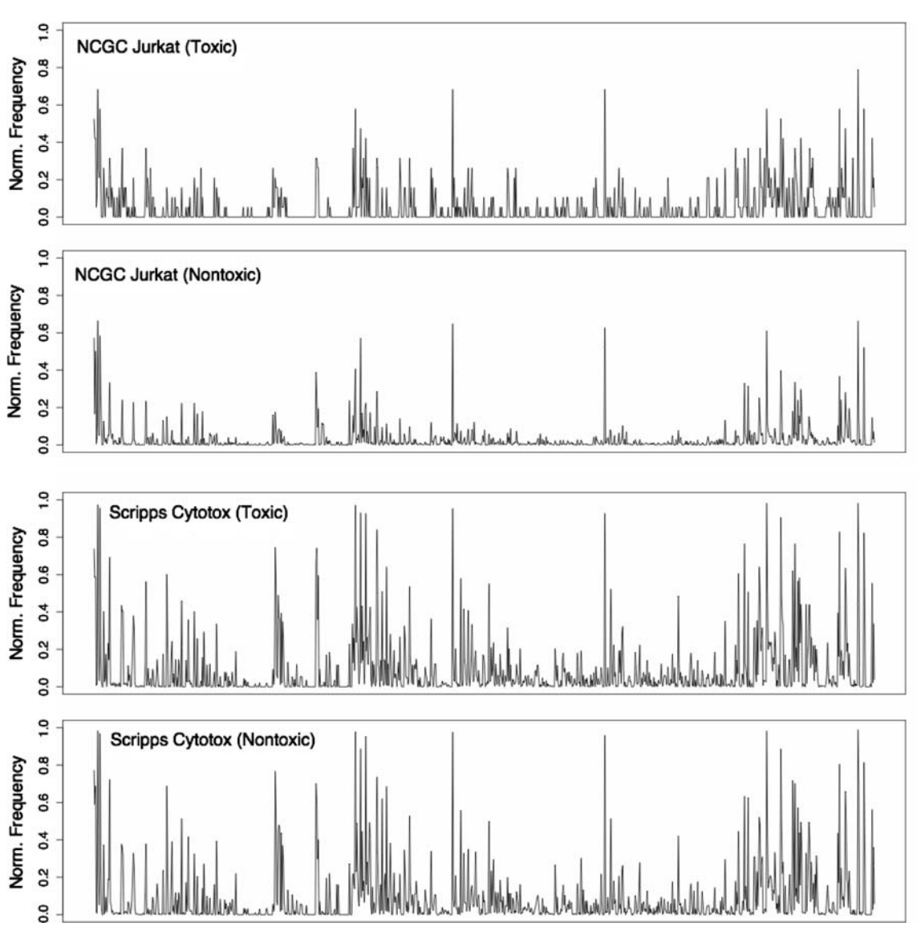
Explaining Poor Model Performance
Training set for model
Poor predictions on test set
Both test set classes look like the toxic class in the training set
Guha & Schurer, J. Comp. Aided. Molec. Des., 2008, 22, 367

Slide 19
Benchmarking Retrieval

