Slide 2
Getting Twitter Data
Accessing Twitter is relatively easy using many languages
We obtained tweets via a PHP client running over an extended period of time
Won’t focus on accessing Twitter data from within R
Very straightforward with twitteR

Slide 3
Quantifying Sentiment
Based on identifying words with positive or negative connotations
Fundamentally based on looking up words from a dictionary
If a tweet has more positive words than negative words, the tweet is positive
More sophisticated scoring schemes are possible

Slide 4
Better Dictionaries?
SentiWordNet
Derived from WordNet, each term is assigned a positivity and negativity score
Objectivity score defined as 1 – (Pos+Neg)
206K terms
Converted to simple CSV for easy import into R

Slide 5
SentiWordNet
Most words are neutral (ObjScore = 1.0)
To derive a score for a tweet, we should ideally perform POS tagging
Many cases where the same term can be used as different POS and scores will differ

Slide 6
Scoring Tweets
Given a scoring function, we can process the tweets
Perfect use case for parallel processing
Easily switch out the scoring function
swn.match <- function(w) {
tmp <- subset(swn, Term == w)
if (nrow(tmp) >= 1)
return(tmp[1,c(3,4)])
else return(c(0,0))
}
score.swn <- function(tweet) {
words <- strsplit(tweet, "\\s+")[[1]]
cs <- colSums(do.call('rbind',
lapply(words, function(z) swn.match(z))))
return(cs[1]-cs[2])
}
scores <- mclapply(d$text, score.swn)

Slide 7
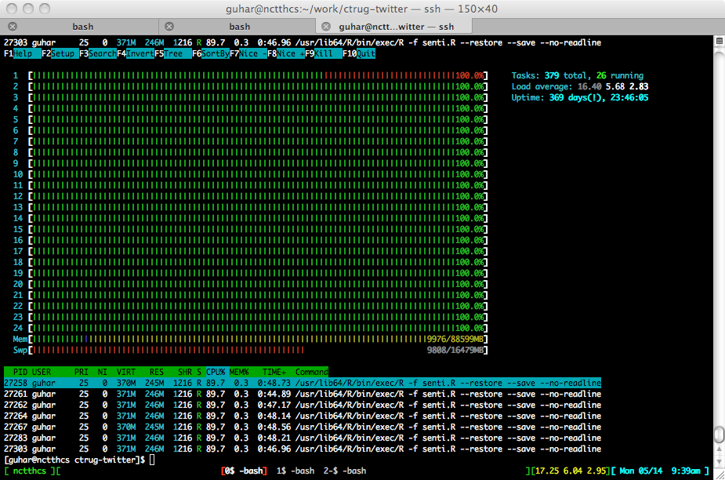

Slide 8
Other Considerations
Should take into account negation
Scan for negation terms and adjust score appropriately
Oblivious to sarcasm

Slide 9
Sentiment and Geography

