Slide 1
Happy, Sad, Indifferent … Quantifying Text Sentiment in R
Rajarshi Guha
CT R Users Group
May 2012

Slide 2
Preamble
https://github.com/rajarshi/ctrug-tweet
Focus is on using R to perform this task
Won’t comment on validity, rigor, utility, … of sentiment analysis methods
Some of the example data is available freely, other parts available on request

Slide 3
Getting Twitter Data
Based on a collaboration with Prof. Debs Ghosh (Uconn), studying obesity & social media
Accessing Twitter is easy using many languages
We obtained tweets via a PHP client running over an extended period of time
Ended up with 108,164 tweets
Won’t focus on accessing Twitter data from R
Very straightforward with twitteR

Slide 4
Cleaning Text
Load in tweet data, get rid of urls, HTML escape codes, punctuation etc
d <- read.csv('pizza-unique.csv', colClass='character',
comment='', header=TRUE)
d$geox <- as.numeric(d$geox)
d$geoy <- as.numeric(d$geoy)
remove.urls <- function(x) gsub("http.*$", "", gsub('http.*\\s', ' ', x))
remove.html <- function(x) gsub('&quot;', '', x)
d$text <- remove.urls(d$text)
d$text <- remove.html(d$text)
d$text <- gsub("@", "FOOBAZ", d$text)
d$text <- gsub("[[:punct:]]+", " ", d$text)
d$text <- gsub("FOOBAZ", "@", d$text)
d$text <- gsub("[[:space:]]+", ' ', d$text)
d$text <- tolower(d$text)

Slide 5
Quantifying Sentiment
Based on identifying words with positive or negative connotations
Fundamentally based on looking up words from a dictionary
If a tweet has more positive words than negative words, the tweet is positive
More sophisticated scoring schemes are possible

Slide 6
Better Dictionaries?
SentiWordNet
Derived from WordNet, each term is assigned a positivity and negativity score
206K terms
Converted to simple CSV for easy import into R
Ideally, should perform POS tagging

Slide 7
Scoring Tweets
Given a scoring function, we can process the tweets
Perfect use case for parallel processing
Easily switch out the scoring function
swn <- read.csv('sentinet_r.csv', header=TRUE,
as.is=TRUE)
swn.match <- function(w) {
tmp <- subset(swn, Term == w)
if (nrow(tmp) >= 1) return(tmp[1,c(3,4)])
else return(c(0,0))
}
score.swn <- function(tweet) {
words <- strsplit(tweet, "\\s+")[[1]]
cs <- colSums(do.call('rbind',
lapply(words, function(z) swn.match(z))))
return(cs[1]-cs[2])
}
scores <- mclapply(d$text, score.swn)

Slide 8
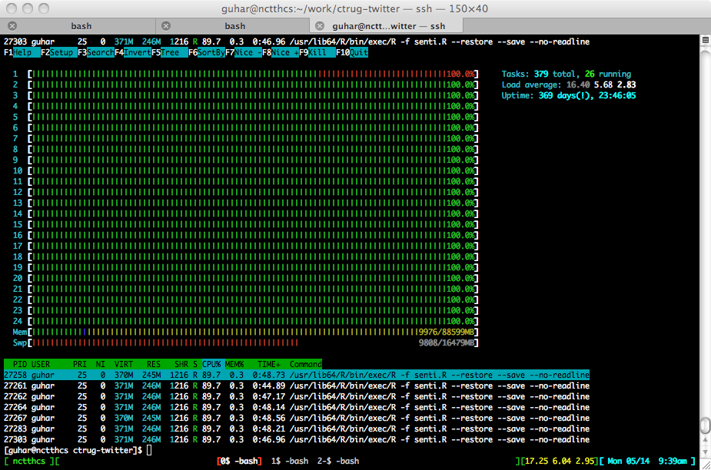

Slide 9
Profiling Makes Me Happy
swn.match <- function(w) {
tmp <- subset(swn, Term == w)
if (nrow(tmp) >= 1) return(tmp[1,c(3,4)])
else return(c(0,0))
}
score.swn <- function(tweet) {
words <- strsplit(tweet, "\\s+")[[1]]
cs <- colSums(do.call('rbind',
lapply(words, function(z) swn.match(z))))
return(cs[1]-cs[2])
}
score.swn.2 <- function(tweet) {
words <- strsplit(tweet, "\\s+")[[1]]
rows <- match(words, swn$Term)
rows <- rows[!is.na(rows)]
cs <- colSums(swn[rows,c(3,4)])
return(cs[1]-cs[2])
}
6052 sec with 24 cores
Rprof() is a good way to identify bottlenecks*
461 sec with 24 cores
* overkill for this example

Slide 10
Looking at the Scores
Bulk of the tweets are neutral
Similar behavior from either scoring function
d$swn <- unlist(scores.swn)
d$breen <- unlist(scores.breen)
tmp <- rbind(data.frame(Method='SWN', Scores=d$swn),
data.frame(Method='Breen', Scores=d$breen))
ggplot(tmp, aes(x=Scores, fill=Method)) +
geom_density(alpha=0.25) +
xlab("Sentiment Scores")

Slide 11
Sentiment & Time of Day
Group tweets by hour and evaluate how proportions of positive, negative, etc vary .
tmp <- d
tmp$hour <- strptime(d$time, format='%a, %d %b %Y %H:%M')$hour
tmp <- subset(tmp, !is.na(swn))
tmp$status <- sapply(tmp$swn, function(x) {
if (x > 0) return("Positive")
else if (x < 0) return("Negative")
else return("Neutral")
})
tmp <- data.frame(do.call('rbind',
by(tmp, tmp$hour, function(x) table(x$status))))
tmp$Hour <- factor(rownames(tmp), levels=0:23)
tmp <- melt(tmp, id='Hour', variable_name='Sentiment')
ggplot(tmp, aes(x=Hour,y=value,fill=Sentiment))+geom_bar(position='fill')+
xlab("")+ylab("Proportion")

Slide 12
Sentiment & Time of Day

Slide 13
Contradictions?
Tweets that are negative according to one score but positive according to another
subset(d, swn < -2 & breen > 1)
"i m trying to get some legit food right now like pizza or chicken not this shitty ass school lunch”
"24 i like reading 25 i hate hopsin 26 i love chips salsa 27 i love chevys 28 i
was a thug in middle school 29 i love pizza”
"@naturesempwm had a raw pizza 4 lunch today but i was not impressed with the dried out
not fresh vegetable spring roll i bought threw out "

Slide 14
Sentiment and Geography
What’s the spatial distribution of tweet sentiment?
Extract tweets located in the CONUS (~ 500)
Visualize the direction and strength of sentiments
Correlate with other socio- economic factors?

Slide 15
Other Considerations
Should take into account negation
Scan for negation terms and adjust score appropriately
Oblivious to sarcasm
Sentiment scores should probably be modified by context
Lots of M/L opportunities
Spatial analysis
Topic modeling / clustering
Predictive models

