Slide 1
Happy, Sad, Indifferent – Quantifying Text Sentiment in R
Rajarshi Guha
CT R Users Group
May 2012

Slide 2
Preamble
https://github.com/rajarshi/ctrug-tweet
Focus is on using R to perform this task
Won’t comment on validity, rigor, utility, … of sentiment analysis methods
Some of the example data is available freely, other parts available on request

Slide 3
Getting Twitter Data
Accessing Twitter is relatively easy using many languages
We obtained tweets via a PHP client running over an extended period of time
Won’t focus on accessing Twitter data from within R
Very straightforward with twitteR

Slide 4
Quantifying Sentiment
Based on identifying words with positive or negative connotations
Fundamentally based on looking up words from a dictionary
If a tweet has more positive words than negative words, the tweet is positive
More sophisticated scoring schemes are possible

Slide 5
Better Dictionaries?
SentiWordNet
Derived from WordNet, each term is assigned a positivity and negativity score
Objectivity score defined as 1 – (Pos+Neg)
206K terms
Converted to simple CSV for easy import into R

Slide 6
SentiWordNet
Most words are neutral (ObjScore = 1.0)
To derive a score for a tweet, we should ideally perform POS tagging
Many cases where the same term can be used as different POS and scores will differ

Slide 7
Scoring Tweets
Given a scoring function, we can process the tweets
Perfect use case for parallel processing
Easily switch out the scoring function
swn <- read.csv('sentinet_r.csv', header=TRUE,
as.is=TRUE)
swn.match <- function(w) {
tmp <- subset(swn, Term == w)
if (nrow(tmp) >= 1) return(tmp[1,c(3,4)])
else return(c(0,0))
}
score.swn <- function(tweet) {
words <- strsplit(tweet, "\\s+")[[1]]
cs <- colSums(do.call('rbind',
lapply(words, function(z) swn.match(z))))
return(cs[1]-cs[2])
}
scores <- mclapply(d$text, score.swn)

Slide 8
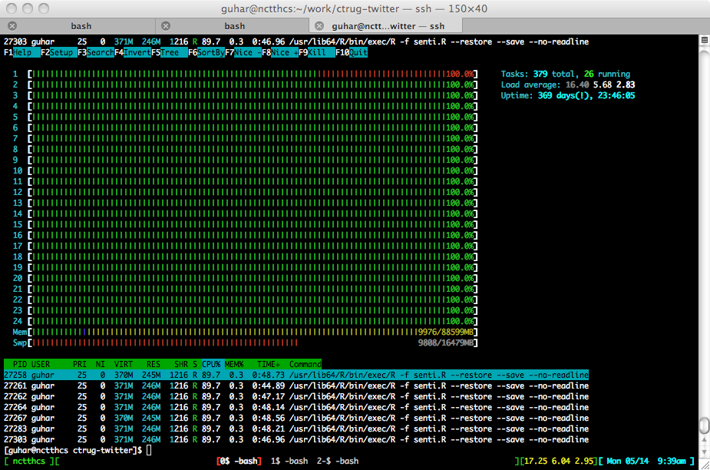

Slide 9
Other Considerations
Should take into account negation
Scan for negation terms and adjust score appropriately
Oblivious to sarcasm
Sentiment scores should probably be modified by context
ML methods will be sensitive to the nature of the corpora employed

Slide 10
Sentiment and Geography

