Slide 1


8
Training and Developing
Employees
Human Resource Management
14th Edition, Global Edition
Gary Dessler
Copyright © 2015 Pearson Education Ltd.
Notes:
Employers are finding that a lack of ability to handle basic reading, writing, and arithmetic tasks means that there is a very real need for basic skills and literacy training. Language training is often required as well, and not just for English. Many customers and stakeholders speak a variety of languages, resulting in the need for a multilingual workforce.
Once employees are on board, the employer must train them. The purposeof this chapter is to increase your effectiveness in training employees. The main topicswe’ll cover include orienting employees, thetraining process, analyzing training needs,implementing training and development programs, and evaluating the training effort.

Slide 2
Learning Objectives
Summarize the purpose and process of employee orientation.
List and briefly explain each of the steps in the training process.
Explain how to use five training techniques.
Copyright © 2015 Pearson Education Ltd.
Notes:
After studying this chapter, you will be able to:
1. Summarize the purpose and process of employee orientation.
2. List and briefly explain each of the steps in the training process.
3. Explain how to use five training techniques.

Slide 3
Learning Objectives
List and briefly discuss four management development methods.
List and briefly discuss the importance of the steps in leading organizational change.
Explain why a controlled study may be superior for evaluating the training
program’s effects.
Copyright © 2015 Pearson Education Ltd.
Notes:
After studying this chapter, you will be able to:
4. List and briefly discuss four management development methods.
5. List and briefly discuss the importance of the steps in leading organizational change.
6. Explain why a controlled study may be superior for evaluating the training
program’s effects.

Slide 4
HRM In Action: Executive Onboarding For External Hires
Up to 40% of externally hired executives fail within first 18 months
Others that are recruited from outside the firm leave within five years
Companies often do a poor job of onboarding
Provides a guide to new corporate culture and its people and personalities
Copyright © 2014 Pearson Education
Notes:
Up to 40 percent of externally hired executives fail within the first 18 months and many others that are recruited from outside the firm leave within five years. Although considerable time, effort, and money are spent recruiting top talent, companies often do a poor job of onboarding. In fact, few companies take the time to familiarize new executives about the workings of the corporate culture beyond the standard, one-size-fits-all orientation session. However, what new executives need to know in order to be effective differs significantly from the focus of most general employee orientation programs. If an executive is coming in from another company, a great deal of attention needs to be paid to explaining how things work in the new environment.

Slide 5
Summarize the purpose and process of employee orientation.
Copyright © 2015 Pearson Education Ltd.
Notes:
Employee orientation (or “onboarding”) provides new employees with the information they need tofunction (such as computer passwords and company rules). Ideally, though, it shouldalso help new employees start getting emotionally attached to the firm.

Slide 6
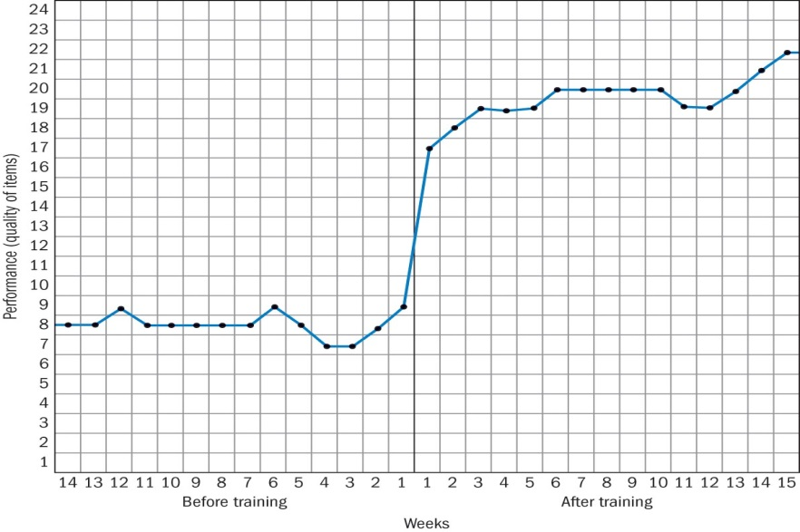
Orienting and Onboarding New Employees
Welcome
Basic information
Understanding the organization
Socialization
Copyright © 2015 Pearson Education Ltd.
Notes:
Carefully selecting employees doesn’t guarantee they’ll perform effectively. Even highpotential employees can’t do their jobs if they don’t know what to do or how to do it.
The purposes for an effective orientation program is to:
Make the new employee feel welcome and at home and part of the team.
Make sure the new employee has the basic information to function effectively,such as e-mail access, personnelpolicies and the like.
Help the new employee understand the organization in a broad sense.
Start the process of a person becoming socialized into the firm’s culture, values, and waysof doing things.

Slide 7

The Orientation Process
Employee handbook
Orientation technology
Copyright © 2015 Pearson Education Ltd.
Notes:
The length of orientation varies, but it usually includes time with HR to review benefits, vacations, and other policies. It also includes time with the supervisor to learn the organization and culture of the department.
Carefully crafted employee handbooks are helpful to the employer and employee. Under certain conditions, courts may find that the employee handbook’s contents represent legally binding employment commitments.
Employers use technology to support orientation. Some employers put all or some of their orientation media on the Web.

Slide 8
Review
Purposes
Welcome
Basic information
Understanding the organization
Socialization
Employee handbook
Orientation technology
Training process overview
Copyright © 2015 Pearson Education Ltd.
Notes:
We have discussed the purposes of an employee orientation including providing a welcome, basic information, socialization and understanding the organization. Part of the orientation process includes the use of a handbook and technology. Finally, we have provided an overview of the training process which include aligning strategy and training and performance. See FIGURE 8-1 New Employee Departmental Orientation Checklist.

Slide 9
List and briefly explain each of the steps in the training process.
Copyright © 2015 Pearson Education Ltd.
Notes:
Next, we will discuss the five steps of a commonly used instructional design technique known as ADDIE.

Slide 10
Overview of the Training Process
Inadequate training can expose the employer to liability for negligent training
Training begins after orientation
Ask what competencies employees will need
Copyright © 2015 Pearson Education Ltd.
Notes:
Training might involve having the current jobholder explain the job to the new hire, or multi-week classroom or Internet classes.
Training is found to be important. If even high-potential employees don’t know what to do and how to do it, they will improvise or do nothing useful at all. Furthermore, by one estimate, about three fourths of 30-something age high achievers start looking for new positions within a year starting, often due to dissatisfaction with inadequate training.
“It’s clear from the case law that where an employer fails to train adequately and an employee subsequently does harm to third parties, the court will find the employer liable.” Among other things, the employer should review skill and experience levels and provide adequate training (particularly where employees work with dangerous equipment), and evaluate the training to ensure that it is actually reducing risks.
The training programs will have the competencies the employees need to achieve the strategic plans of the company.

Slide 11

Overview of the Training Process
Aligning strategy and training
Training and performance
Copyright © 2015 Pearson Education Ltd.
Notes:
Training means giving new or current employees the skills that they need to perform their jobs. The task is to identify the employee behaviors the firm will require to execute its strategy, and from that deduce what competencies employees will need.
One survey found that “establishing a linkage between learning and organizational performance ”…was the number-one pressing issue facing training professionals.”

Slide 12
Training and Performance
Ensure training translates into improved performance
Define training purpose
Have company strategies drive the training
Check with mangers on the training success
Ask “how are we doing.”
Copyright © 2015 Pearson Education Ltd.
Notes:
Training ranks higher than appraisal and feedback and just below goal setting in its effect on productivity. Companies spend on average $1,103 per employee for training per year and offer each about 28 hours of training. Some experts use the phrase “workplace learning and performance” in lieu of training to emphasize that training aims to boost both employee learning and organizational performance.

Slide 13
IMPROVING PERFORMANCE:
HR as a Profit Center
Training Program Turning Macy’s Around
Changed the 90-minute interactive video to:
Attending 3 ½-hour training to cultivate higher levels of customer service
Sales up 3.5% in 2013
Copyright © 2015 Pearson Education Ltd.
Notes:
The Training Program That Turned Macy’s Around
For about 6 years after buying May Department Stores Co., Macy’s Inc. was in a consolidation/cost-cutting mode. During these years, Macy’s customer service suffered. Many sales associates weren’t providing the level of service that customers wanted. The question was, what should Macy’s do about it now?
Macy’s top management turned to a new strategy. As its CEO said, “We are [now] talking about a cultural shift . . . becoming more of a growth company.”
However, Macy’s top management knew that growth would not occur without a big improvement in how its sales associates treated customers. To produce the improved customer service Macy’s needed to achieve its new strategy, Macy’s installed a new training program. Rather than just watching a 90-minute interactive video as they previously did, sales associates now attended 3 ½-hour training sessions aimed at cultivating higher levels of customer service.
Macy’s management believed the training program and resulting customer service improvement would be the biggest factor in driving their company’s sales growth. And indeed, same store sales rose 5.3% in 2011, 3.7% in 2012, and about 3.5% in 2013, well above many competitors’.
Discussion Question: Show in outline form the strategy map steps that you think would explain how training produced improved sales at Macy’s.

Slide 14
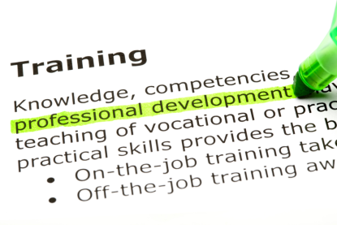
The ADDIE Five-Step Training Process
Analyze
Design
Develop
Implement
Evaluate
Copyright © 2015 Pearson Education Ltd.
Notes:
The tried-and-proven ADDIE five-step training program includes:
Analyzing the training need.
Designing the overall training program.
Developing the course.
Implementing training by actually training the targeted employee group.
Evaluating the effectiveness of the course.

Slide 15
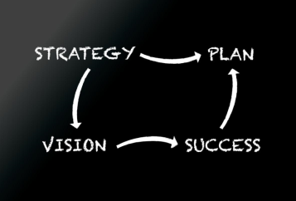
Conducting the Training Needs Analysis
Strategic needs
Strategic training needs analysis
Copyright © 2015 Pearson Education Ltd.
Notes:
The training needs analysis should address the employer’s strategic/longer term trainingneeds and/or its current training needs. See TABLE 8-1 Sample Task Analysis Record Form.
Strategic goals (perhaps to enter newlines of business or go abroad) usually mean the firm will have to fill new jobs.
Strategic training needs analysis focuses on identifying the training that employees willneed to fill these new future jobs.

Slide 16
Performance Analysis: Current Employees’ Training Needs
Definition
Current training needs analysis
Task analysis
Talent management
Performance analysis
Can’t do/won’t do
Copyright © 2015 Pearson Education Ltd.
Notes:
Performance analysis is the process of verifying that there is a performance deficiency and determining whether the employer should correct such deficiencies. This can be done by comparing the person’s actual performance to what it should be.
Most training is focused on improving current performance. Analyzing current employee needs is more complex than the new employee needs. You also must decide whether training is the solution to the underlying problem or is it just convenient to refer the employee to a program.
A task analysis can be used to determine the training needs of new employees. A task analysis record form also can be used for tracking purposes.
Best talent management practice suggests using the same set of job-related competencies for training the employee as for recruiting, selecting, appraising, and paying him or her. We saw that doing so often begins with summarizing the job’s required human competencies (required skills, knowledge, and behaviors such as leadership) in a competency model. Thebiggest issue is to figure out what is causing reduced performance. Can the person perform or are they unwilling to do so? If the problem is employee motivation then training is unlikely to fix this.
For underperforming current employees, you can’t assume that training is the solution. In other words, is it lack of training, or something else? Performance analysis is the process of verifying that there is a performance deficiency and determining whether the employer should correct such deficiencies through training or some other means (like transferring the employee).
The aim here is to distinguish between can’t-do and won’t-do problems. First, determine whether it is a can’t-do problem and, if so, its specific causes. For example: The employees don’t know what to do or what your standards are; there are obstacles in the system such as lack of tools or supplies.
Or, it might be a won’t-do problem. Here employees could do a good job if they wanted to, instead of training the better solution might be to change the incentives.

Slide 17
Designing the Training Program
Copyright © 2015 Pearson Education Ltd.
Notes:
Designing the Training Program
With the needs analysis results, the manager next designs the training program. Design means planning the overall training program including training objectives, delivery methods, and program evaluation. Sub-steps include setting performance objectives, creating a detailed training outline (all training program steps from start to finish), choosing a program delivery method (such as lectures or Web), and verifying the overall program design with management.

Slide 18

Designing the Training Program
Setting learning objectives
Creating a motivational learning environment
Copyright © 2015 Pearson Education Ltd.
Notes:
Training, development, learning, or (more generally) instructional objectives should specify in measurable terms what the trainee should be able to do after successfully completing the training program.
In setting the learning environment, the manager therefore should address several trainee-ability issues. For example, how will our program accommodate differences in trainee abilities? Do we need to provide remedial training?
Second, the learner must also be motivated. In terms of ability, the learner–trainee needs the required reading, writing, and mathematics skills. In addition, he or she must posses the required educational level,intelligence, and knowledge base. As every student knows, the learner also must be motivated to learn the material.

Slide 19

Designing the Training Program
Make the Learning Meaningful
Bird’s-eye view
Familiar examples
Organize
Familiar terms
Perceived need
Copyright © 2015 Pearson Education Ltd.
Notes:
At the start of training, provide a bird’s-eye view of the material that you are goingto present. For example, show why it’s important, and provide an overview. Use a variety of familiar examples. Organize the information so you can present it logically, and in meaningful units. Use terms and concepts that are already familiar to trainees. Use as many visual aids as possible. Finally, create a perceived training need in trainees’ minds.

Slide 20

Making Skills Transfer Obvious and Easy
Similarity
Practice
Label
Attention
“Heads-up”
Pace
Copyright © 2015 Pearson Education Ltd.
Notes:
Maximize the similarity between the training situation and the work situation. Provide adequate practice. Label or identify each feature of the machine and/or step in the process. Direct the trainees’ attention to important aspects of the job. Provide “heads-up” information about what could happen. And remember, trainees learn best at their own pace. Adjust your pace and rhythm to connect with the group.

Slide 21

Reinforce The Learning
Reinforce correct responses
Schedule
Follow-up assignments
Transfer of training
Other issues
Copyright © 2015 Pearson Education Ltd.
Notes:
Trainees learn best when the trainers immediately reinforce correct responses,perhaps with a quick “well done” or head nod.
The schedule is important. The learning curve goes down late in the day so plan accordingly. Also, start and end on time or “re-negotiate” the learning contract should unforeseen circumstances arise.
Provide follow-up assignments at the close of training. Ensure transfer of learning to the job. During training, provide trainees with training experiences and conditions (surroundings, equipment) that resemble the actual work environment. After training, reinforce what trainees learned, for instance, by appraising and rewardingemployees for using new skills.
Finally, review relevant alternative training methodologies (lectures, web-based, and so on) and choose the best methodsfor their program.

Slide 22
Developing the Program
Assemble training content and materials
Training Methods
iPads
Workbooks
Lectures
PowerPoint slides
Web- and computer-based activities course activities
Trainer resources and manuals
Support materials
Copyright © 2015 Pearson Education Ltd.
Notes:
Some employers create their own training content, but there’s also a vast selection of online and offline content. (See, for example, the American Society for Training and Development’s Infoline at www.astd.org, www.trainerswarehouse.com, and www.gneil.com, among thousands of such suppliers.) Turnkey training packages often include a trainer’s guide, self-study book, video, and other content.
Once you design, approve, and develop the program, management can implement and then evaluate it.

Slide 23
Review
ADDIE
Analyze
Design
Develop
Implement
Evaluate
Strategic needs
Strategic training needs analysis
Copyright © 2015 Pearson Education Ltd.
Notes:
The ADDIE model of instructional development follows a logical step-by-step process. It allows trainers and HR professionals to analyze needs, design and develop a training program then implement and evaluate results. Ultimately, the evaluation step leads back to the earlier steps for possible revisions and other changes.
Long-term business strategies should align closely with the training and development needs of the firm.

Slide 24

Review
Program development
Training equipment
Implement
Copyright © 2015 Pearson Education Ltd.
Notes:
Program development means actually assembling the program’s training content and materials. It means choosing the actual content the program will present, as well as designing/choosing the specific instructional methods (lectures, cases, Web-based, etc.) you will use. Training equipment was also discussed. Implement means actually provide the training, using one or more of the instructional methods (such as lectures).

Slide 25
Review
Overview
Familiarity
Organization
Needs
Similarity
Practice
Labels
Heads-up
Pace
Reinforcement
Schedule
Follow-up
Alternatives
Copyright © 2015 Pearson Education Ltd.
Notes:
The steps we have covered include providing an overview, offering familiar examples and terminology, keeping organized and showing how and why the training is important. As you provide training, keep the connection alive between what is known and the new material being learned. Always provide practice opportunities and use familiar labels. Provide a “heads-up” for what might happen on the job and keep the pace of learning aligned with what the learners need. Reinforce what you do, stay on track, provide follow-up opportunities and keep an eye out for alternative learning methods.

Slide 26
Explain how to use five training techniques.
Copyright © 2015 Pearson Education Ltd.
Notes:
Lets discuss how to use five training techniques. With objectives set and the program designed and developed, you can turn to implementing the training program. This means actually doing the training, using one or more of the following training methods.
At the Hotel Paris:
As Lisa and the CFO reviewed measures of the Hotel Paris’s current training efforts, it was clear that some changes were in order. Most other service companies provided at least 40 hours of training per employee per year, while the Hotel Paris offered, on average, no more than five or six. See pages 252-253 on how this was handled.

Slide 27
Implementing Training Programs
On-the-job training
Types of on-the-job training
Job rotation
Special assignments
Copyright © 2015 Pearson Education Ltd.
Notes:
On-the-job training (OJT) means having a person learn a job by actually doing it. The most familiar on-the-job training is the coaching or understudy method. Here, an experienced worker or the trainee’ssupervisor trains the employee. This may involve acquiring skills by observingthe supervisor, or having the supervisor show the newemployee the ropes. Job rotation, in which an employee moves from job to job at plannedintervals, is another OJT technique. Special assignments similarly give lower-levelexecutives firsthand experience in working on actual problems.

Slide 28

The OJT Process
Preparation
Present the operation
Tryout
Follow-up
Copyright © 2015 Pearson Education Ltd.
Notes:
The following steps will assist in creating an effective On-the-Job (OJT) program.
Prepare the learner by putting the learner at ease and explaining why he or she is being taught.
Present the operation. Explain quantity and quality requirements and go through the job at a normal pace.
Do a tryout and have the learner go through the job several times at a reduced, then normal, pace.
Follow-up and designate to whom the learner should go for help. Gradually decrease supervision.

Slide 29
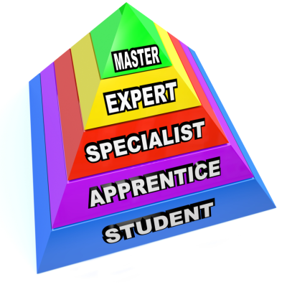
Other Types of Learning
Apprenticeship training
Informal learning
Copyright © 2015 Pearson Education Ltd.
Notes:
Apprenticeship training is a process by which people become skilled workers, usuallythrough a combination of formal learning and long-term on-the-job training. Traditionally, a master craftsperson will serve as a role model and guide.
Surveys estimate that asmuch as 80% of what employees learn on the job they learn through informal means,including performing their jobs on a daily basis with their colleagues. Other types of informal training occurs between people in the lunch or break room.

Slide 30
Other Types of Learning
Job instruction training
Lectures
Programmed learning
Behavior modeling
Audiovisual-based training
Vestibule training
Copyright © 2015 Pearson Education Ltd.
Notes:
Many jobs (or parts of jobs) consist of a sequence of steps that one best learns step-by-step. Such step-by-step training is called job instruction training.
Lecturing is a quick and simple way to present knowledge to large groups of trainees, aswhen the sales force needs to learn a new product’s features.
Whether the medium is a textbook, PC, or the Internet, programmed learning is a step-by-step, self-learning method. It consists of three parts:
1. Presenting questions, facts, or problems to the learner
2. Allowing the person to respond
3. Providing feedback on the accuracy of answers, with instructions on what to do next
Behavior modeling involves (1) showing trainees the right (or “model”) way of doing something, (2) letting trainees practice that way, and then (3) giving feedback on the trainees’ performance.
Behavior modeling training is one of the most widely used, well-researched, and highly regarded psychologically based training interventions.
Although increasingly replaced by Web-based methods, audiovisual-based trainingtechniques like DVDs, films, PowerPoint, and audiotapes are still popular.
With vestibule training, trainees learn on the actual or simulated equipment they willuse on the job, but are trained off the job (perhaps in a separate room or vestibule).

Slide 31
Other Types of Learning
Electronic performance support systems (EPSS)
Videoconferencing
Computer-based training(CBT)
Simulated learning
Copyright © 2015 Pearson Education Ltd.
Notes:
Electronic performance support systems (EPSS) are computerized tools anddisplays that automate training, documentation, and phone support. Performance support systems are modern job aids. Job aids are sets of instructions, diagrams, or similar methods available at the job site to guide the worker.
Videoconferencing is popular for training geographically dispersed employees. It involves delivering programs via compressed audio and video signals over cablebroadband lines, the Internet, or satellite.
Computer-based training refers to training methods that use interactive computer-based systems to increase knowledge or skills.
Simulated learning activities include virtual reality-type games with a step-by-step animated guide, and online role-play with photos and videos. In general, interactive and simulated technologies reduce learning time by an average of 50%.

Slide 32
IMPROVING PERFORMANCE: HR Practices Around the Globe Diversity
ABC Virtual Communications, Inc. (www.abcv.com/) in Des Moines, Iowa, provides customized software
8-hour orientation overview
“Effective communications” training
Specialized classes for individual needs
Copyright © 2015 Pearson Education Ltd.
Notes:
Training at ABC Virtual Communications, Inc.
Diversity training aims to improve cross-cultural sensitivity, with the goal of fostering more harmonious working relationships among a firm’s employees. Such training typically includes improving interpersonal skills, understanding and valuing cultural differences, improving technical skills, socializing employees into the corporate culture, indoctrinating new workers into the U.S. work ethic, improving English proficiency and basic math skills, and improving bilingual skills for English-speaking employees.
Discussion Question: List five competencies that you believe such a diversity program should cultivate.

Slide 33
Other Types of Learning
Lifelong and Literacy Training Techniques
Team training
Internet-based training
Learning Management Systems (LMS)
Virtual classrooms
Mobile Learning
Copyright © 2015 Pearson Education Ltd.
Notes:
Lifelong learning means providing employees with continuing learning experiencesover their tenure with the firm. This helps with the aims of ensuring they have the opportunityto learn the skills they need to do their jobs and to expand their horizons. By one estimate, about 39 million people in the UnitedStates have learning disabilities. Employers often turn to private firms to provide the requisite education.
Teamwork is not something that always comes naturally. Companies therefore devotemany hours to training new employees to listen to each other and cooperate.
Trainers increasingly employ Internet-based learning to deliver programs. There are two basic ways to offer online courses to employees. First, the employer canarrange for its employees take relevant online courses from eitherits own online offerings or from online training vendors on theWeb. The second approach is to arrange with an online trainingvendor to make its courses available via the employer’s intranet-based learning portal.
Learning management systems (LMS) are special software tools that supportInternet training by helping employers identify training needs. An LMS also can help in scheduling,delivering, assessing, and managing the online training itself.
A virtual classroomuses special collaboration software to enable multiple remote learnersto participate in live discussions, communicate viawritten text, and learn via content such as PowerPoint slides.
Mobile learning (or “on-demand learning”) means delivering learning content ondemand via mobile devices like cell phones, laptops, and iPads,.
Employers also are moving from textbook and classroom-based learning to interactivelearning.

Slide 34
IMPROVING PERFORMANCE: HR Tools
for Line Managers and Entrepreneurs
Creating Your Own Training Program
Prepackaged training solutions
Outsourced learning
Create your own
Copyright © 2015 Pearson Education Ltd.
Notes:
First for either the individual manager or small business owner there are literally hundreds of suppliers of prepackaged training solutions.
Second, small and medium-sized companies may also want to take advantage of the new trend toward outsourced learning. Major consulting firms such as Accenture and IBM Global Services can obtain increased returns to scale by providing training solutions to multiple clients. Therefore many employers are now saving training dollars by outsourcing their entire learning functions to them.
Third, you can create your own “costless” training program, using the following process.
Step 1. Set Training Objectives. First, write down your training objectives. For example, your objective might be to reduce scrap, or to get new employees up to speed within 2 weeks.
Step 2. Write a Detailed Job Description. A detailed job description is the heart of any training program. It should list the daily and periodic tasks of each job, along with a summary of the steps in each task.
Step 3. Develop an Abbreviated Task Analysis Record Form. For practical purposes, the individual manager or small business owner can use an abbreviated version of the Task Analysis Record Form (Table 8-1) containing just four columns.
Step 4. Develop a Job Instruction Sheet. Next, develop a job instruction sheet for the job. We saw earlier that a job instruction training sheet shows the steps in each task as well as key points for each.
Step 5. Prepare a Training Package for the Job. At a minimum, your training package should include the job description, abbreviated Task Analysis Record Form, and job instruction sheet, all collected in a training manual.

Slide 35

Review
On-the-job training
The OJT process
Apprenticeships
Informal
Other forms of training and learning
Copyright © 2015 Pearson Education Ltd.
Notes:
On-the-job training simply means the new employee has an opportunity to practice work behaviors while performing the job. The process steps of OJT include preparation, presenting the operation in terms of quantity and quality issues, trying the job out and providing follow-up.
Other forms of learning include becoming an apprentice to a highly experienced worker and learning informally from others.
We also discussed job instruction training, lectures, programmed learning,audiovisual-based training, and vestibule training. Electronic Performance Support Systems (EPSS), videoconferencing, computer-based training and simulated training were among the topics we covered. Learning Management Systems (LMS), lifelong and literacy training techniques, and team training, virtual classrooms and mobile learning all address specific training and learning needs.

Slide 36
List and briefly discuss four management development methods.
Copyright © 2015 Pearson Education Ltd.
Notes:
The management development process consists of: (1) assessing the company’s strategicneeds (2)appraising managers’ current performance, and then (3) developing the managers. Using such an approach will help support the firm’s overall strategy.

Slide 37
Implementing Management Development Programs
Strategy and development
Candidate Assessment and the
9-Box Grid
Managerial on-the-job training
Coaching/understudy approach
Action learning
Copyright © 2015 Pearson Education Ltd.
Notes:
Management development is any attempt toimprove managerial performance by imparting knowledge, changing attitudes, orincreasing skills. The management development process consists of (1) assessing the company’s strategic needs (2) appraising managers’ current performance, then (3) developing the managers.
The 9-Box Grid is one tool. It shows Potential from low to medium to high on the vertical axis, and Performance from low to medium to high across the bottom—a total of nine possible boxes. The grid can simplify, somewhat, the task of choosing development candidates.
Managerial on-the-job training methods include job rotation, the coaching/understudyapproach, and action learning. Job rotation is a widely used method to help managers develop. Itmeans moving managers from department to department broadening their understanding of the business and testing their abilities.
In coaching, the understudy works directly witha senior manager or with the person he or she is to replace.
Action learning programs give managers and othersrelease-time to work analyzing and solving problems in departments other thantheir own.

Slide 38
Off-the-Job Management Training and Development Techniques
Case studies
Computerized management games
Outside seminars
University programs
Role-playing
Copyright © 2015 Pearson Education Ltd.
Notes:
The case study methodpresents a trainee with a written description of an organizational problem. Theperson then analyzes the case, diagnoses the problem, and presents his or her findingsand solutions in a discussion with others.
Computerized management games enable trainees tolearn by making realistic decisions in simulated situations.
Numerous companies and universities offer Web-based andtraditional classroom management development seminars and conferences. Many universities provide executiveeducation and continuing education programs in leadership, supervision, and thelike.
The aim of role playing is to create a realistic situation and thenhave the trainees assume the parts (or roles) of specific persons in that situation.

Slide 39
Off-the-Job Management Training and Development Techniques
Behavior modeling
Corporate universities
Executive coaches
SHRM learning system
Copyright © 2015 Pearson Education Ltd.
Notes:
Behavior modeling involves (1) showing trainees theright (or “model”) way of doing something, (2) letting trainees practice that way, andthen (3) giving feedback.
Many firms, particularly larger ones, establishin-house development centers (often called corporate universities).
An executive coach is an outside consultant who questionsthe executive’s boss, peers, subordinates, and (sometimes) family. The coach’s goal is to identify theexecutive’s strengths and weaknesses. The coach also will counsel the executive so he or she can capitalize on strengths and overcome weaknesses.
The Society for Human Resource Management (SHRM) encourages HR professionals to qualify for professional designation by taking certification examinations. Such exams are similar to what a Certified Public Accountant must complete to receive his or her professional designation.

Slide 40
Off-the-Job Management Training and Development Techniques
Leadership Development at GE
Talent Management and Differential Development Assignments
Copyright © 2015 Pearson Education Ltd.
Notes:
General Electric is known for its success in developing its executive talent. Their current mix of executive development programs illustrate what they offer:
Leadership programs: These multiyear training programs rotate about 3,000 employees per
year through various functions with the aim of enabling people to run a large GE business.
Session C: This is GE’s intense multi-level performance appraisal process. The CEO personally
reviews GE’s top 625 officers every year.
Crotonville: This is GE’s corporate training campus in New York and offers a mix of conventional
classroom learning and team-based training and cultural trips.
Boca Raton: At this annual meeting of GE’s top 625 officers, they network, share their best
ideas, and get to understand the company’s strategy for the coming year.
The next big thing: Whether it’s productivity and quality improvement through “Six Sigma”
or “innovation,” GE focuses its employees on central themes or initiatives.
Monthly dinners: Jeffrey Immelt, GE’s CEO, meets periodically at dinners and breakfasts to
learn more about his top executives and to “strengthen his connections with his top team.”
Probably the most distinctive talent management best practice is to actively manageemployees. Employers
need to thinkthrough how to allocate resources in a way that makes the most sense given theirstrategic aims.

Slide 41

Review
Strategy
On- and off-the-job
Coaching
Action learning
Cases
Games
Copyright © 2015 Pearson Education Ltd.
Notes:
For this objective we have discussed more than four types of management development programs. They include developing managers to align with the overall strategy of the firm. On- and off-the job training programs along with coaching, action learning, case studies and computerized “games” may be part of the developmental process used.

Slide 42
Review
Outside and university
Role-playing
Behavior modeling
Corporate universities
SHRM
GE and Talent Management
Copyright © 2015 Pearson Education Ltd.
Notes:
Seminars, workshops and classroom learning experiences often are provided by outside companies and universities. Some of the techniques used in training programs include role-playing, behavior modeling, and the creation and use of in-house corporate universities.
Finally, the Society for Human Resource Management (SHRM) provides an examination-type certification and learning system. Such a certification allows the human resource professional to display the designation on their business cards, resumes and the like. GE is an example of a company whose talent is actively managed.

Slide 43
List and briefly discuss the importance of the steps in leading organizational change.
Copyright © 2015 Pearson Education Ltd.
Notes:
Managing change is important in today’s challenging environment.Professor Edward Lawler says that as more employers face rapid competitive change,“focusing on strategy, organizational development, and organizational change is a highpayoff activity for the HR organization.”

Slide 44

Managing Organizational Change Programs
What to change
Structure
Technology
Other
Lewin’s change process
Unfreezing
Moving
Refreezing
Copyright © 2015 Pearson Education Ltd.
Notes:
Perhaps the hardest part of leading a change is knowing what to change and overcoming resistance to it. However, Professor George Wynn claims, “People don’t resist change; they resist being changed.” OD can help in the management of the entire change process.
Strategy and technology are two of many changes that could be made. Of course, strategic, cultural, structural, and technological changes,no matter how logical, will fail without employees’ active support.
Unfreezing means reducing the forces that are striving to maintain the status quo. Moving means developing new behaviors, values, and attitudes. Refreezing means building in the reinforcement to make sure the organization doesn’t slide back into its former ways of doing things.

Slide 45

Leading Organizational Change
Unfreezing stage
Urgency
Commitment
Moving stage
Coalition
Vision
Acceptance
Gains
Refreezing stage
Reinforcement
Monitor
Copyright © 2015 Pearson Education Ltd.
Notes:
The Unfreezing Stage requires establishing a sense of urgency and mobilizing a commitment to change. You can mobilize commitment through joint diagnoses of problems.
In the Moving Stage, you create a guiding coalition. No one can really implement major organizational change alone. Most CEOs create a guiding coalition of influential people. Develop and communicate a shared vision. It is likely your organizational renewal may require a new vision. Help employees make the change. If lack of skills, pedantic policies or the organization itself stands in the way, remove the obstacles to make way for the change. Finally, consolidate gains and produce more change. Aim for attainable short-term accomplishments to encourage ongoing achievement.
For the Refreezing Stage, reinforce the new ways of doing things by using such things as a new appraisal or incentive system.
Finally, the leader must monitor and assess progress. In brief, this involves comparingwhere the company is today with where it should be.

Slide 46

Using Organizational Development
Characteristics
Human processes
Technostructural
HR management
Strategic OD
Evaluating
Copyright © 2015 Pearson Education Ltd.
Notes:
Organizational development (OD) is a change process through which employeesformulate the change that’s required then implement it.
OD has several distinguishing characteristics:
It usually involves action research, which means collecting data, and feeding the information back to employees. Employees then analyze it and develop hypotheses about the problems and possible solutions.
It applies behavioral science knowledge to improve the organization’s effectiveness.
And, it changes the organization in a particular direction such as toward empowerment or improved problem solving,.
HUMAN PROCESS APPLICATIONS
The goal of human process OD techniquesis to give employees the insight and skills required to analyze behavior more effectively. They can then solve interpersonal and intergroupproblems.
TECHNOSTRUCTURAL INTERVENTIONS
OD practitioners also get involvedin changing firms’ structures, methods, and job designs. They then use various strategies such as quality circles to help manage needed changes.
HUMAN RESOURCE MANAGEMENT APPLICATIONS
OD practitioners useaction research to enable employees to analyze and change their firm’s humanresources practices.
STRATEGIC OD APPLICATIONS
Strategic interventions use actionresearch to improve a company’s strategic management for alignment with long-term organizational plans.

Slide 47
Review
What to change
Structure
Technology
Other
Lewin’s change process
Unfreezing
Moving
Refreezing
OD change process
Copyright © 2015 Pearson Education Ltd.
Notes:
We have been discussing managing and leading organizational change processes. Some of the concerns include deciding what to change, such as structure, technology, and the like.
The overall process involves Kurt Lewin’s eight-step process beginning with unfreezing, moving and refreezing.
Organizational development (OD) is a change process through which employeesformulate the change that’s required then implement it. It usually involves action research, behavioral science knowledge and changes the organization. There are four basic categories of OD applications: human process, technostructural, human resource management, and strategic applications (see Table 8-2).
Measurement of results is a key component of OD and typically involves a controlled experiment. The goal is to measure reactions, learning, behavioral change and results.

Slide 48
Explain why a controlled study may be superior for evaluating the training
program’s effects.
Copyright © 2015 Pearson Education Ltd.
Notes:
With today’s emphasis on measuring results, it is crucial that the manager evaluate the training program.

Slide 49

Evaluating the Training Effort
Designing the study
Controlled experimentation
Training Effects to Measure
Reactions
Learning
Behavior
Results
Copyright © 2015 Pearson Education Ltd.
Notes:
There are two basic issues to address when evaluating training programs. One is the design of the evaluation study and, in particular, whether to use controlled experimentation. The second is, “What should we measure?”
There are several things you can measure: reactions to the program, what (if anything) was learned,and to what extent on-the-job behavior or results change. See FIGURE 8-3 Using a Time Series Graph to Assess a Training Program’s Effects.
Also see FIGURE 8-4 A Training Evaluation Form.
Comparison of the training program’s costs and benefits can enable the human resource team to compute the program’s return on investment. Online calculators are available to facilitate such analyses. See for instance, exceltemplates.net/images/2009/
trainingcost.jpg, www.tjtaylor.net/resources-tools2.htm, www.redhat.com/resourcelibrary/onlinetools/trainingroi-
calculator, and www.fastrak-consulting.co.uk/tactix/Features/tngroi/tngroi.htm.

Slide 50

Review
Designing the study
Controlled experimentation
Training Effects to Measure
Copyright © 2015 Pearson Education Ltd.
Notes:
With today’s emphasis on measuring results, it is crucial that the manager evaluate the training program. There are several things you can measure: participants’ reactions to the program, what (if anything) the trainees learned from the program, and to what extent their on-the-job behavior or results changed as a result of the program.

Slide 51
Improving Performance at
The Hotel Paris
The New Training Program
Based on what you read in this chapter, what would you have suggested Lisa and her team do first with respect to training?
Have Lisa and the CFO sufficiently investigated whether training is really called for?
Copyright © 2015 Pearson Education Ltd.
Notes:
As Lisa and the CFO reviewed measures of the Hotel Paris’s current
training efforts, it was clear that (when compared to similar companies)
some changes were in order. Most other service companies provided at
least 40 hours of training per employee per year, while the Hotel Paris
offered, on average, no more than five or six.
Similar firms offered at east 40 hours of training per new employee, while
the Hotel Paris offered, at most, 10. Even the apparently “good” metrics
comparisons simply masked poor results. For example, whereas most service
firms spend about 8% of their payrolls on training, the Hotel Paris spent less
than 1%. The problem, of course, was that the Hotel Paris’s training wasn’t
more efficient, it was simply nonexistent.
Lisa and the CFO were not at all surprised to find that within a year of
instituting the new training programs, scores on numerous employee
capabilities and behavior metrics (including speed of check-in/out, percent
of employees scoring at least 90% on Hotel Paris’s values quiz, and percent
room cleaning infractions) improved markedly.
Discussion Question: Develop a detailed training program for one of these
hotel positions: security guard or valet.

Slide 52
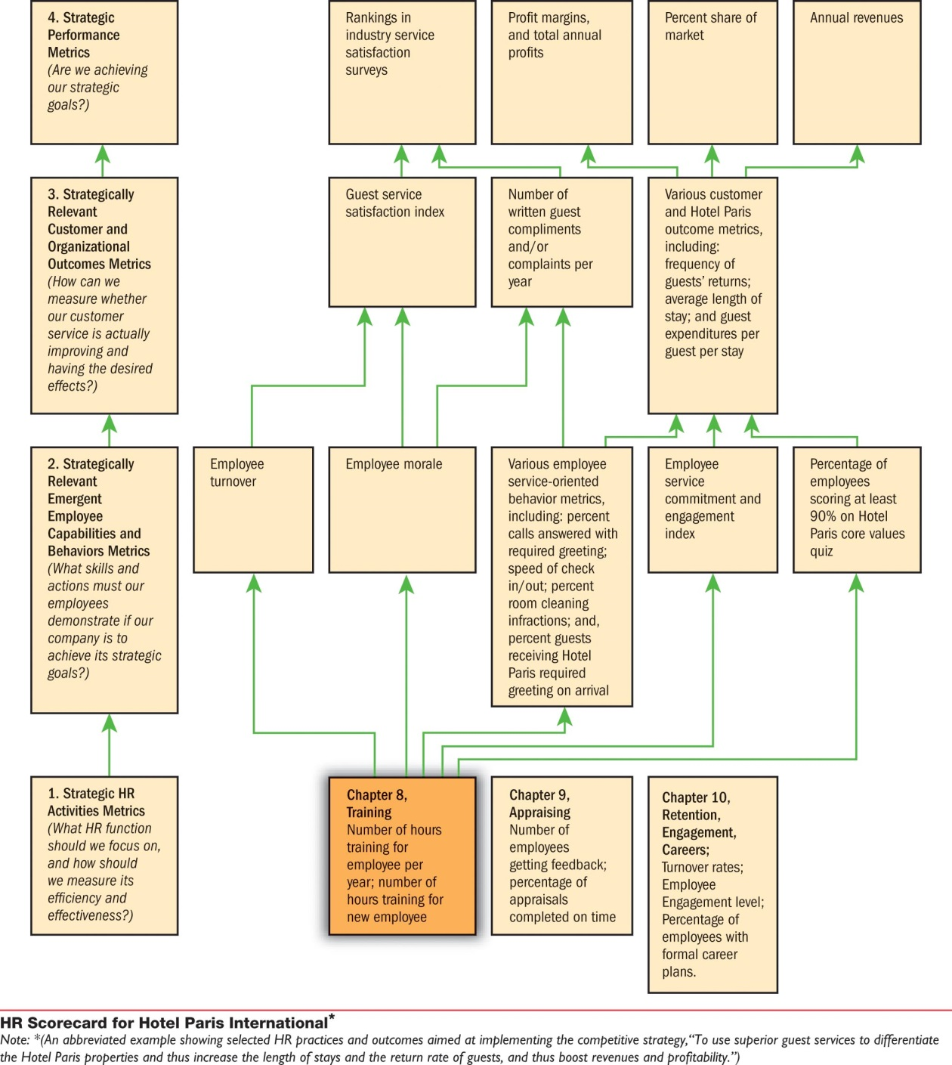
Hotel Paris
Strategy
Chapter 8
Copyright © 2015 Pearson Education Ltd.
Notes:
Hotel Paris Strategy Chapter 8

Slide 53

Copyright © 2015 Pearson Education Ltd.
Notes:
Copyright

