Slide 1
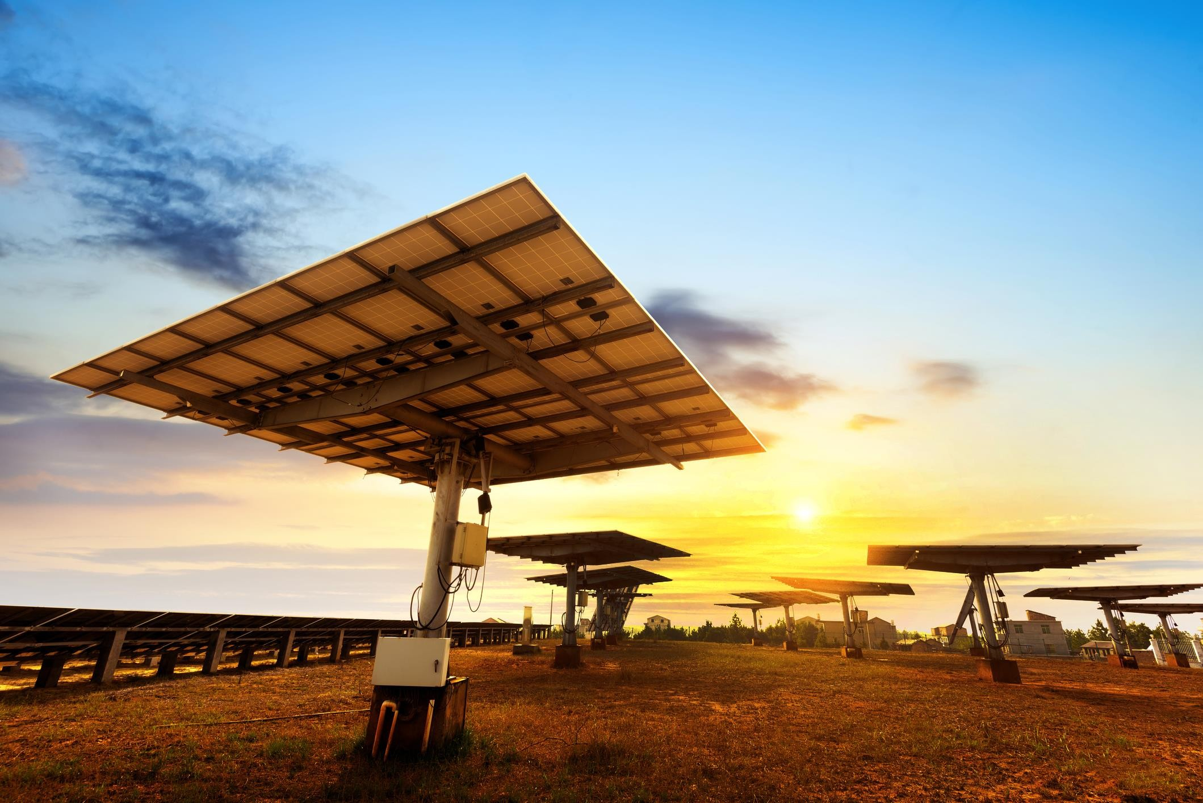



SOLAR TRACKING
SYSTEM
REPRESENTED BY
Nilam Maity Biswajit Samanta Pritam Bera Rajarshi Hazra Siddhartha Acharya

Slide 2

CONTENT
INTRODUCTION
WHAT IS SOLAR TRACKER
WHY SOLAR TRACKING SYSTEM USED
TYPES OF SOLAR TRACKER
TYPES OF SOLAR COLLECTOR
WORKING PRINCIPLE
HARDWARE COMPONENTS
ADVANTAGES
DISADVANTAGES
CONCLUSION

Slide 3

INTRODUCTION
A solar tracker is a device that orients a payload toward the sun.
Payloads can be photovoltaic panels, reflectors, lenses or other optical devices.
The optics in concentrated solar applications accept the direct component of sunlight and therefore must be oriented appropriately to collect energy.
Tracking systems are found in all concentrator applications because such systems do not produce energy unless pointed at the sun.

Slide 4

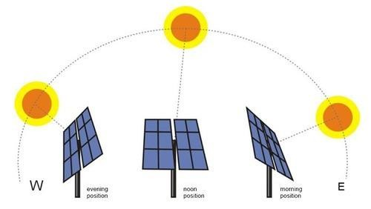
WHAT IS SOLAR TRACKER
Solar Trackers are used to increase the Energy Output from Solar Panels and Solar Receivers.
Solar Tracker is a Device which follows the movement of the sun as it rotates from the east to the west every day.
Solar Trackers are used to keep solar collectors/solar panels oriented directly towards the sun as it moves through the sky every day.

Slide 5
WHY SOLAR TRACKING SYSTEM USED
Global warming has increased the demand and request for green energy produced by renewable sources such as solar power.
Solar Tracking System is a device for orienting a solar panel or concentrating a solar reflector or lens towards the sun.
solar tracking is increasingly being applied as a sustainable power generating solution.

Slide 6

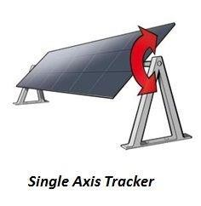
TYPES OF SOLAR TRACKER
Single Axis Trackers :-
Single-axis solar trackers track the sun east to west, rotating on a single point, moving either in unison, by panel row or by section

Slide 7
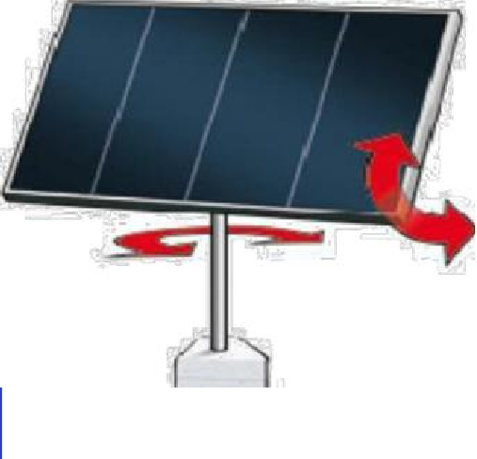
Dual Axis Trackers
Double axis solar trackers have both a horizontal and vertical axis.
It can track the Sun's apparent motion exactly anywhere in the world
Dual Axis Trackers

Slide 8
TYPES OF SOLAR COLLECTOR
FIXED COLLECTOR / MOVING MIRROR
MOVING COLLECTOR

Slide 9
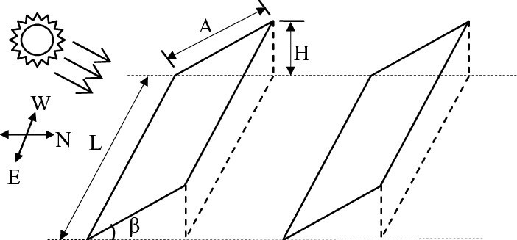
FIXED COLLECTOR / MOVING MIRROR
Many collectors cannot be moved, for example high-temperature
collectors where the energy is recovered as hot liquid or gas .
In such cases it is necessary to employ a moving mirror so that, regardless of where the Sun is positioned in the sky, the Sun's rays are redirected onto the collector.

Slide 10
MOVING COLLECTOR
Trackers can be grouped into classes by the number and orientation of the tracker's axes.
Compared to a fixed mount, a single axis tracker increases annual output by approximately 30%, and a dual axis tracker an additional 6%.

Slide 11
WORKING PRINCIPLE
Auto-tracking control system composed of PLC, sensors, signal processing units, PV cells, electromagnetic and mechanical motion control modules and power supply systems.
Panel detects the sun light strength to sensors.
The sensors output is given to the PLC which compares it and produces an equivalent output so as to rotate the motor and align the panel in the direction of sun.

Slide 12

HARDWARE COMPONENTS
10 rpm Gear Motor
4 volt Small Solar Panel
L293d Motor Driver
IR Sensor
Arduino Uno
9v Battery

Slide 13
10 rpm Gear Motor
A gear motor, also called a gear motor or a geared motor, is a combination of a gear system or gearbox and an electric motor.
Electric Gear motors are used in applications that require high output torque and lower output shaft rotational speed, especially where space and available power are limited. This describes a wide range of common equipment applications across multiple industries.

Slide 14
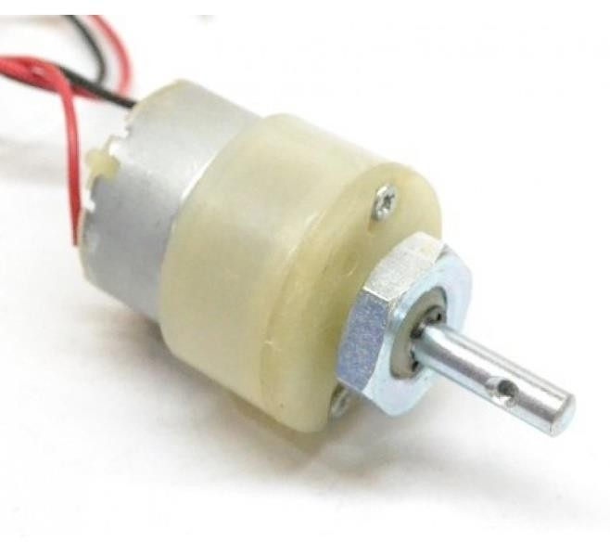
This DC Motor – 10RPM can be used in all-terrain robots and a variety of robotic applications.
Gear Motor

Slide 15
4V Small Solar panel
Mini solar panels are miniature panels that conduct solar power, receiving energy from the sun and using it to provide power to a product.
Mini solar panels typically are portable and usable when larger panels are unnecessary or impractical.

Slide 16
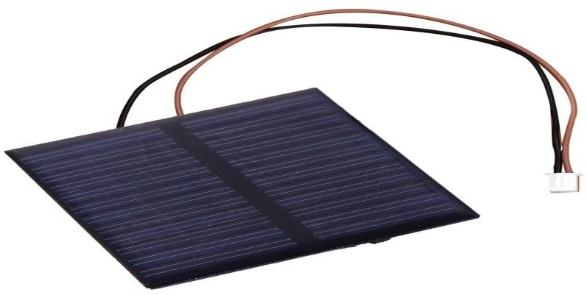
Mini solar panels can be used to power a host of applications that require low power.
They are good for devices that do not consume too much energy.
They can be used to power pocket calculators, watches, flashlights, cameras, wearable devices and radios.
Small Solar Panel

Slide 17
L293d Motor Driver
The L293D IC receives signals from the microprocessor and transmits the relative signal to the motors.
It has two voltage pins, one of which is used to draw current for the working of the L293D and the other is used to apply voltage to the motors.

Slide 18
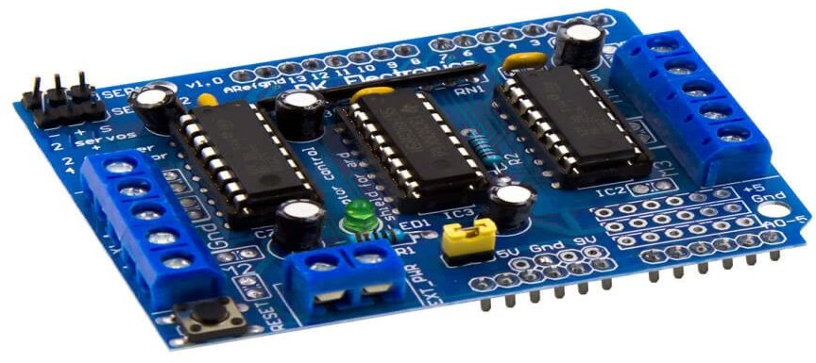
Motor drivers acts as an interface between the motors and the control circuits. Motor require high amount of current whereas the controller circuit works on low current signals.
So the function of motor drivers is to take a low-current control signal and then turn it into a higher-current signal that can drive a motor.
L293D Motor Driver

Slide 19
IR Sensor
An infrared (IR) sensor is an electronic device that measures and detects infrared radiation in its surrounding environment.
When an object comes close to the sensor, the infrared light from the LED reflects off of the object and is detected by the receiver.

Slide 20
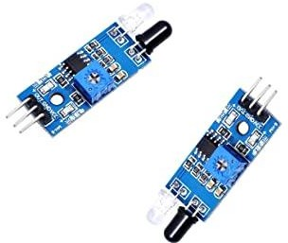
Infrared sensors are also used to measure distance or proximity.
The reflected light is detected and then an estimate of distance is calculated between sensor and object.
IR Sensor

Slide 21
Arduino Uno
Arduino UNO is a low-cost, flexible, and easy-to-use programmable open-source microcontroller board that can be integrated into a variety of electronic projects.
This board can be interfaced with other Arduino boards, Arduino shields, Raspberry Pi boards and can control relays, LEDs, servos, and motors as an output.

Slide 22
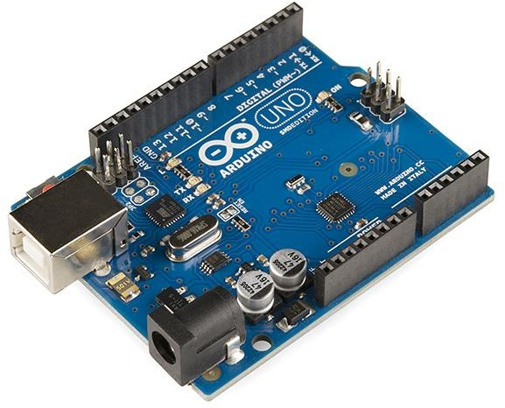
Arduino UNO board is used in the following applications.
Weighing Machines.
Traffic Light Count Down Timer. Parking Lot Counter.
Embedded systems.
Home Automation.
Arduino Uno
Industrial Automation.
Medical Instrument. Emergency Light for Railways.

Slide 23
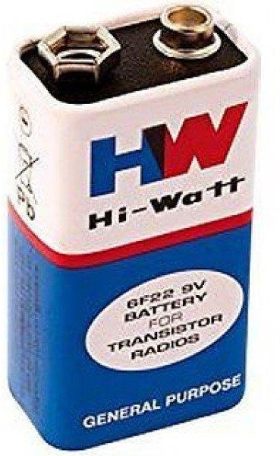
9V Battery
A battery is a device that converts chemical energy contained within its active materials directly into electric energy by means of an electrochemical oxidation-reduction (redox) reaction.
This type of reaction involves the transfer of electrons from one material to another via an electric circuit.
Battery

Slide 24
ADVANTAGES
It is a Simple Process to generate the power.
Low cost.
Eco-Friendly.
We can monitor directly using PC.
Solar trackers generate more electricity.
Reduce the usage of power from power grid

Slide 25
DISADVANTAGES
Solar electricity is not available at night and is less available in cloudy weather conditions.
A storage or complimentary power system is required.
Limited power density.
Solar cells produce DC which must be converted to AC when used in currently existing distribution grids.

Slide 26
CONCLUSION
The invention of Solar Tracking System helps us improve the performance of
PV solar system in a simple way
Used relative method of sunlight strength.
Established a model of automatic tracking system to keep vertical contact between solar panels and sunlight.
Improved the utilization rate of solar energy and efficiency of photovoltaic power generation system.

Slide 27
REFERENCE
https://www.playppt.com
https://www.slideshare.net

Slide 28
THANK YOU

