Slide 1
WHAT IF ALL CURRENCY WAS ENTIRELY DIGITAL?

Slide 2

CRYPTOCURRENCIES
Cryptocurrency is a digital or virtual form of money that uses cryptography for security, making it difficult to counterfeit. The most notable feature of cryptocurrencies is their decentralized nature, typically using a system called blockchain—a distributed ledger technology.
Most times, they are acquired through a process known as mining or can be purchased from various online exchanges. While cryptocurrencies have been celebrated for their innovation and potential for financial inclusion, they are also known for their high volatility and regulatory uncertainties.
Despite these challenges, they continue to grow in popularity and are increasingly accepted for various transactions, investments, and as a means of raising capital.

Slide 3

CURRENCIES COVERED IN THIS PRESENTATION
Bitcoin (BTC):
Bitcoin, created in 2009 by an unknown person or group using the pseudonym Satoshi Nakamoto, is the first and most well-known cryptocurrency. It operates on a decentralized network of computers and uses blockchain technology to record transactions.
Ethereum (ETH):
Ethereum, launched in 2015 by Vitalik Buterin and others, is more than just a cryptocurrency; it's a platform for building decentralized applications (dApps) using smart contracts.

Slide 4

Binance Coin (BNB):
Initially launched in 2017 as a utility token for the Binance cryptocurrency exchange, Binance Coin has expanded its use beyond just covering transaction fees on the Binance platform.
Ripple (XRP):
XRP, created by Ripple Labs Inc. in 2012, is both a digital currency and a platform. The Ripple platform facilitates rapid and low-cost international transactions and is known for its real-time settlement system.
Solana (SOL):
Launched in 2020, Solana is a highly functional opensource project that banks on blockchain technology's permissionless nature to provide decentralized finance (DeFi) solutions.

Slide 5
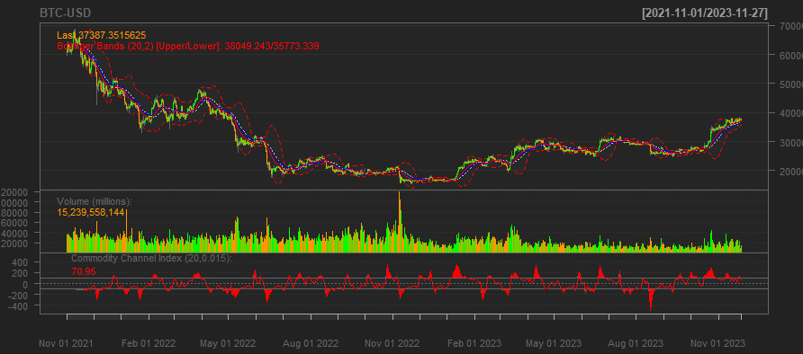
BITCOIN:

Slide 6
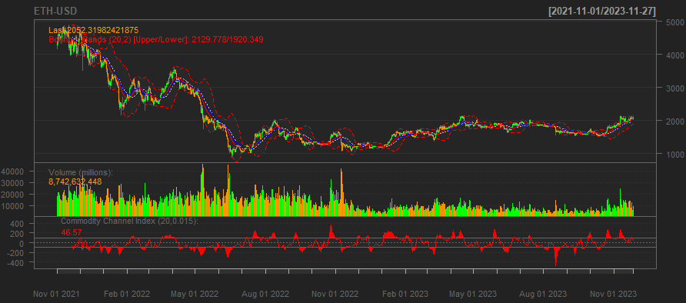
ETHEREUM:

Slide 7
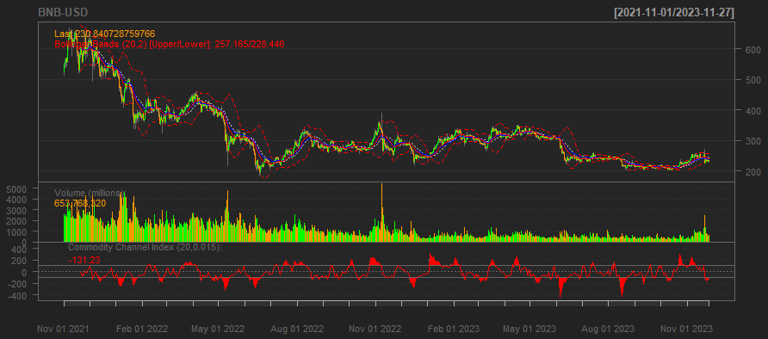
BINANCE:

Slide 8
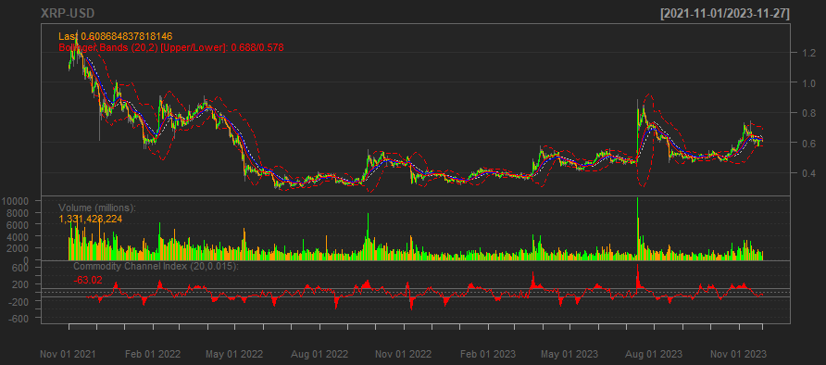
RIPPLE:

Slide 9
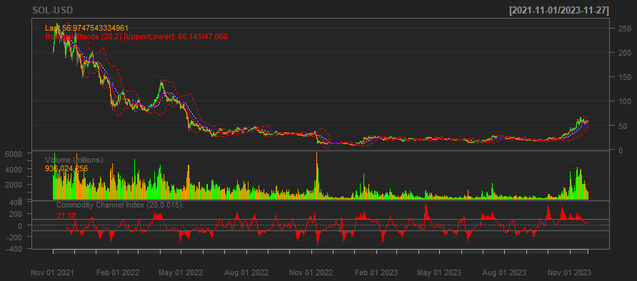
SOLANA:

Slide 10

For financial analysis, we have calculated the monthly returns for our selected cryptocurrencies.
Monthly Returns Calculation: We used a lapply function to apply the monthly Return method to the adjusted closing prices for each cryptocurrency, which is a common method for assessing investment performance over time.
Data Aggregation: We then combined these individual monthly returns into a single cohesive data frame, allowing for a comparative view across different digital currencies.
Results Interpretation: The resulting data frame, returns_df, provides a structured overview of the returns, setting the stage for us to analyze market trends, assess risk, and gauge the relative performance of each cryptocurrency on a month-by-month basis.

Slide 11
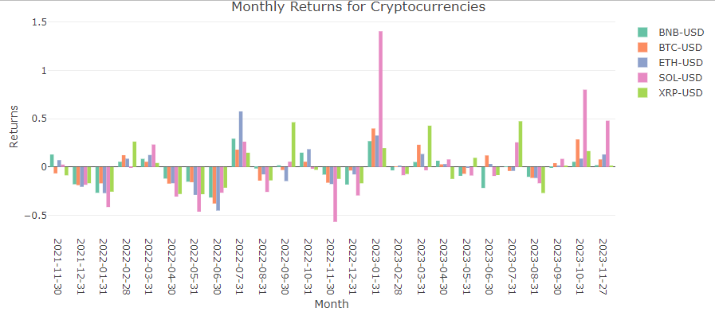
A QUICK PEEK AT THE RETURNS:
SOLANA WITH THE HIGHEST RETURNS FOR THE OBSERVED PERIOD (ALMOST 150% !!)
THAT’S RIGHT, THE RISK IS SUPER HIGH. IT’S A CRYPTO THING :)

Slide 12

Our latest step in the financial analysis involves quantifying the volatility, which is a common measure of risk, for our selected cryptocurrencies. Here's how we approached it:
Volatility Computation: We employed the apply function to calculate the standard deviation across the monthly returns for each cryptocurrency within our data frame. The standard deviation serves as a statistical measure of market volatility.
Risk Summary Creation: With the calculated volatilities, we constructed a risk_summary data frame, pairing each cryptocurrency with its corresponding volatility score.
Insights Gained: This summary provides us with a clear perspective on the risk associated with each digital currency, enabling us to compare their relative stability. Higher volatility indicates a riskier asset, which is vital information for portfolio management and investment decisions.

Slide 13

We computed Sharpe Ratios for a suite of prominent cryptocurrencies. The Sharpe Ratio is a risk-adjusted measure that allows investors to understand the return of an investment compared to its risk.
Risk-Free Rate Consideration: We started by establishing a baseline risk-free rate of 0.0425, which is the expected return of an investment with zero risk.
Average Return and Volatility: For each cryptocurrency, we calculated the average monthly return and the standard deviation of those returns, which represents their volatility.
Sharpe Ratio Calculation: By subtracting the risk-free rate from the average returns and dividing by the volatility, we determined the Sharpe Ratio for each crypto asset.
Sharpe Summary Overview: These ratios were then compiled into a sharpe_summary data frame, clearly juxtaposing each cryptocurrency with its respective performance metric.
Cryptocurrency | Sharpe Ratio
BTC-USD | -28%
ETH-USD | -24%
BNB-USD | -43%
XRP-USD | -18%
SOL-USD | -6%

Slide 14
In our comprehensive risk assessment, we've calculated the Value at Risk (VaR) and Conditional Value at Risk (CVaR) for a range of cryptocurrencies. These metrics are pivotal for evaluating the potential downside risk and the severity of investment losses.
Value at Risk (VaR) Analysis: We've applied the quantile function to our returns data, estimating the VaR at a 95% confidence level. This metric predicts the maximum expected loss over a specified time frame, under normal market conditions.
Conditional Value at Risk (CVaR) Insight: To gauge the expected loss in the worst 5% of cases, we calculated the CVaR, which provides a more comprehensive risk picture by focusing on the tail end of the distribution.
These calculations allow investors to better understand and compare the risk profiles of various cryptocurrencies, considering not just typical market conditions but also extreme market scenarios.
Cryptocurrency | Volatility | VaR_95 | CVaR_95
BTC-USD | 0.1709317 | -0.184508 | -0.2826859
ETH-USD | 0.2091404 | -0.2848609 | -0.3695393
BNB-USD | 0.1513564 | -0.2566342 | -0.2911716
XRP-USD | 0.2287707 | -0.2771543 | -0.2803428
SOL-USD | 0.4159373 | -0.4525957 | -0.5146596

Slide 15
We've transformed a matrix of cryptocurrency returns into a more accessible format for visualization. The R code snippet presented takes our returns_df data frame and enriches it with a 'Month' column, which is extracted from the row names. We then reshape the data into a long format suitable for plotting with ggplot2.
Using the plotly function from the plotly library, we create an interactive bar chart that vividly displays the monthly returns for each cryptocurrency. This chart not only makes it easy to compare the performance across different currencies over time but also enhances the interpretability of the data with its interactive features.
Such a visual tool is invaluable for presentations and discussions, as it allows stakeholders to intuitively grasp market trends and the relative performance of each digital asset.

Slide 16
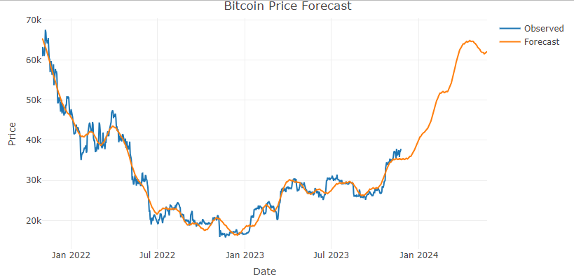
This graph showcases the result of our time series analysis on Bitcoin prices. The observed data, represented by the blue line, illustrates the historical price movements up to the present. The orange line, on the other hand, projects the forecasted prices into the future.
The forecast model takes into account trends, seasonality, and other factors to predict future prices. While the model provides a directional trend, it's important to note that actual future prices may vary due to the volatile nature of the cryptocurrency market.
Price prediction for May, 2024: $61, 964.65

Slide 17
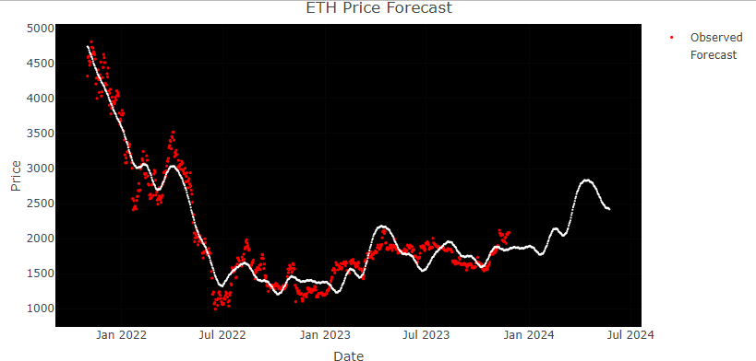
This graph showcases the result of our time series analysis on Bitcoin prices. The observed data, represented by the blue line, illustrates the historical price movements up to the present. The orange line, on the other hand, projects the forecasted prices into the future. This forecast is generated after meticulously cleaning and structuring the data—converting dates to a standard format, transforming price-related figures into numeric values by removing commas, and adjusting volume figures by stripping away characters like 'K’.
The forecast model integrates various factors, including underlying trends and seasonal variations, to estimate future prices.
Price prediction for May, 2024: $2,418.71

Slide 18
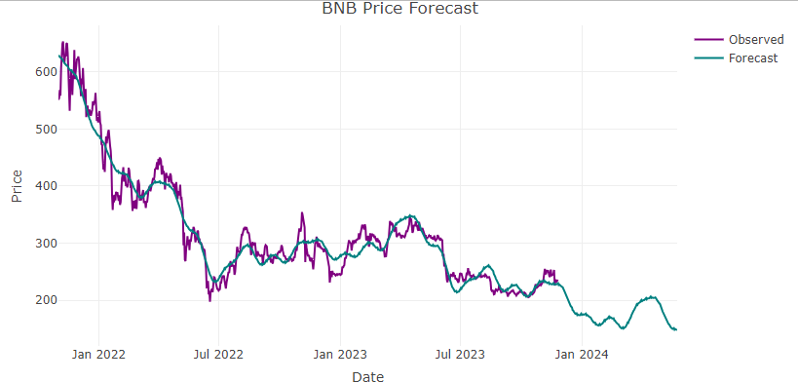
The displayed graph provides a visual representation of our time series analysis on Binance Coin (BNB) prices. The historical prices are traced by the purple line, detailing the coin's value trajectory up to the current date. Extending from this data, the green line offers a forecast into the future, based on our analytical model.
The code illustrates the transformation of raw market data into a refined format suitable for analysis—dates are converted, non-numeric characters are stripped from price and volume figures, and percentages are standardized.
Price prediction for May, 2024: $147.91

Slide 19
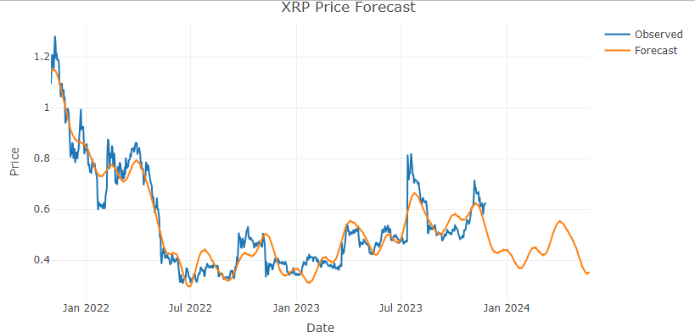
The graph provided shows the time series analysis for the cryptocurrency XRP. The blue line represents the actual observed prices, capturing the coin’s fluctuating value over time. The orange line extends from the last known data point into the future, serving as a prediction of the potential price trajectory of XRP based on current and past trends.
The R code snippet reflects the data preparation process for XRP, which likely underpins the analysis leading to the forecast graph. This involves transforming the raw data into a structured format appropriate for time series forecasting.
Price prediction for May, 2024: $0.3523

Slide 20
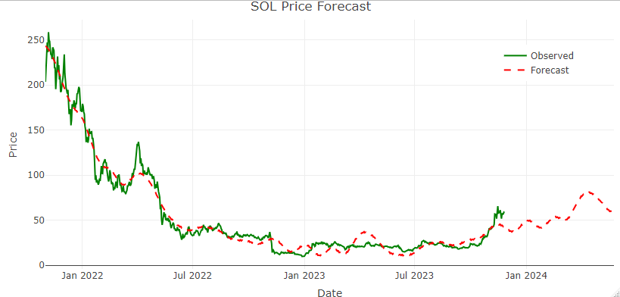
The graph illustrates a price forecast for Solana (SOL). The solid green line maps the observed historical prices, showing the volatility and the price pattern of SOL over time. In contrast, the dashed red line indicates the forecasted price movement, suggesting a possible future trend based on the model's predictions.
Price prediction for May, 2024: $57.47

Slide 21


